Slide 1
Talking Data Kaggle competition
Sowmya Vasan
Daisy Du
Erika Pelaez
Mentor: Nick Janetos

Slide 2
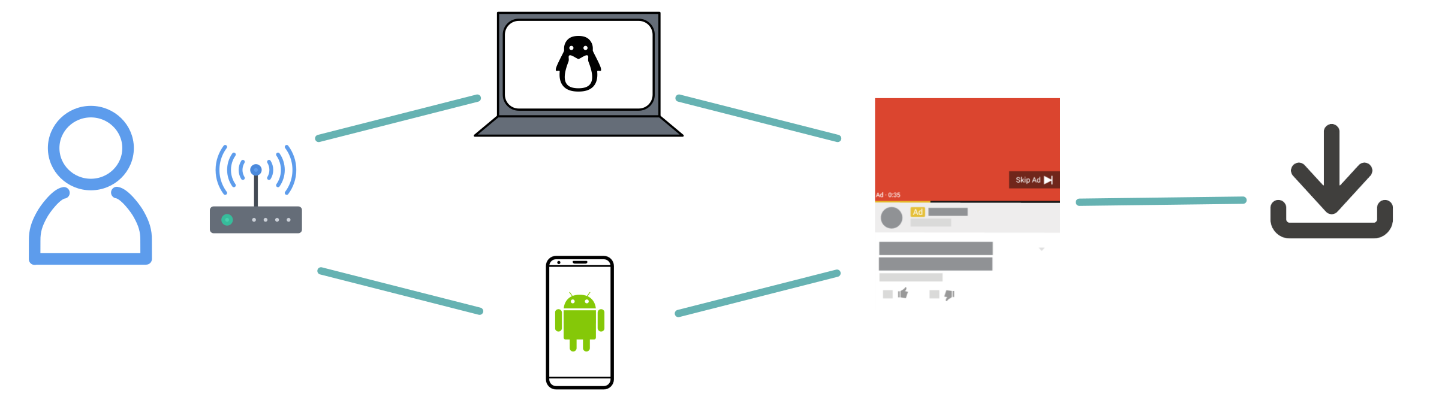
Click journey

Slide 3
Explanatory Analysis
Feature | Unique Count
IP address | 277396
Device | 3475
OS | 800
App type | 706
Channel | 202
Notes:
Ip is abandoned because it doesn’t provide enough insights

Slide 4
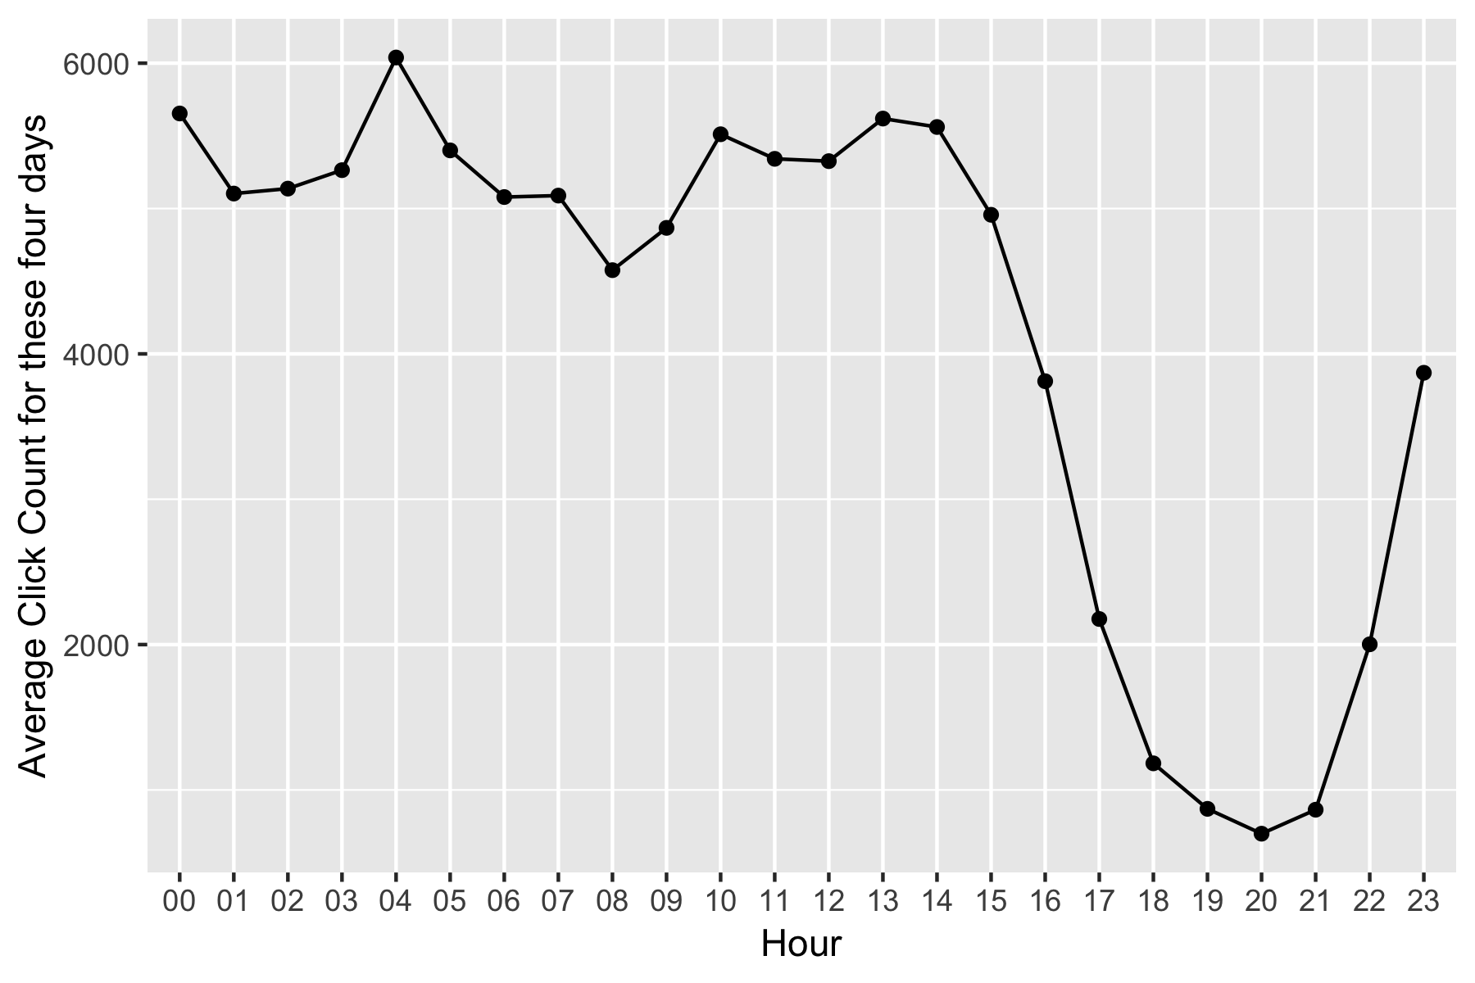
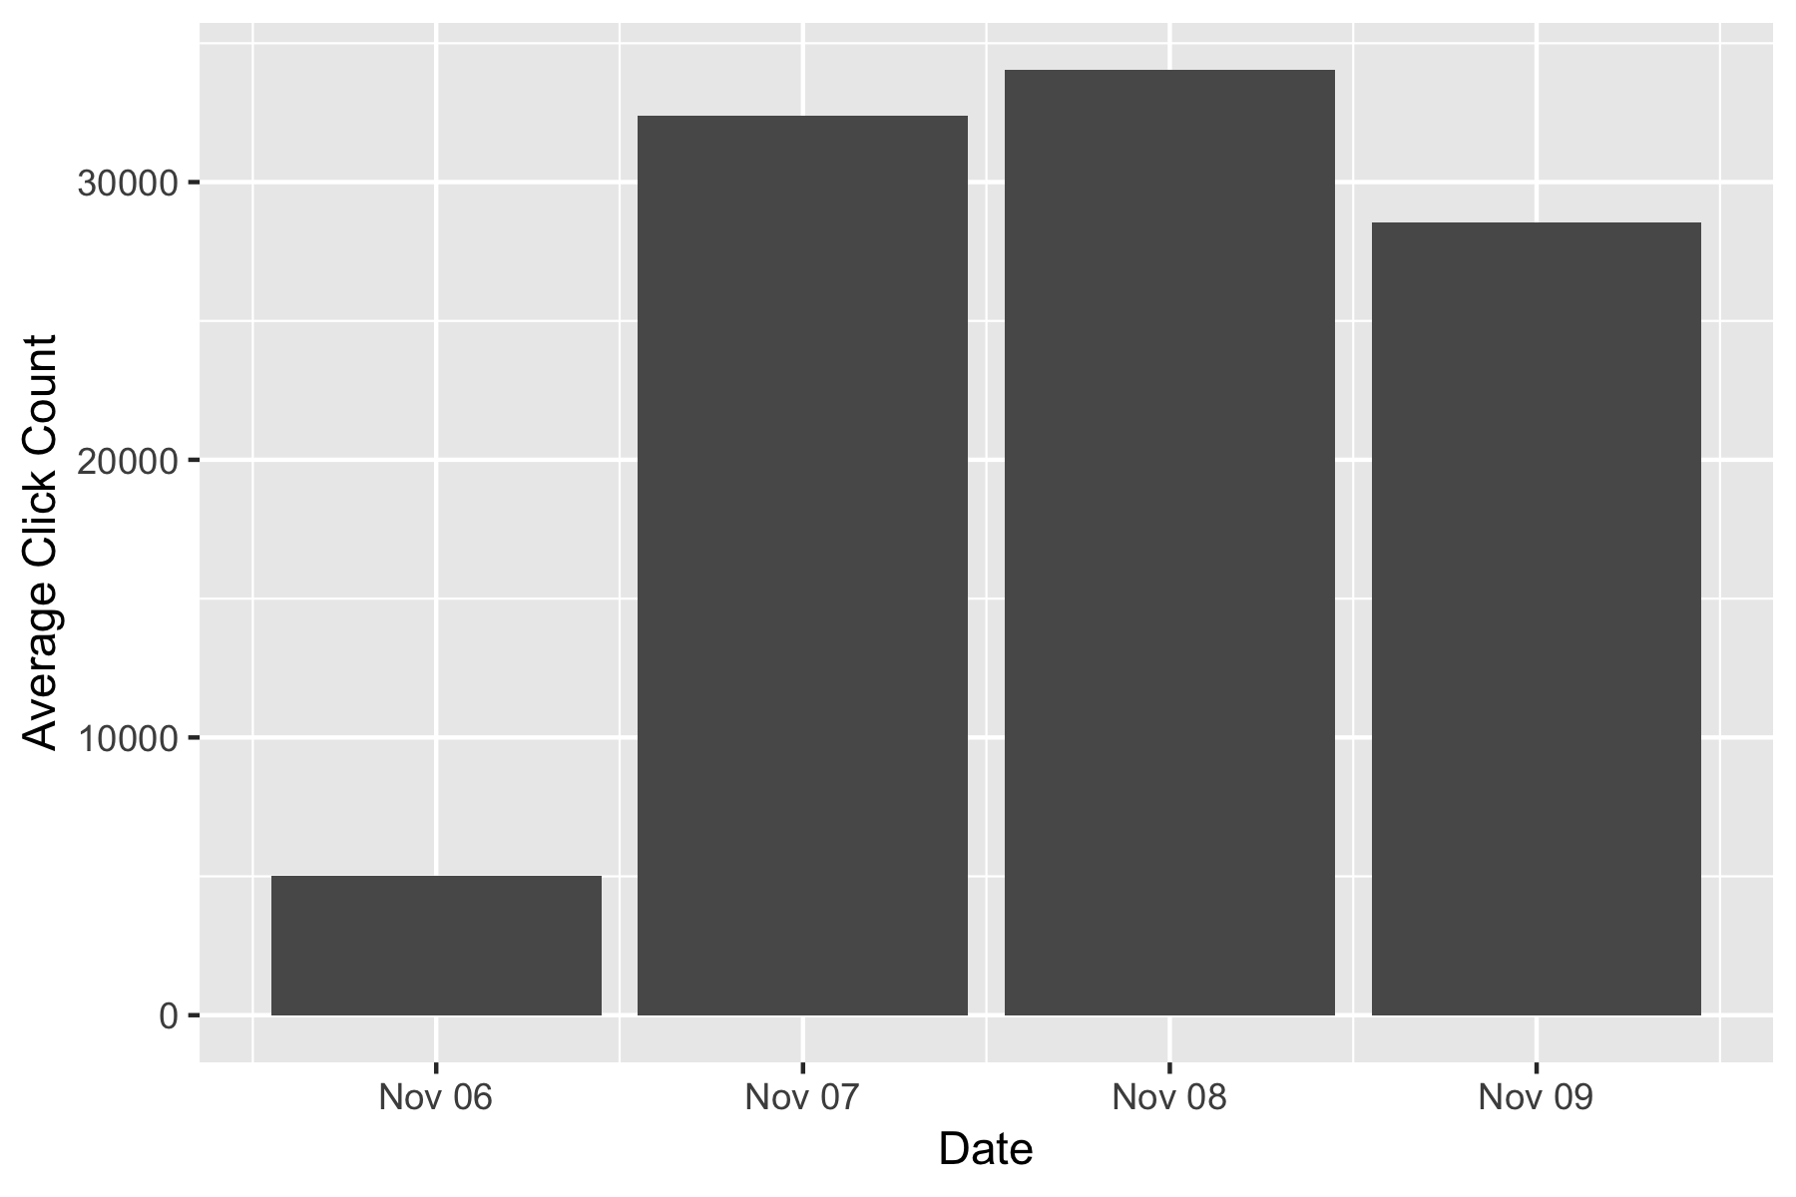
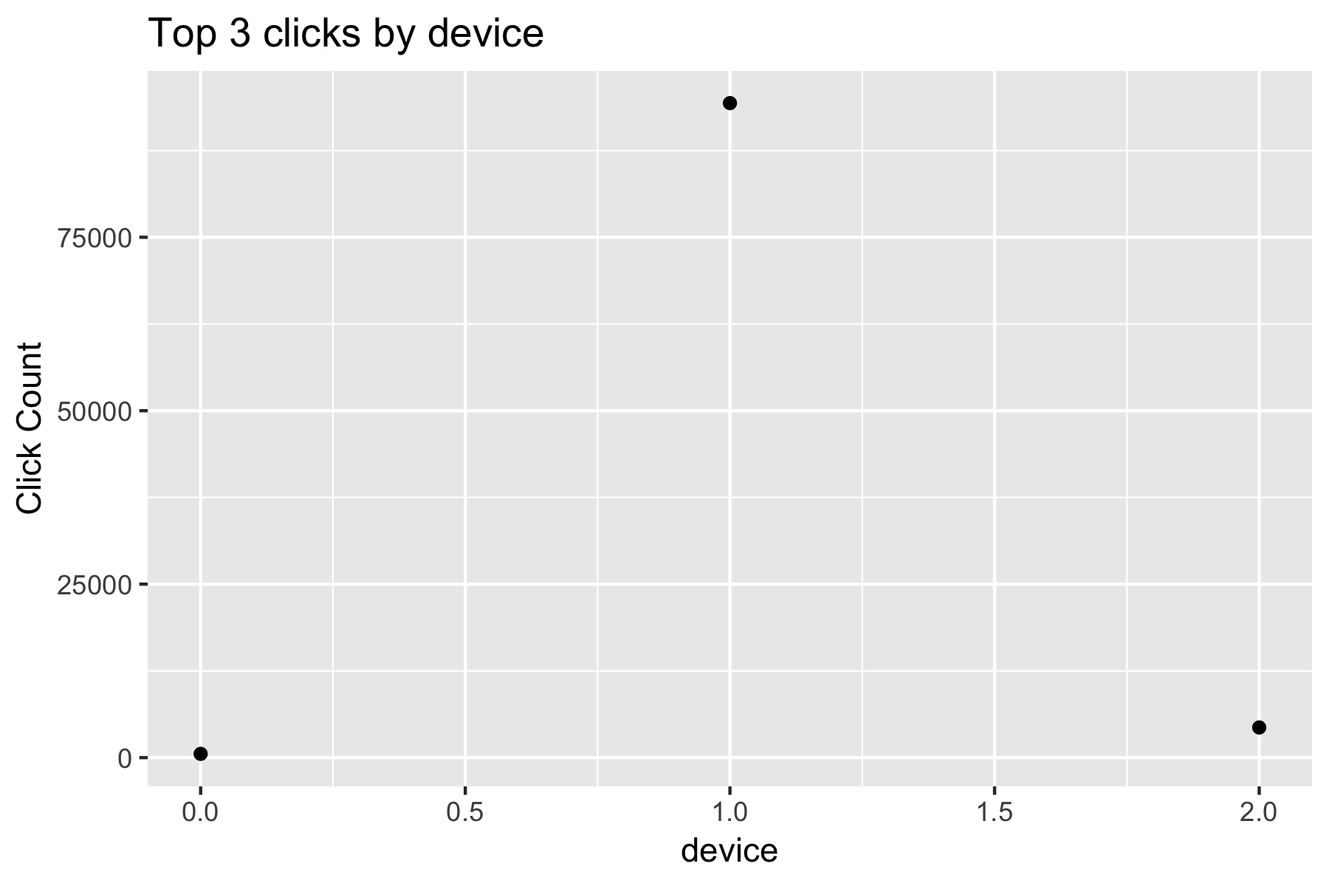
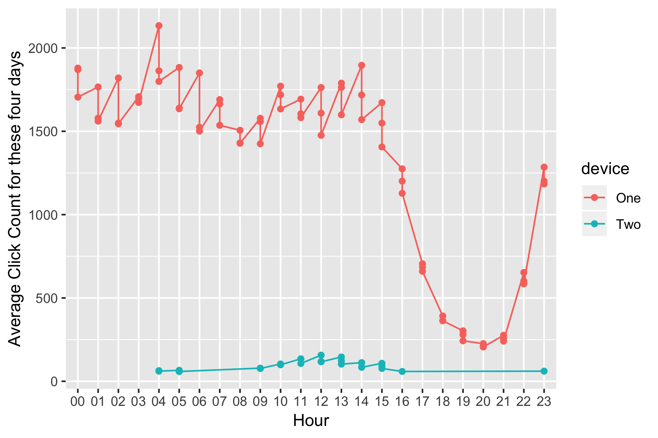
Anatomy of the dataset

Slide 5
Feature Engineering
IP is an important feature but is highly dynamic. We decided to create various frequency based features on IP, to retain the importance of IP without actually having the feature, namely:
Number of clicks every hour by an IP
Number of clicks every hour by an IP-App combination
Number of clicks every hour by an IP-OS combination
Number of clicks every hour by an IP-Device combination
Number of clicks every hour by an IP-Channel combination
Another feature we thought as interesting was to see if time from the previous click of the same click journey had any relation with app downloads hence we incorporated the following feature:
Time from the previous click for every unique IP-App-OS-Device combination

Slide 6
Sampling
Training
20%
Validation
20%
All Positives +

Slide 7
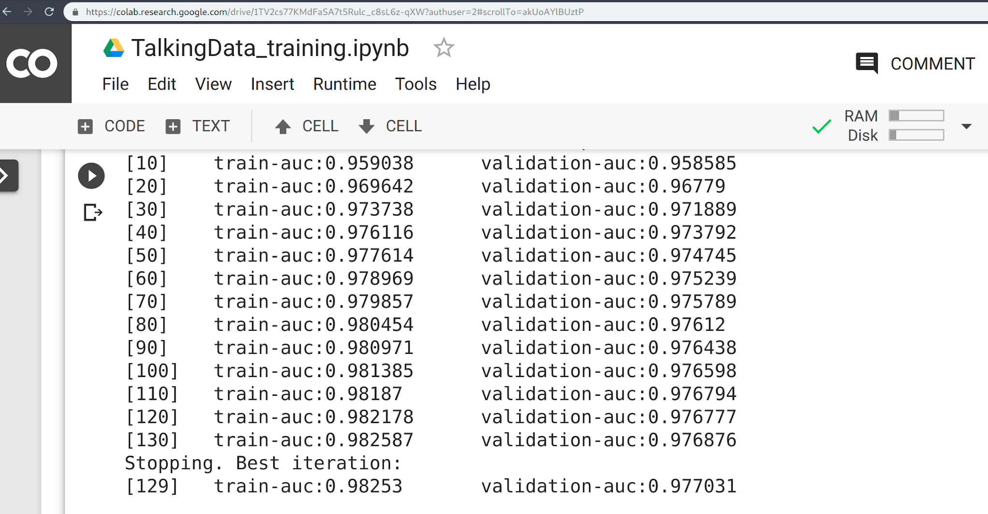
Model selection and performance
Xgboost
Learning Rate:0.1
Max Depth : 6
1000 estimators
Early stopping rounds: 10
Subsample : 80% (0.8)

Slide 8
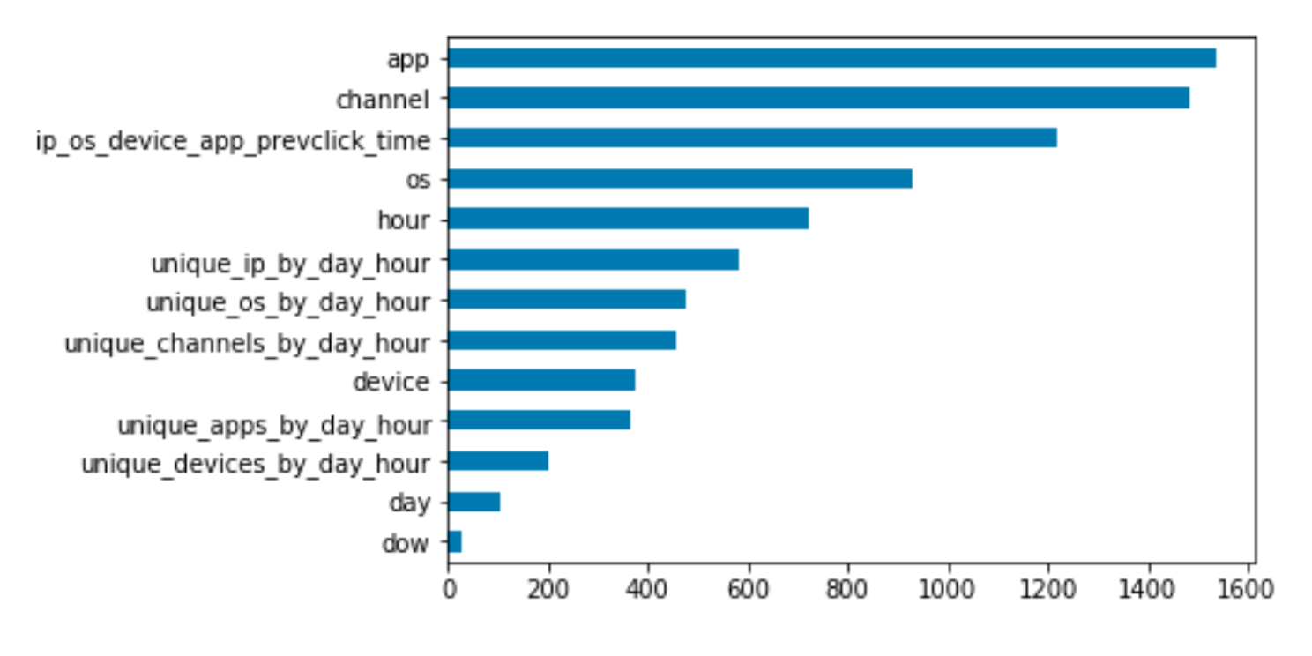

Final results
Kaggle AUC Score:
0.82768

Slide 9
Following steps
Things Learnt
Hyper parameter tuning
More effective sample selection
Different evaluation metrics (F1 score, suggestions?)
Rolling frequency features which is applicable in a production setting
Effective feature engineering when dealing with big data and limited memory
Efficient way to handle big data with Dask
Creative ways of handling sample selection with limited memory
Modeling with large scale imbalanced dataset

Slide 10
Questions?

Slide 11
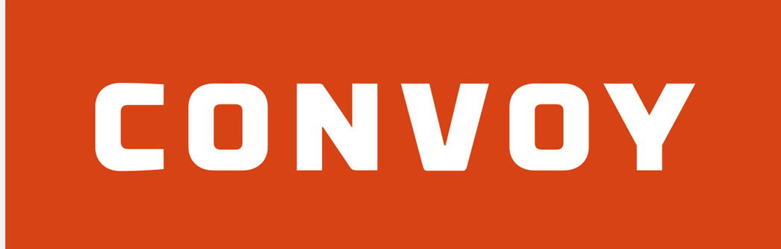
Thank you!!

