Slide 1
TalkingData
AdTracking Fraud Detection
SeaWIDS Kaggle Team 3
Sonia Arora
Janet Carson
Leila Norouzi
Laura Kehrl - Mentor

Slide 2
Background
TalkingData
Chinese data platform covering 75% of mobile devices nationwide
3 billion clicks per day
90% or more are potentially fraudulent
7.5+ GB containing 184,903,890 rows
Kaggle Challenge: Look for the legitimate customers
Predict whether a user will download an app after clicking an ad for it

Slide 3
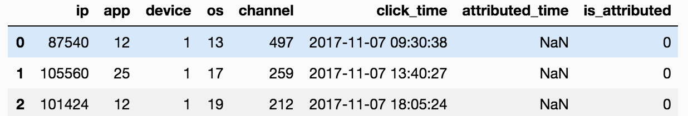


IP
OS
Device
IP
OS
Device
Notes:
Training set: 4 days of sample data, about 185 million rows Test set:18 million clicks to predict day 5 Criteria:ROC AUC

Slide 4
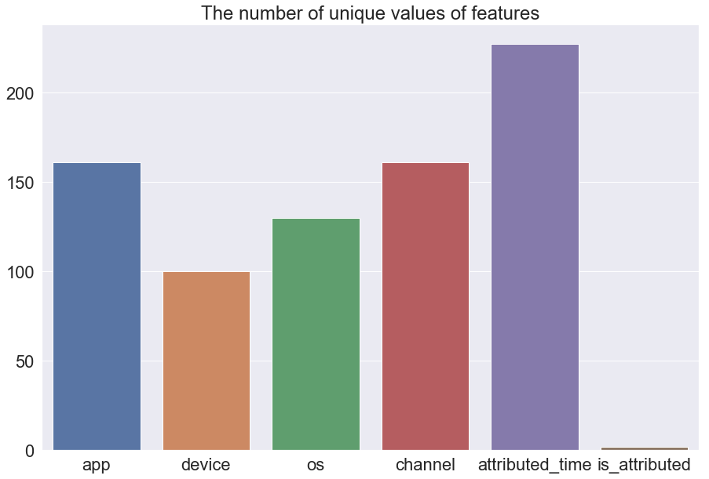
Number of Unique Values per Category
IP unique numbers in sample data set: 34587
New IP addresses each day
The unique number of values of features in sample data set

Slide 5
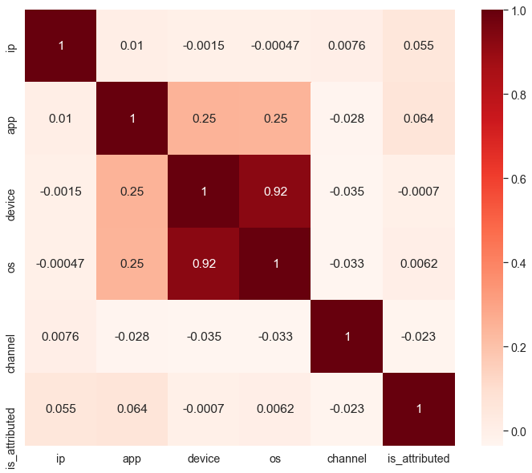
Associations between features

Slide 6
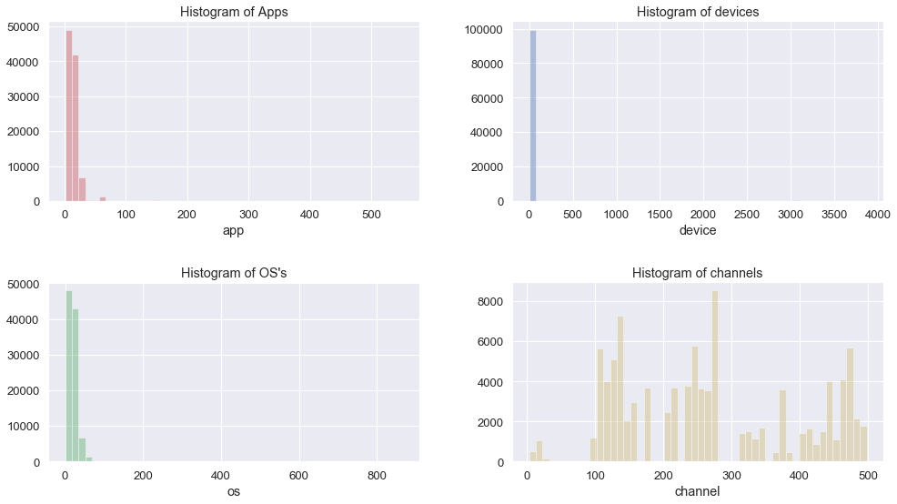
Feature values are unevenly distributed

Slide 7
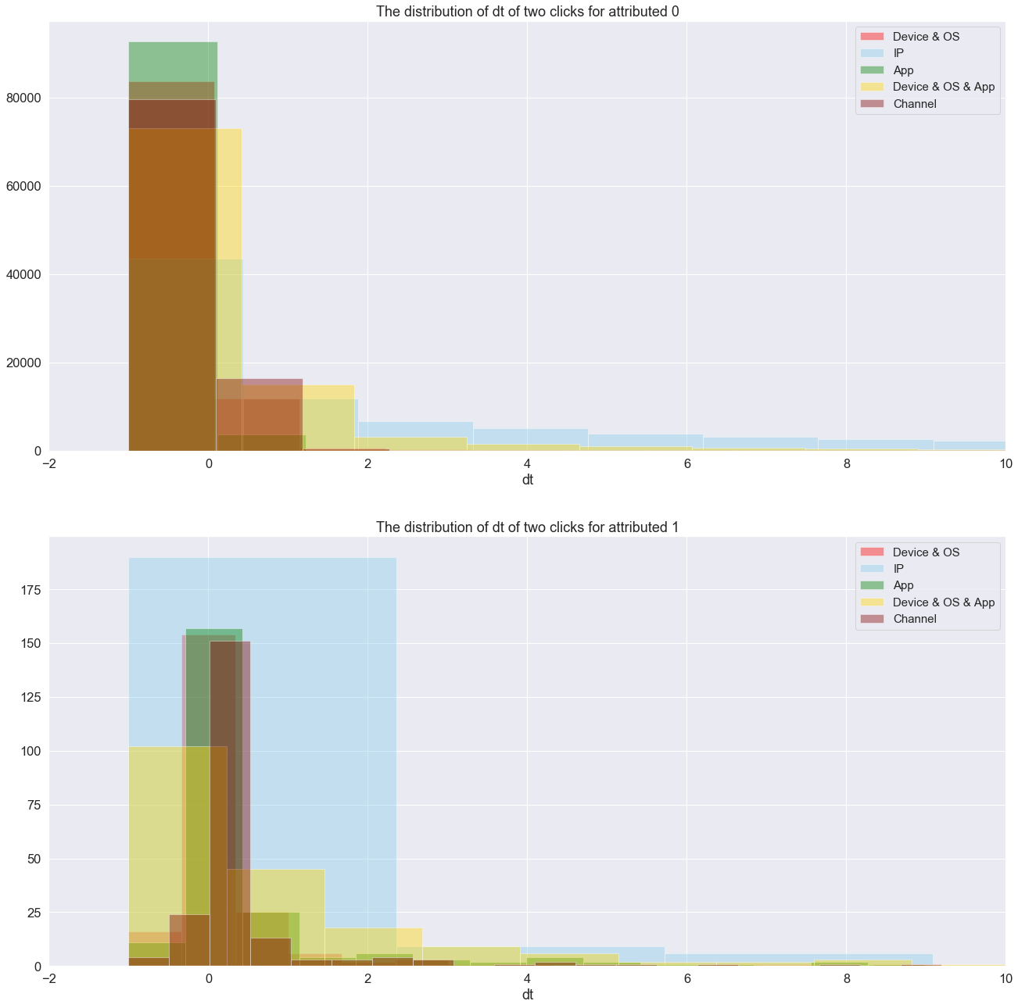

Feature engineering approaches: 1- clickers
Defining the time difference between two consecutive click in each group of features
Click time
Clustering based on the time difference of two clicks Using GMM
Defining min time as a indication of fraudulent click:
dt _{min}(app): 1.08 sec
Fraud: dt _{min}(app)< 1.08

Slide 8
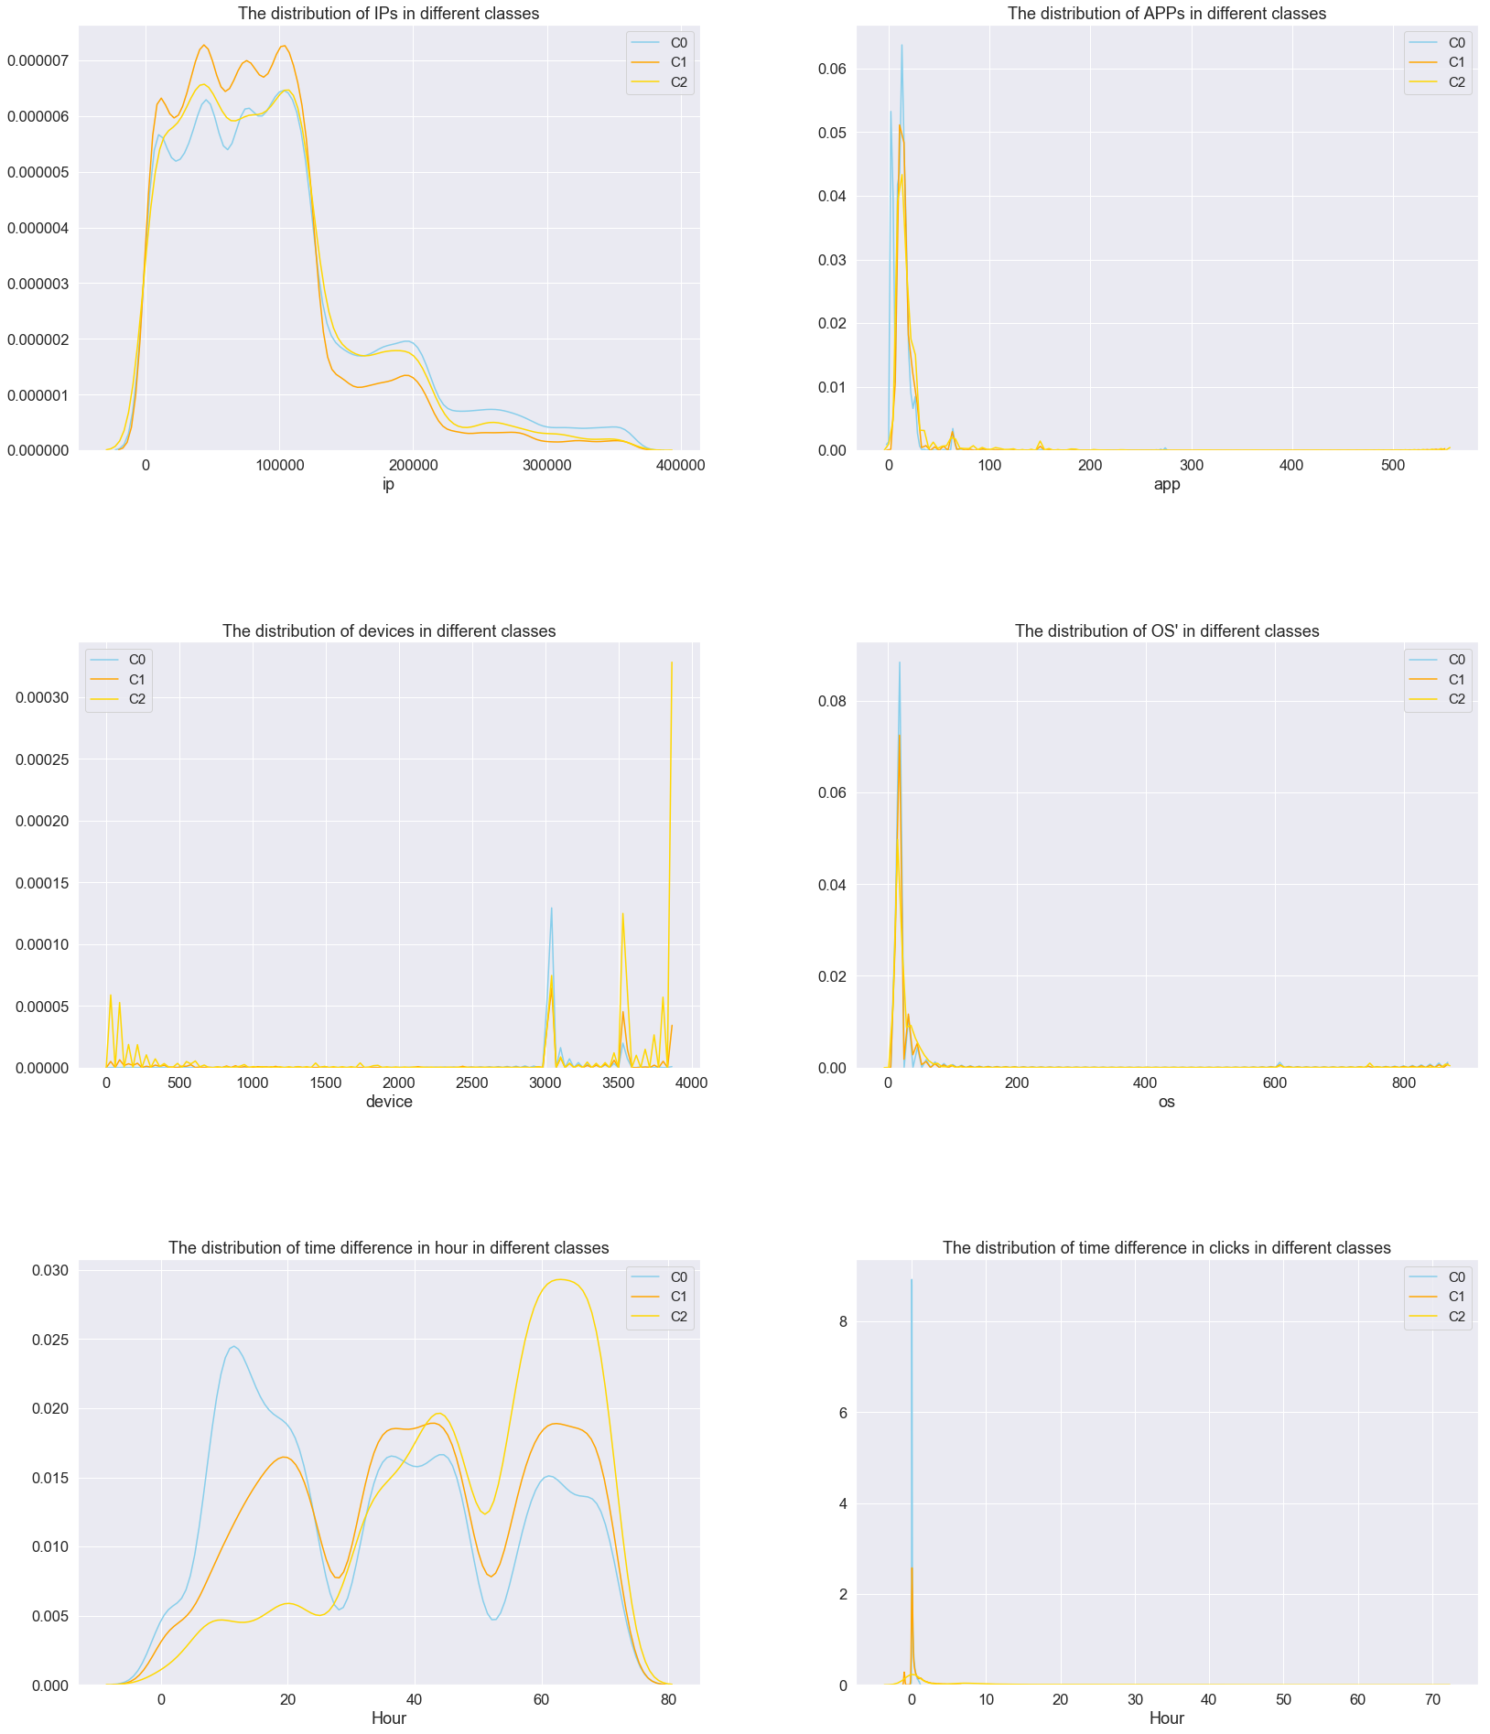
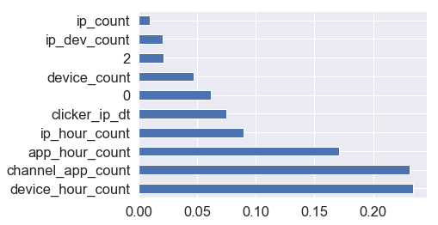
Feature selection

Slide 9
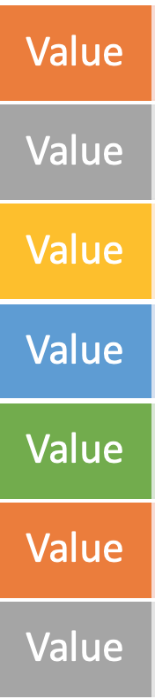
Normalized Value Counts
Count up appearances of each category
2 orange, 2 gray, 1 yellow, 1 blue, 1 green...
2. Divide by the largest count found
Orange -> 2/2, Yellow -> 1/2 etc.
3. Calculated over training set, database merge to test set
Except : IP addresses, because they come and go over time, were binned and recalculated each day

Slide 10
Normalized Value Counts
We’re training on whether it’s a popular or long-tail app/channel/etc, not on a specific value
Normalized to adjust to different development stages
We found two useful recurring pairs of features:
Device + App Channel + App

Slide 11
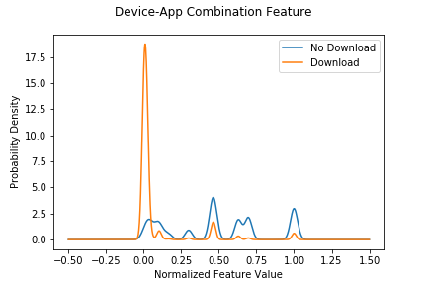
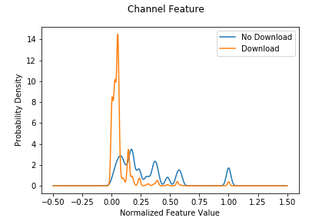
Feature Engineering - Two Examples

Slide 12
Model Building
PySpark - Spark.ML library
GBTree model
Class imbalance
Downsampled majority class (2.7 percent of class “no download”)
Upsampled minority by 4 times (bootstrap with replacement)
7 million rows per model - three different random seeds
Train Validation Split on each of the three sets

Slide 13
Results
Train Set:
Area under ROC: .97104 Precision: 11.9%
Accuracy: 98.4% Recall: 85.7%
Test Set: Area under ROC:
Our best model (private score) 0.96586 Kaggle winner: 0.98349

Slide 14
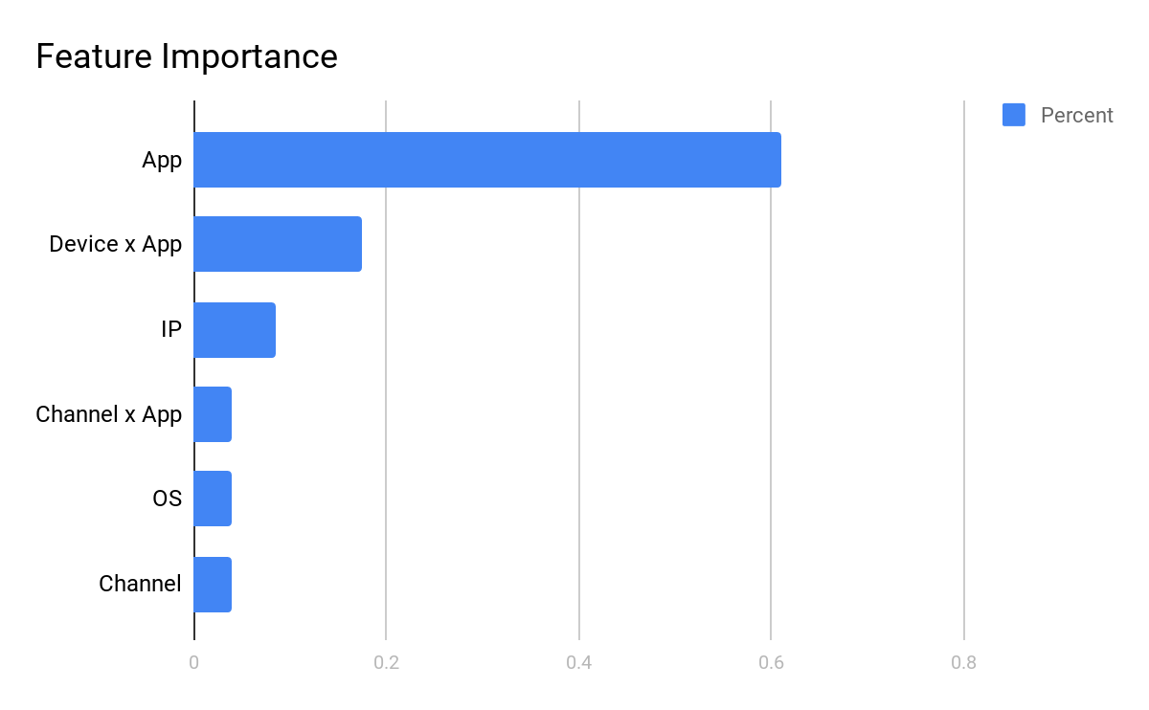

Slide 15
Discussion
SEAWIDS Team 3 Model
Six features
Downsampled training sets
Average of three random sets
15 submissions
Kaggle Competition Winner
“Hundreds” of features
Even more highly downsampled
Average of five random sets
106 submissions

Slide 16
Thank You!

