Slide 1
TalkingData AdTracking Fraud Detection Challenge
Can you detect fraudulent click traffic for mobile app ads?
TEAM NAME : hire-us
CHHAYA CHOUDHARY, IRINA VIRNIK,
VANDANA IYER
Notes:
Kaggle link : https://www.kaggle.com/c/talkingdata-adtracking-fraud-detection/overview

Slide 2
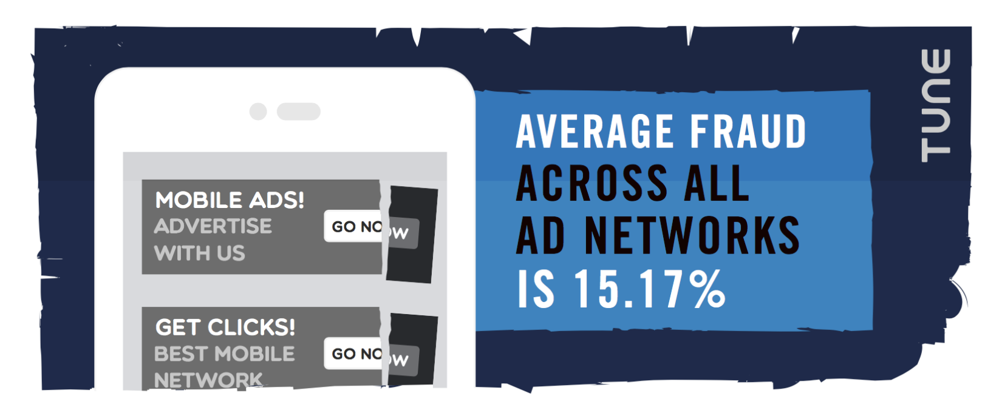

MOTIVATION
Ref: https://blog.branch.io/mobile-ad-fraud-what-24-billion-clicks-on-700-ad-networks-reveal/

Slide 3
GOAL
Predict a probability for the target is_attributed variable for each click_id in the test set.
is_attributed: the target that is to be predicted, indicating the app was downloaded.
Click id | is_attributed
1 | 0.003
2 | 0.001
Evaluation:
Submissions are evaluated on area under the ROC curve between the predicted probability and the observed target.

Slide 4
DATASET STATISTICS
DATASET NAME | NUMBER OF ROWS | SIZE(Unzipped)
Train | 187,903,890 | 7.5 GB
Train Sample | 100,000 | 4.1 MB
Test | 18,790,469 | 863.3 MB
Test supplement | 57,537,505 | 2.7 GB
% of Negative data: 99.8%
% of Positive data: 0.2%

Slide 5

More complicated than we initially thought
Image Source: google.com

Slide 6
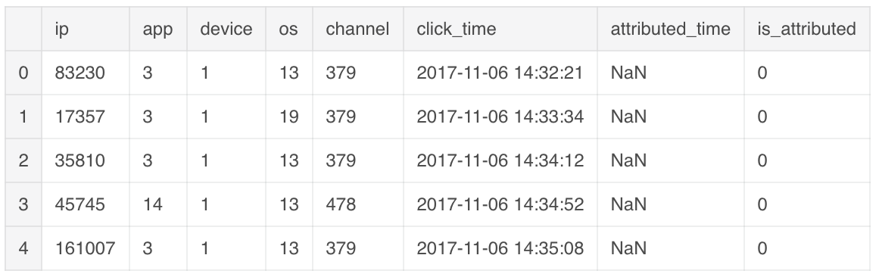
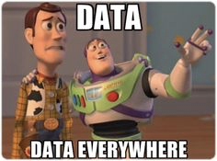
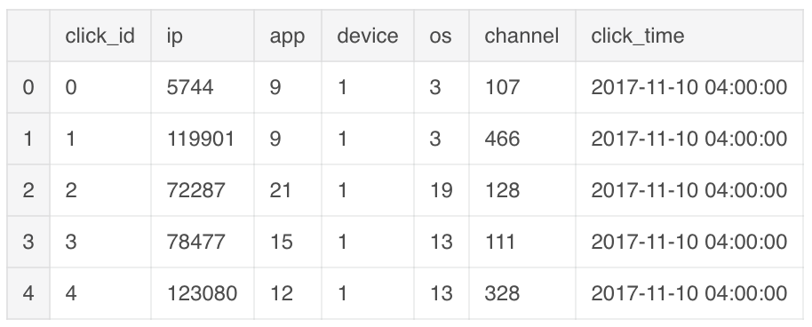
DATASET DESCRIPTION
Train Dataset
Test Dataset
Notes:
Each row of the training data contains a click record, with the following features.
ip: ip address of click.
app: app id for marketing.
device: device type id of user mobile phone (e.g., iphone 6 plus, iphone 7, huawei mate 7, etc.)
os: os version id of user mobile phone
channel: channel id of mobile ad publisher
click_time: timestamp of click (UTC)
attributed_time: if user download the app for after clicking an ad, this is the time of the app download
is_attributed: the target that is to be predicted, indicating the app was downloaded Note that ip, app, device, os, and channel are encoded.
The test data is similar, with the following differences:
click_id: reference for making predictions
is_attributed: not included

Slide 7
OUR METHODOLOGY
Exploratory Data Analysis - Time Series Analysis
Handling large dataset - Down Sampling
Feature Engineering - Time based, Velocity based
Model selection and preparation
Hyperparameter tuning
Resources utilized:
Kaggle Kernels (12GB RAM)
Google Colab
Google Cloud Platform (GCP) - 8 Cores, 52GB RAM

Slide 8
RESULTS - APPROACH
Classifier | LB Public Score(AUC) | LB Private Score(AUC)
XGBoost with down sampling | 0.96273 | 0.96549
XGBoost with training on consecutive 10M rows from end | 0.95613 | 0.95558
XGBoost with full data | 0.96107 | 0.95846
Gradient Boosting Classifier | 0.95819 | 0.95673
Logistic Regression | 0.60725 | 0.62578
LB: Leaderboard on Kaggle

Slide 9
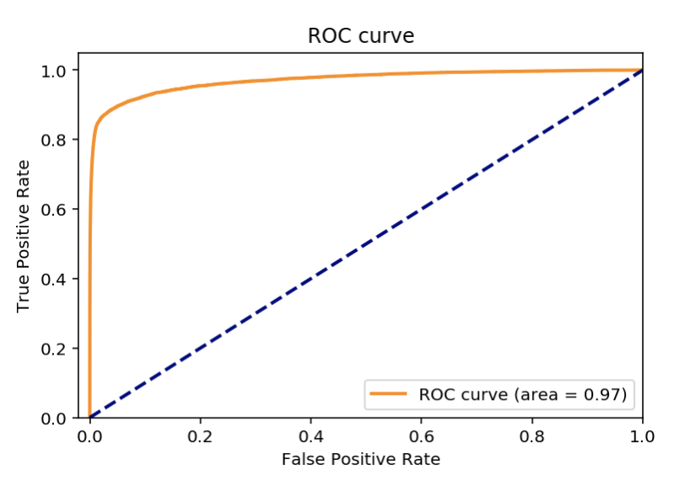
ROC CURVE - VALIDATION SET
Used XGBoost:
Learning rate = 0.3
Objective function: binary logistic
No. of iterations: 200
Early Stopping : 20
Eval_metric : auc

Slide 10
FEATURE ENGINEERING
Day of the week
Day of the year
Hour of the click time
Minute of the click time
Second of the click time
Click counts by ip
ip clicks to attribution percentage
Click counts by os
os clicks to attribution percentage
Click counts by device
Device clicks to attribution percentage

Slide 11
BEST WORKING ALGORITHM: XGBOOST
Advantages:
Regularization - It helps to reduce overfitting
Parallel Computing - It is enabled with parallel processing (using OpenMP); i.e., when you run xgboost, by default, it would use all the cores of your laptop/machine.
High Flexibility - XGBoost allow users to define custom optimization objectives and evaluation criteria
Handling missing values - has an in-built routine to handle missing values
Tree Pruning - XGBoost make splits upto the max_depth specified and then start pruning the tree backwards and remove splits beyond which there is no positive gain
Built-in cross validation - XGBoost allows user to run a cross-validation at each iteration of the boosting process and thus it is easy to get the exact optimum number of boosting iterations in a single run

Slide 12
CHALLENGES
Resource and memory limitations
Working with huge imbalanced data
Feature engineering
Dividing tasks within a team

Slide 13
FUTURE WORK
More feature Engineering
Experimentation with neural networks
Deploy using Flask
Experimentation with Dask
Turn this into a product for ad analytics

Slide 14
KEY TAKEAWAYS
Learned about handling class imbalance in Click fraud data
Hands on - Google Cloud Platform (GCP)
More data is not always useful
Github: https://github.com/WomenInDataScience-Seattle/talking_data_fraud_detection/tree/master/hire-us

Slide 15
QUESTIONS?

Slide 16



