Slide 1
TalkingData Kaggle Challenge
Analysis and lessons learned
Elyse Kadokura, Jenifer De Figueiredo, Keyuri Raodeo

Slide 2


Analysis
Session Crashed
No more available RAM

Slide 3
Creating test dataset
Creating val dataset
Creating train dataset
Day 6 to Day 9
Day 9
12pm-4pm
Sampled: 5 million
Day 6 to Day 9
Day 8
12pm-4pm
Sampled: 16 million
Day 6 to Day 9
Day 7-8
Day 7 12pm -
Day 8 12pm
Sampled: 16 million

Slide 4
Features:
Grouped by date-hour, ip:
Number of unique apps
Number of unique devices
Number of unique channels
Number of unique OS
Number of clicks
Attribution rate for OS, device, channel, and app

Slide 5
LightGBM
 | Actual + | Actual - | Total
Predicted + | 10,227 | 137,026 | 147,253
Predicted - | 1,192 | 4,851,555 | 4,852,747
Total | 11,419 | 4,988,581 | 5,000,000
Recall (TP/TP+FN): 0.90
Precision (TP/TP+FP): 0.07
F1-score (2 * (P*R/P+R)): 0.13

Slide 6
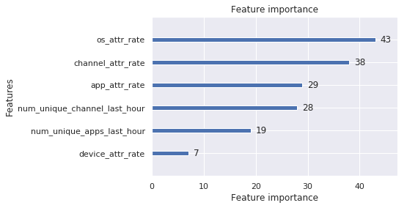
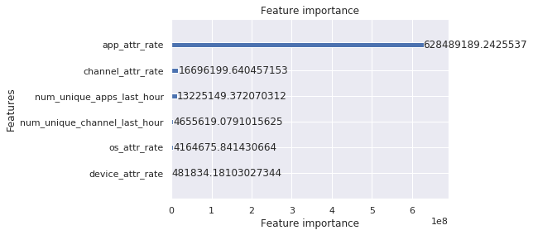
Feature importance
Split:
Gain:

Slide 7
To do:
More feature engineering
Hyperparameter tuning
Explore other models
Explore cloud computing

Slide 8


Jeny’s Takeaways...
Always look at how big the training and test datasets are before deciding on a Kaggle project!
  Dask
  Hvplot
  Holo Views
Azure ML studio has space limitations, even if they don’t think they do, but attentive customer service…
Get a good grasp on test dataset and features before moving forward with model
Load without ip
Remove rows that contain hours that aren’t in test dataset
Determine resulting class imbalance and size of dataset
Apply SMOTE or other balance technique
Move on to more complex feature engineering and alternate algorithms
Use Logistic regression first to save time and assess.
Depending on size of dataset, break into smaller randomized datasets to train model

Slide 9
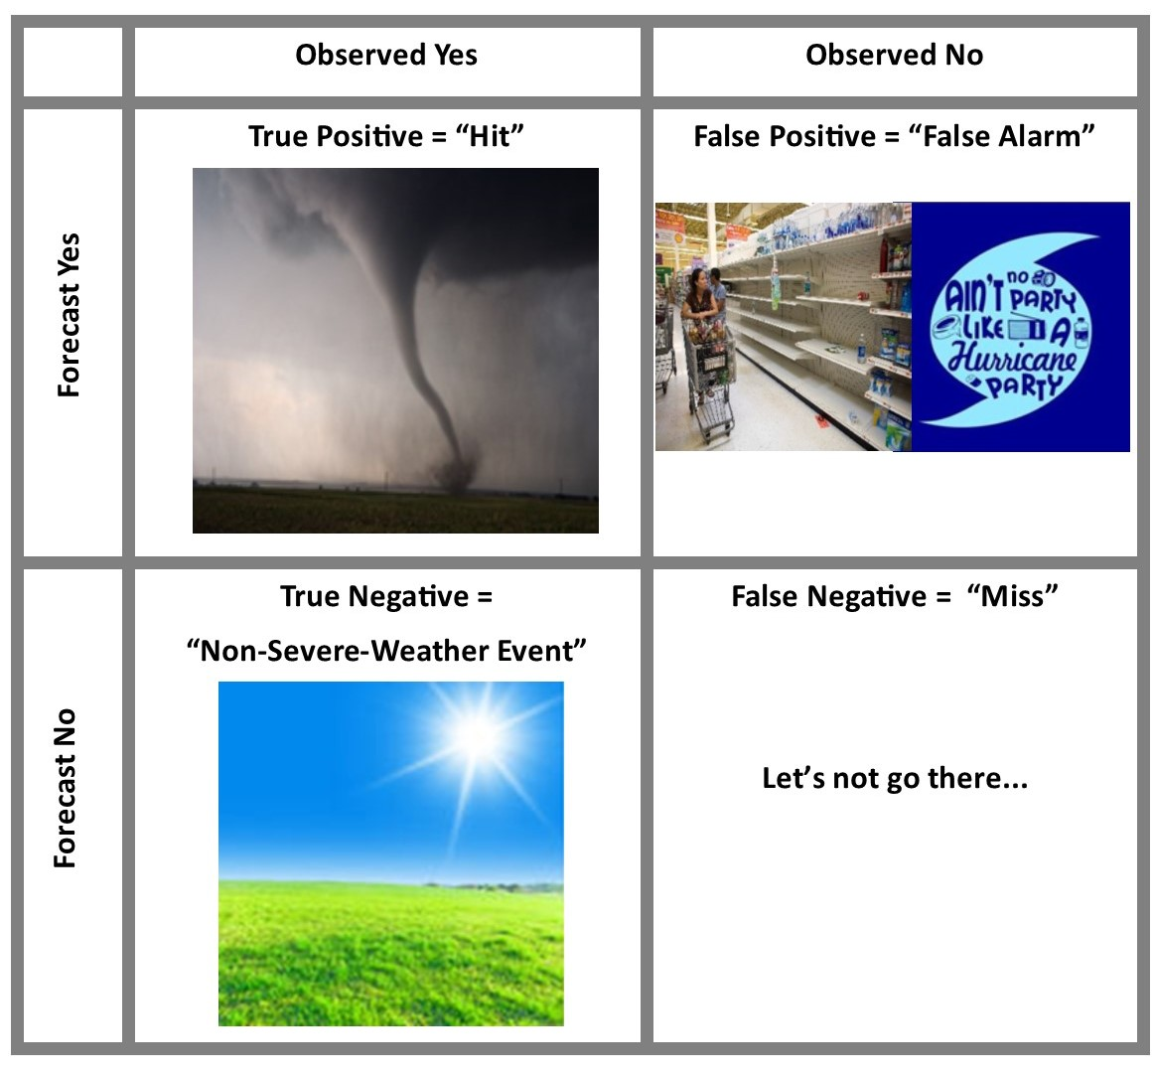
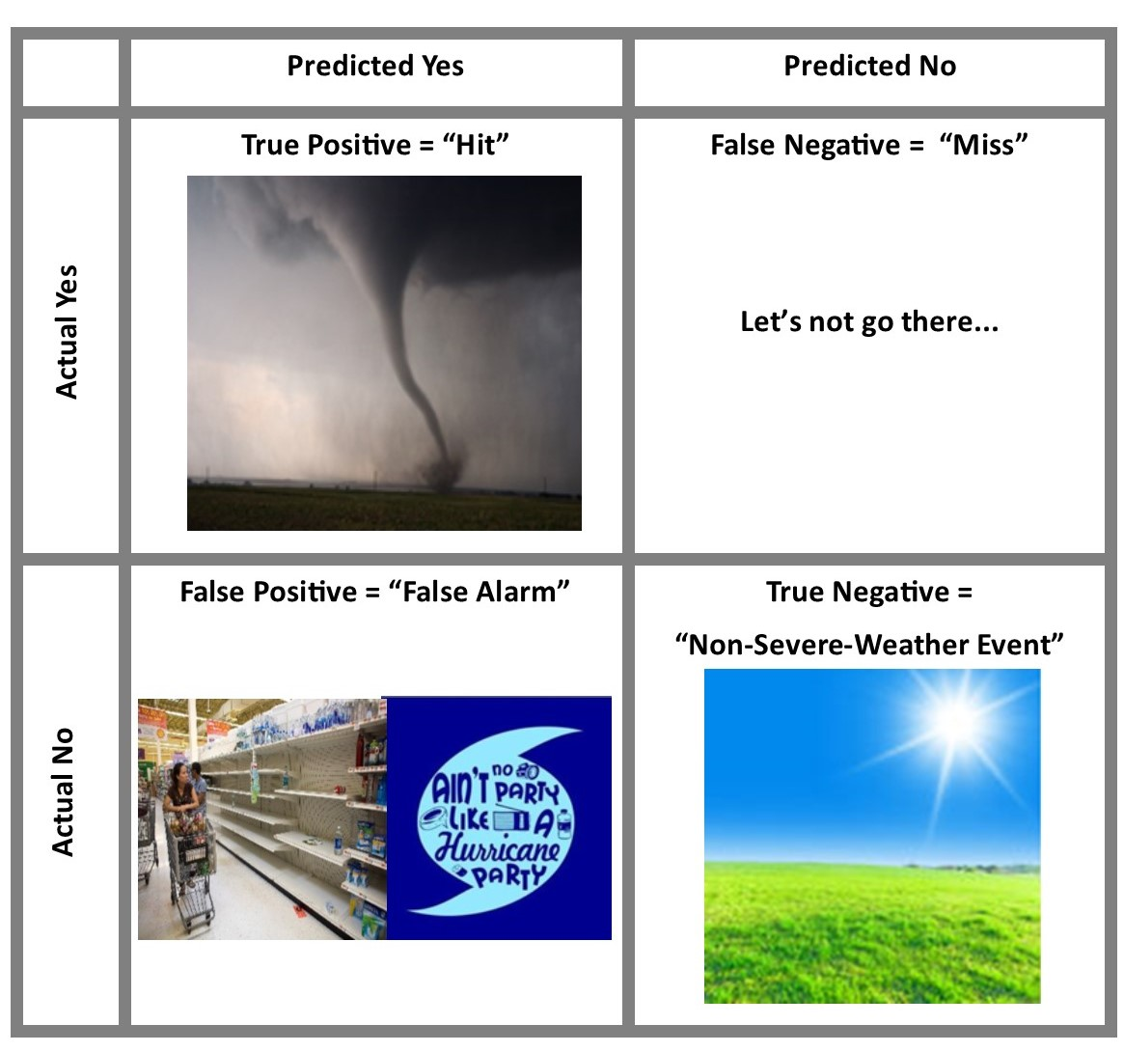
Jeny’s Takeaways cont’d...
4. The Confusion Matrix Enlightenment
Meteorological Contingency Table Data Science Confusion Matrix

