Slide 1



TITANIC
A prediction of survival
FANK
Farhana , Aram, Nevenka and Kenneth

Slide 2
THE TEAM
Kenneth Frykler GIT-manager
Nevenka Lukić Group president
Aram Özer Break manager
Farhana Rahman Documentation manager

Slide 3

PURPOSE
In this challenge, we build a predictive model that answers the question: “what sorts of people were more likely to survive?” using passenger data (ie name, age, gender, socio-economic class, etc).

Slide 4
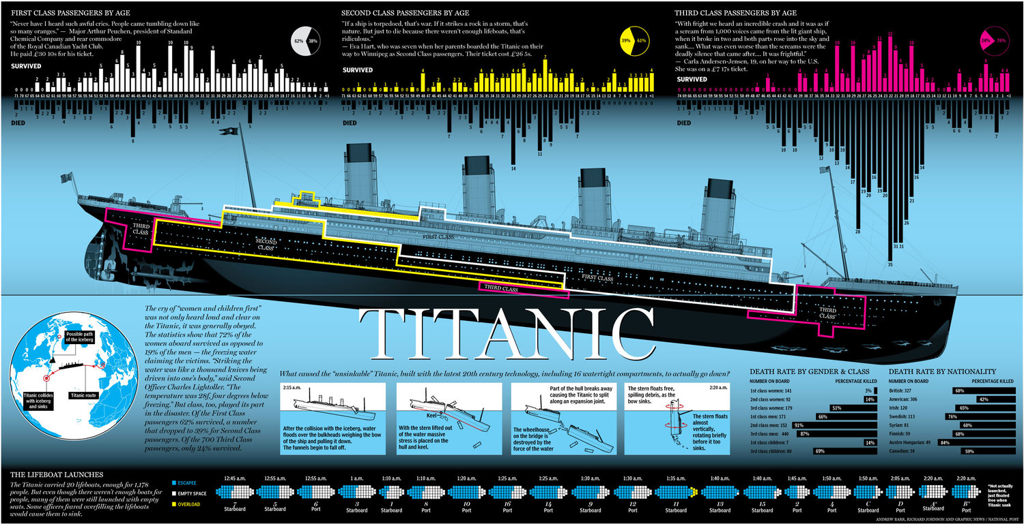

Slide 5
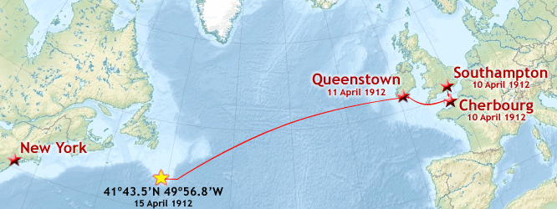
BACKGROUND STORY
On April 15, 1912, during her maiden voyage, the widely considered “unsinkable” RMS Titanic sank after colliding with an iceberg. Unfortunately, there weren’t enough lifeboats for everyone onboard, resulting in the death of 1502 out of 2224 passengers and crew.

Slide 6
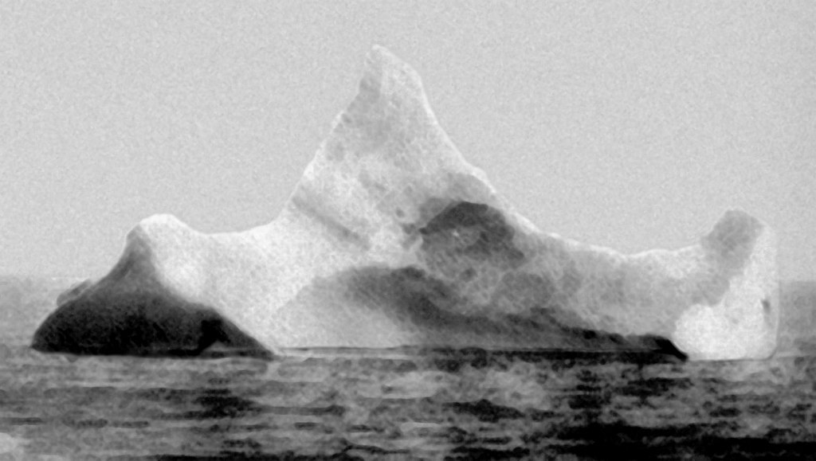
THE SUSPECT!?
The iceberg thought to have been hit by Titanic, photographed on the morning of 15 April 1912. Note the dark spot just along the berg's waterline, which was described by onlookers as a smear of red paint

Slide 7
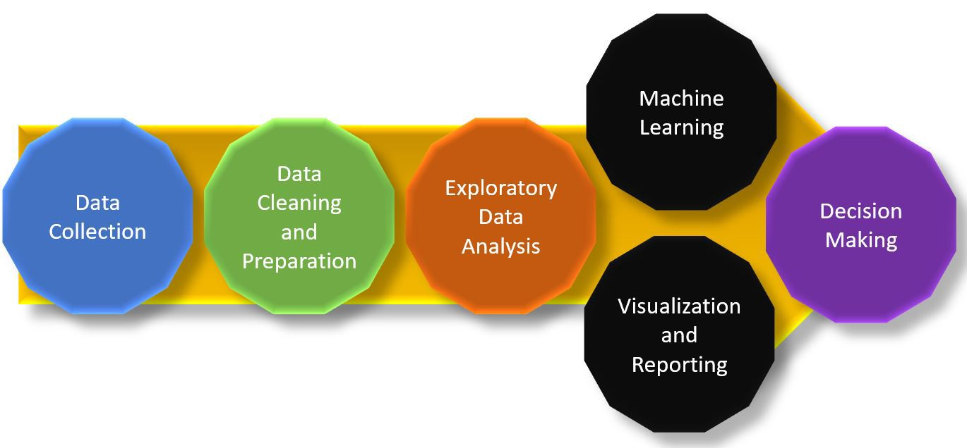
METHODOLOGY

Slide 8







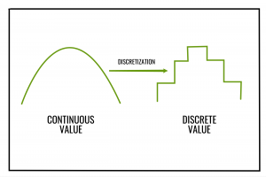


Techniques

Slide 9

WORK PROCESS
Daily stand up – daily scrum
Researching individually how the machine learning process is structured
Eight-eye principle (four-eye principle, Extreme programming)
A lot of discussions and searching during the process
Checkout
Notes:
Farhana

Slide 10

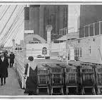
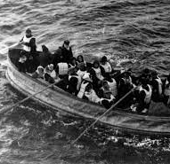
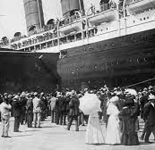
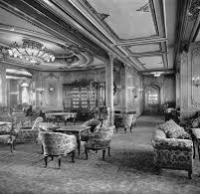
TITANIC Dataset
891 samples and 12 features

Slide 11
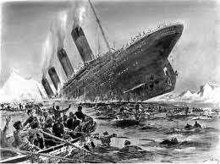
DATA dictionary
Categorical variables: Survived is a flag that indicates if a passenger survived or died ( i.e., 0 = No, 1 = Yes).
Sex indicates the gender of the passenger (i.e., Male or female).
Pclass is the passenger class (i.e., 1 = 1st class, 2 = 2nd class, 3 = 3rd class).
Embarked indicates the port where the passenger embarked from (i.e., C = Cherbourg, Q = Queenstown, S = Southampton).
Cabin indicates the cabin category occupied by the passenger.
Name is the name of the passenger.
Ticket indicates the ticket number issued to the passenger.
Sibsp is the number of siblings/spouses aboard.
Parch is the number of parents/children aboard.
Numerical variables: Fare indicates the amount of money spent on their ticket.
Age indicates the age of the passenger.
PassengerId is a unique identifying number assigned to each passenger.
Notes:
Categorical and Numerical Variables
- Categorical Variable: Survived, Sex, Pclass (ordinal), Embarked, Cabin, Name, Ticket, SibSp, and Parch.
- Numerical Variable: Fare, Age, and PassengerId.

Slide 12
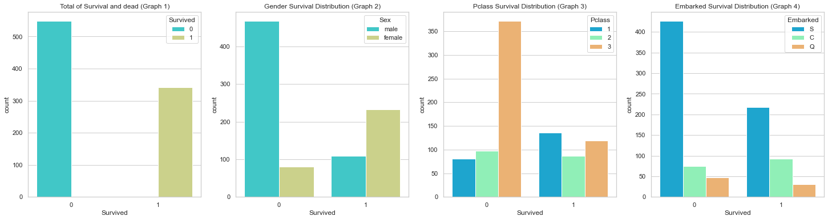
SURVIVAL
Notes:
Graph 1: 549 died (61,1 %) and 342 survived (38,9 %). Stepping on to the boat of Titanic only looking at the first graph one would have 38,9 % chance of surviving.
Graph 2: Adding another feature knowing the gender of the person stepping on the boat, if you are a male you only have a 19 % percent chance of survival. But if you are a female you will have 75 % survival rate.
Graph 3: Choosing the right class is very important when looking in the graph 3 above. If you paid for a class 3 ticket you will only have a 24 % survival rate, but if you instead paid for a class 2 ticket your survival rate will go up significantly to 47 %. For the highest chance of survival you would need to pay for a class 1 ticket, then you would have a 63 % survival rate.
Graph 4: Due to an over representation of 'S' in the statistics. The prediction of survival rate between the different classes in the feature is not reliable. Therefore the two NaN values will be replaced with 'S'. (S = 34%, C = 55%, Q = 39%)
C = Cherbourg, Q = Queenstown, S = Southampton

Slide 13
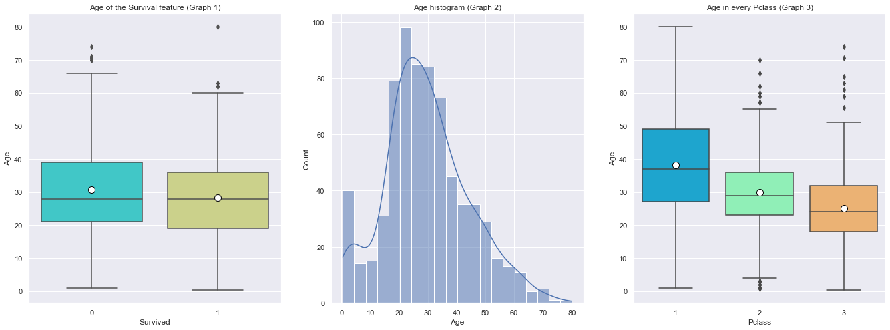
AGE
Notes:
The Age feature is almost normal distributed with just a small skewness to the left. Comparing Graph 1 and Graph 3 we can see the big difference in the mean. Therefore in the Feature Engineering part we will not fill the NaN values with the overall mean, but we will instead use the mean for each Pclass (Graph 3).

Slide 14
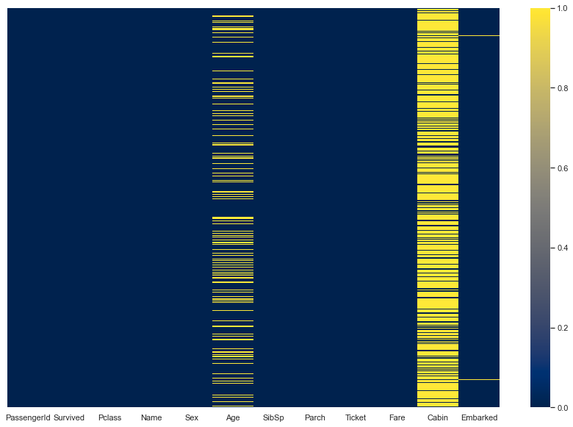
HEAT MAP
Notes:
Cabin 77.10 %
Age 19.87 %
Embarked 0.22 %

Slide 15
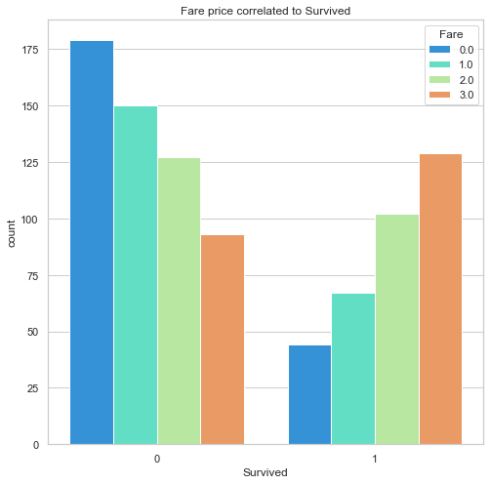
BINNING METHOD
for data in training_data:
data.loc[ data['Fare'] <= 7.91, 'Fare'] = 0
data.loc[(data['Fare'] > 7.91) &(data['Fare'] <= 14.45), 'Fare'] = 1
data.loc[(data['Fare'] > 14.45) & (data['Fare'] <= 31), 'Fare'] = 2
data.loc[ data['Fare'] > 31, 'Fare'] = 3
Notes:
Binning method

Slide 16
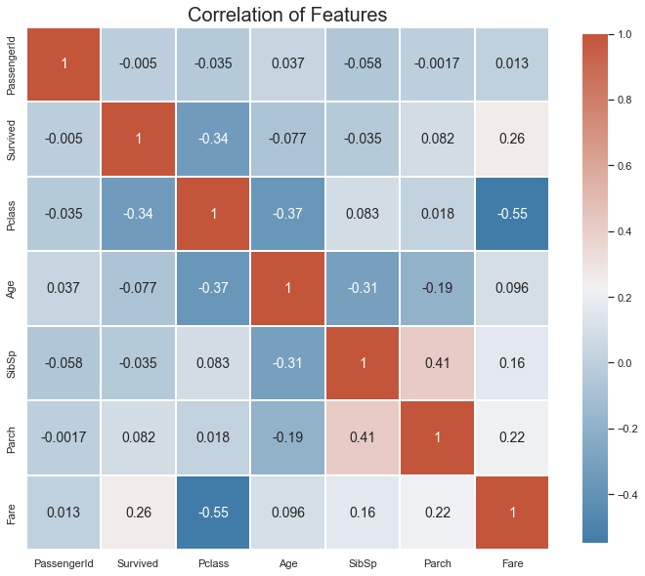
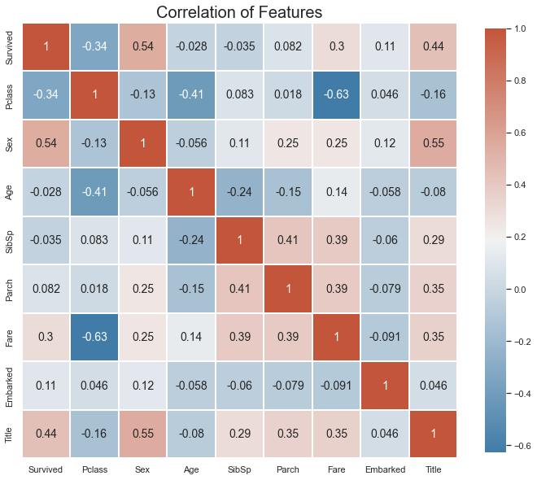
BEFORE
AFTER
Notes:
PCA

Slide 17
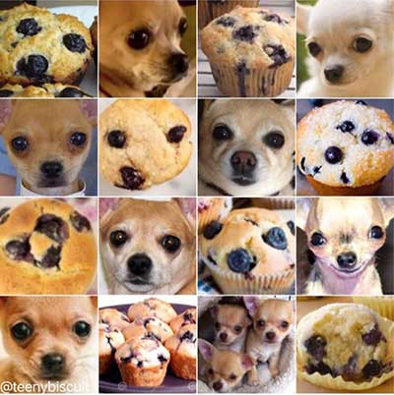
Classifying models we will use to train on our data
KNN – K Nearest Neighbors
Decision Tree
Random Forest
NB – Naïve Bayes
SVC – Support Vector Machine
Logistic Regression

Slide 18
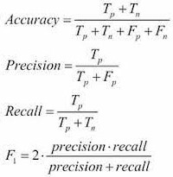
EVALUATION OF MODELLING
Accuracy - Among all the cases, count how many of them have been predicted correctly.
Precision - Among all the positive predictions, count how many of them are really positive.
Recall - Among all the real positive cases, count how many of them are predicted
positive.
F1-score - Harmonic mean of precision and recall.

Slide 19
RESULTS
Random Forest
KNN – K Nearest Neighbors
Decision Tree
NB – Naïve Bayes
SVC – Support Vector Machine
Logistic Regression
 | Accuracy | Precision | Recall | F1-score
RF_score: | 83.8% | 79.73% | 80.82% | 80.27%
KNN_score: | 82.68% | 79.73% | 78.67% | 79.19%
DT_score: | 81.56% | 77.03% | 78.08% | 77.55%
GNB_score: | 77.65% | 79.73% | 70.24% | 74.68%
SVC_score: | 81.01% | 75.68% | 77.78% | 76.71%
LR_score: | 81.01% | 79.73% | 75.64% | 77.63%

Slide 20

Challenges
Understanding the machine learning process from start to finish
Hard to know how deep to go into EDA. When is it good enough?
When is it a data leakage?
Making good visualization is a challenge
Notes:
Nevenka

Slide 21

LEARNINGS
How to explore data.
80 – 90 % of the time was spent on EDA and feature engineering.
Visualization gives a good understanding of the data

Slide 22

THE FUTURE
Go deeper into the EDA process and feature engineering
Hyperparameter tuning
Choosing a more optimized model
PCA – Principal Component Analysis
Notes:
Sibs and Parch features could have been used in EDA and feature engineering
Title had many more options for optimizing
EDA kunde blivit djupare med univariant och bivariant

Slide 23

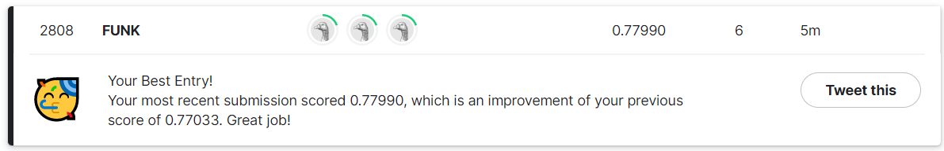
QUESTIONS?
Thank you for listening!

