Slide 1
Classification of ncRNAs using machine learning methods
Stefan Simm
31. March 2023

Slide 2
Convolutional Neural Network

Slide 3
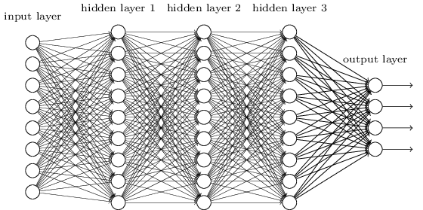
ANN or CNN?
We know it is better to train on small models if possible.
From this fully connected model, do we really need all the edges?
Can some of these be shared?

Slide 4
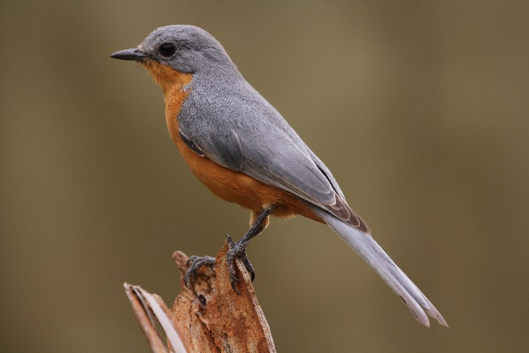
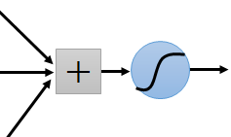
Consider learning from images:
Some patterns are much smaller than the whole image
Can represent a small region with fewer parameters
“beak” detector

Slide 5
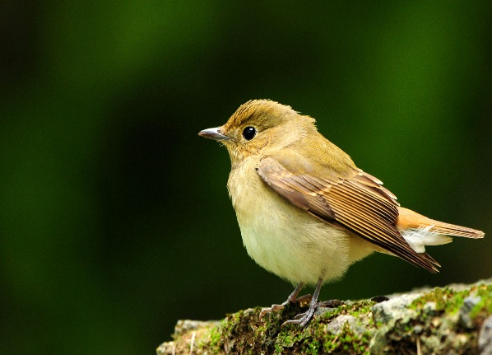
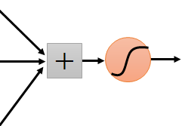
Same pattern appears in different places: They can be compressed! What about training a lot of such “small” detectors and each detector must “move around”.
“upper-left beak” detector
They can be compressed
to the same parameters.
“middle beak” detector

Slide 6
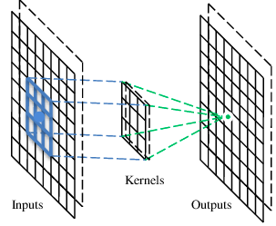
A convolutional layer
A CNN is a neural network with some convolutional layers
(and some other layers). A convolutional layer has a number
of filters that does convolutional operation.
Beak detector
A filter

Slide 7
Convolution
These are the network parameters to be learned.
1 | -1 | -1
-1 | 1 | -1
-1 | -1 | 1
1 | 0 | 0 | 0 | 0 | 1
0 | 1 | 0 | 0 | 1 | 0
0 | 0 | 1 | 1 | 0 | 0
1 | 0 | 0 | 0 | 1 | 0
0 | 1 | 0 | 0 | 1 | 0
0 | 0 | 1 | 0 | 1 | 0
Filter 1
-1 | 1 | -1
-1 | 1 | -1
-1 | 1 | -1
Filter 2
……
6 x 6 image
Each filter detects a small pattern (3 x 3).

Slide 8
Convolution
1 | -1 | -1
-1 | 1 | -1
-1 | -1 | 1
Filter 1
stride=1
1 | 0 | 0 | 0 | 0 | 1
0 | 1 | 0 | 0 | 1 | 0
0 | 0 | 1 | 1 | 0 | 0
1 | 0 | 0 | 0 | 1 | 0
0 | 1 | 0 | 0 | 1 | 0
0 | 0 | 1 | 0 | 1 | 0
Dot
product
3
-1
6 x 6 image

Slide 9
Convolution
1 | -1 | -1
-1 | 1 | -1
-1 | -1 | 1
Filter 1
If stride=2
1 | 0 | 0 | 0 | 0 | 1
0 | 1 | 0 | 0 | 1 | 0
0 | 0 | 1 | 1 | 0 | 0
1 | 0 | 0 | 0 | 1 | 0
0 | 1 | 0 | 0 | 1 | 0
0 | 0 | 1 | 0 | 1 | 0
3
-3
6 x 6 image

Slide 10
Convolution
1 | -1 | -1
-1 | 1 | -1
-1 | -1 | 1
Filter 1
stride=1
1 | 0 | 0 | 0 | 0 | 1
0 | 1 | 0 | 0 | 1 | 0
0 | 0 | 1 | 1 | 0 | 0
1 | 0 | 0 | 0 | 1 | 0
0 | 1 | 0 | 0 | 1 | 0
0 | 0 | 1 | 0 | 1 | 0
3
-1
-3
-1
-3
1
0
-3
-3
-3
0
1
3
-2
-2
-1
6 x 6 image

Slide 11
Convolution
-1 | 1 | -1
-1 | 1 | -1
-1 | 1 | -1
Filter 2
stride=1
Repeat this for each filter
1 | 0 | 0 | 0 | 0 | 1
0 | 1 | 0 | 0 | 1 | 0
0 | 0 | 1 | 1 | 0 | 0
1 | 0 | 0 | 0 | 1 | 0
0 | 1 | 0 | 0 | 1 | 0
0 | 0 | 1 | 0 | 1 | 0
3
-1
-3
-1
-1
-1
-1
-1
-3
1
0
-3
-1
-1
-2
1
Feature
Map
-3
-3
0
1
-1
-1
-2
1
3
-2
-2
-1
6 x 6 image
-1
0
-4
3
Two 4 x 4 images
Forming 2 x 4 x 4 matrix

Slide 12
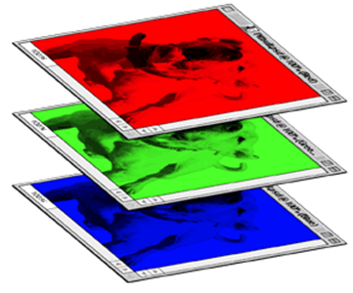
Color image: RGB 3 channels
1 | -1 | -1
-1 | 1 | -1
-1 | -1 | 1
-1 | 1 | -1
-1 | 1 | -1
-1 | 1 | -1
1 | -1 | -1
-1 | 1 | -1
-1 | -1 | 1
-1 | 1 | -1
-1 | 1 | -1
-1 | 1 | -1
1 | -1 | -1
-1 | 1 | -1
-1 | -1 | 1
-1 | 1 | -1
-1 | 1 | -1
-1 | 1 | -1
Filter 1
Filter 2
Color image
1 | 0 | 0 | 0 | 0 | 1
0 | 1 | 0 | 0 | 1 | 0
0 | 0 | 1 | 1 | 0 | 0
1 | 0 | 0 | 0 | 1 | 0
0 | 1 | 0 | 0 | 1 | 0
0 | 0 | 1 | 0 | 1 | 0
1 | 0 | 0 | 0 | 0 | 1
0 | 1 | 0 | 0 | 1 | 0
0 | 0 | 1 | 1 | 0 | 0
1 | 0 | 0 | 0 | 1 | 0
0 | 1 | 0 | 0 | 1 | 0
0 | 0 | 1 | 0 | 1 | 0
1 | 0 | 0 | 0 | 0 | 1
0 | 1 | 0 | 0 | 1 | 0
0 | 0 | 1 | 1 | 0 | 0
1 | 0 | 0 | 0 | 1 | 0
0 | 1 | 0 | 0 | 1 | 0
0 | 0 | 1 | 0 | 1 | 0

Slide 13
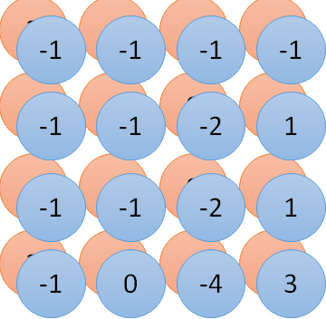
Convolution vs. Fully Connected
1 | 0 | 0 | 0 | 0 | 1
0 | 1 | 0 | 0 | 1 | 0
0 | 0 | 1 | 1 | 0 | 0
1 | 0 | 0 | 0 | 1 | 0
0 | 1 | 0 | 0 | 1 | 0
0 | 0 | 1 | 0 | 1 | 0
1 | -1 | -1
-1 | 1 | -1
-1 | -1 | 1
-1 | 1 | -1
-1 | 1 | -1
-1 | 1 | -1
convolution
image
1 | 0 | 0 | 0 | 0 | 1
0 | 1 | 0 | 0 | 1 | 0
0 | 0 | 1 | 1 | 0 | 0
1 | 0 | 0 | 0 | 1 | 0
0 | 1 | 0 | 0 | 1 | 0
0 | 0 | 1 | 0 | 1 | 0
Fully-connected
……
……

Slide 14
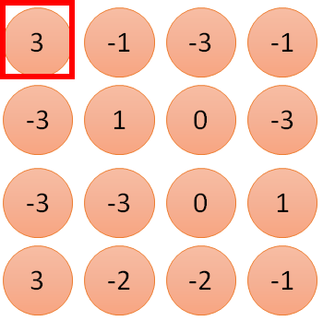
1 | -1 | -1
-1 | 1 | -1
-1 | -1 | 1
1
1
Filter 1
2
0
3
0
3
4:
0
1 | 0 | 0 | 0 | 0 | 1
0 | 1 | 0 | 0 | 1 | 0
0 | 0 | 1 | 1 | 0 | 0
1 | 0 | 0 | 0 | 1 | 0
0 | 1 | 0 | 0 | 1 | 0
0 | 0 | 1 | 0 | 1 | 0
…
0
8
1
9
0
10:
0
…
13
0
6 x 6 image
14
0
fewer parameters!
15
Only connect to 9 inputs, not fully connected
1
16
1
…

Slide 15
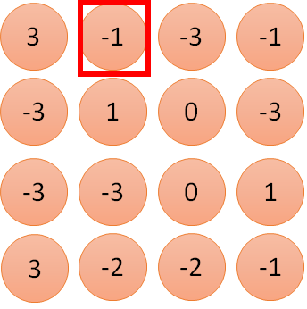
1 | -1 | -1
-1 | 1 | -1
-1 | -1 | 1
1:
1
Filter 1
2:
0
3:
0
3
4:
0
1 | 0 | 0 | 0 | 0 | 1
0 | 1 | 0 | 0 | 1 | 0
0 | 0 | 1 | 1 | 0 | 0
1 | 0 | 0 | 0 | 1 | 0
0 | 1 | 0 | 0 | 1 | 0
0 | 0 | 1 | 0 | 1 | 0
…
7:
0
8:
1
-1
9:
0
10:
0
…
13:
0
6 x 6 image
14:
0
Fewer parameters
15:
1
16:
1
Shared weights
Even fewer parameters
…

Slide 16
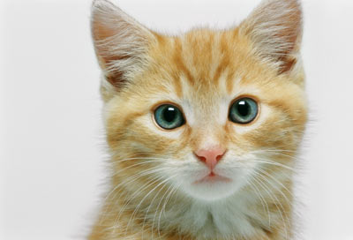
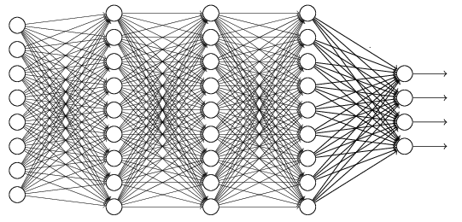
The whole CNN
cat dog ……
Convolution
Max Pooling
Can repeat many times
Fully Connected Feedforward network
Convolution
Max Pooling
Flattened

Slide 17
Max Pooling
1 | -1 | -1
-1 | 1 | -1
-1 | -1 | 1
-1 | 1 | -1
-1 | 1 | -1
-1 | 1 | -1
Filter 1
Filter 2
3
-1
-3
-1
-1
-1
-1
-1
-3
1
0
-3
-1
-1
-2
1
-3
-3
0
1
-1
-1
-2
1
3
-2
-2
-1
-1
0
-4
3

Slide 18
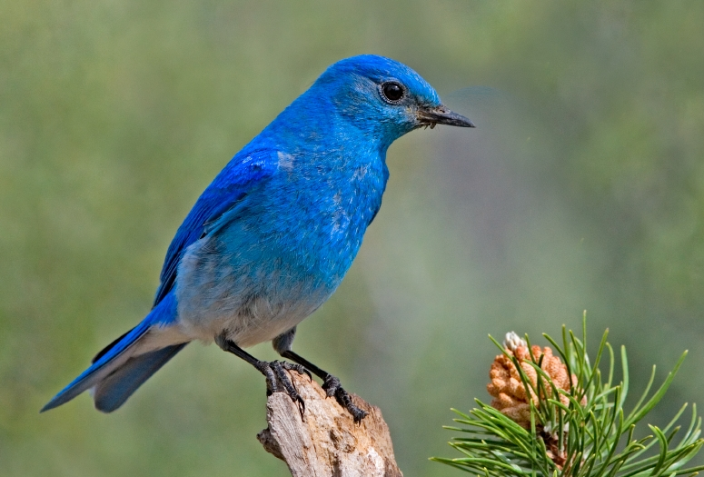

Why Pooling
Subsampling pixels will not change the object
bird
bird
Subsampling
We can subsample the pixels to make image smaller
fewer parameters to characterize the image

Slide 19
Max Pooling
New image
but smaller
1 | 0 | 0 | 0 | 0 | 1
0 | 1 | 0 | 0 | 1 | 0
0 | 0 | 1 | 1 | 0 | 0
1 | 0 | 0 | 0 | 1 | 0
0 | 1 | 0 | 0 | 1 | 0
0 | 0 | 1 | 0 | 1 | 0
Conv
3
0
-1
1
Max
Pooling
3
1
0
3
2 x 2 image
6 x 6 image
Each filter
is a channel

Slide 20
The whole CNN
3
0
-1
1
Convolution
3
1
0
3
Max Pooling
Can repeat many times
A new image
Convolution
Smaller than the original image
The number of channels is the number of filters
Max Pooling

Slide 21
The whole CNN
cat dog ……
Convolution
Max Pooling
Fully Connected Feedforward network
A new image
Convolution
Max Pooling
Flattened
A new image

Slide 22
Flattening
3
0
1
3
0
-1
1
3
3
1
-1
0
3
Flattened
1
Fully Connected Feedforward network
0
3

Slide 23
Transfer on other data input
How to deal with Text as input?
Transform to image?
Is the input parameter independent?
Same requirements fitting?
Letters transform to integers?
Is the sequence order important?
Why smaller portions?

Slide 24
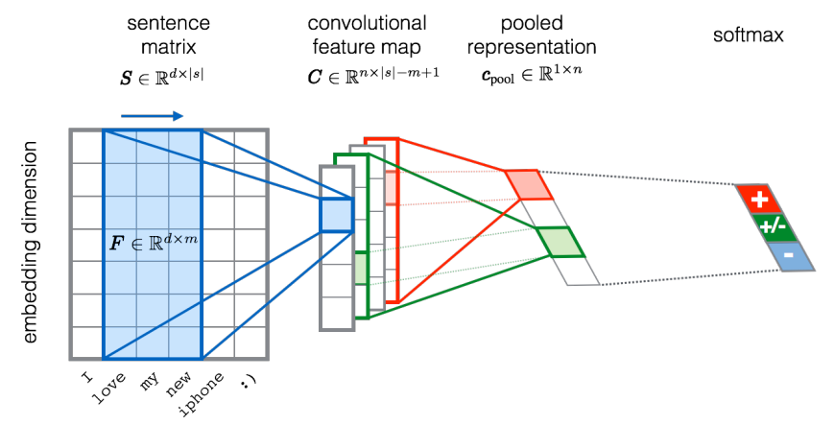
CNN in text classification
?
Source of image: http://citeseerx.ist.psu.edu/viewdoc/download?doi=10.1.1.703.6858&rep=rep1&type=pdf

Slide 25
Types of RNA and their specific structures

Slide 26
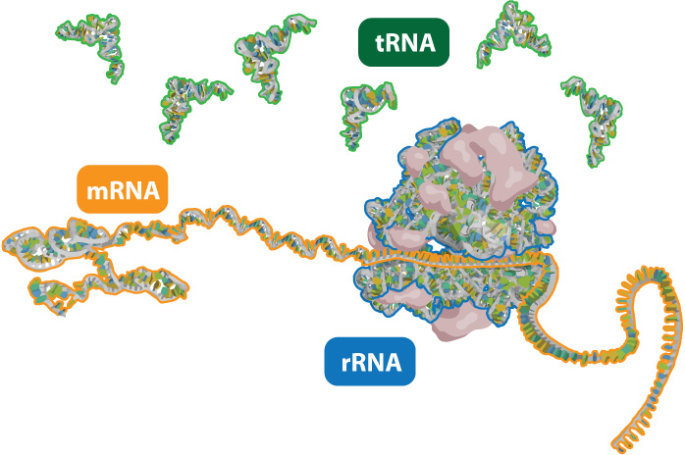
Types of RNA
http://learn.genetics.utah.edu/content/molecules/beyond/images/tmr_rna.jpg

Slide 27
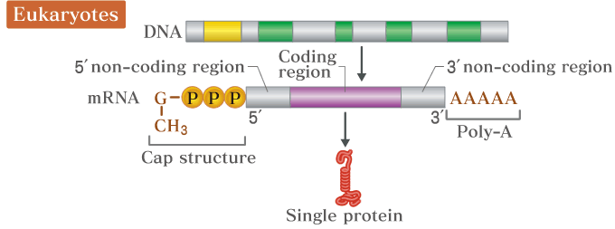
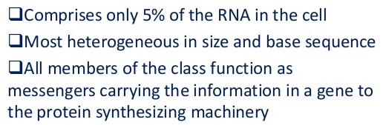
mRNA features / structure

Slide 28
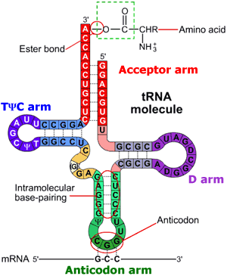
tRNA features / structure
http://www.alamy.com/search-results.asp?qt=Friedrich+Saurer+Einstein&npgs=7
Small RNA species (74 – 95 nucleotides)
Transfer amino acid to translation machinery (easily soluble RNA )
At least 20 species for 20 amino acids required
http://higheredbcs.wiley.com/legacy/college/boyer/0471661791/structure/tRNA/trna_diagram_small.gif

Slide 29
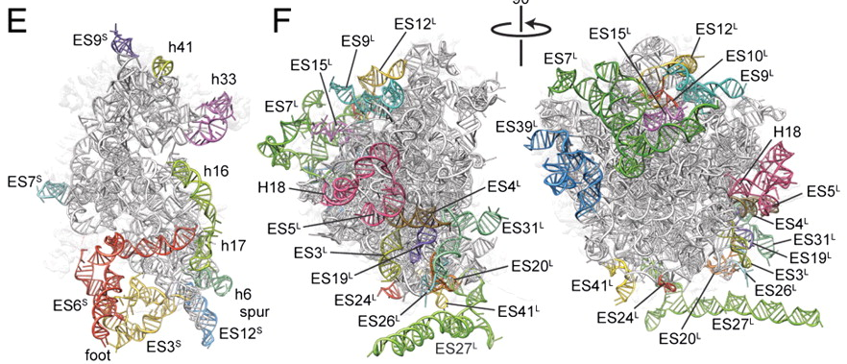
rRNA features / structure
http://www.alamy.com/search-results.asp?qt=Friedrich+Saurer+Einstein&npgs=7
http://www.pnas.org/content/107/46/19748/F3.large.jpg
Large and small ribosomal subunit:
60S → 5S, 5.8S and 28S rRNA
40S → 18S rRNA
5S is independently transcribed
All other comes from 45S precursor

Slide 30
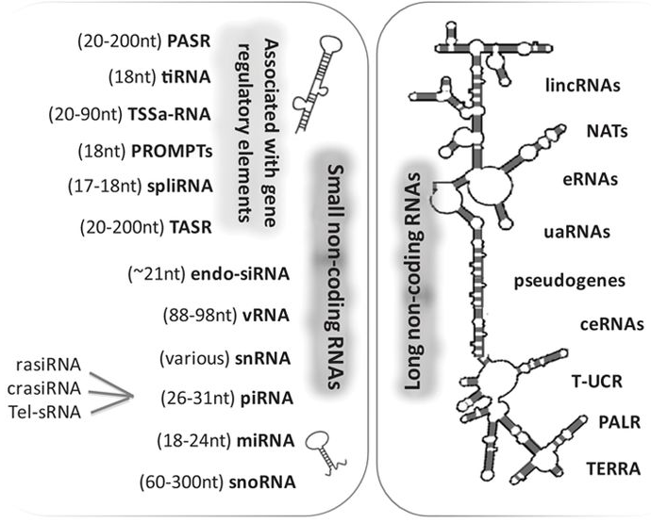
non-coding (nc) RNAs
Schonrock N et al. Circulation Research. 2012;111:1349-1362
Notes:
PASR: promoter-associated short
tiRNA: transcription initiation
TSSa-RNA: transcription start site-associated
PROMPT: promoterupstream transcripts
spliRNA: splice junction-associated
vRNA: vault
rasiRNA: repeat associated small interfering
crasiRNA: centromere repeat associated short interacting
Tel-sRNA: telomere specific small
lincRNA: long intergenic non-coding
Nat: natural antisense transcripts
eRNA: enhancer RNA
uaRNA: 3ÙTR-derived
ceRNA: competing endogenous
T-UCR: transcribed ultraconserved region
PALR: promoter-associated long
TERRE telomeric repeat-containing

Slide 31
CNN for Sequence classification
Aim for todays lesson

Slide 32
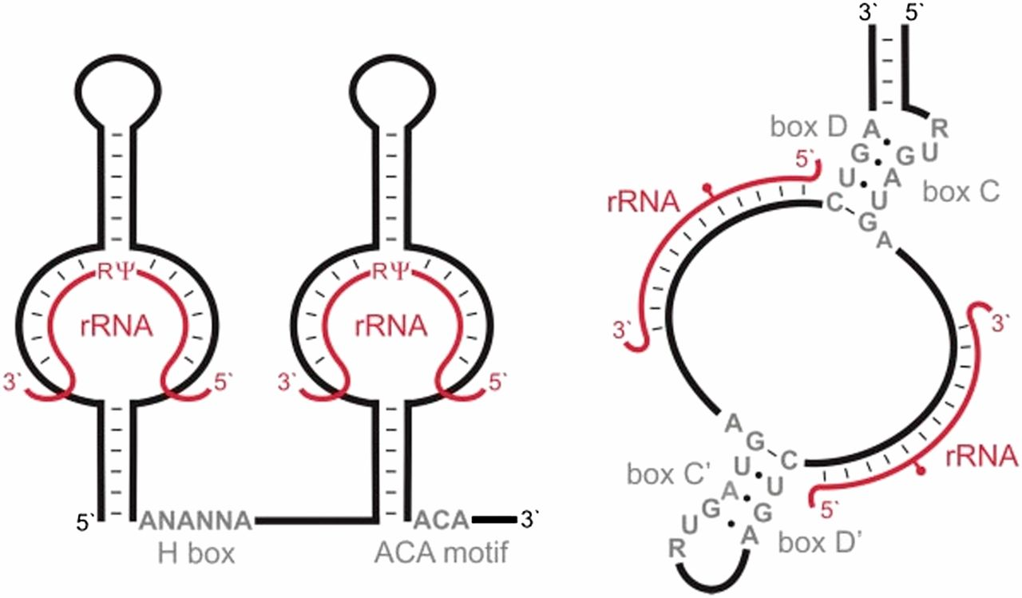
snoRNAs
2′-O-ribose methylation
Pseudouridylation
http://www.genetics.org/content/genetics/195/3/643/F6.large.jpg

Slide 33
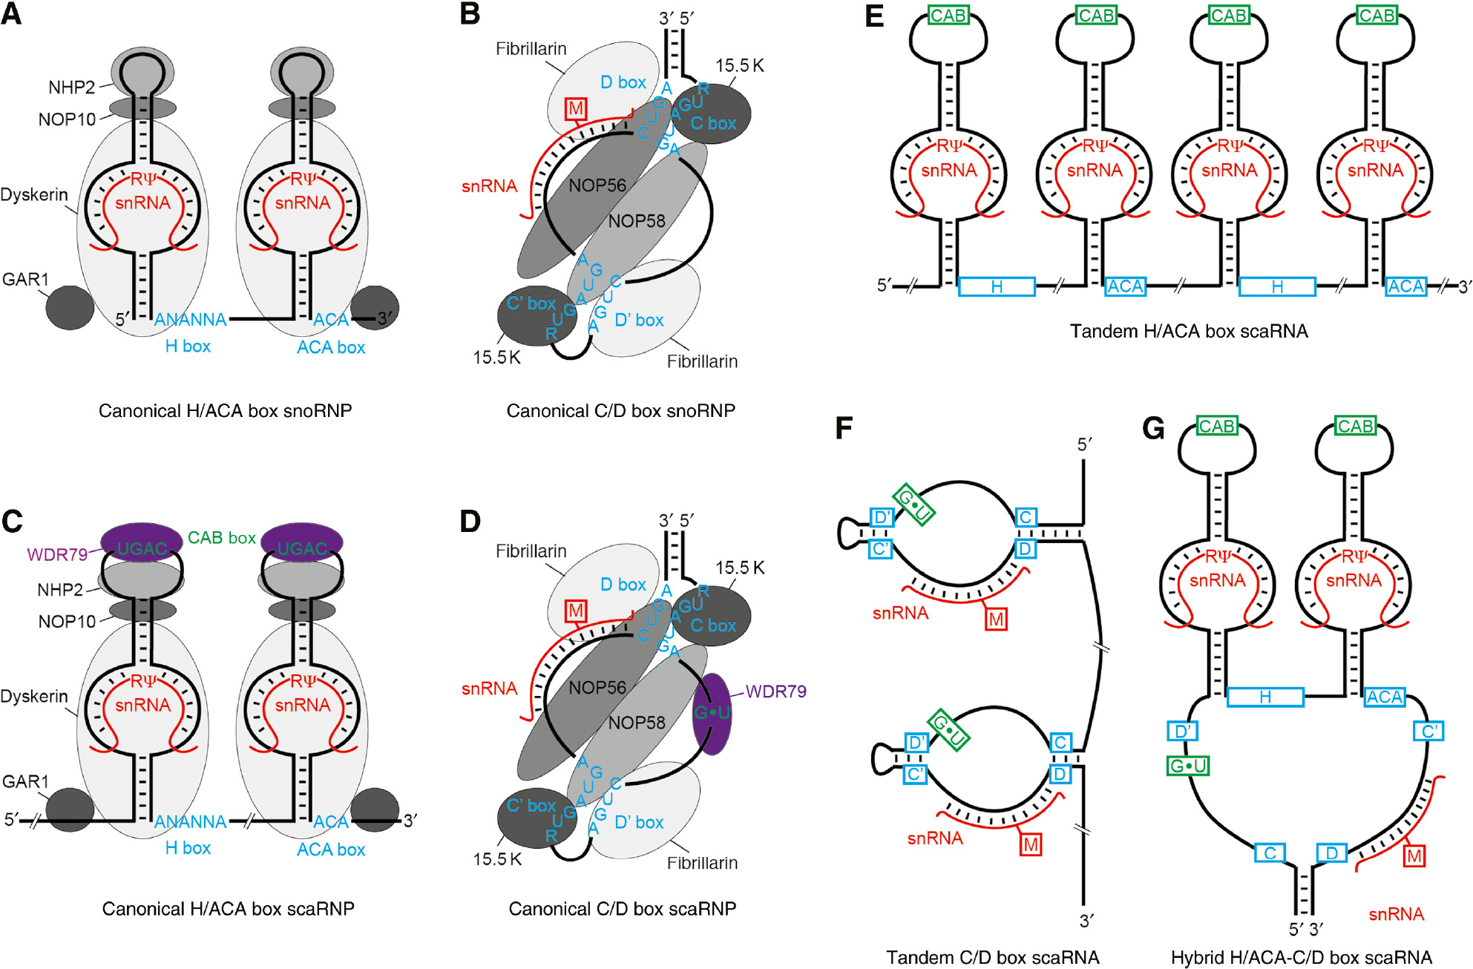
scaRNAs
https://www.degruyter.com/document/doi/10.1515/hsz-2018-0205/html?lang=de

Slide 34
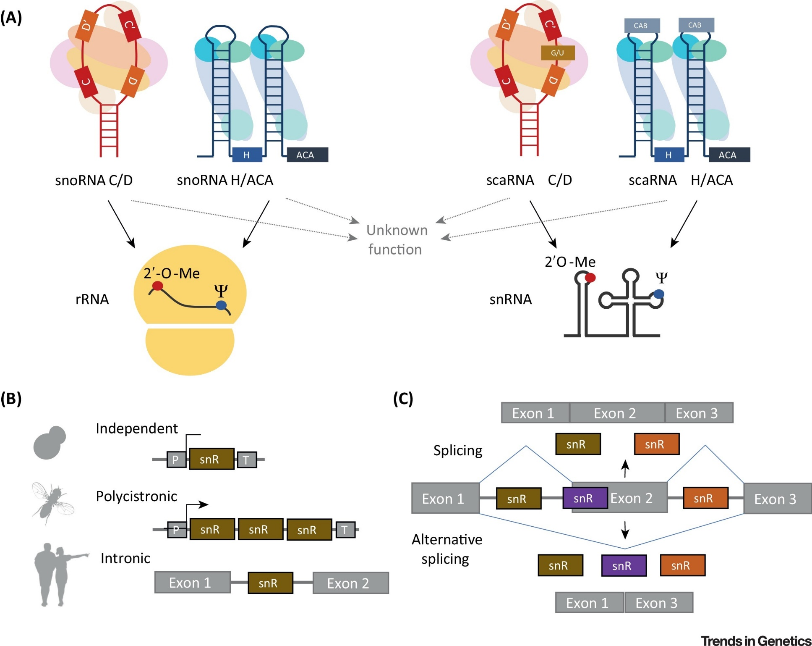
scaRNAs vs snoRNAs
https://www.cell.com/trends/genetics/fulltext/S0168-9525%2818%2930203-8

Slide 35
The dataset
RNAcentral
snoRNA (C/D-box, H/ACA-box), scaRNA
No hypotheticals, no partials
Preprocessing step
Clustered via CD-HIT to a max. of 0.9 (90%) similarity
Balanced to 1913 sequences per class
 | snoRNA (H/ACA) | snoRNA (C/D) | scaRNA
Overall | 89,522 | 152,235 | 6,747
Mammalia | 57,640 | 34,286 | 4,094
Insecta | 976 | 2,388 | 47
Fish (Actinopterygii) | 7,320 | 11,530 | 752
Plants (Viridiplantae) | 5,808 | 76,445 | 28
Fungi (Ascomycota) | 5,375 | 7,835 | 1

Slide 36
Workflow
Get data
Inspect data
Split data into Train / Test sets
Create model
Train model
Validate model
Run 10-fold cross validation
Extend to different input features
Compare accuracy
First Notebook
Repeat for
optimiziation
Second Notebook
Third Notebook

Slide 37
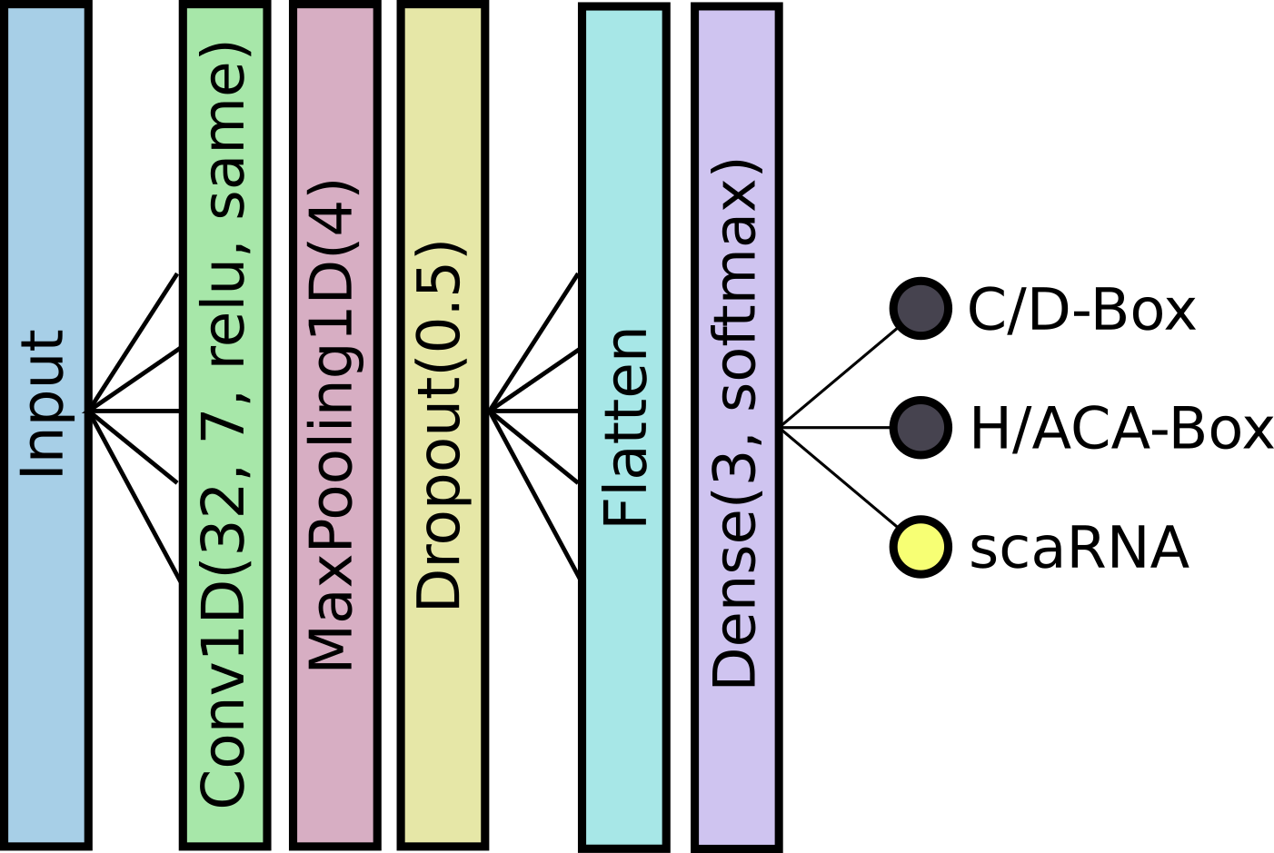
CNN our Standard Architecture

Slide 38
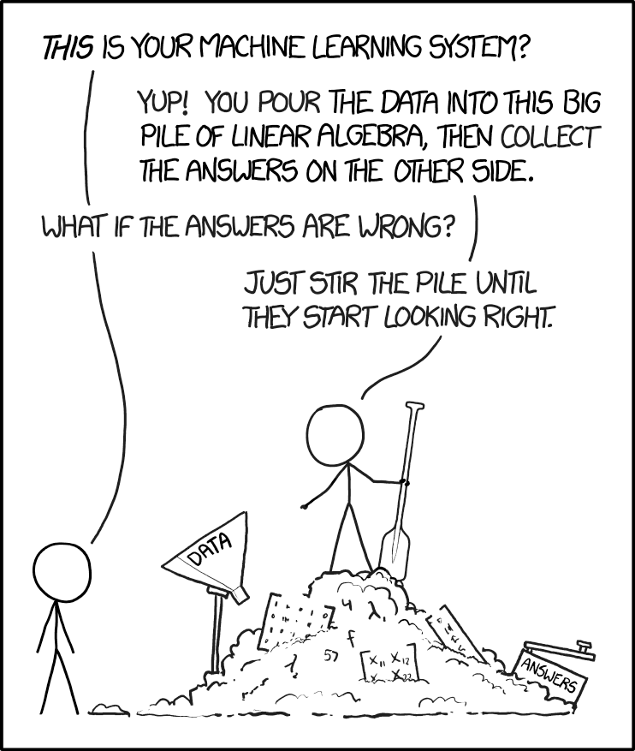
Let’s Classify

