Slide 1
Horizon Scanning
January 06 - 11, 2025 - EXAMPLE

Slide 2
Aramco was mentioned in 91 articles last week
Weekly Theme Sentiment
INTERNATIONAL THEMES
Fuel Prices and Market Dynamics: Aramco raised February crude prices for Asia amid OPEC+ cuts, while crude supply to China is set to fall to 43.5 million barrels. (Reuters, Oil Price, The Business Standard)
Strategic Partnerships and Investments: Wa’ed Ventures invested $30 million in Zension Technologies, and Aston Martin Aramco F1 announced a 2025 partnership with Pepperstone. Kent’s $2 billion sales were driven by Aramco and Adnoc deals. (Bloomberg, AP News, Upstream)
Global Economic Impact: Aramco’s January fuel price hike will slightly affect SABIC, Almarai, and SEC, while LPG price cuts with Sonatrach were noted. Aramco also boosts L&T’s growth. (S&P Global, Reuters, The Economic Times)
DOMESTIC THEMES
Fuel Price Hikes and Cost Implications: Aramco’s fuel price hikes for January 2025 raised costs for Tabuk Cement, Petro Rabigh, and Riyadh Cement, with diesel price hikes impacting SABIC and Almarai. (Argaam, Al Yaum, Al Eqtisadiah)
Major Projects and Discoveries:Aramco announced a major Jafurah gas discovery and is advancing a $10 billion Master Gas System expansion alongside carbon capture initiatives. (Attaqa, Meed, Al Jazirah)
Economic Contributions and Future Outlook: AlJazira Capital forecasts SAR 95.4 billion in Q4 2024 profits for Aramco, while its $11.2 billion FMO milestone supports Vision 2030. (Argaam, Maaal, Arabian Business)
Promote Strategic Investments: Highlight Aramco’s global partnerships, like Aston Martin F1, and innovation-driven investments, such as Zension Technologies, to showcase its industry leadership.
Showcase Energy Transition: Emphasize Aramco’s efforts in sustainability through major gas discoveries, carbon capture initiatives, and renewable energy projects like Blue Whale-1.
Highlight Economic Impact: Share Aramco’s role in driving economic growth through job creation, industrial expansion, and infrastructure projects.
Notes:
20-Dec-24
Big Oil’s Next Cash Cow Is Plastics
Foreign Policy
Patrick Schröder

Slide 3
Planned Activities – January
Activity | Date | Implication/Consideration/Actions | IMR/RM
Iktva Forum & Exhibition | Jan. 13-16 | Press release in Arabic and English Media brief in Arabic and English 11 journalists confirmed for media visit Media engagement invitations prepared 3 speeches prepared: HRH Governor, CEO, Chairman | RMR
Financial Times Interview | Jan. 13 | Virtual interview with AOK and YMM Questionnaires finalized | IMR
Future Minerals Forum (FMF) | Jan. 14-16 | Invitation for MRD engagement drafted Joint press release changed to Aramco press release Arabic written interview under development-MEED and Al Arabiya under consideration Upstream president to deliver speech Fireside chat cancelled | RMR
15th Professional Development Conference & Exhibit | Jan. 19-23 | Media engagement with exhibit planned Six Bahraini media figures from approved list will be invited No executive participation | RMR
World Economic Forum (WEF) 2025 | Jan. 20-24 | Plastic production and pollution may be major topic – messaging on this developed Media brief has been approved by CEO’s office WEF Lighthouse Status for Ghawar to be announced during WEF Press release in English and Arabic | IMR
35+ Years Service/Safety Awards | Jan. 21 | Speech in Arabic to be delegated | EWG
RECSO EnviroSpill Conference & Exhibition | Jan. 21-23 | Media plan is approved and will include MRD engagement with exhibit Media invitations to go out January 13. | RMR
Global Labor Market Conference | Jan. 29-30 | Media engagement and exhibit planned. Invite to be shared by January 19th. Speech planned but Executive not confirmed Media Advisory on how to amplify speech to be prepared | RMR
Center for strategic and international studies (CSIS) | Jan. 30 | Event to be assessed and evaluated CEO will be in Washington DC for event Engagement is usually speech or fireside chat | IMR
Project Blue Closing Announcement | Jan. 31 | English and Arabic press release with proponent Date is tentative | MRC

Slide 4


Media Inquiries Jan 5-11
Request for comment on Reuters report re: Oil Price Hikes for Asia
Action: Pending
3
Total media inquiries
January 5-11
Request for comment on media reports about LPG price hikes, and crude supplies
Action: Pending
Interview in Petrogram Magazine
Action: On Hold
5
YTD inquiries
Notes:
2 media inquiries from Upstream and S&P Global.

Slide 5


New slide on issues + global reports
On Aramco’s Radar
ISSUE 1
ISSUE 2
ISSUE 3
Brief description of issue – BURSON/HK
Recommendation provided for issue – BURSON/HK
Did Aramco follow recommendation? – BURSON/HK
What is the on-going action on this issue? - MECD
Brief description of issue – BURSON/HK
Recommendation provided for issue – BURSON/HK
Did Aramco follow recommendation? – BURSON/HK
What is the on-going action on this issue? - MECD
Brief description of issue – BURSON/HK
Recommendation provided for issue – BURSON/HK
Did Aramco follow recommendation? – BURSON/HK
What is the on-going action on this issue? - MECD
Upcoming Global Report
Brief description of Report
What was some key coverage from last year about this report?
Summary of this year’s report
Implications for Aramco
Recommendation summary from advice note/intel note
Links to Articles with Publication Logos

Slide 6

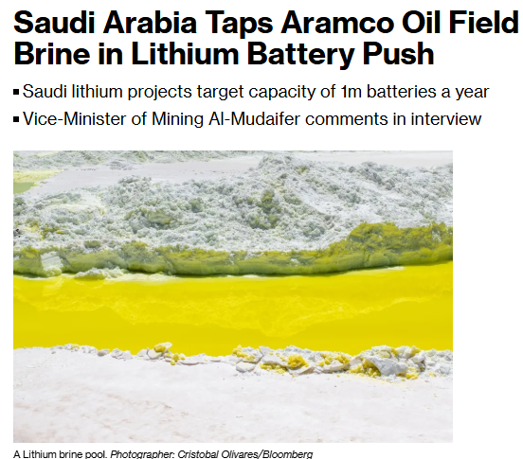



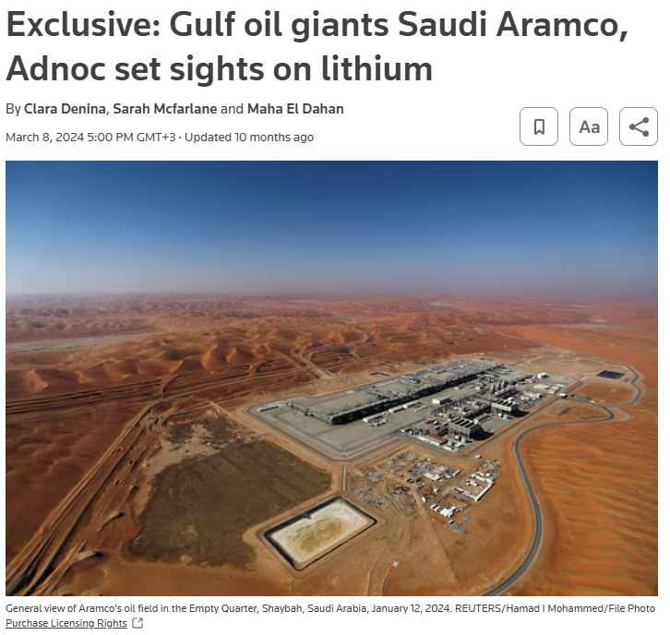


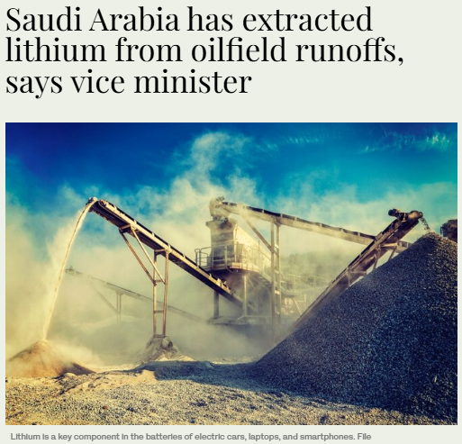



Event specific slide to cover major events in the past week. Next week’s report will cover IKTVA and FMF and how they were covered
EVENT SPECIFIC SLIDE: Future Minerals Forum
The Future Minerals Forum (FMF) is the world’s premier platform for shaping the future of the minerals industry. With 14,000 participants from 178 countries, including 75 government representatives, FMF facilitates global collaboration among governments, organizations, and industry leaders. Scheduled for January 14-16, 2025, it serves as a catalyst for innovation and strategic connections in the sector.
Anticipated Discussions
Critical Minerals for Sustainability: Highlighting their pivotal role in global development, fostering lasting partnerships and to sustainable growth and resilient economies.
Green Metals and Clean Energy: Exploring innovative value chains supported by advanced technologies and clean energy solutions for regional integration and future-ready production.
Centers of Excellence: Presenting actionable plans for capacity building, knowledge sharing, and innovation in mining practices to transform the mining sector and ensure environmental and social responsibility.
Regional Value Creation: Shifting from raw material export to retaining more value locally through innovation and responsible production ultimately creating a Super Region that leads in shaping global mining practices.
Resilient Mineral Value Chains: Promoting ethical, sustainable, and collaborative approaches across Africa, Western, and Central Asia to establish transparent and secure supply chains for the future.

Slide 7
Event specific slide to cover major events in the current or forward weeks. Next report to cover WEF and associated coverage.
EVENT SPECIFIC SLIDE: Future Minerals Forum
The Future Minerals Forum (FMF) is the world’s premier platform for shaping the future of the minerals industry. With 14,000 participants from 178 countries, including 75 government representatives, FMF facilitates global collaboration among governments, organizations, and industry leaders. Scheduled for January 14-16, 2025, it serves as a catalyst for innovation and strategic connections in the sector.
Anticipated Discussions
Critical Minerals for Sustainability: Highlighting their pivotal role in global development, fostering lasting partnerships and to sustainable growth and resilient economies.
Green Metals and Clean Energy: Exploring innovative value chains supported by advanced technologies and clean energy solutions for regional integration and future-ready production.
Centers of Excellence: Presenting actionable plans for capacity building, knowledge sharing, and innovation in mining practices to transform the mining sector and ensure environmental and social responsibility.
Regional Value Creation: Shifting from raw material export to retaining more value locally through innovation and responsible production ultimately creating a Super Region that leads in shaping global mining practices.
Resilient Mineral Value Chains: Promoting ethical, sustainable, and collaborative approaches across Africa, Western, and Central Asia to establish transparent and secure supply chains for the future.

Slide 8









On Aramco’s Radar
FIFA World Cup
Saudi Market Dynamics
Economy & Business
3
1
2
Conflicts with FIFA and FIFA-related organizations over financial mismanagement are raising concerns about the transparency and reliability of fiscal practices within Saudi entities, possibly affecting perceptions globally.
Saudi Aramco navigates various international dynamics, from oil price hikes and refinery expansions in Bangladesh (inaccurate report) to strategic market adjustments amid global regulatory and economic changes. These efforts reflect Aramco's adaptability in a fluctuating energy landscape.
Aramco navigates evolving markets with strategic funding and diversification, aligning with Vision 2030 to enhance infrastructure, innovation, and investment appeal, despite economic fluctuations and government borrowing efforts in Saudi Arabia.
Highlighted Issues
Highlighted Issues
Negative Perception: The non-payment by Al-Orobah may cast a shadow over Saudi financial practices and governance.
Reputation Risk: Issues could precipitate scrutiny of Saudi business dealings, potentially influencing international trust and investment behaviors.
Highlighted Issues
Market Dynamics: Global oil markets face volatile conditions due to price adjustments, regulatory challenges, and geopolitical tensions.
Economic Complexity: Rising inflation and potential tariffs introduce uncertainties impacting oil demand and pricing strategies.
Economic Volatility : Debt and bond market dynamics impact funding strategies and capital-raising efforts.
Strategic Alignment: Aramco's involvement in Vision 2030 projects is crucial amidst national borrowing.
Innovation Drive: Investment in technology startups underscores diversification and reputation management.
Considerations
Considerations
Considerations
Ensure Stability: Communicate Aramco's stable supply chain strategies to reassure partners amidst market changes.
Reactive Statement : Do not proactively comment on Bangladesh story. But if asked, either decline to comment (speculative) or emphasize that the story is inaccurate.
Communicate Stability: Emphasize Aramco’s stable financial strategies
Highlight Innovation: Showcase investments in innovation, enhancing Aramco's role as a leader in economic transformation.
Engage Strategically: Emphasize strong partnerships and investor relations to support financial growth and market confidence.
Monitor Continuously: Keep updated on FIFA matters. Any financial news has the potential to spillover into greater scrutiny of the entire ecosystem including sponsors.

Slide 9







Industry Developments
Competitors
Energy Transition
3
Sustainability
1
2
Global market changes present both challenges and opportunities for Aramco, from infrastructure and technological advancements to sustainability initiatives and competitive positioning in diverse energy sectors.
Aramco navigates a complex global landscape, balancing market expansions, technological advancements, and sustainability commitments amidst geopolitical tensions and regulatory shifts impacting energy supply and demand.
Saudi Arabia advances its petrochemical sector with new regulations to boost efficiency and sustainability, while regional projects in renewable energy and international market collaborations aim to enhance Aramco's influence amidst global energy transitions.
Highlighted Issues
Competitive Landscape: Regional expansions and investments by competitors in Africa, India, and Mexico present new market dynamics.
Technological Advancements: Emphasis on innovation and technology is critical for maintaining competitiveness.
Sustainability Goals: Growing industry focus on sustainable practices highlights the need for environmentally friendly solutions.
Highlighted Issues
Highlighted Issues
Geopolitical Tensions: Sanctions, regional instabilities, and shifting alliances affect trade routes and market strategies.
Sustainability and Regulation: Environmental commitments and policy changes influence Aramco's exploration and operational tactics.
Market Dynamics: Adjustments in production forecasts and supply chains present opportunities and challenges.
Regulatory Reforms: New petrochemical regulations in Saudi Arabia aim to boost energy efficiency and investor confidence.
Sustainability Initiatives: Emphasis on renewable energy projects aligns with Vision 2030 and addresses global energy shifts.
Geopolitical Dynamics: Regional collaborations and strategic positioning in global markets are pivotal amidst energy transitions.
Considerations
Considerations
Highlight Leadership: Communicate Aramco's advancements in technology and sustainable solutions to reinforce market leadership.
Enhance Partnerships: Explore strategic collaborations in infrastructure and clean energy projects to expand influence.
Focus on Innovation: Showcase Aramco’s cutting-edge technologies and solutions in targeted communications to stakeholders.
Considerations
Communicate Stability: Highlight Aramco’s adaptability and leadership in a changing energy market landscape.
Promote Sustainability: Emphasize commitment to eco-friendly practices and regulatory compliance.
Enhance Partnerships: Strengthen alliances to support strategic growth and market positioning.
Promote Regulatory Advances: Highlight benefits of the new petrochemical system
Emphasize Sustainability: Communicate Aramco's commitment to renewable projects and sustainable practices.

Slide 10




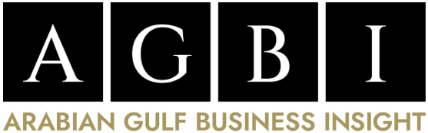



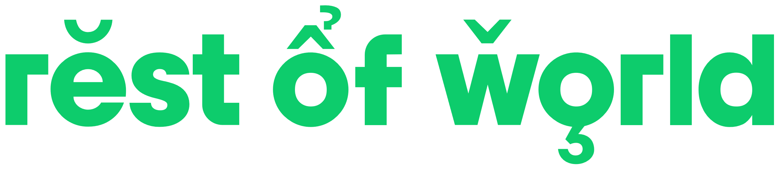

Around the World
India
Eyes on the Region
China
2
3
1
Aramco navigates evolving global markets by positioning as a reliable oil supplier amidst sanctions, aligning with clean energy trends, and adapting financial strategies in response to China's economic shifts and resource competition.
Aramco is strategically navigating India's evolving market landscape, focusing on regulatory compliance, energy security, and market diversification, while leveraging geopolitical shifts and economic collaborations with the U.S. for growth and innovation.
Aramco is positioned to enhance regional influence and economic development through renewable energy projects in Saudi's livestock city, and collaboration on a Middle Eastern oil benchmark. Syrian oil Minister looks to raise production.
Highlighted Issues
Highlighted Issues
Highlighted Issues
Regulatory and Economic Shifts: Changing Indian regulations and economic slowdown necessitate adaptive strategies.
Geopolitical Dynamics: Geopolitical tensions affect operations and highlight India as a key growth market.
Partnership Potential: Collaborations with India and the U.S. enhance strategic positioning and technological advancement opportunities.
Geopolitical and Market Shifts: Adapting to sanctions and overcapacity in China's refinery sector.
Sustainability and Diversification: Aligning with global clean energy trends and strategic resource investments.
Economic Stability: Navigating financial market fluctuations due to China's monetary policies.
Economic Diversification: Emphasis on sustainable practices and local economic development in line with Vision 2030.
Market Influence: Potential global impact through collaborative oil benchmark initiatives.
Considerations
Considerations
Considerations
Monitor Trends and Policies: Stay updated on regulatory and economic changes to inform strategies.
Communicate Stability and Innovation: Highlight Aramco's resilience, financial management, and technological commitments.
Strengthen Media Partnerships: Engage in strategic media collaborations to reinforce Aramco's market presence and growth in India.
Monitor Geopolitical Changes: Track political developments in Syria and regionally.
Promote Renewable Energy: Highlight Aramco's sustainability initiatives in local and regional projects.
Leverage Oil Expertise: Utilize Aramco's leadership in shaping and communicating benchmark benefits.
Promote Reliability and Innovation: Communicate Aramco's stable supply chain and clean energy initiatives.
Monitor Financial Trends: Track market and currency changes to inform strategic planning.
Engage with Stakeholders: Keep investors informed about Aramco’s adaptive strategies and market engagement efforts.

Slide 11
Appendix

Slide 12
KSA/GCC led positive coverage during Jan 5 - 11
Overall Sentiment in Current Reporting Period – By Geography

Slide 13
2025 Cumulative Analysis of Media Articles
Cumulative Article Sentiment
Coverage Sentiment by Tier
Cumulative article sentiment remains largely positive to neutral.
Tier 1 and 2 coverage remain largely positive to neutral.

Slide 14
Analysis of Media Articles – Jan 5 - 11
Weekly Theme Sentiment
Weekly Sentiment by Outlet
No negative stories on any topics or themes. The coverage was largely neutral and focused on business ops.
Largely positive to neutral sentiment across the board with no negative stories .

