Slide 1
Demo: Data management planning tools and the Curation Profiles Toolkit

Slide 2
Agenda
Data management planning tools
Demo of DMPTool and DMPOnline
Curation profiles toolkit
Review and discuss application to data management planning
Explore toolkit

Slide 3
Data Management Plans
A data management plan (DMP) is a formal document that outlines how data will be managed during and after a project
If you’re going to develop data management services, creating support for DMPs is one of the first things you should do

Slide 4
Why create a DMP – or ask your patrons to create DMPs?
Helps make sure data is managed early and often!
Distributes data management responsibility through out the data curation lifecycle

Slide 5
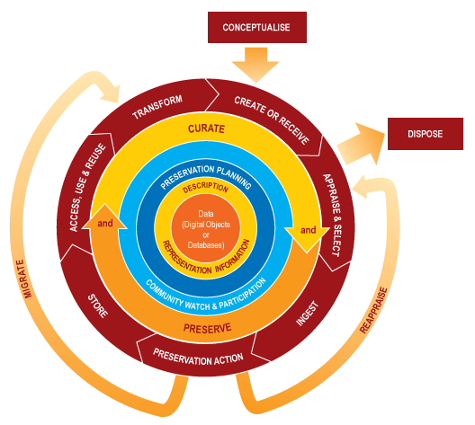
Remember: data curation takes place at all stages of the lifecycle!

Slide 6
Remember: data curation takes place at all stages of the lifecycle!
A data management plan helps guide researchers through data management work that can’t happen in a repository

Slide 7
Types of DMPs
Individual
Outlines data management guidelines for an individual researcher, a research laboratory, or office
Might focus on establishing good personal data management practices (e.g. file naming conventions, stable file formats)

Slide 8
Types of DMPs
Institutional
Outlines data management guidelines for a university or a department
Policy-driven: policy is set by the institutional repository or library

Slide 9
Types of DMPs
Funding agency
Submitted as part of a grant application
Increasingly required by US funding agencies and some federal agencies (e.g. the US Geological Survey)
Often few clear guidelines in what to include; researchers often need help from library or a template

Slide 10
Libraries and Repositories can offer important guidance for any of these
Individual: can educate researchers about digital preservation best practices, importance of sharing data
Institutional: can help ensure data is well curated before it enters the repository
Funding agency: can help ensure researchers aren’t just fulfilling requirements, but following through

Slide 11
How to Help?
Two tools:
DMPTool
DMPOnline

Slide 12
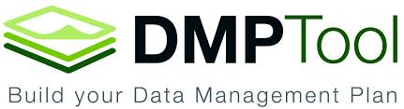
Developed by California Digital Libraries
Templating tool to help librarians and researchers create data management plans

Slide 13
DMPTool Demo

Slide 14
Go to dmptool.org, click “log in”

Slide 15
Select “not in list”, create an account

Slide 16
Select “Create a New DMP”

Slide 17
Exploring the DMP Tool
Try selecting different templates – what are the differences? What could be used in your work?
Try copying existing templates – when would these be helpful?

Slide 18
Activity: Make a DMP
Using the worksheet from the last activity, make a Data Management Plan using the DMP Tool.

Slide 19
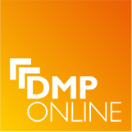
Developed by the Digital Curation Centre (Edingburgh)

Slide 20
DMPOnline Demo

Slide 21
Create an account

Slide 22
Create a new plan

Slide 23
Select funding agency & organization

Slide 24
Fill in basic project information

Slide 25
Answer Questions

Slide 26
Answer questions, and read through guidance

Slide 27
Export your plan!

Slide 28
Curation Profiles Toolkit

Slide 29
Curation Profiles Toolkit
Developed through IMLS grant between U of Illinois and Purdue Universities
Set of resources and methods intended to help librarians/data curators in understanding a researcher’s data
Can potentially be used to inform data management plans and policy

Slide 30
What is a profile?
“A Data Curation Profile is a tool that can be used to provide a foundational base of information about a particular set of data that may be curated by an academic library or other institution.”
(Carlson and Witt, 2010)

Slide 31

Provides
User guide
Interviewers manual
Interview worksheet for “investigating what data researchers are willing to share, when and with whom, and researchers’ needs and requirements for sharing those data through an IR” (or other archive)
Template for generating final report (profile)
Offers definitions and general explanations about how to generalize from interview worksheets
Notes:
Developed here at UIUC and Purdue –
Idea was to create generalizable worksheets and interview techniques for libraries, cultural heritage instituions and non-profits to go out to data producers and better understand preserving their data in a repository environment.
And the vision, really was to that whomever conducted one of these interviews would then be able to take the answers from their subject, and create a profile for that discipline, or laboratory….and then submit that report to a centralized location where other curators can access and read the findings of the interview.
It is still somewhat young, but very very promissing. And it’s such low hanging fruit for curators – I think we’ll see in the next few years the repository where these are submitted really take off.
So the toolkit itself provides ….
READ

Slide 32
Completed profiles
Contain two types of information about data:
Standardized description of a dataset (or series of datasets)
2. Description of a researchers needs surrounding the data, including how and when the data can be shared, the metadata and documentation that should be created or captured, and details about current preservation practices.

Slide 33
What can profiles do?
Individually: provide a structure for a data interview between library / archive and lab, or within lab.
Institutionally: guide management and curation of data in repository setting, provide shareable documentation across staff & use cases for systems development
Globally: guide development of generic adaptable research services at new institutions.

Slide 34
What shouldn’t profiles do?
Inventory a lab/individual’s holdings - profiles provide depth, not breadth
Be interpreted as permanent: needs for a dataset will shift, and use of a dataset will likely change.

Slide 35
Profiles are snapshots, and should be viewed through narrow time windows of relevance.
But longitudinally they are very helpful guides.

Slide 36
Why profile data?
Can help librarians understand disciplinary or workgroup specific differences in data
Can help guide repository policies
Can be used to inform creation of a data management plan

Slide 37
What makes a good profile?
Selecting data that are "typical" and well understood by participant.
Extensive background work.
One person operation.

Slide 38
Interviewer’s Manual
Basic instructions on on how to conduct a data interview, including a very thorough questionnaire (“Ask this…”)
Maps responses to final report template
Provides context for data worksheet

Slide 39
Interview Worksheet
Introduced at beginning of the interview process
Filled out by participant
Acts as prompt for further inquiry
Very difficult to do quickly, but very effective
Why not beforehand or after?
critical incident technique
Notes:
Before I have you begin Module 1 of the worksheet,
Could you please provide me with a brief overview of the research project associated with the data that we will be discussing in this interview?

Slide 40
Interview
Should take place on 2 separate dates
Interview one – complete worksheet, and first four modules of interview
Interview two – develop follow-up questions to worksheet and finish modules.
Modules will map to Profile template

Slide 41
Walkthrough: worksheets and interview guide

Slide 42
Finished Profile (1 of 3)
Summary of data curation needs
Overview of the research
Data kinds and stages
Intellectual property context and information - owners, terms of use, attribution
Notes:
So the curation profile – the end product
Summary is usually about a dataset, or a laboratory with a number of datasets that an IR manager or campus library, or instistion might want to preserve in some way.
Overview of the search is about
Data kinds and stages is laid out, I think, quite nicely in the user manual – it specifies a generic vocabulary to use.
The intellectual property issues are interesting, because they’re so rarely used.

Slide 43
Finished Profile (2 of 3)
Organization and description of data
Ingest and transfer
Sharing and access
Discovery
Tools (used)

Slide 44
Finished Profile (3 of 3)
Measuring impact
What does researcher want to know about how their data is used? What is valuable idea of impact?
Data Management
Preservation
Personnel

Slide 45

Walkthough: Four Examples of Completed Profiles
Architectural history,
seismology,
biophysics,
sociology / demographics

Slide 46
Discussion
Did the worksheet provide you with enough information to write a DMP?
How would you use this tool in your work?
Would you be interested in creating templates with the DMPTool?

Slide 47
Resources
DMPTool
https://dmptool.org/
DMPOnline
https://dmponline.dcc.ac.uk/
Screencast of how to use: https://dmponline.dcc.ac.uk/assets/index.files/html5video/screencast-a1b336c9c8a8281b6b320bd54c433f18.mp4
Curation profiles
Directory of completed profiles: http://docs.lib.purdue.edu/dcp/
Toolkit and community site: http://datacurationprofiles.org/
Paper: Witt, M., Carlson, J., Brandt, D. S., & Cragin, M. H. (2009). Constructing data curation profiles. International Journal of Digital Curation, 4(3), 93-103. http://www.ijdc.net/index.php/ijdc/article/view/137

