Slide 1

Metadata II: Evaluating and Selecting Metadata Schemas

Slide 2
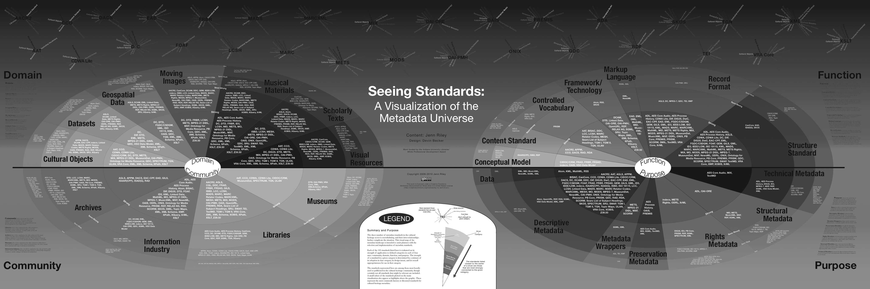
“The great thing about standards is that there’s so many of them”

Slide 3
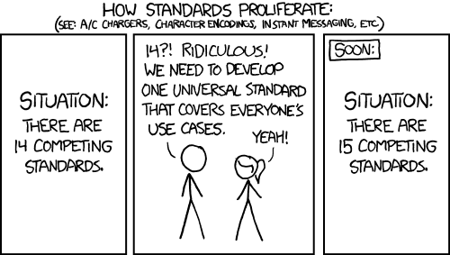
And yet

Slide 4
Metadata for research data
Tie back to nic’s section about how research data has particular needs

Slide 5
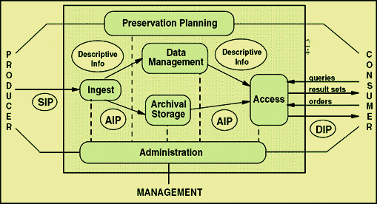
Producer vs. Manager vs. Consumer needs
Notes:
Also

Slide 6
Manager (e.g. your) Needs
Before looking at schemas, articulate the “specificities” of your repository
What are your institution’s needs? What are the practical constraints of your work?

Slide 7
“Nine questions” for needs assessment
From Kennedy, 2008:
Who will be using the collection?
Who is the collection cataloguer?
How much time/money do you have?
How will your collection be accessed?
Notes:
Before we start looking at and comparing schemas its important to ask, “what’s the goal”
She’s not talking about data –
Still an emerging set of resources about data objects

Slide 8
Kennedy 2008 continued
How is your collection related to other collections?
What is the scope of your collection?
Will your metadata be harvested?
Do you want your collection to work with other collections?
How much maintenance or quality control do you wish?

Slide 9
Kennedy 2008 continued
How is your collection related to other collections?
What is the scope of your collection?
Will your metadata be harvested?
Do you want your collection to work with other collections?
How much maintenance or quality control do you wish?

Slide 10
Consumer needs
Notes:
Also

Slide 11
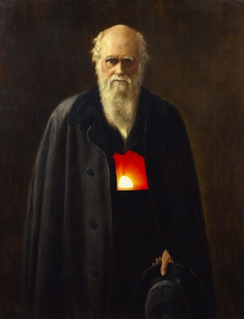
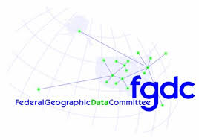



Domain Specific Standards
more
Notes:
For research data, more often than not, if this means trying to find a domain-specific standard

Slide 12
Pros: can better facilitate reuse by better describing data; greatly improves interoperability
Cons: hard to use and understand by non-expert; do not cover all use cases, even for their domain

Slide 13
Different goals of scientific metadata
(Willis, Greenberg & White, 2012)

Slide 14
There will always be many possible ways to do the same thing
100 a Shakespeare, William d 1564-1616
245 a Hamlet
260 a New York: b Penguin Books, c 2003
<dc:creator>Shakespeare, William, 1564-1616</>
<dc:title>Hamlet</>
<dc:publisher>Penguin Books</>
<dc:date>2003</>
Notes:
Note that these are equally flawed, too…

Slide 15
ICOADS dataset in 2 repositories
Notes:
Note that these are equally flawed, too…
Talk more about trade offs and affordances here
GCMD is broader, RDA is more specific (narrower Designated community)
Then show XML
Decision of what attrinbute value pair to use has a real consequence

Slide 16
Standards (and your ability to implement them) will always have limitations
Expressivity
Interoperability
Local needs
Community needs

Slide 18
Metadata III: Crosswalking, reconciliation and propagation

Slide 19
How would we aggregate these records?
100 a Shakespeare, William d 1564-1616
245 a The Tempest
260 a London: b Arden Shakespeare, c 1999
<dc:creator>Shakespeare, William, 1564-1616</>
<dc:title>Hamlet</>
<dc:publisher>Penguin Books</>
<dc:date>2003</>

Slide 20
Or move this one into a more general repository?
Notes:
Note that these are equally flawed, too…
Talk more about trade offs and affordances here
GCMD is broader, RDA is more specific (narrower Designated community)
Then show XML
Decision of what attrinbute value pair to use has a real consequence

Slide 22
GCMD Result
Notes:
Note that these are equally flawed, too…
Talk more about trade offs and affordances here
GCMD is broader, RDA is more specific (narrower Designated community)
Then show XML
Decision of what attrinbute value pair to use has a real consequence

Slide 23
GCMD Result
Notes:
Note that these are equally flawed, too…
Talk more about trade offs and affordances here
GCMD is broader, RDA is more specific (narrower Designated community)
Then show XML
Decision of what attrinbute value pair to use has a real consequence

Slide 24
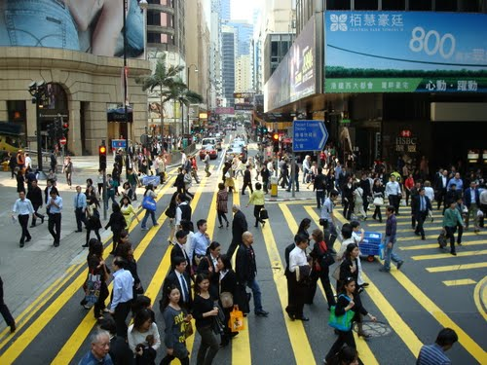
Crosswalking
Brings overlapping standards together
Necessary for aggregation and integration
Important but tricky
Notes:
As a result of the high amount of specificy for each repository and data center, when bringing records together, or publishing to more general repositories, there’s a need to translate, (or crosswalk) one standard into another.

Slide 25
A more familiar example
CDWA | MARC/AACR | MODS | Dublin Core
Catalog Level | 655 Genre/Form 300a Physical Description - Extent | <genre> <extent>
Object/Work Type | 655 Genre - Form | <genre> | Type
Components/Parts | 300a Physical Description - Extent | <extent> | Format.Extent
Classification Term | 050 084 "Other classification number" | <classification> | Subject (classification schema)
Title Text | 24Xa Title and Title - Related Information | <classification> | Subject (classification schema)

Slide 26
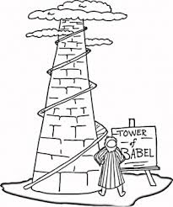
Crosswalking research data
Can be more complicated
Unit conversion
Idiosyncratic controlled vocabularies
Can be “lossy”

Slide 28

Metadata in the wild
Notes:
Those tensions– mean that

Slide 29
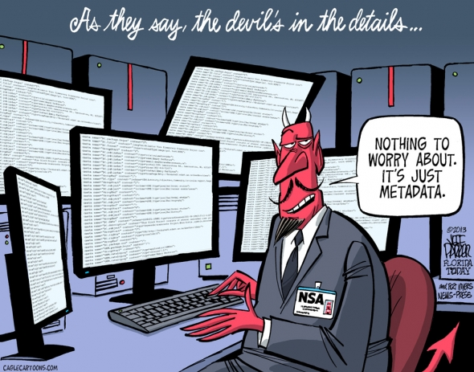

Slide 30
From Greenberg, 2005
Notes:
There have been efforts to ask similar questions of the schemas themselves
Going to step through one example that’s out of the Research in DC world
It is more complex than the last example but might still be useful.
community, domain, function, and purpose

Slide 31
Just as there are many metadata schemas there are many ways to categorize metadata schemas…
From Greenberg, 2005
Notes:
My poit

Slide 32
The MODAL framework
Developed by Jane Greenberg (Drexel)
Conceptual framework for analyzing Metadata Objectives and principles, Domain, and Architectural Layout
2005 paper establishes framework, Willis, Greenberg & White apply it to scientific data schemas in 2012
Notes:
Note that these categories are similar to descrptive, technical

Slide 33
MODAL applied
Research questions:
What is the scope of scientific metadata schemes?
What are the similarities and differences between scientific metadata schemes?
What may be the fundamental requirements of metadata schemes for scientific data?

