Slide 1
Case Studies in Data Citation
Day 2

Slide 2
Agenda
Why cite data?
Anatomy of a data citation
Implementing data citation initiatives
NCAR
IQSS @ Harvard
Tracking and tracing data citations
Bonus: schema.org tutorial.

Slide 3
Why cite data…
Co data report: http://openscholar.mit.edu/sites/default/files/dept/files/outofcite.pdf
NCAR Report: http://nldr.library.ucar.edu/repository/assets/technotes/TECH-NOTE-000-000-000-860.pdf

Slide 4
Why do we cite…?
Paying homage
Giving credit
Identifying methodology
Background reading
Correcting own work
Correcting other’s work
Criticising previous work
Alerting re: forthcoming work
Providing leads
Authenticating data
Identifying the original paper
Arguing with others
Disputing the work of others
+more...
Garfield, E. (1996) When to cite. Library Quarterly, 66 (4): 449-458

Slide 5
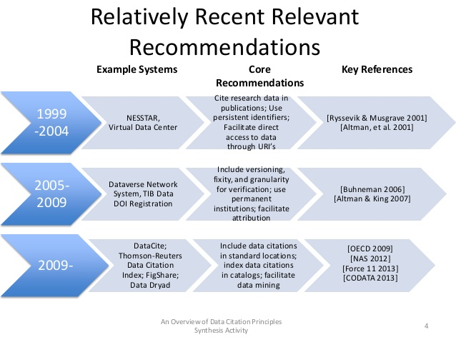
c/o Micah Altman http://www.slideshare.net/drmaltman/data-citationsynthesisteaser
Notes:
Relatively Recent Relevant Recommendations An Overview of Data Citation Principles Synthesis Activity 4 1999 -2004 NESSTAR, Virtual Data Center Cite research data in publications; Use persistent identifiers; Facilitate direct access to data through URI’s [Ryssevik & Musgrave 2001] [Altman, et al. 2001] 2005- 2009 Dataverse Network System, TIB Data DOI Registration Include versioning, fixity, and granularity for verification; use permanent institutions; facilitate attribution [Buhneman 2006] [Altman & King 2007] 2009- DataCite; Thomson-Reuters Data Citation Index; FigShare; Data Dryad Include data citations in standard locations; index data citations in catalogs; facilitate data mining [OECD 2009] [NAS 2012] [Force 11 2013] [CODATA 2013] Example Systems Core Recommendations Key References

Slide 6

Working group to define data citation principles covering:
Cover purpose, function and attributes of citations. T
Citations that are both human understandable and machine-actionable.
Is not comprehensive recommendations for data stewardship.
Do not include recommendations for specific implementations, but encourage communities to develop practices and tools that embody these principles.

Slide 7
Importance
Data should be considered legitimate, citable products of research. Data citations should be accorded the same importance in the scholarly record as citations of other research objects, such as publications

Slide 8
Credit and Attribution
Data citations should facilitate giving scholarly credit and normative and legal attribution to all contributors to the data, recognizing that a single style or mechanism of attribution may not be applicable to all data

Slide 9
Evidence
In scholarly literature, whenever and wherever a claim relies upon data, the corresponding data should be cited[

Slide 10
Unique Identification
A data citation should include a persistent method for identification that is machine actionable, globally unique, and widely used by a community[4].

Slide 11
Access
Data citations should facilitate access to the data themselves and to such associated metadata, documentation, code, and other materials, as are necessary for both humans and machines to make informed use of the referenced data

Slide 12
Persistence
Unique identifiers, and metadata describing the data, and its disposition, should persist -- even beyond the lifespan of the data they describe

Slide 13
Specificity and Verifiability
Data citations should facilitate identification of, access to, and verification of the specific data that support a claim. Citations or citation metadata should include information about provenance and fixity sufficient to facilitate verfiying that the specific timeslice, version and/or granular portion of data retrieved subsequently is the same as was originally cited

Slide 14
Interoperability and Flexibility
Data citation methods should be sufficiently flexible to accommodate the variant practices among communities, but should not differ so much that they compromise interoperability of data citation practices across communities

Slide 15
Brainstorm …
How are citations to data different than citations to bibliographic resources?
What are some problems in citing that should be remedied, and how might we solve them?

Slide 16
Problems in citing data
Authorship
Dynamic / Versioned resources (which data?)
Granularity – no chapter, page, or paragraph markings

Slide 17
Anatomy of a Data Citation
Could include any of the the following elements:
Author, publication date, publisher, resource type (database, dataset, image, etc.), location, identifier, version, edition, title, etc.
Ball, A. & Duke, M. (2012). ‘How to Cite Datasets and Link to Publications’. DCC How-to Guides. Edinburgh: Digital Curation Centre. Available online: http://www.dcc.ac.uk/resources/how-guides - See more at: http://www.dcc.ac.uk/resources/how-guides/cite-datasets#sthash.EY03YKRD.dpuf

Slide 18
Anatomy of a Data Citation:
Earth Science Informatics Partners (ESIP) recommendation:
Zwally, H.J., R. Schutz, C. Bentley, J. Bufton, T. Herring, J. Minster, J. Spinhirne, and R. Thomas. 2003. GLAS/ICESat L1A Global Altimetry Data V018, 15 October to 18 November 2003. National Snow and Ice Data Center. dataset accessed 2011-07-21 at doi:10.3334/NSIDC/gla01.

Slide 19
Anatomy of a Data Citation:

Slide 20
Anatomy of a Data Citation
APA Cool, H. E. M., & Bell, M. (2011). Excavations at St Peter’s Church, Barton-upon-Humber [Data set]. doi:10.5284/1000389
Chicago (notes) 2. H. E. M. Cool and Mark Bell, Excavations at St Peter’s Church, Barton-upon-Humber (accessed May 1, 2011), doi:10.5284/1000389.
Cool, H. E. M., and Mark Bell. Excavations at St Peter’s Church, Barton-upon-Humber (accessed May 1, 2011). doi:10.5284/1000389.
MLA Cool, H. E. M., and Mark Bell. “Excavations at St Peter’s Church, Barton-upon-Humber.” Archaeology Data Service, 2001. Web. 1 May 2011. <http://dx.doi.org/10.5284/1000389>.
Oxford Cool, H. E. M. & Bell, M. (2011) Excavations at St Peter’s Church, Barton-upon-Humber [data-set]. York: Archaeology Data Service [distributor] <DOI 10.5284/1000389>.
See more at: http://www.dcc.ac.uk/resources/how-guides/cite-datasets#x1-13000
Notes:
Humanities and Social Science standards.

Slide 21
Data Citation in the Humanities?
http://www.nap.edu/openbook.php?record_id=13564&page=59

Slide 22
Policies for data citation
Funding agencies /
In scholarly journals

Slide 23
Tracking and tracing data citations…

Slide 24
IDENTIFIERS
ORCID ID – people
Accession numbers – data
PIs – resource landing page
Versions
Institutions
Titles

Slide 25
Schema.org
A gateway drug to the Semantic Web, RDF, and all things Linked Data.
http://schema.org/Dataset

Slide 26
Case Study
@ NCAR
AMS – took long period of gestation, but eventually agreed to data citation policy in journals: [Link?] https://drive.google.com/file/d/0B2L-EJ5-i7x7cWlaVk5IU2JtaDRVUnFUMDE3dlVPVTdZc1ZF/view?usp=sharing

Slide 27
Case Study
ICPSR - best prcatices
ASA reluctant to take strong stance… http://www.asanet.org/about/committees/publications/August2014.cfm

Slide 28
Social science data and the UNF
http://thedata.org/citation
IQSS + Dataverse

Slide 29
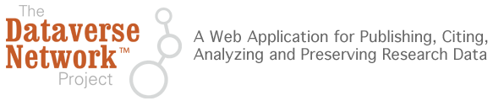
…develops software, protocols, and community connections for creating research data repositories that automate professional archival practices, guarantee long term preservation, and enable researchers to share, retain control of, and receive web visibility and formal academic citations for their data contributions.

Slide 30

From International Studies Quarterly, King and Zeng, 2007, p. 209:
- Gary King; Langche Zeng, 2006, "Replication Data Set for 'When Can History be Our Guide? The Pitfalls of Counterfactual Inference'" hdl:1902.1/DXRXCFAWPK UNF:3:DaYlT6QSX9r0D50ye+tXpA== Murray Research Archive [distributor]
From Political Analysis, Hanmer, Banks, and White, 2013:
- Hanmer, Michael J.; Banks, Antoine J., White, Ismail K., 2013, "Replication data for: Experiments to Reduce the Over-reporting of Voting: A Pipeline to the Truth", http://dx.doi.org/10.7910/DVN/22893 UNF:5:eJOVAjDU0E0jzSQ2bRCg9g== IQSS Dataverse Network [Distributor]
Notes:
Examples of data cited in dataverse holdings…

Slide 31
Depends upon a UNF…
http://thedata.org/book/universal-numerical-fingerprint

Slide 32
Part of replication initatives
Copy over the replication criteria from IQSS:
http://thedata.org/book/replication-guidelines

Slide 33
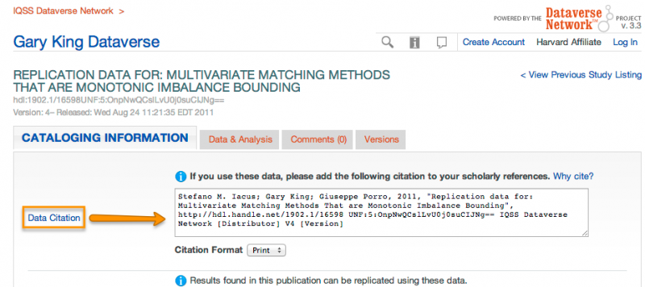
DataVerse: Citation Baked-In

Slide 34
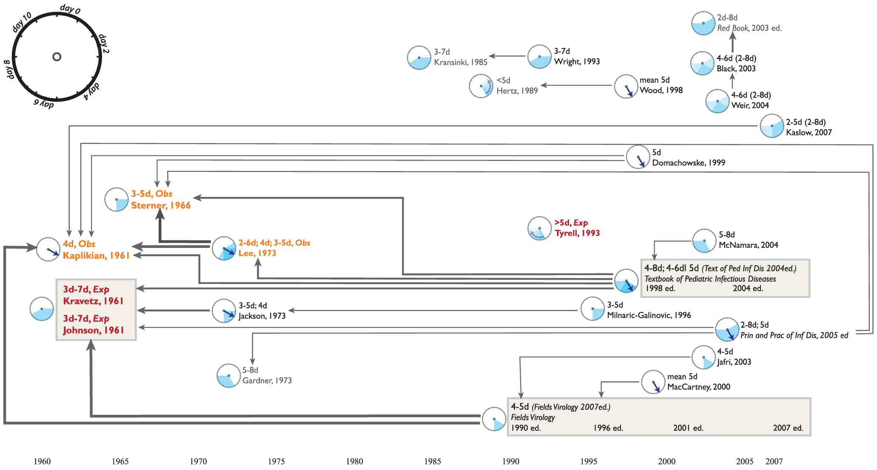
... tracking and tracing data…sometimes the facts don’t add up
Reich NG, Perl TM, Cummings DAT, Lessler J (2011) Visualizing Clinical Evidence: Citation Networks for the Incubation Periods of Respiratory Viral Infections. PLoS ONE 6(4): e19496. doi:10.1371/journal.pone.0019496

