Slide 1

Metadata II: Evaluating and Selecting Metadata Schemas

Slide 2
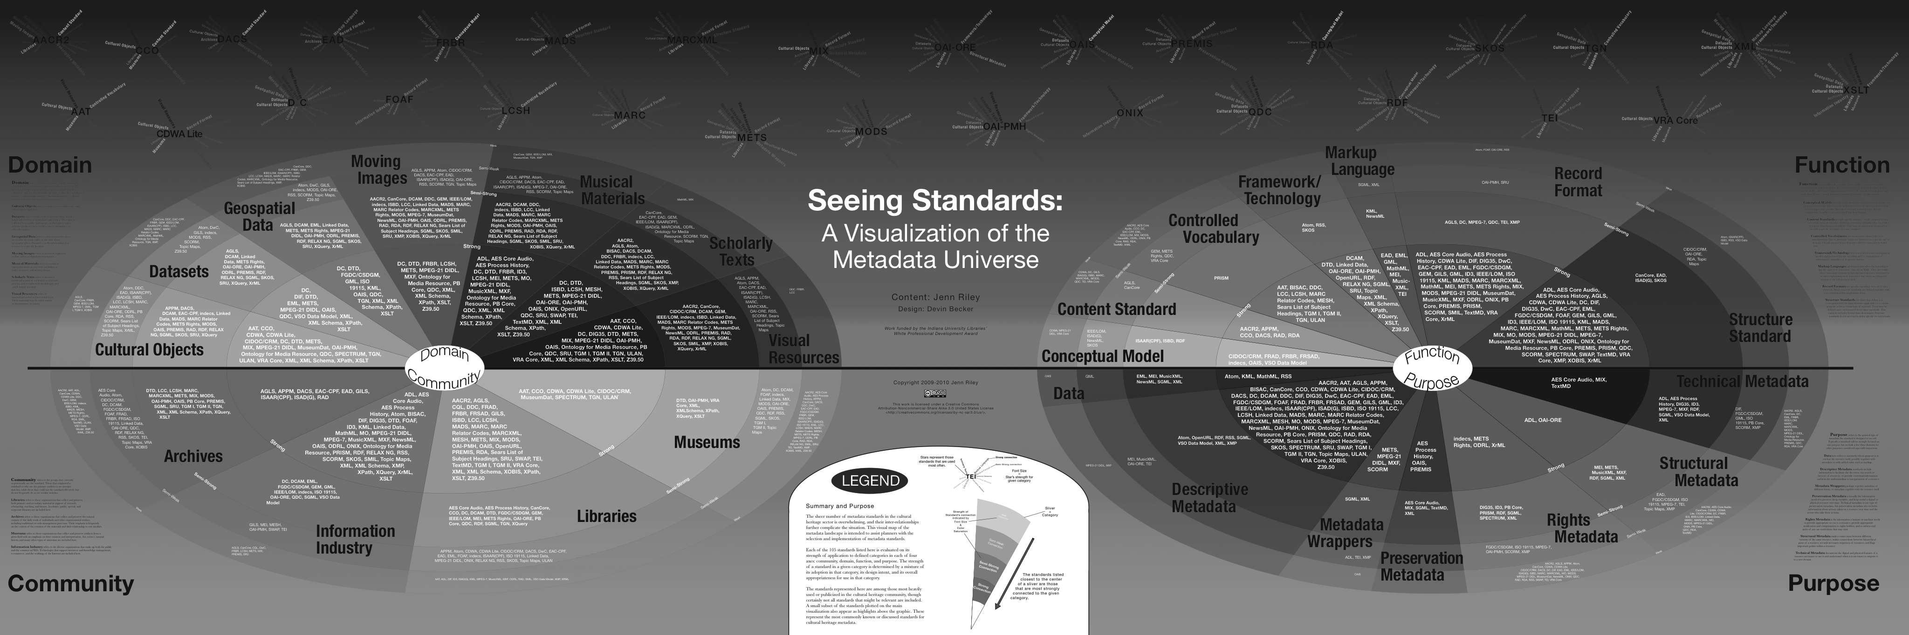
“The great thing about standards is that there’s so many of them”

Slide 3
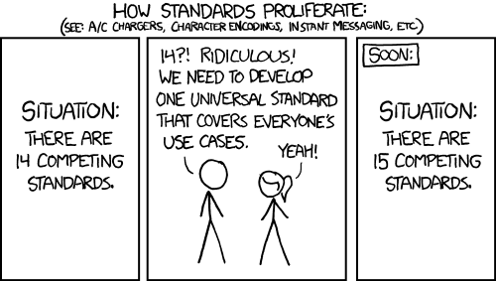
And yet

Slide 4
Understanding needs before selecting standards
Before looking at schemas, articulate the specificities of your repository and your users
What are your needs? What are the practical constraints of your work?

Slide 5
“Nine questions”
Some questions to ask (from Kennedy, 2008):
Who will be using the collection?
Who is the collection cataloguer?
How much time/money do you have?
How will your collection be accessed?
Notes:
Before we start looking at and comparing schemas its important to ask, “what’s the goal”
She’s not talking about data –
Still an emerging set of resources about data objects

Slide 6
Kennedy 2008 continued
How is your collection related to other collections?
What is the scope of your collection?
Will your metadata be harvested?
Do you want your collection to work with other collections?
How much maintenance or quality control do you wish?

Slide 7
Kennedy 2008 continued
How is your collection related to other collections?
What is the scope of your collection?
Will your metadata be harvested?
Do you want your collection to work with other collections?
How much maintenance or quality control do you wish?

Slide 8
Community needs
Remember your Designated Community?
What are their needs?
What standards do they use?
What constraints do they have?
Notes:
After understanding strengths priorities and constraints of your repository

Slide 9
Some communities have very specific standards and needs
For instance:
Biodiversity scientists use DarwinCore records
GIS data are increasingly rendered in FGDC
Something else

Slide 10
THEN Evaluate Schemas
Notes:
With these requirements in mind, you can return to resources like “Seeing Standards” or
http://www.dcc.ac.uk/resources/metadata-standards
and begin the process of choosing a metadata schema.
Unfortunately, while the 9 questions do help you determine the scope of your collections and needs, they don’t provide you with a mechanism to point you to a schema

Slide 11
There will always be many possible ways to do the same thing
100 a Shakespeare, William d 1564-1616
245 a Hamlet
260 a New York: b Penguin Books, c 2003
<dc:creator>Shakespeare, William, 1564-1616</>
<dc:title>Hamlet</>
<dc:publisher>Penguin Books</>
<dc:date>2003</>
Notes:
Note that these are equally flawed, too…

Slide 12
Standards (and your ability to implement them) will always have limitations
Expressivity
Interoperability
Local needs
Community needs

Slide 14
Metadata III: Crosswalking, reconciliation and propagation

Slide 15

Metadata in the wild
Notes:
Those tensions– mean that

Slide 16
Consider the following
100 a Shakespeare, William d 1564-1616
245 a The Tempest
260 a London: b Arden Shakespeare, c 1999
<dc:creator>Shakespeare, William, 1564-1616</>
<dc:title>Hamlet</>
<dc:publisher>Penguin Books</>
<dc:date>2003</>

Slide 17
Consider the following
100 a Shakespeare, William d 1564-1616
245 a The Tempest
260 a London: b Arden Shakespeare, c 1999
<dc:creator>Shakespeare, William, 1564-1616</>
<dc:title>Hamlet</>
<dc:publisher>Penguin Books</>
<dc:date>2003</>

Slide 18
Consider the following
Notes:
Note that these are equally flawed, too…
Talk more about trade offs and affordances here
GCMD is broader, RDA is more specific (narrower Designated community)
Then show XML
Decision of what attrinbute value pair to use has a real consequence

Slide 19
RDA ICOADS record
Notes:
Note that these are equally flawed, too…
Talk more about trade offs and affordances here
GCMD is broader, RDA is more specific (narrower Designated community)
Then show XML
Decision of what attrinbute value pair to use has a real consequence

Slide 20
GCMD ICOADS record
Notes:
Note that these are equally flawed, too…
Talk more about trade offs and affordances here
GCMD is broader, RDA is more specific (narrower Designated community)
Then show XML
Decision of what attrinbute value pair to use has a real consequence

Slide 21
Consider the following
One more example – maybe HTRC?

Slide 22
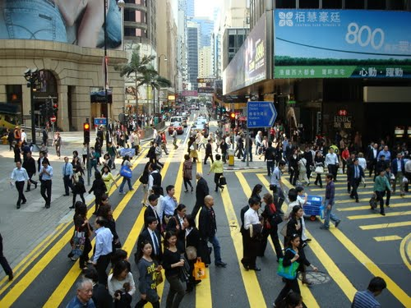
Crosswalking
bringing different overlapping standards together
Necessary for aggregation and integration
Can be hugely time consuming!

Slide 23
Resources for crosswalking:
http://www.getty.edu/research/publications/electronic_publications/intrometadata/crosswalks.html
https://marinemetadata.org/guides/mdatastandards/crosswalks
http://www.dlib.org/dlib/december04/godby/12godby.html
http://www.ukoln.ac.uk/metadata/interoperability/

Slide 24
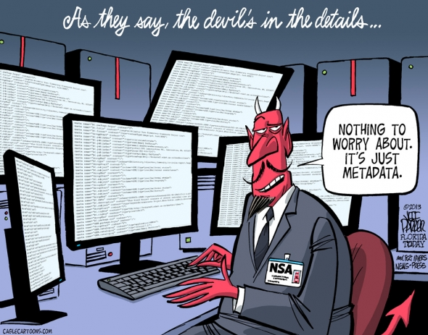

Slide 25
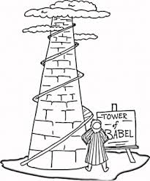
Crosswalking

Slide 26
From Greenberg, 2005
Notes:
There have been efforts to ask similar questions of the schemas themselves
Going to step through one example that’s out of the Research in DC world
It is more complex than the last example but might still be useful.
community, domain, function, and purpose

Slide 27
Just as there are many metadata schemas there are many ways to categorize metadata schemas…
From Greenberg, 2005
Notes:
My poit

Slide 28
The MODAL framework
Developed by Jane Greenberg (Drexel)
Conceptual framework for analyzing Metadata Objectives and principles, Domain, and Architectural Layout
2005 paper establishes framework, Willis, Greenberg & White apply it to scientific data schemas in 2012
Notes:
Note that these categories are similar to descrptive, technical

Slide 29
MODAL applied
Research questions:
What is the scope of scientific metadata schemes?
What are the similarities and differences between scientific metadata schemes?
What may be the fundamental requirements of metadata schemes for scientific data?

