Slide 1

Reference models, lifecycles and workflows: Review of data curation lifecycle models

Slide 2
Why a lifecycle?
“much of the most crucial information required for effective long-term curation and reuse must be captured at the conceptualisation and collection stages."
(IDCC, 2014).
We need to understand what data is being collected when in order to curate it

Slide 3
Why a lifecycle?
A few applied examples
You’re given X dataset to curate but you don’t know Y –
…
A way of generalizing provenance

Slide 4
OAIS reference model: ur-lifecycle
Many of you will be familiar with the OAIS reference model
If not: it’s a conceptual framework that models a preservation system
Goal is to preserve information for a ‘designated community’

Slide 5
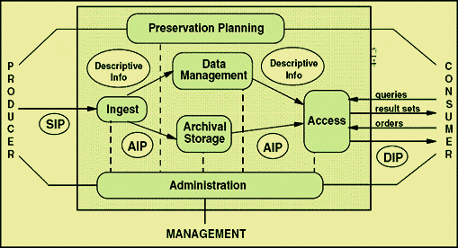
OAIS reference model

