Slide 1

Reference models, lifecycles and workflows: Overview of data curation lifecycle models

Slide 2
Why lifecycles?
“much of the most crucial information required for effective long-term curation and reuse must be captured at the conceptualisation and collection stages." - (IDCC, 2014)
In other words: we need more than a finished data product to curate a finished data product

Slide 3
Why lifecycles?
Digital materials are fragile and susceptible to change from technological advances throughout their life cycle, i.e. from creation onwards;
Activities (or lack of) at each stage in the life cycle directly influence our ability to manage and preserve digital materials in subsequent stages;
Reliable re-use of digital materials is only possible if materials are curated in such a way that their authenticity and integrity are retained.
-- (Pennock, 2007)

Slide 4
A way of generalizing provenance
Notes:
In the last session we talked about

Slide 5
Scenarios
What if you’re given:

Slide 6
OAIS Reference Model

Slide 7
OAIS Reference Model
ISO 14721:2003
conceptual framework of a preservation system
accommodates both digital and analog data
Prioritizes information for a ‘designated community’
A vocabulary of “terms that are not already overloaded with meaning so as to reduce conveying unintended meanings”

Slide 8
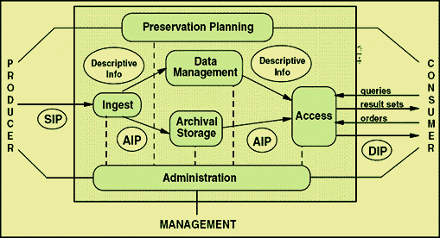
OAIS Reference Model

Slide 9
OAIS terminology
SIP: Submission information package
AIP: Archival information package
DIP: Dissemination information package
Functional Entities:
Ingest; Archival Storage; Data management; Administration; Access

Slide 10
OAIS Reference Model
Pros:
Good high-level model of preservation system
Adopted by a range of institutions
Common terminology
very library/archives oriented
Concentrating on the needs of a “designated community” can help focus curatorial goals and priortities

Slide 11
OAIS Reference Model
Cons:
What if your “designated community” is very broad? (e.g. an entire university)
Does not provide any guidelines about what should be contained in an SIP
Does not provide insight into data creation/management before creation of SIP

Slide 12
DCC Lifecycle Model

Slide 13
DCC Lifecycle Model
Considers and models a data object’s “life” (creation, use) prior to its submission to a preservation system or repository
Developed by the IDCC
divides curatorial tasks into three nested categories

Slide 14
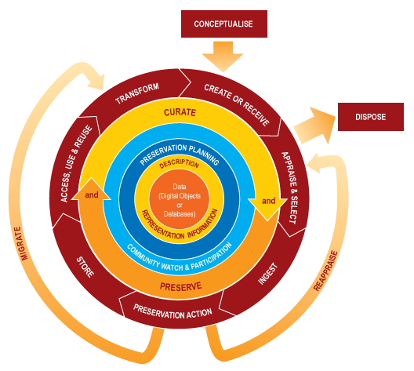

Slide 15
Full lifecycle actions

Slide 16
Full Lifecycle Actions
Preservation Planning: Plan for preservation throughout the curation lifecycle of digital material. This would include plans for management and administration of all curation lifecycle actions.
Community Watch and Participation: Maintain a watch on appropriate community activities, and participate in the development of shared standards, tools and suitable software.

Slide 17
Full Lifecycle Actions
Curate and Preserve: Be aware of, and undertake management and administrative actions planned to promote curation and preservation throughout the curation lifecycle.
Description and Representation Information: Assign administrative, descriptive, technical, structural and preservation metadata, using appropriate standards, to ensure adequate description and control over the long-term. Collect and assign representation information required to understand and render both the digital material and the associated metadata.

Slide 18
Full lifecycle actions
Sequential actions

Slide 19
Sequential Actions
Conceptualise: Conceive and plan the creation of data, including capture method and storage options.
Create or Receive: Create data including administrative, descriptive, structural and technical metadata. Preservation metadata may also be added at the time of creation. Receive data, in accordance with documented collecting policies, from data creators, other archives, repositories or data centres, and if required assign appropriate metadata.
Appraise and Select: Evaluate data and select for long-term curation and preservation. Adhere to documented guidance, policies or legal requirements.

Slide 20
Sequential Actions
Ingest: Transfer data to an archive, repository, data centre or other custodian. Adhere to documented guidance, policies or legal requirements.
Preservation Action: Undertake actions to ensure long-term preservation and retention of the authoritative nature of data. Preservation actions should ensure that data remains authentic, reliable and usable while maintaining its integrity. Actions include data cleaning, validation, assigning preservation metadata, assigning representation information and ensuring acceptable data structures or file formats.

Slide 21
Sequential Actions
Store: Store the data in a secure manner adhering to relevant standards.
Access, Use and Reuse: Ensure that data is accessible to both designated users and reusers, on a day-to-day basis. This may be in the form of publicly available published information. Robust access controls and authentication procedures may be applicable.
Transform: Create new data from the original, for example: by migration into a different format, or by creating a subset, by selection or query, to create newly derived results, perhaps for publication

Slide 22
Full lifecycle actions
Sequential actions
Occasional actions

Slide 23
Occasional Actions
Conceptualise:
Reappraisal: Return data which fails validation procedures for further appraisal and re-selection.
Migration: Migrate data to a different format. This may be done to accord with the storage environment or to ensure the data's immunity from hardware or software obsolescence.
Disposal: Dispose of data, which has not been selected for long-term curation and preservation in accordance with documented policies, guidance or legal requirements.... The data's nature may, for legal reasons, necessitate secure destruction.

Slide 24
All centered on the data object
Full lifecycle actions
Sequential actions
Occasional actions

Slide 25
DCC model
Pros:
Remains library/archive focused while also representing earlier stages of data work
Generalized without being too broad
Cons:
Domain scientists/researchers tend to hate this model (it’s confusing)
Still does not represent full range of research activities prior to datawork

Slide 26
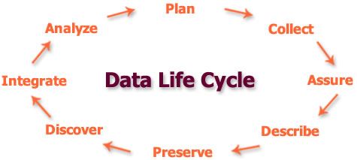
DataOne: DCC simplified

Slide 27
SBDC workflow

Slide 28
SBDC workflow
Goal: to represent a very specific workflow as a way of identifying
Important data products for preservation
Links between data products
Points for future curatorial intervention
6 stages in this case: Planning, Fieldwork, Processing and Analysis, Data Assessment, Standardizing, Packaging

Slide 29
Data products here

Slide 30
Workflow here

Slide 31
Workflow documentation as a curatorial tool
While this is very specific to our case, workflow documentation as a method may be helpful for those working with a very specific community, research group, or lab
Will discuss further in lab

