Slide 1
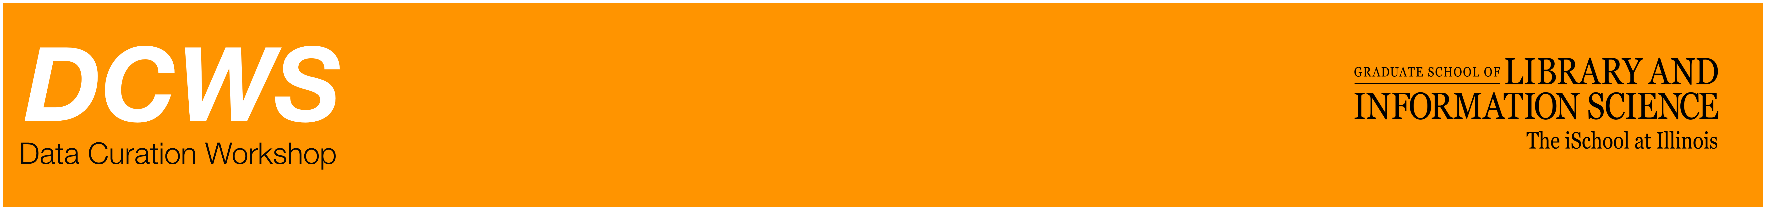
Archives & Records Management for Data Curation

Slide 2
Agenda
Mapping archives and RM concepts to data curation
Records
Context
Provenance

Slide 3
ISO 15489
Precedes the OAIS (and DCC lifecycle model)
Provides a high-level framework for records management workflow.
Focuses on essential characteristics of a records: authenticity, reliability, usability and integrity.

Slide 4
The notion of a “record”
“data or information fixed on some medium which has content, context, and structure"
(AAA, 2014).
Data curation treats information objects as a “scholarly record”
Notes:
Critical to archives and records management is the notion of a record – the unit of analysis which is preserved for future use.
This idea is – similarly – important to data curation in that we want to focus on a scholarly record… often for the benefit of understanding where

Slide 5
ISO 15489: Authoritative Records
Authentic — what the record purports to be to have been created or sent by the purported person to have been created or sent at the purported time
Reliable — trusted contents which accurately reflect the business transaction documented
Have integrity — complete and unaltered
Useable — can be located, retrieved, presented and interpreted.
Notes:
These are high level definitions from

Slide 6
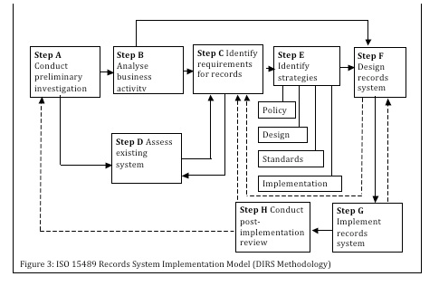
Model of RM Workflow

Slide 7
The notion of a “record”
“data or information fixed on some medium which has content, context, and structure"
(AAA, 2014).
Data curation treats information objects as a “scholarly record”
Notes:
This idea is – similarly – important to data curation in that we want to focus on a scholarly record… again, this relies on our definition of data being a role played by an information object, and that role is evidence.

Slide 8
Content, Context, and Structure
Respect “des fonds” - original order of record keeper.
Important first step in a data curation process:
Define the intended goal of preservation
Access to record creator / access to potential reusers
Notes:
Arrangement

Slide 9
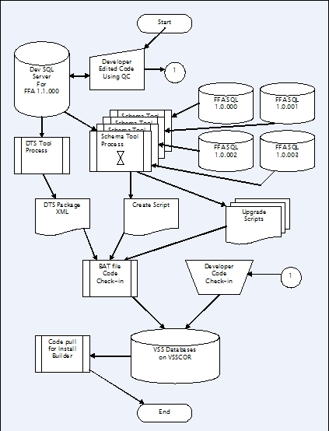
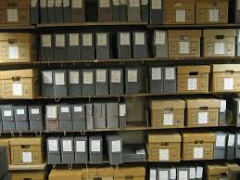
Content, Context, and Structure
Notes:
Records are stored in boxes, described through finding aides, and made available to scholars through an appontment
In digital context of course we store records in a database, we describe them with metadata and we make the available to scholars via query languages
So obviously – the context of our work is quite different.

Slide 10
Content, Context, and Structure
Provenance is about the context of a records production, use, and ownership.
In short “…the significance of archival materials is heavily dependent on the context of their creation, and that the arrangement and description of these materials should be directly related to their original purpose and function.”

Slide 11
Provenance in Data Curation
Data provenance - a type of metadata that “pertains to the derivation history of a data product starting from its original sources.”
(Simmhan Plale and Gannon, 2005)
Notes:
We have the same

Slide 12
Data Provenance
“…information about entities, activities, and people involved in producing a piece of data or thing, which can be used to form assessments about its quality, reliability or trustworthiness.” W3C Provenance Incubator Group
http://www.w3.org/TR/prov-dm/

Slide 13
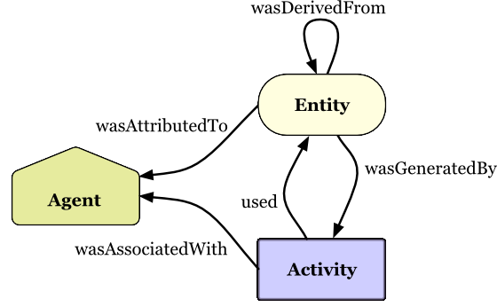
Prov-O
Notes:
Will talk more about this on day three….

Slide 14
Example of Provenance

Slide 15
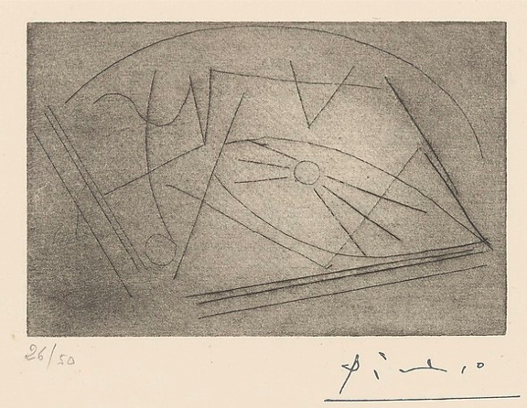
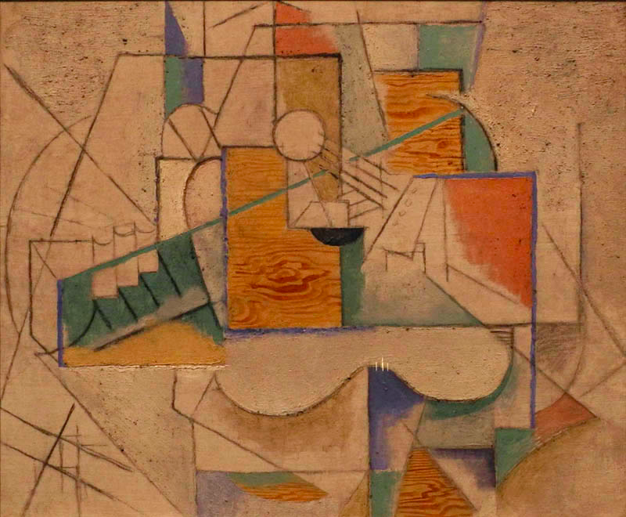
Provenance of ‘Guitar on a Table’

Slide 16
Provenance of ‘Guitar on a Table’
This painting was acquired by Gertrude Stein (American, 1874-1946, in Paris after 1902) directly from the artist. After Stein died, her collection was entrusted to her companion, Alice B. Toklas (American, 1877-1967, in Paris after 1907) until her death. Guitar on a Table was bought by Nelson A. Rockefeller in 1968 from Stein's estate. The painting was donated to Dartmouth College by Rockefeller, an alumnus of the college, in 1975. The painting has hung at the Hood Museum of Art since the building opened to the public, in 1985.
Notes:
This is less straight forward – we have information that is more general, deeper – and more difficult to put in machine readable formats for using
Source: http://hoodmuseum.dartmouth.edu/collections/overview/europe/provenance/provenancesample.html

Slide 17
Descriptive Metadata
<creator> Pablo Picasso, Spanish, 1881-1973, in Paris after 1904
<title> Guitar on a Table
<date> 1912
<medium> Oil, sand, and charcoal on canvas
<size> 20 1/8 x 24 1/4 in (51.1 x 61.6 cm)
<origin> Gift of Nelson A. Rockefeller, Class of 1930; P.975.79

Slide 18
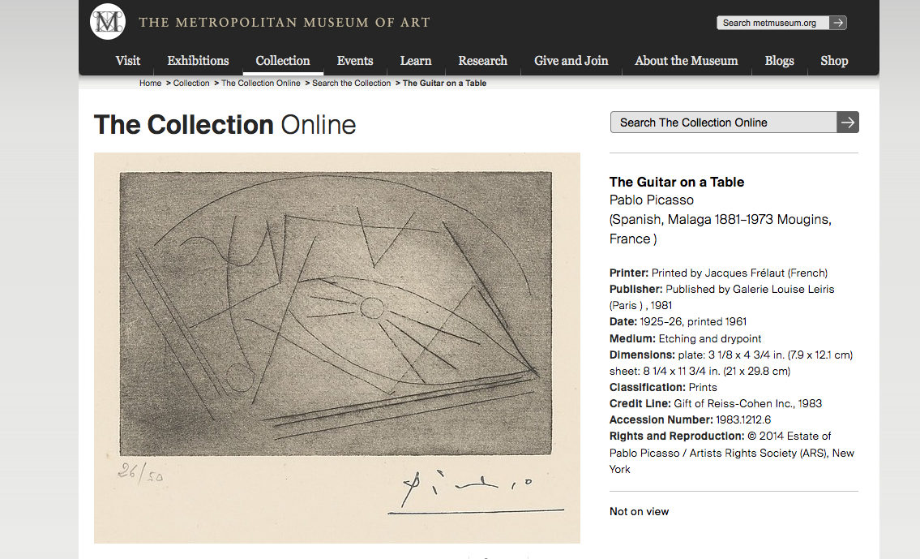
Notes:
Same exact banem aytgiyr ,,,,, sketch for the painting,… but look at the date --- what is going on here?
http://www.metmuseum.org/collection/the-collection-online/search/369777

Slide 19
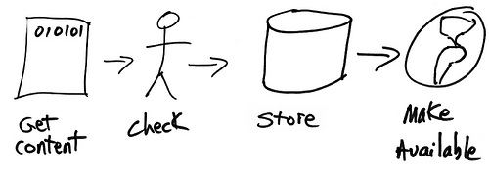
Data Provenance
Image from: leadership2013.thatcamp.org

Slide 20
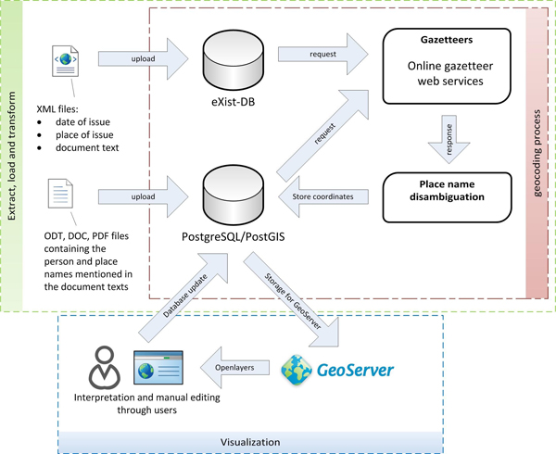
Data Provenance
Creates an executable workflow that tells us where the content comes from, how it is changed over time, and how those changes can be communicated to a user of the end product.
http://www.dh2012.uni-hamburg.de/conference/programme/abstracts/rigeonet-a-lab-for-spatial-exploration-of-historical-data.1.html
Notes:
The important point about provenance – is that it is a communication act –
At graunlar level like this it deals with content ….
At a much higher level – when we think about content, context, and structure of scholarly records – we need to have a framework which models their lifecycle – acorss different contexts of planning, use, and reuse.
So in a data centric world, we have to evolve away from the ISO 15489 standards – and move towards life cycles that are particular to research data …. And that is where Andrea is going to pick up.

