Slide 1
Data Publication
Day 1

Slide 2
Discovery + Attribution
Data publication and linking (expressing relationships) are really about three concepts:
Increasing discoverability (and reuse)
First step in receiving credit for data sharing
Notes:
Critical to these three concepts are also data citation – and descriptive metadata.
We will talk about metadata tommorow
We will talk about data citation this afternoon…
But first we need to clarify what it means to publish data, and then how we link those publications to other datasets, and more broadly other types of research objects that are important to reuse.

Slide 3
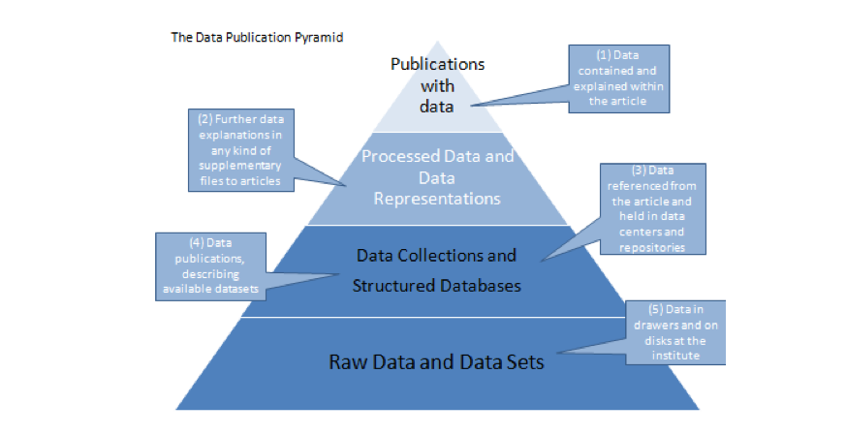
Data Publication Pyramid
http://www.alliancepermanentaccess.org/wp-content/uploads/downloads/2011/11/ODE-ReportOnIntegrationOfDataAndPublications-1_1.pdf

Slide 4

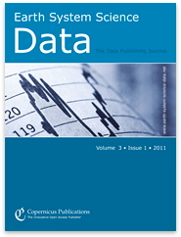



“Publish” data in journals
Notes:
Top level – is to get data published in traditional journals

Slide 5
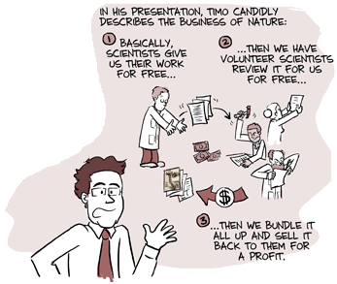
h/t Carly Strasser’s smart blog: http://datapub.cdlib.org/2011/12/12/the-skinny-on-data-publication/
From: http://www.phdcomics.com/comics/archive.php?comicid=1200
Notes:
This is very good for attribution sake. There is a long history of publishing papers about data.
What is wrong with this….
Writing papers takes a lot of time – the system doesn’t work that well to begin with ….
( However, I think Ubiquity press is doing it the right way…)

Slide 6
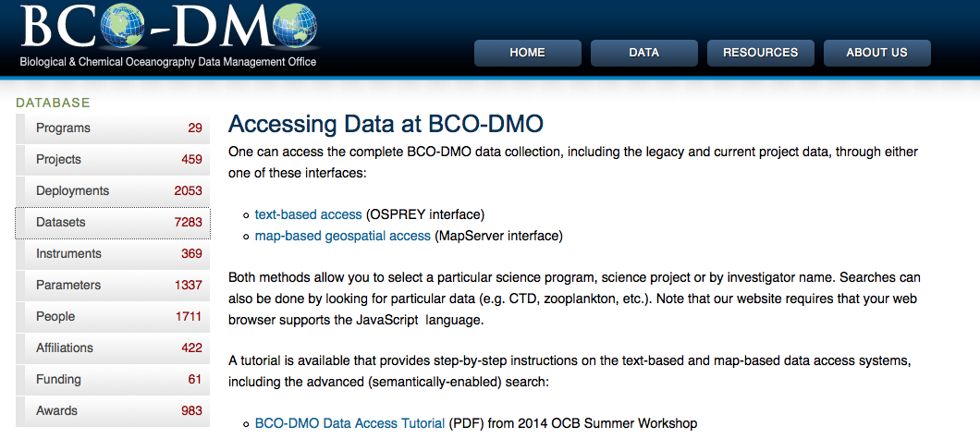
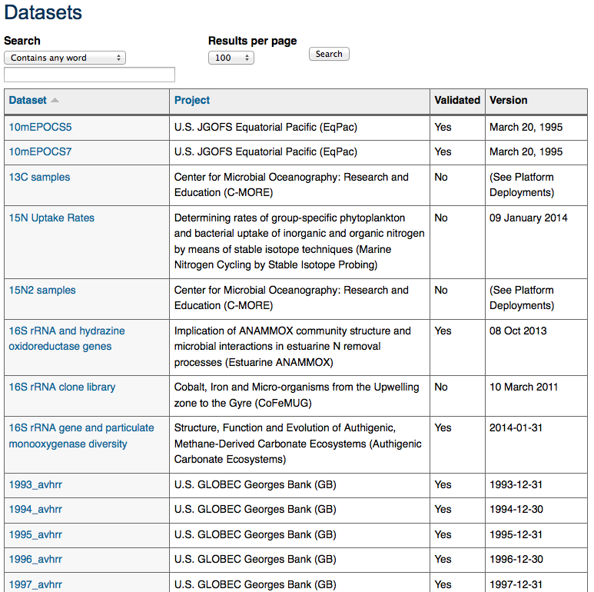
“Publish” data on the web
Notes:
What is good about this … ?
Discoverable – lots of information, customizable
What is bad about this approach…
It is incredibly labor intensive, takes much

Slide 7
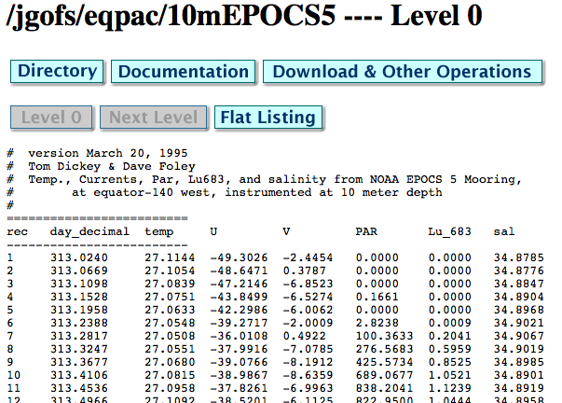

Slide 8
Attribution?
Published data is institutionalized data sharing…
Receive MORE citations than 99% of traditional publications
(for Oceanography (Belter, 2014)
…more likely to be reused in high impact studies (Mayernik et al., 2013)
Increases ability to build knowledge, and reputation (Wallis, et al 2012)
Provides a citation advantage for related literature (Piwowar and Vision, 2013)

Slide 9
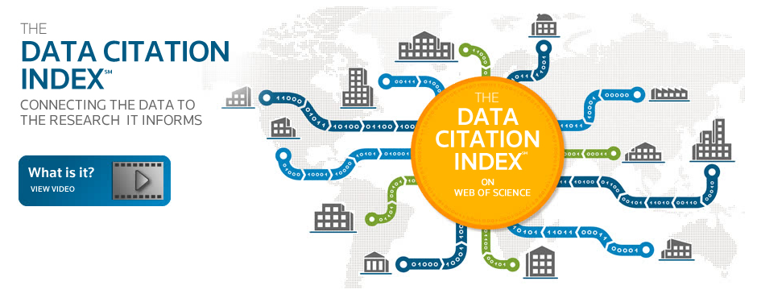

Slide 10
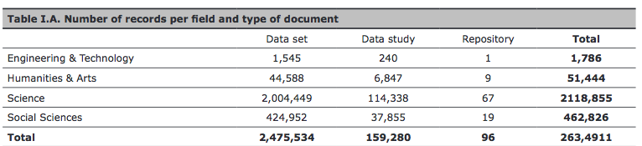
Coverage (poor)
Notes:
2012 study that looked at the coverage – (in short, very poor)

Slide 11

Very much an emerging field…
Follow: https://rd-alliance.org/groups/rdawds-publishing-data-ig.html

