Slide 1
Metadata for Research Data Curation: Design, Select, and Adapt.

Slide 2
Agenda
Metadata for data curation
A framework for evaluating and selecting between existing standards
Reconcile and Propagate from existing standards
Application Profiles + Bespoke Metadata

Slide 3
Metadata for data curation
A framework for evaluating and selecting between existing standards
Reconcile and Propagate from existing standards
Application Profiles + Bespoke Metadata

Slide 4
What does metadata look like?
Can look like anything… (bugs in drawers / i.e take a photo of Andreas apartment)
But we want machine readable expressions of our metadata… and that means
XML motherfuckers (picture of Karen yelling at Happy)
Tree structure that structures attribute and value pairs

Slide 5
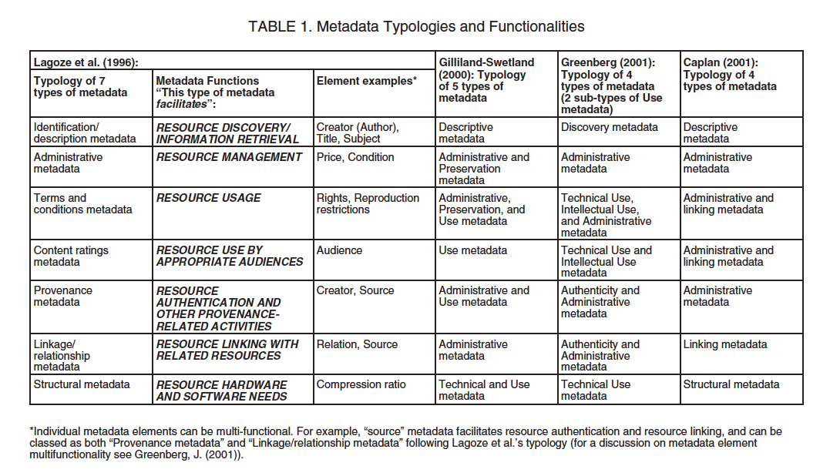
Notes:
There are holy wars over just this topics

Slide 6
Types of Metadata
Descriptive
Structural
Administrative
Rights Management
Preservation
NISO. (2004) Understanding Metadata. Bethesda, MD: NISO Press, pp.1-2.
Notes:
NISO. (2004) Understanding Metadata.
Bethesda, MD: NISO Press, pp.1-2.

Slide 7
Descriptive Metadata
… describes a resource for purposes such as discovery and identification. It can include elements such as title, format, author (s), keywords, spatial coverage, date, etc.

Slide 8
Example

Slide 9
Structural Metadata
…indicates how compound objects are put together, for example, how pages are ordered to form chapters, or, how different observation events were combined for a “set” of data observations, etc.

Slide 10
Example

Slide 11
Administrative Metadata
…provides information to help manage a resource, such as when and how it was created, file type and other technical information, and who can access it.

Slide 12
Subsets of Admin. Metadata
Rights management metadata, which deals with intellectual property rights,
Preservation metadata, which contains information needed to archive and preserve a resource.

Slide 13
Premis (preservation metadata)
2003 OCLC + RLG created Preservation Metadata Implementation Strategy working group
Builds upon fundamentals of OAIS
Produced: data vocabulary, data dictionary, and data model
Notes:
See http://www.slideshare.net/jenlrile/premis for more info.

Slide 14
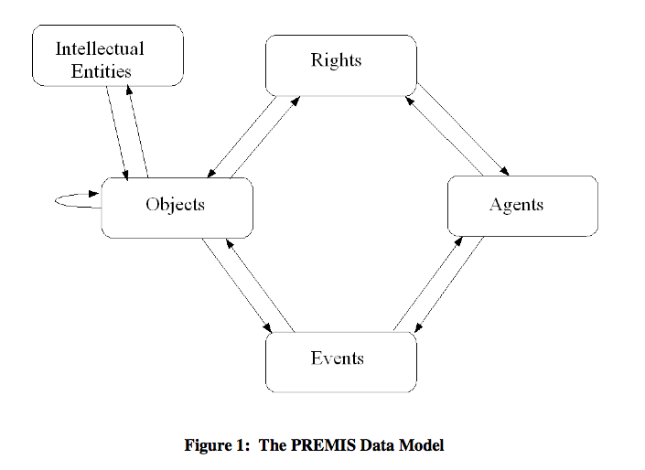
PREMIS: Data Model
Captures information that “supports and documents digital preservation process”

Slide 15
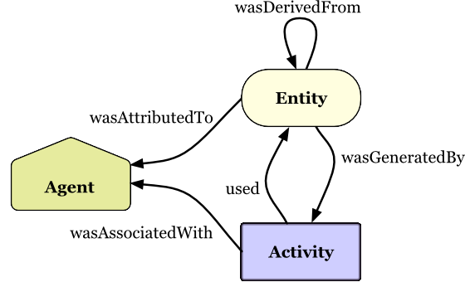
Evolution of a Standard
Captures information that “supports and documents digital preservation process”
Notes:
As scholarship begins to happen on the web, this is the evolution of this model …. From

Slide 17
IP Metadata

Slide 18
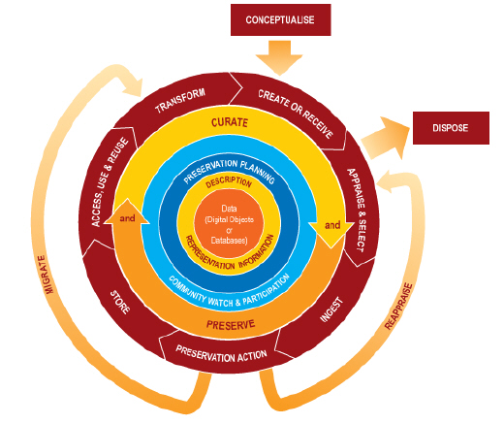
Notes:
Where in this lifecycle do we create metadata? Creating and recieiving data – ingesting into a new data management environment – any time we perform a preservation action we create metadata – and any time the data are reused, there is likely additional linkages to be created or maintained.
Different actors have different roles In the creation of metadata in this lifecycle

Slide 19
Who creates What metadata, and When…
Curators : When data are received / ingested, preservation actions are taken, after reuse occurs.
Type: Descriptive, Structural, and (esp) Admin
Data creators: When data are collected, transformed, reused.
Type: Descriptive + Structural
Notes:
What your metadata should describe, and when are subject of next module.

