Slide 1
Identifiers for Digital Material

Slide 2
What is an identifier?
“a name that identifies either a unique object or a unique class of objects”

Slide 3
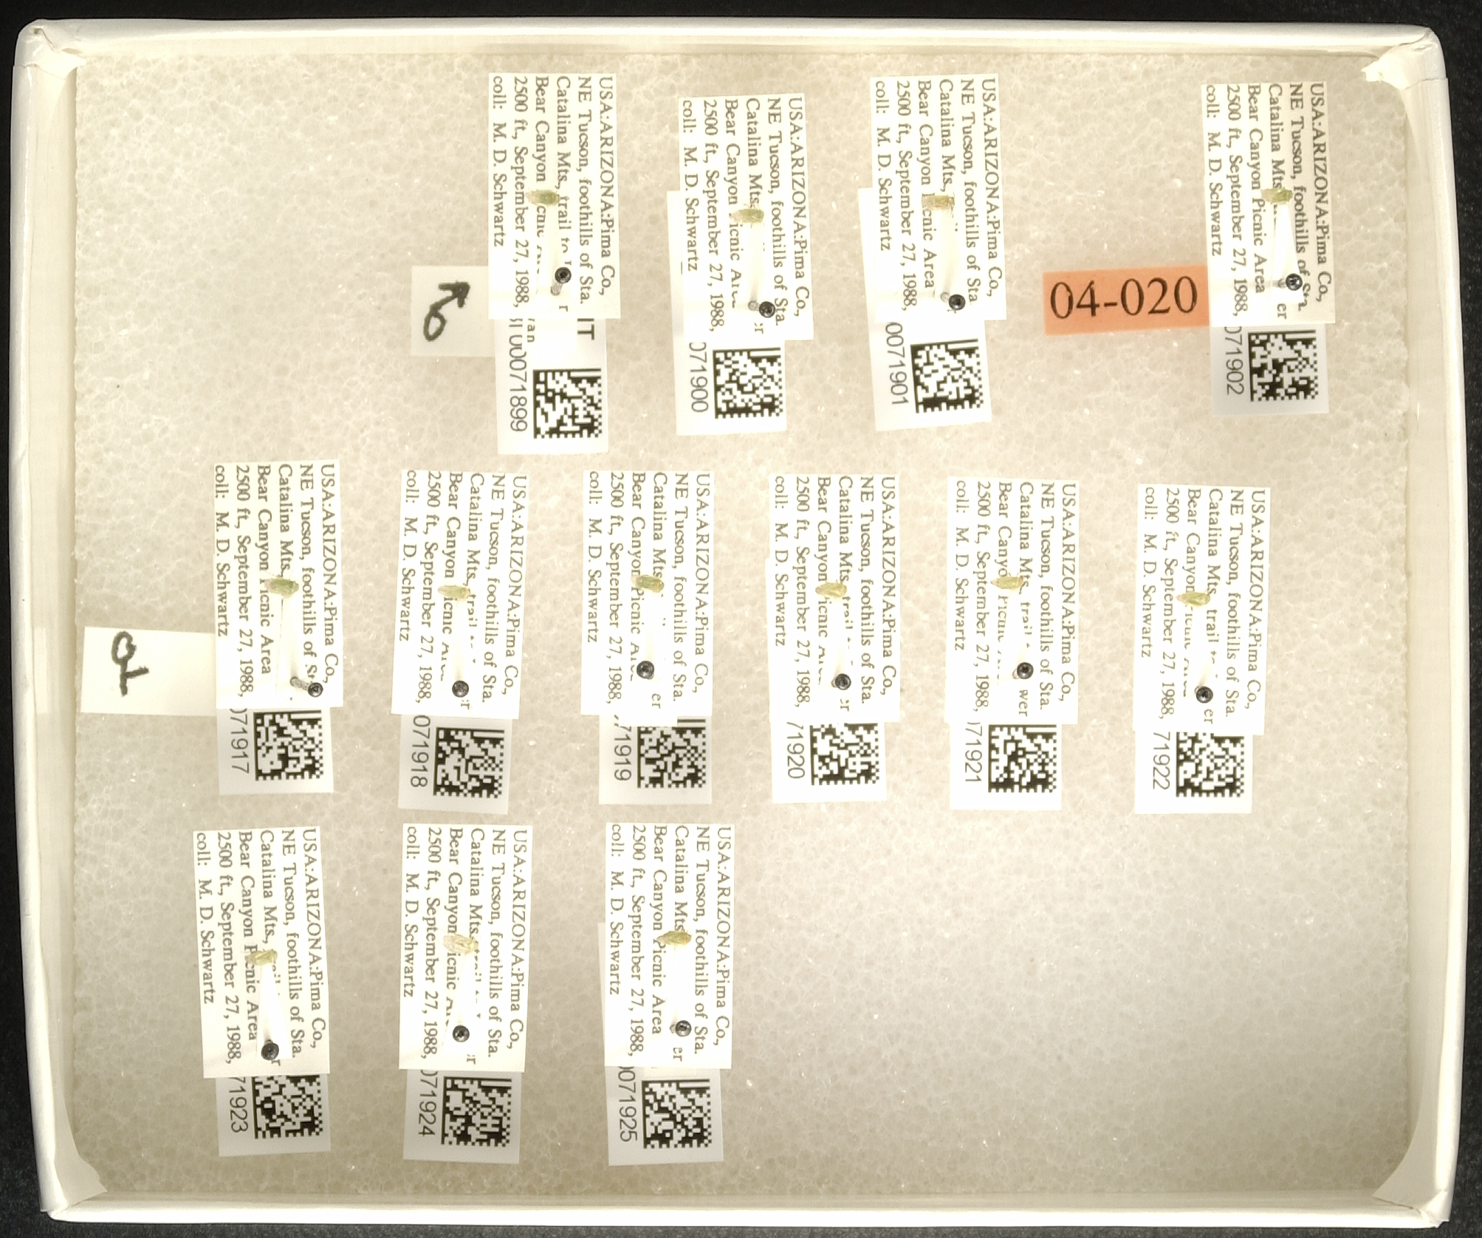
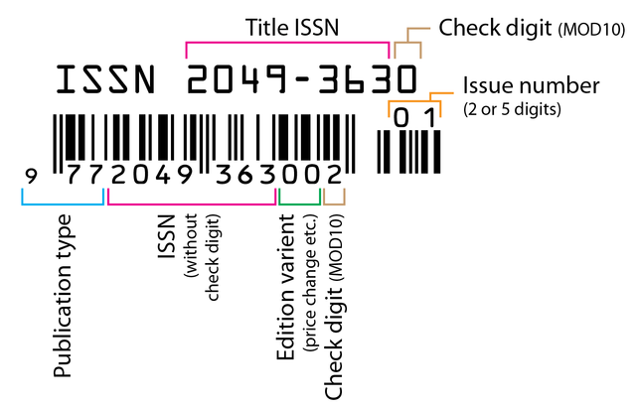
Identifiers are everywhere

Slide 4
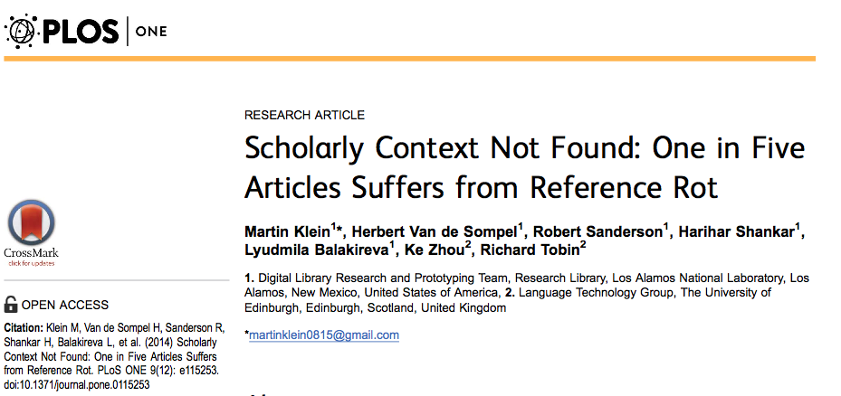
Why IDs matter for data curation?
Test corpus: 3.5 million scholarly articles published 1997-2012
20% had content that was not accessible for review.
If data are playing a role of evidence… we need to make sure that they are accessible for the long-term

Slide 5
Qualities of an ID for data curation
Machine Readable
Unique
Persistent
Resolvable

Slide 6
Values of different ID schemes
Technical value: assessing the technology underlying the identifier scheme;
User value: assessing how the scheme is likely to make end user’s lives easier or more difficult; and
Archive value: assessing whether an identifier scheme is likely to make the job of data management easier or more complicated
Duerr, et al. 2011

Slide 7
Example Schemas
Archival Resource Keys (ARKs)
Digital Object Identifiers (DOIs)
Extensible Resource Identifiers (XRIs)
Handle System (Handles)
Life Science Unique Identifiers (LSIDs)
Object Identifiers (OIDs)
Persistent Uniform Resource Locators (PURLs)
Uniform Resource Identifiers/Names/Locators (URIs/ URNs/URLs)
Universally Unique Identifiers (UUIDs)

Slide 8
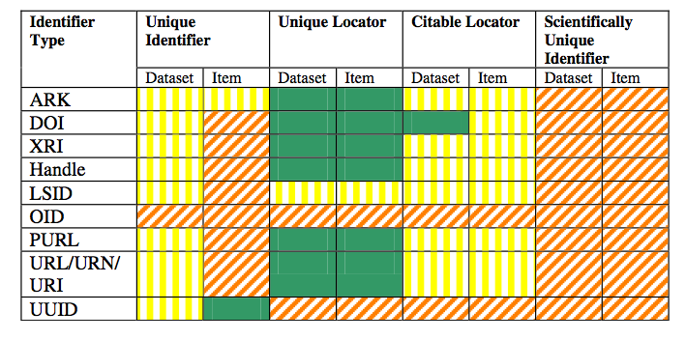
Evaluating different ID schemas

Slide 9



Services for data DOIs
But not ideal

Slide 10
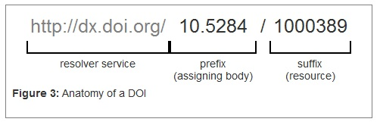
What is a DOI ?
Notes:
Spend time talking about what the doi does
It resolves to a landing page… and even though the resorce might change, the doi doesn’t – so we can move doi to continue to point at the resource… (I obviously do not know how this works)

Slide 11
Qualities of an ID for data curation
Machine Readable
Unique
Persistent
Resolvable

Slide 12
Qualities of an ID for data curation
Machine Readable
Unique
Persistent
Resolvable

