Slide 1

Archives & Records Management for Data Curation

Slide 2
[make agenda]

Slide 3
The notion of a “record”
“data or information fixed on some medium which has content, context, and structure"
(AAA, 2014).
Data curation treats information objects as a “scholarly record”

Slide 4
Content, Context, and Structure
Provenance is about the context of a records production, use, and ownership.
In short “…the significance of archival materials is heavily dependent on the context of their creation, and that the arrangement and description of these materials should be directly related to their original purpose and function.”

Slide 5
Provenance in Data Curation
Data provenance - a type of metadata that “pertains to the derivation history of a data product starting from its original sources.”
(Simmhan Plale and Gannon, 2005)
Notes:
We have the same

Slide 6
Data Provenance
“…information about entities, activities, and people involved in producing a piece of data or thing, which can be used to form assessments about its quality, reliability or trustworthiness.” W3C Provenance Incubator Group
http://www.w3.org/TR/prov-dm/

Slide 7
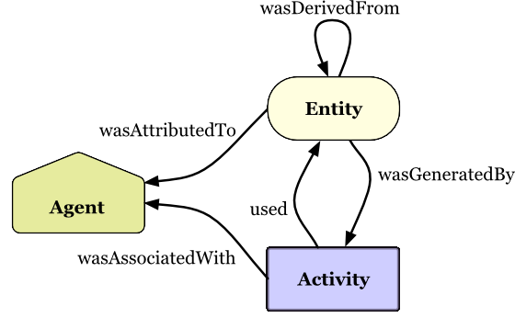
Prov-O

Slide 8
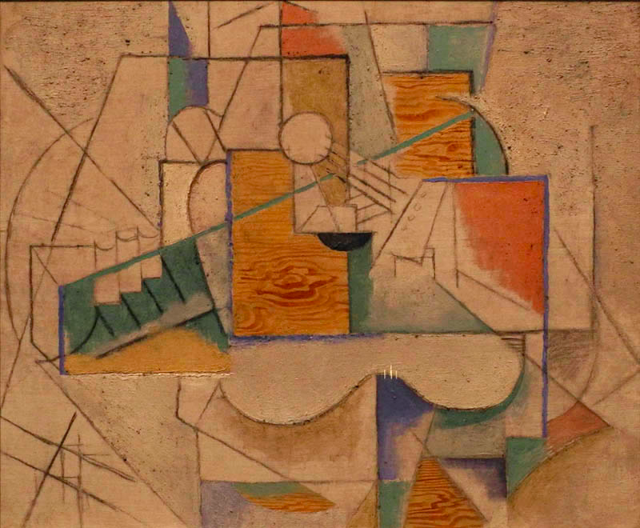

Slide 9
Descriptive Metadata
<creator> Pablo Picasso, Spanish, 1881-1973, in Paris after 1904
<title> Guitar on a Table
<date> 1912
<medium>Oil, sand, and charcoal on canvas
<size> 20 1/8 x 24 1/4 in (51.1 x 61.6 cm)
<origin> Gift of Nelson A. Rockefeller, Class of 1930; P.975.79

Slide 10
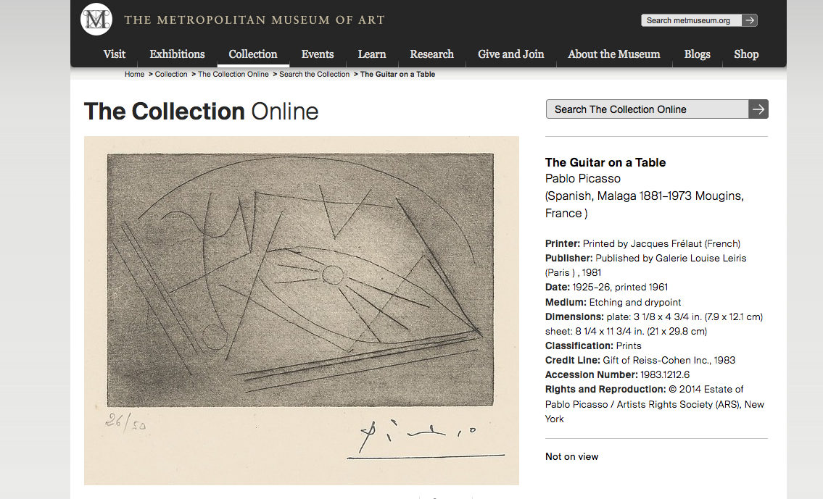
Notes:
Same exact banem aytgiyr ,,,,, sketch for the painting,… but look at the date --- what is going on here?
http://www.metmuseum.org/collection/the-collection-online/search/369777

Slide 11
Provenance of ‘Guitar on a Table’
This painting was acquired by Gertrude Stein (American, 1874-1946, in Paris after 1902) directly from the artist. After Stein died, her collection was entrusted to her companion, Alice B. Toklas (American, 1877-1967, in Paris after 1907) until her death. Guitar on a Table was bought by Nelson A. Rockefeller in 1968 from Stein's estate. The painting was donated to Dartmouth College by Rockefeller, an alumnus of the college, in 1975. The painting has hung at the Hood Museum of Art since the building opened to the public, in 1985.
Notes:
This is less straight forward – we have information that is more general, deeper – and more difficult to put in machine readable formats for using
Source: http://hoodmuseum.dartmouth.edu/collections/overview/europe/provenance/provenancesample.html

Slide 12
Data Provenance (example)

Slide 13
Schema.org
A gateway drug to the Semantic Web, RDF, and all things Linked Data.
http://schema.org/Dataset

Slide 15
Data Provenance (example)

