Slide 1

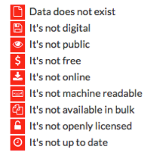
http://index.okfn.org/place/

Slide 2


