Slide 1
Case Studies of Data Curation in Academic Libraries
Day 1

Slide 2
Agenda
What is case study research in data curation?
Tools and frameworks
Examples:
Johns Hopkins University
Data Conservancy
Penn State University
Scholar Sphere
Discussion sections

Slide 3
Case Study Research
…it is not so much a method as it is a comprehensive research strategy
Yin,2003, p. 14
This includes the logic of design, data collection techniques, and specific approaches to data analysis.

Slide 4
What is the case?
Investigates a contemporary phenomenon within its real-life context
Is appropriate when the boundaries between phenomenon and context are not clearly evident
Copes with the technically distinctive situation in which there will be many more variables of interest than data points,
Relies on multiple sources of evidence, with data needing to converge in a triangulating fashion.
Benefits from the prior development of theoretical propositions to guide data collection and analysis

Slide 5
Frameworks for Case Study
Institution and Organizational level
Formal
Social Science Case studies (Yin, 2014)
Informal
‘Landscape studies’ (Akers et al, 2014)
Unit / department / individual level:
Data Curation profiles (in laboratory)

Slide 6
Case Study research
Following elements:
1. A study's questions
2. Propositions
3. Unit(s) of analysis
4. Logic linking the data to the propositions
5. Criteria for interpreting the findings
(Yin, 2003).

Slide 7
Validity
Internal Validity Is largely applicable to causal explanations, and requires intensive pattern matching, repeated findings across cases, building a logic model, and addressing rival explanations in answering a set of propositions.
External Validity Concerns the generalizability of the findings, and the extent to which they are representative of a phenomenon in different contexts. In single cases, external validity is addressed through the use of theory, and comparing or contrasting the support of that theory with the explanations produced from a case study.

Slide 8
Some influential case studies in Data Curation

Slide 9
ARL 2010
Purpose
….build an understanding of how libraries can contribute to eScience activities in their institution”
…survey gathered 57 responses to the survey from the 123 ARL member libraries in the United States and Canada.
Twenty-one respondents report their institution provides infrastructure or support services for eScience, 23 institutions are in the planning stages, and 13 do
not provide support for e-science.
From 21 eScience providers…. 6 case studies conducted (in-depth interviews, profiles of institutional capacity, etc.)

Slide 10
Findings
Many survey respondents cited lack of money and resources as the most obvious physical limitations to quick mobilization around these issues. However,
just as compelling were pressures from lack of faculty interest and common direction on campus.
“This area is very important, but is much larger than a single institution. We need a national framework for addressing the management, re-use and preservation of scientific data.”
http://www.arl.org/storage/documents/publications/escience-report-2010.pdf
Notes:
Post questions here… what do you think about these problems…. What are your experiences at your institution….

Slide 11
Akers et al. 2014
“… how eight different universities have developed programs of RDM support, focusing on the prominent role of the library in educating and assisting researchers with managing their data throughout the research lifecycle.”
First surveyed, and then interviewed subjects at university. Participants included research data staff, curators, librarians, administrators at department and campus level.
Akers, K. G., Sferdean, F. C., Nicholls, N. H., & Green, J. A. (2014). Building support for research data management: Biographies of eight research universities. International Journal of Digital Curation, 9(2), 171-191. http://www.ijdc.net/index.php/ijdc/article/viewFile/9.2.171/376

Slide 12
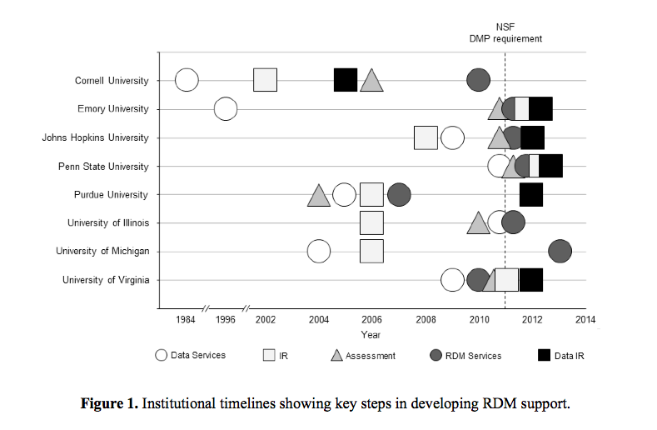
From Akers et al 2014 : http://www.ijdc.net/index.php/ijdc/article/viewFile/9.2.171/376
Notes:
DATA IR – ARE RELATIVELY NEW ....

Slide 13

Data Conservancy
Cost Recovery Model

Slide 14


Slide 15

Scholar Sphere :
Hydra (repository development) : http://projecthydra.org/

Slide 16
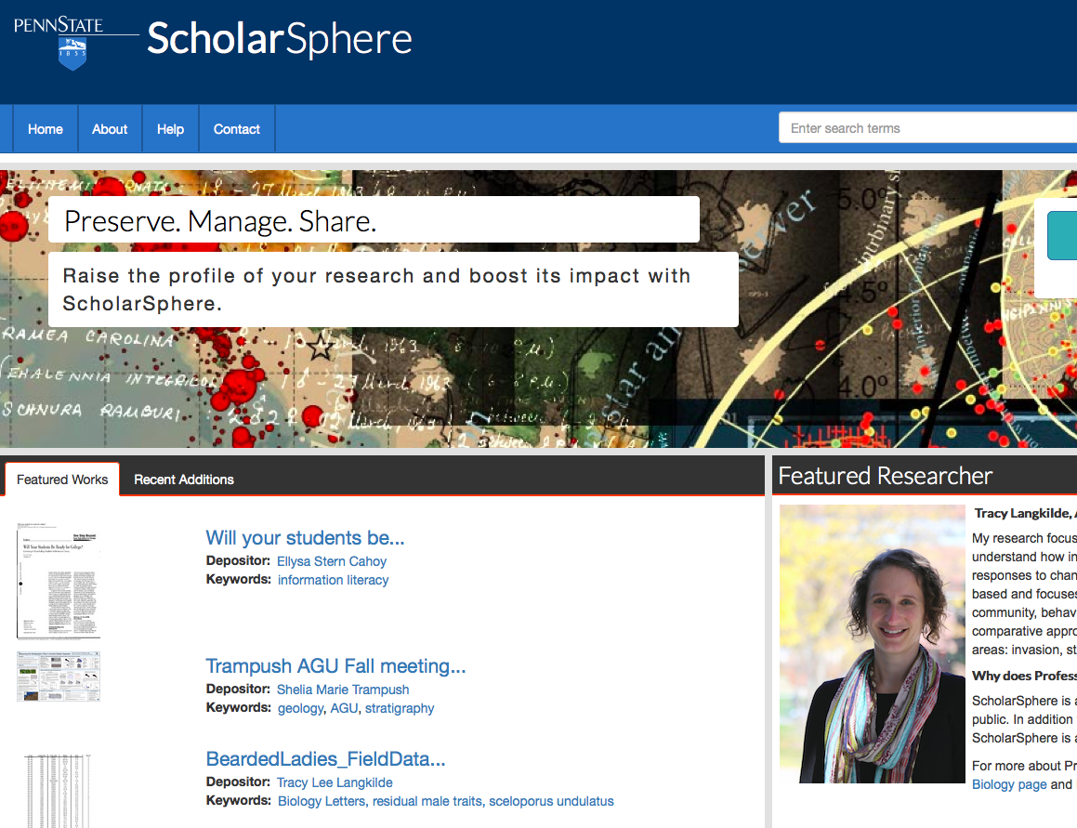

Slide 17
Activity
In five small groups:
Look at one of the academic libraries in Akers et al 2014 Use links / web to answer questions listed in book
In 20 minutes we will report back

Slide 18
Report back
Choose one person to record notes
Chose two people to report back to larger group
Answer questions from book
Tell us what is helpful, and what more would you like to know...

