Slide 1
Introduction to Data Curation: Core Concepts
Day 1

Slide 2
What this session will include:
Scoping research data curation
Archives and records management concepts
Overview of Life Cycle models
Identifier schemes
Data publication
Notes:
This will give us a shared vocabulary, and a point of reference for the rest of the workshop … if you take notes –start now

Slide 3
What this session will include:
Scoping research data curation
Archives and records management concepts
Overview of Life Cycle models
Identifier schemes
Data publication
Notes:
This will give us a shared vocabulary, and a point of reference for the rest of the workshop … if you take notes –start now

Slide 4
Background
Notes:
Why do data curation?

Slide 5
Why do data curation?
Three arguments (go hand in hand)
Policy mandates (accountability & access)
Economics (financial)
Costs: Labor, Opportunity, Intellectual
Intellectual Assets (social capital)

Slide 6
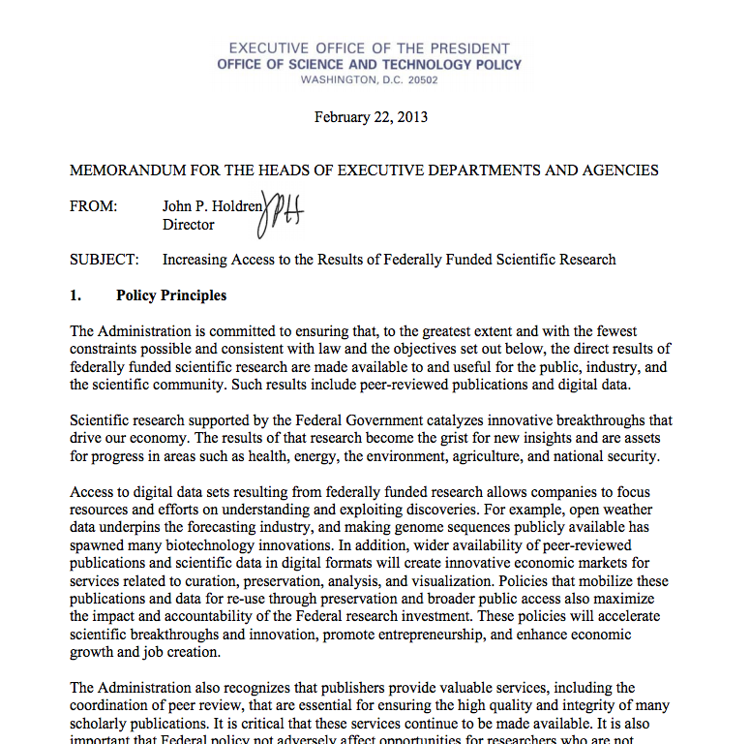

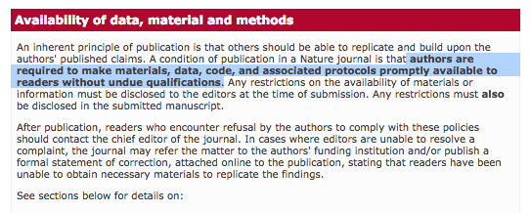

Federal
Journals & Professional Societies
Notes:
Policy…
This is about creating integrity

Slide 7
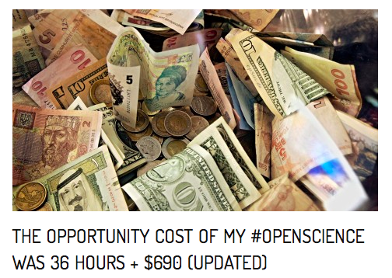
Includes time to:
Create metadata
Reformat, clean data
Archive data
Clean, comment, and refactor code
Create code repository + archive
That is a large amount of time from
a public employee whose salary is
high and expertise unrivaled…
http://brunalab.org/blog/2014/09/04/the-opportunity-cost-of-my-openscience-was-35-hours-690/
Notes:
Financial
We should want to improve this process, not only because it saves money ,,, but because it is the only tenable way to move research forward… think about how much time our students will spend doing these activities as the result of federal initatives

Slide 8
Cost including salary: $2948
Cost of publication in Open Access journal:
~ $ 3000
Fully reproducible, open access research product – code, data, and publication is (at least) : $6000
Notes:
The price to the university includes his salary too…. So
http://www.ir.ufl.edu/factbook/v-14_salaries.pdf

Slide 9
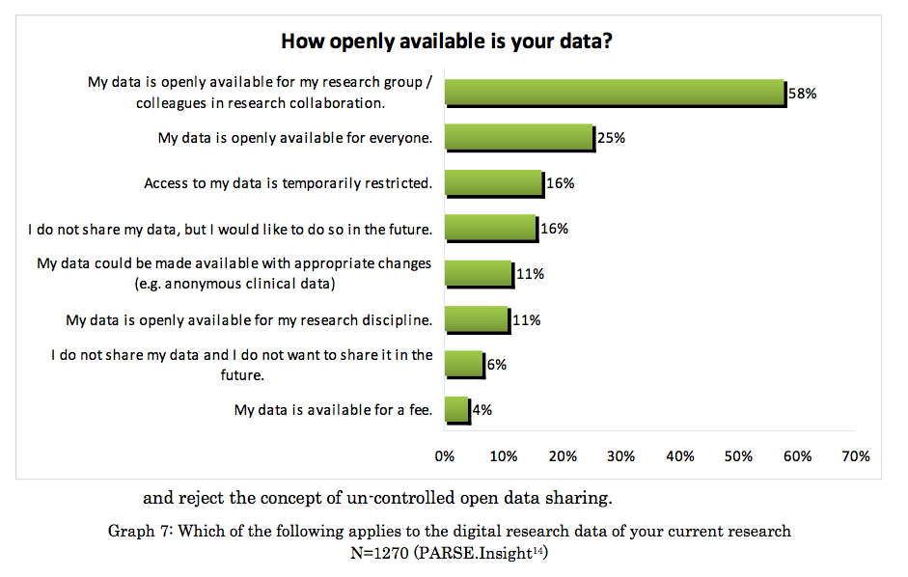

Slide 10
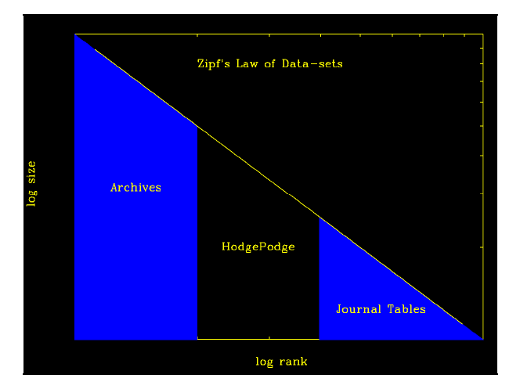
Most research institutions
SOURCE: Todd Vision, Dryad …. http://www.nap.edu/openbook.php?record_id=13564&page=164
Notes:
The problem isn’t so much the archives… bigger, larger data sits in archives – the Sloan Digital Sky Survey for instance…
And small data – I mean on the single digit megabyte scale – the type that sits in tables – that really isn’t so much of a problem. Journals occasionally host this small data for free – and there now exists a number of very reliable software for extracting this data from publications… it is not ideal, but it is not a problem like the HodgePodge is a problem.
The hodgepodge is the medium sized data that sits on servers, in

Slide 11
Access to ‘Data on Request’ Wicherts, Borsboom, Kats, & Molenaar (2006)
149 authors
249 data sets that had appeared then recently in American Psychological Association journals.
Only 11% complied with the initial request,
16% with repeated requests.
73% refused to release their work
Notes:
Problem is that requests are rarely granted …

Slide 12
Data curation is a response to each of these concerns: 1. Compliance with policy 2. Economic efficiency 3. Maximizes value of institutional assets

Slide 13
Data Curation
Is a relative term
Not just digital preservation…
Not only data management…
Notes:
It helps to understand – first – what we mean when we talk about data, and what we mean when we talk about curation

Slide 14
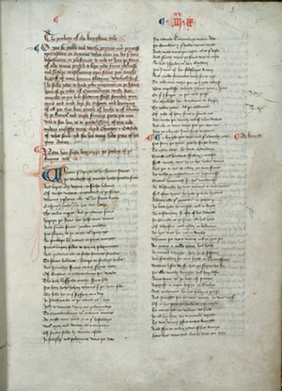
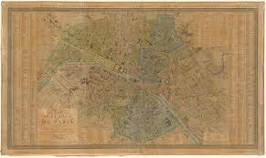
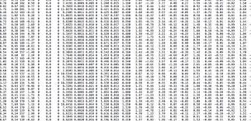
Data
Can include many different types of information objects:

Slide 15
Data
Asking what are data isn’t the right question…

Slide 16
Data as a role, not a type
Instead, we think about data as an information object (of various types) that plays a certain role within a community of practice.

Slide 17
Data
Instead, we think about data as an information object (of various types) that plays a certain role within a community of practice.
The role that data play in a scholarly community is that of evidence…

Slide 18
Research Data
Research data are the informational resources that scholars draw on in doing research, supporting their findings, and producing new knowledge.

Slide 19
Scientific Data
… support the making of new knowledge claims.
… are the result of purposeful observation, experimentation, and simulation.
… are encoded and described with the aim of supporting retrieval, meaningful interpretation, use, and reuse (Wickett et al. 2012).
Notes:
Note that in this definition we do not make a distinction about these informational resources being digital; research data could include any number of physical objects, such as a biological specimen, an architectural blue print, a paper map, etc.
The focus of this workshop will be on the curation of digital data. However, there are times when it is necessary to consider how digital data are linked to other forms of physical data - as we discuss in later sessions related to provenance and workflow technologies.
The verifiability, and validity of a new knowledge claim within most scientific domains is often dependent upon access to underlying data - which makes the curation of this material a vital part of contemporary scientific practice.

Slide 20
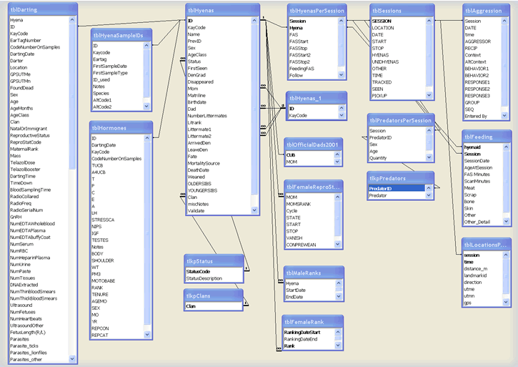
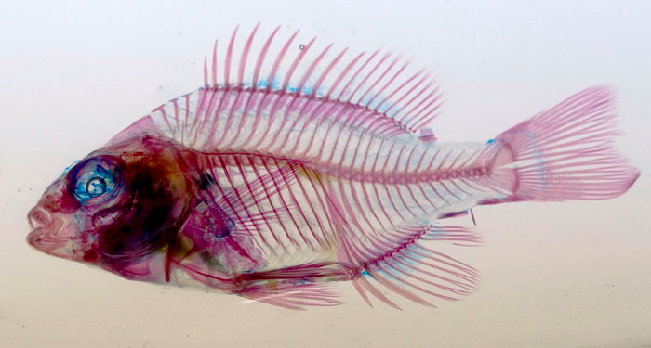
Scientific Data
Digitized physical materials
Born-digital data
Notes:
Our focus is on digital data…

Slide 21
Humanities Data
… are the starting point of argumentation within a community.
…often have propositions that are closely linked to their production
( how texts were transcribed, what was depicted, etc.)

Slide 22
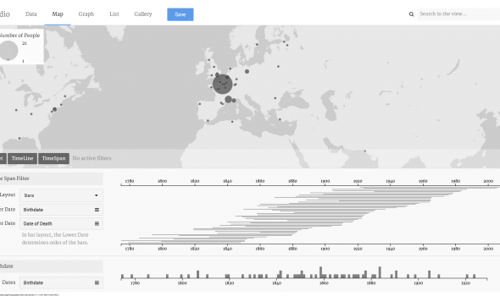
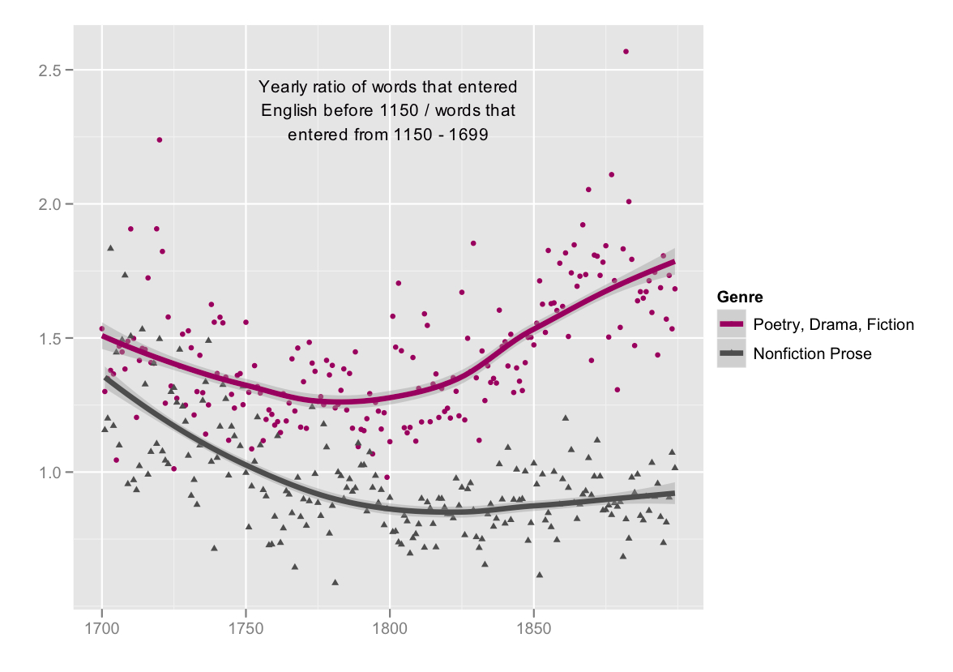
Humanities Data
journalofdigitalhumanities.org/1-2/the-emergence-of-literary-diction-by-ted-underwood-and-jordan-sellers/
http://hestia.open.ac.uk/palladio-humanities-thinking-about-data-visualization/

Slide 23
Data
… are an information object
… in a particular role
And in a scholarly community, data play an evidentiary role that supports the production of new knowledge.

Slide 24
Data “types”
Documents (text, Word), spreadsheets
Laboratory notebooks, field notebooks, diaries
Questionnaires, transcripts, codebooks
Audiotapes, videotapes
Photographs, films
Test responses
Slides, artefacts, specimens, samples
Collection of digital objects acquired and generated during the process of research
Statistical or other data files
Database contents (video, audio, text, images)
Models, algorithms, scripts
Contents of an application (input, output, logfiles for analysis software, simulation software, schemas)
Methodologies and workflows
Standard operating procedures and protocols
http://datalib.edina.ac.uk/mantra/researchdataexplained/

Slide 25
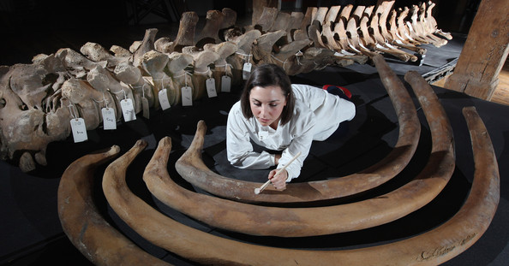
Curation
Traditionally:
Notes:
Steward of physical objects …. preservation, and meaningful arrangement of material collection …

Slide 26
Curation (defined)
(Noun)
Healing, or curing.
Guardianship.

Slide 27
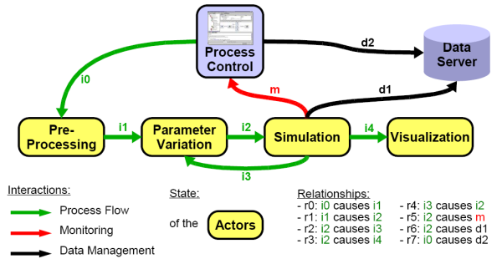
Curation in digital context
Notes:
Over time the concept has been transferred from the context of physical specimens found in natural history museums or the thematic collections of art, to a digital environment where the curatorial roles of stewardship, preservation and meaningful arrangement have taken on new meanings (Weber et al, 2013).
In a scholarly environment curatorial roles include developing indexing systems, metadata standards, ontologies, and retrieval systems that will make it possible for research data to work in concert with existing digital libraries, archives, and repositories (Palmer, Renear and Cragin, 2007). Increasingly, this work is aimed at improving data quality, guaranteeing authentication of digital resources throughout a lifecycle of us e and reuse, and capturing provenance of scholarly activities using workflow technologies.

Slide 28
Curation roles...
Early: Build and maintain data collections, associated indexing systems, metadata standards, ontologies, and retrieval systems.
And….
Emerging: Ensuring data quality, authentication, security, and developing associated documentation and tools (software) necessary for long-term reuse.
Notes:
Explain roles
Explain then the concept of data curation…

Slide 29
Data Curation
Data curation is the active and ongoing management of data throughout its entire lifecycle of interest and usefulness to scholarship, including it's reuse in unanticipated contexts.
(edited from Cragin et al. 2007)
Notes:
All together now

