Slide 1
Open Data & Scholarly Communications
Some Context for Research Data Curation
Nic Weber
University of Hong Kong
February 2015

Slide 2


Slide 3
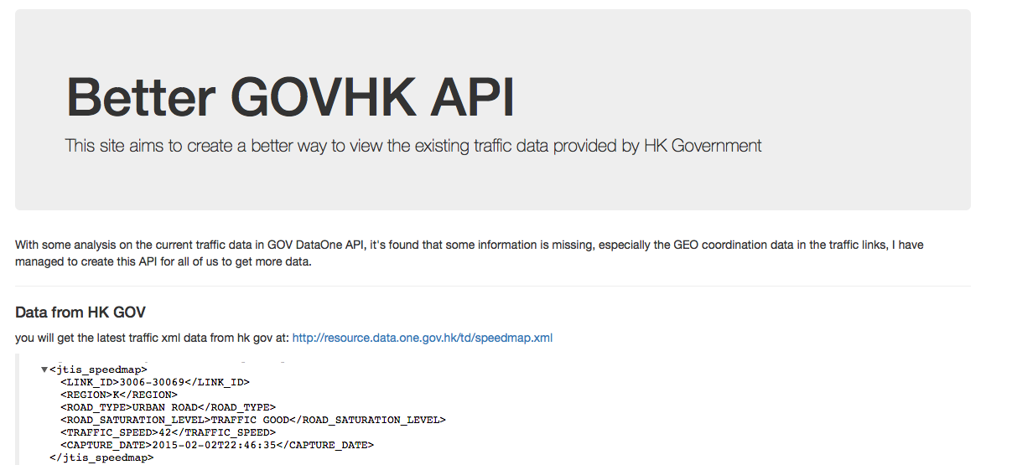
http://govapi.amoebaconsulting.net/

Slide 4
http://electricricecooker.tumblr.com/post/98492317044/hong-kongs-intangible-cultural-heritage-list-and

Slide 5
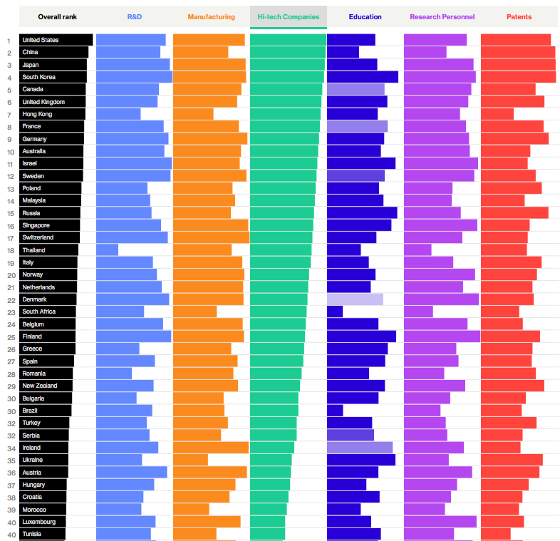
http://www.bloomberg.com/graphics/2015-innovative-countries/
Notes:
I’m going to build an argument which is empirical – it’s based not on a normative framework for why we should do this… that is an important dimmension… but I am going to build an argument based on economics – and efficiency.
To be clear – this is not wholly one way or the other – we can make arguments either way….

Slide 6
Chorus http://www.chorusaccess.org/
Share http://www.arl.org/focus-areas/shared-access-research-ecosystem-share#.VMUyv8ayX_8

Slide 7
Advantage
Data Reuse. Papers with available datasets can be used in ways that papers without data cannot, and may receive additional citations as a result.
Credibility Signalling. The credibility of research findings may be higher for research papers with available data. Such papers may be preferentially chosen as background citations or the foundation of additional research.
Increased Visibility. Third party researchers may be more likely to encounter a paper with available data, either by a direct link from the data or indirectly through cross-promotion. For example, links from a data repository to a paper may increase the search ranking of the research paper.
Early View. When data is made available before a paper is published, some citations may accrue earlier than they would otherwise because of accelerated awareness of the methods, findings, and so on.
Selection Bias. Authors may be more likely to publish data for papers they judge to be their best quality work, because they are particularly proud or confident of the results (Wicherts, Bakker & Molenaar, 2011).

Slide 8
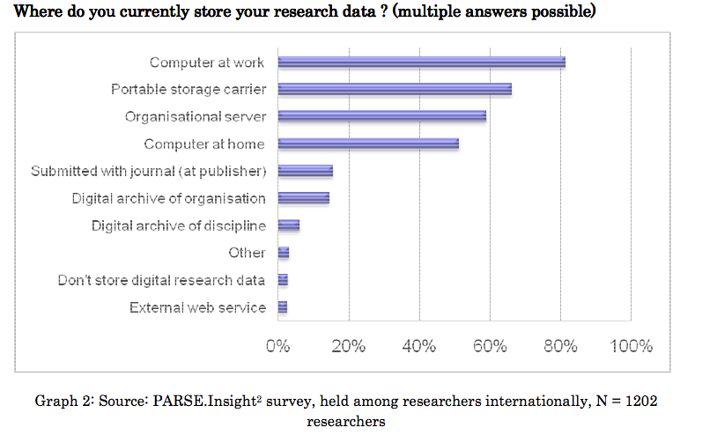

Slide 9
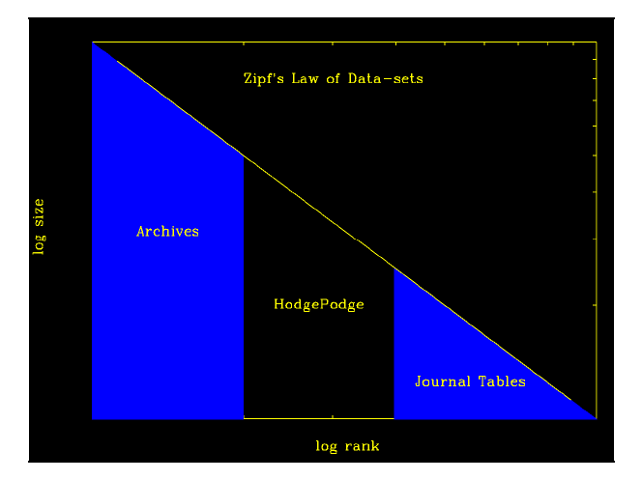
Notes:
The problem isn’t so much the archives… bigger, larger data sits in archives – the Sloan Digital Sky Survey for instance…
And small data – I mean on the single digit megabyte scale – the type that sits in tables – that really isn’t so much of a problem. Journals occasionally host this small data for free – and there now exists a number of very reliable software for extracting this data from publications… it is not ideal, but it is not a problem like the HodgePodge is a problem.
The hodgepodge is the medium sized data that sits on servers, in

Slide 10
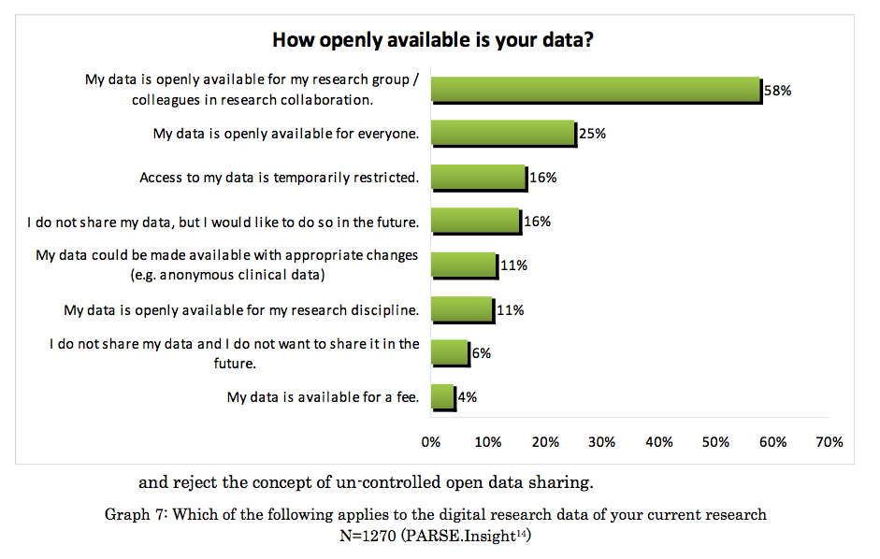

Slide 11
Find something from here: http://journals.plos.org/plosone/article?id=10.1371/journal.pone.0108451#s5

Slide 12
http://journals.plos.org/plosone/article?id=10.1371/journal.pone.0021101#pone-0021101-g001

Slide 13
http://journals.lww.com/academicmedicine/Abstract/2006/02000/Data_Withholding_in_Genetics_and_the_Other_Life.6.aspx

Slide 14

http://opensource.com/sites/default/files/styles/image-full-size/public/images/government/OSCD_GOV_open_data_standards.png?itok=igpITdY0

Slide 15
Agenda
The Context of Research Data Curation
Economic Investment in Public Goods
Reproducibility of New Knowledge
Open Data
Government + Commercial Sector
Research + Higher Education
Scholarly Communications
Decoupling the scholarly record
Research Objects as first-class scholarly products

Slide 16
2 Quick Examples

Slide 17
1st Example: The cost of Open Science

Slide 18
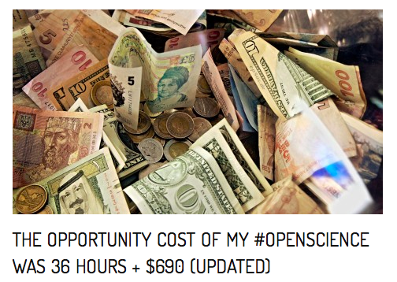
Includes time to:
Create metadata
Reformat, clean data
Archive data
Clean, comment, and refactor code
Create code repository + archive
That is a large amount of time from
a public employee whose salary is
high and expertise unrivaled…
http://brunalab.org/blog/2014/09/04/the-opportunity-cost-of-my-openscience-was-35-hours-690/
Notes:
We should want to improve this process, not only because it saves money ,,, but because it is the only tenable way to move research forward… think about how much time our students will spend doing these activities as the result of federal initatives

Slide 19
Cost including salary: $2948
Cost including publication in Open Access journal: $ 3000
But, the pportunity cost of doing things differently…
Notes:
http://www.ir.ufl.edu/factbook/v-14_salaries.pdf

Slide 20
Crisis? What Crisis?
http://www.cell.com/current-biology/abstract/S0960-9822%2813%2901400-0

Slide 21

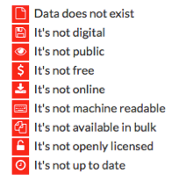
http://index.okfn.org/place/

Slide 22
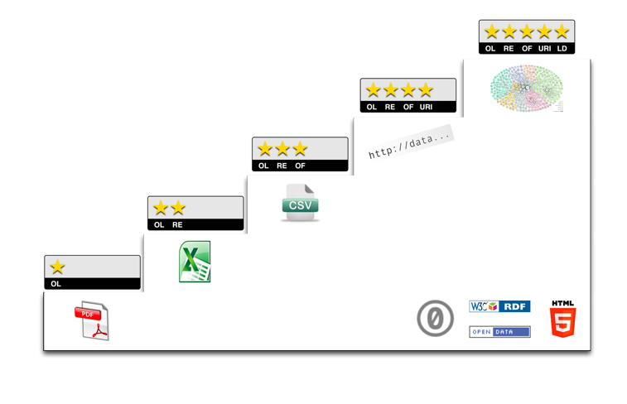
Open Data

Slide 23
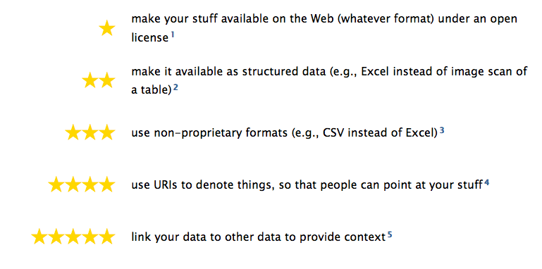
http://5stardata.info/

Slide 24
Willingness to share increases citation counts:
http://journals.plos.org/plosone/article?id=10.1371/journal.pone.0026828

