Slide 1
Lab 3

Slide 2

Informal Workflow
c/o SageCite: http://blogs.ukoln.ac.uk/sagecite/

Slide 3
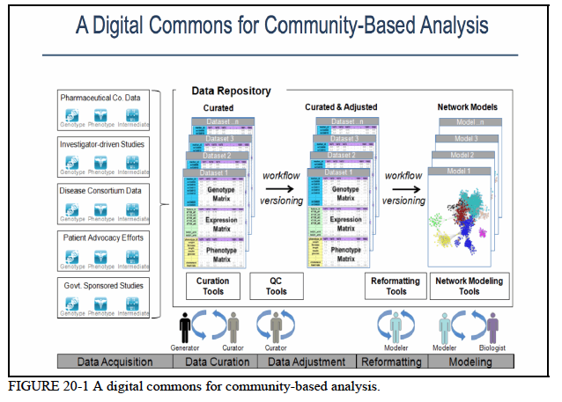
Notes:
In a bit more detail…

Slide 4
The problem is - we want to be able to create usable, reliable workflows – and we want to document things such that our colleagues in another institution, department or college can understand them *immediately*

