Slide 1
Data Publication and Linking

Slide 2
Discovery + Attribution
Data publication and linking (expressing relationships) are really about three concepts:
Increasing discoverability (and reuse)
First step in receiving credit for data sharing
Allow for meaningful integration of different data sources
Notes:
Critical to these three concepts are also data citation – and descriptive metadata.
We will talk about metadata tommorow
We will talk about data citation this afternoon…
But first we need to clarify what it means to publish data, and then how we link those publications to other datasets, and more broadly other types of research objects that are important to reuse.

Slide 3
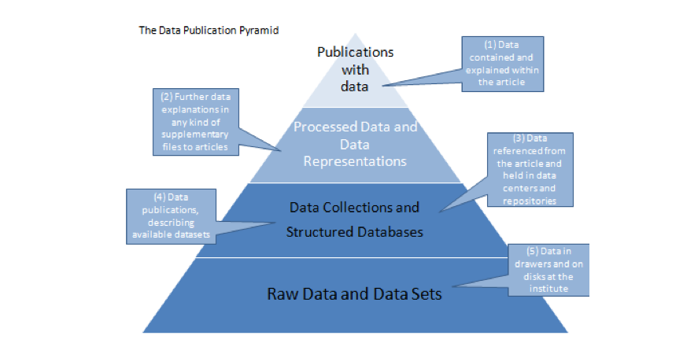
Data Publication Pyramid
http://www.alliancepermanentaccess.org/wp-content/uploads/downloads/2011/11/ODE-ReportOnIntegrationOfDataAndPublications-1_1.pdf

Slide 4

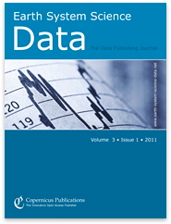

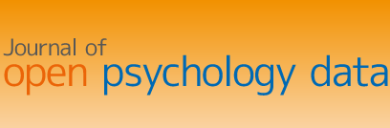
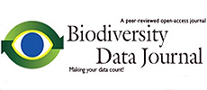
“Publish” data in journals
Notes:
Top level – is to get data published in traditional journals

Slide 5
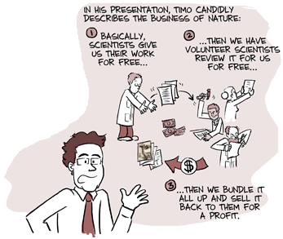
h/t Carly Strasser’s smart blog: http://datapub.cdlib.org/2011/12/12/the-skinny-on-data-publication/
From: http://www.phdcomics.com/comics/archive.php?comicid=1200
Notes:
This is very good for attribution sake. There is a long history of publishing papers about data.
What is wrong with this….
Writing papers takes a lot of time – the system doesn’t work that well to begin with ….
( However, I think Ubiquity press is doing it the right way…)

Slide 6
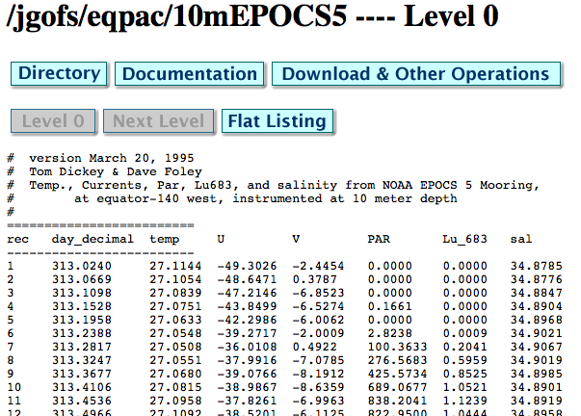
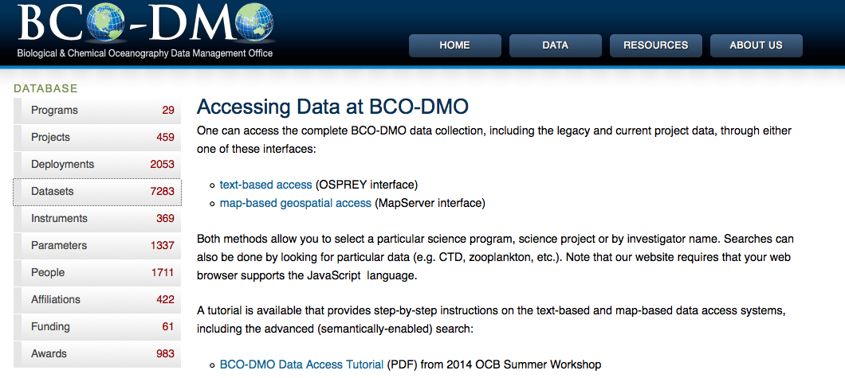
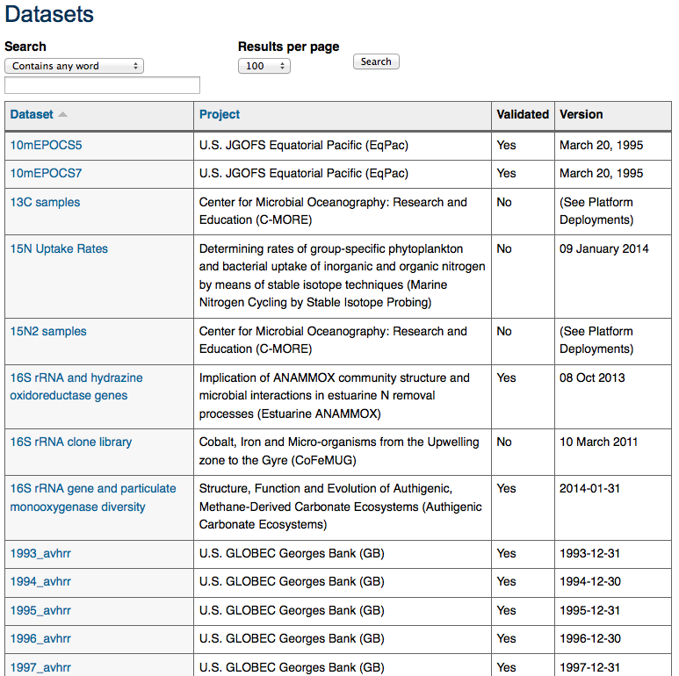
“Publish” data on the web
Notes:
What is good about this … ?
Discoverable – lots of information, customizable
What is bad about this approach…
It is incredibly labor intensive, takes much

