Slide 1
Open Data & Scholarly Communications
Some Context for Research Data Curation
Nic Weber
University of Hong Kong
February 2015

Slide 2
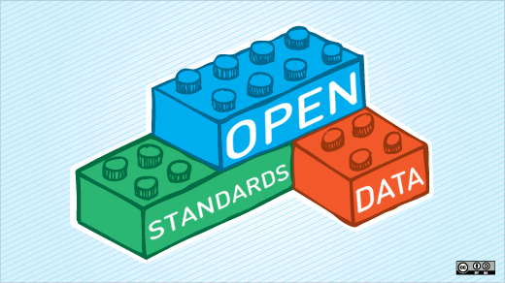
http://opensource.com/sites/default/files/styles/image-full-size/public/images/government/OSCD_GOV_open_data_standards.png?itok=igpITdY0

Slide 3
Agenda
The Context of Research Data Curation
Economic Investment in Public Goods
Reproducibility of New Knowledge
Open Data
Government + Commercial Sector
Research + Higher Education
Scholarly Communications
Decoupling the scholarly record
Research Objects as first-class scholarly products

Slide 4
2 Quick Examples

Slide 5
1st Example: The cost of Open Science

Slide 6
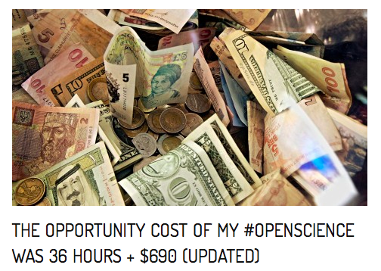
Includes time to:
Create metadata
Reformat, clean data
Archive data
Clean, comment, and refactor code
Create code repository + archive
That is a large amount of time from
a public employee whose salary is
high and expertise unrivaled…
http://brunalab.org/blog/2014/09/04/the-opportunity-cost-of-my-openscience-was-35-hours-690/
Notes:
We should want to improve this process, not only because it saves money ,,, but because it is the only tenable way to move research forward… think about how much time our students will spend doing these activities as the result of federal initatives

Slide 7
Cost including salary: $2948
Opportunity cost… enormous.
Notes:
http://www.ir.ufl.edu/factbook/v-14_salaries.pdf

Slide 8
Crisis? What Crisis?
http://www.cell.com/current-biology/abstract/S0960-9822%2813%2901400-0

Slide 9

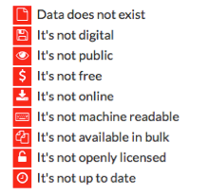
http://index.okfn.org/place/

Slide 10
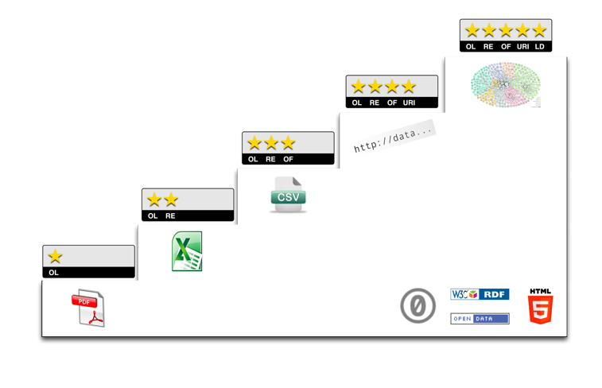
Open Data

Slide 11
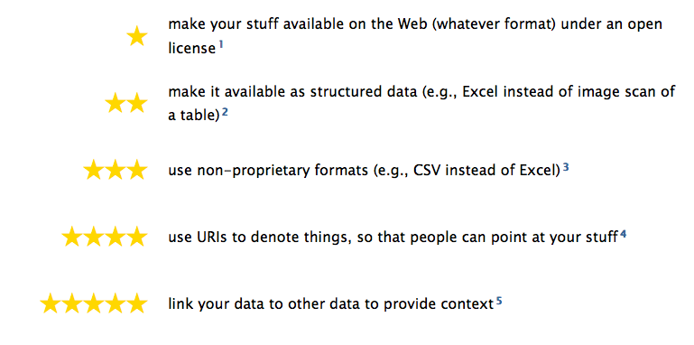
http://5stardata.info/

