Slide 1
Identifiers for Digital Material

Slide 2
What is an identifier?
“a name that identifies either a unique object or a unique class of objects”

Slide 3
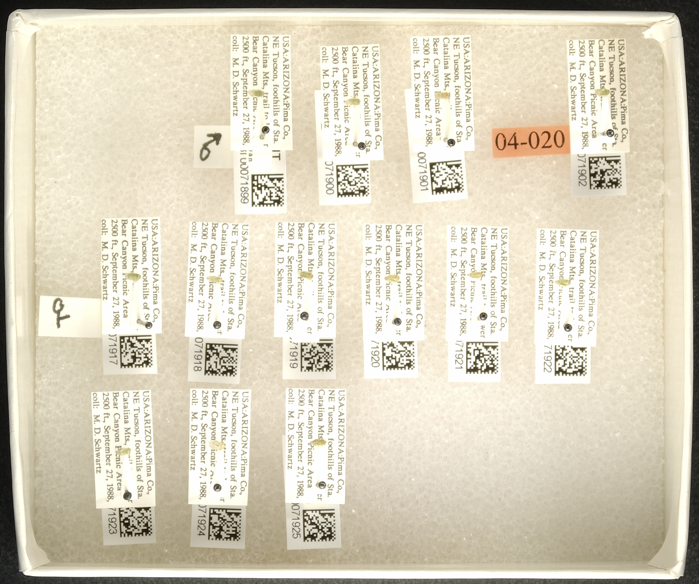
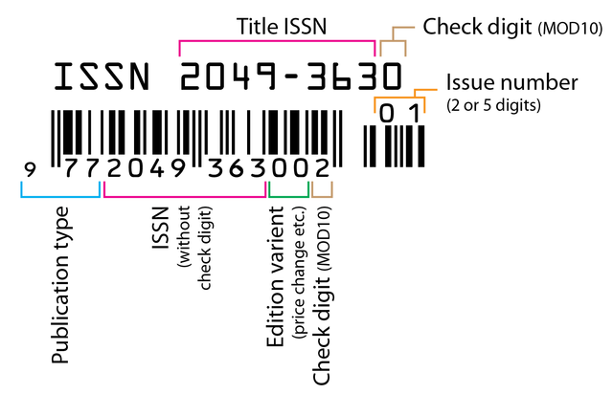
Identifiers are everywhere

Slide 4
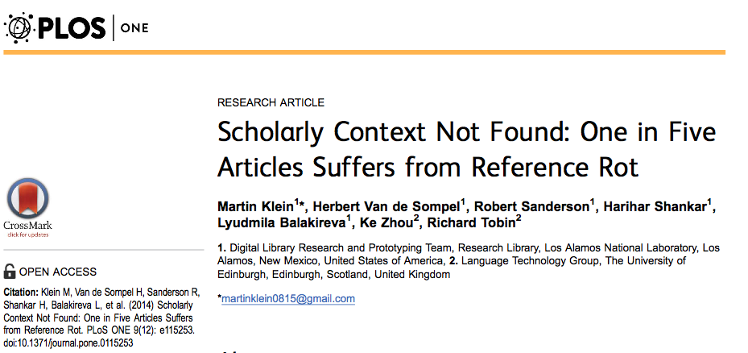
Why IDs matter for data curation?
Test corpus: 3.5 million scholarly articles published 1997-2012
20% had web content that was not accessible for review (e.g. link rot, content drift)
If data are playing a role of evidence… we need to make sure that they are stable and accessible for the long-term
Notes:
Explain link rot and content drift
combination of link rot and content drift to which references to web resources included in Science, Technology, and Medicine (STM) articles are subject. W

Slide 5
Qualities of an ID for data curation
Machine Readable
Unique
Persistent
Resolvable

Slide 6
Example Schemas
Archival Resource Keys (ARKs)
Digital Object Identifiers (DOIs)
Extensible Resource Identifiers (XRIs)
Handle System (Handles)
Life Science Unique Identifiers (LSIDs)
Object Identifiers (OIDs)
Persistent Uniform Resource Locators (PURLs)
Uniform Resource Identifiers/Names/Locators (URIs/ URNs/URLs)
Universally Unique Identifiers (UUIDs)

Slide 7
Values of different ID schemes
Technical value: assessing the technology underlying the identifier scheme;
User value: assessing how the scheme is likely to make end user’s lives easier or more difficult; and
Archive value: assessing whether an identifier scheme is likely to make the job of data management easier or more complicated
Duerr, et al. 2011

Slide 8
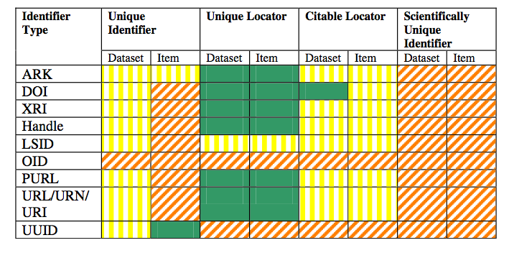
Evaluating different ID schemas
Reference?

Slide 9
Evaluating different ID schemas

Slide 10
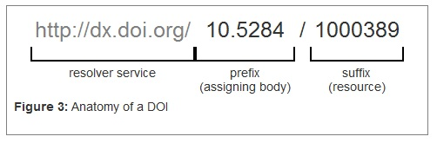
What is a DOI ?
Reference?
Notes:
Spend time talking about what the doi does
It resolves to a landing page… and even though the resorce might change, the doi doesn’t – so we can move doi to continue to point at the resource… (I obviously do not know how this works)

Slide 11



Services for data DOIs
But not ideal

Slide 12
m:1
One resource can have many DOIs
This points us to a key challenge….

Slide 13
Qualities of an ID for data curation
Machine Readable
Unique
Persistent
Resolvable

Slide 14
An ID alone isn’t enough
ID’s are pointers – they need to point to something
Just as an address won’t prevent a house from being demolished or remodeled, an ID will not prevent “content drift” or data from being deleted
They don’t make content more reliable, citable, or trustworthy

Slide 15
DOI services differ!
But not ideal

Slide 16
DOI services differ!
But not ideal
Notes:
NIC – need help with this one

Slide 17
Finally: Data objects “version” differently
Books: volumes, editions, issues
Software: versions, builds
Datasets: are sometimes versioned, but often accrete or change gradually over time
Identifier management must coincide with data management, project management, and creation of good documentation

Slide 18
Identifiers and Data Citation
More on this in this afternoon’s lab

