Slide 1
Application Profiles + Bespoke Metadata Schemas
Notes:
http://www.ukoln.ac.uk/projects/sdapss/

Slide 2
When to design your own schema…
“When it comes to metadata, one size does not fit all. In fact, one size often does not even fit many.”
In data curation, this is doubly true…

Slide 3
A Simple Example: DC-AP
Application profiles…

Slide 4
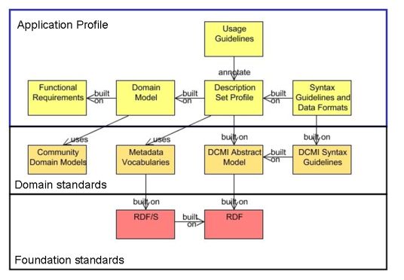
Framework

Slide 5

Case Study from DataCite
“…establish easier access to scientific research data on the Internet, increase acceptance of research data as legitimate, citable contributions to the scientific record, (and) support data archiving that will permit results to be verified and re-purposed for future study”
Notes:
This case study is going to bring a few different threads together…

Slide 6
The Kernel…
“…metadata scheme's core is composed of a discreet number of required properties. It was determined that this set would be restricted to the information necessary to compose a citation.”
Notes:
What is a kernel / core and why does that matter (hang more information off)

Slide 7
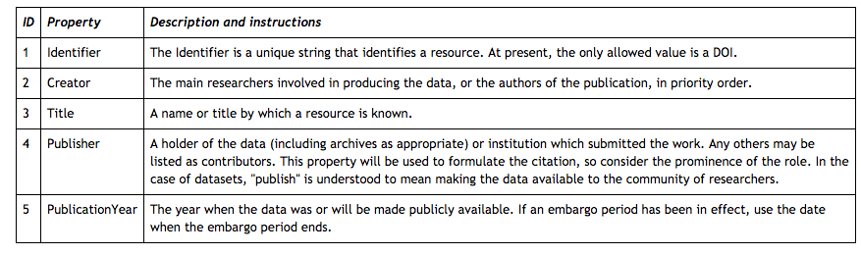
http://www.dlib.org/dlib/january11/starr/01starr.html

Slide 8
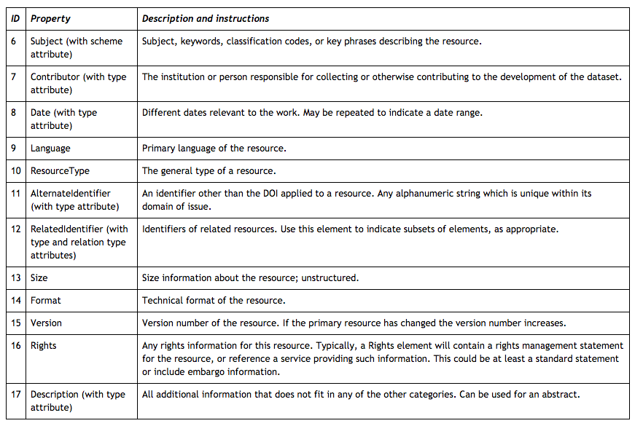

Slide 9


“Data produced and used by researchers in the digital music area are very heterogeneous and change relatively rapidly. As a consequence, using very specific metadata schemas is not very feasible, as it would require creating new customised schemas and metadata-entry pages for each type of dataset. This would also be a problem when defining the metadata fields to be indexed by the repository's search engine.”
Notes:
CDM – Queen Mary University of London
Uses an instance of DuraSpace – which comes with dublin core predefined… but offfers the ability to define new schemas ….

Slide 10
Elements (dublin core crosswalk in parenthesis)
Identifier (dc.identifier.uri)
Title (dc.title)
Creator (dc.contributor.author)
Publisher (dc.publisher)
Publication Year (dc.date.created, where only the year is mandatory)
Subject (dc.subject)
Description (dc.description.abstract)
Resource type (dc.type)
Related Identifier, including related papers and references (dc.relation)
http://rdm.c4dm.eecs.qmul.ac.uk/content/dspace-metadata-schemas-and-data-submission

Slide 11
Crowdsourcing Metadata
http://www.bodleian.ox.ac.uk/bodley/finding-resources/special/projects/whats-the-score

