Slide 1
Metadata for Research Data Curation: Design, Select, and Adapt.

Slide 2
Agenda
Metadata for data curation
Evaluating and selecting between existing standards
Crosswalking
Application Profiles

Slide 3
Metadata for data curation
Evaluating and selecting between existing standards
Crosswalking
Application Profiles

Slide 4
What does metadata look like?
Like data, it is a relational concept. It can look like anything… (bugs in drawers)
But we want machine readable expressions of our metadata… and that means
XML
Tree structure that structures attribute and value pairs

Slide 5
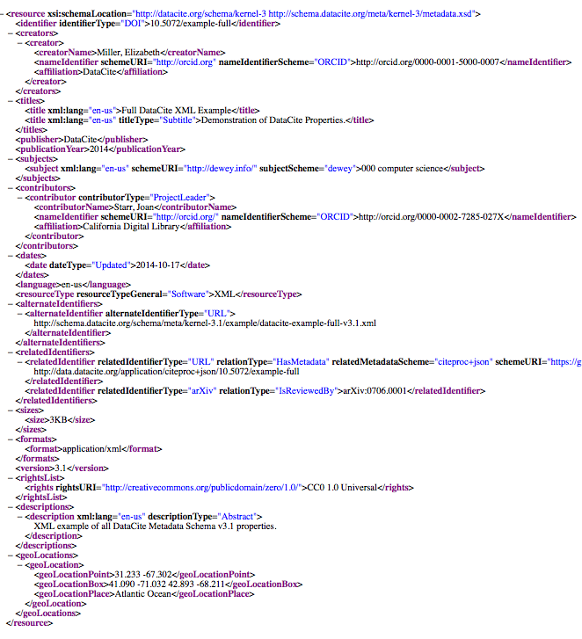

Slide 6
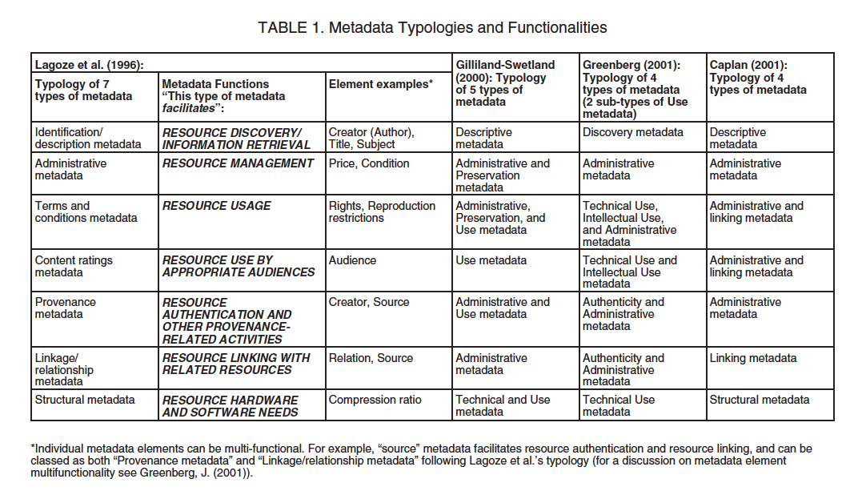
Notes:
There are holy wars over just this topics

Slide 7
Types of Metadata
Descriptive
Structural
Administrative
Rights Management
Preservation
NISO. (2004) Understanding Metadata. Bethesda, MD: NISO Press, pp.1-2.
Notes:
NISO. (2004) Understanding Metadata.
Bethesda, MD: NISO Press, pp.1-2.

Slide 8
Descriptive Metadata
… describes a resource for purposes such as discovery and identification. It can include elements such as title, format, author (s), keywords, spatial coverage, date, etc.

Slide 9
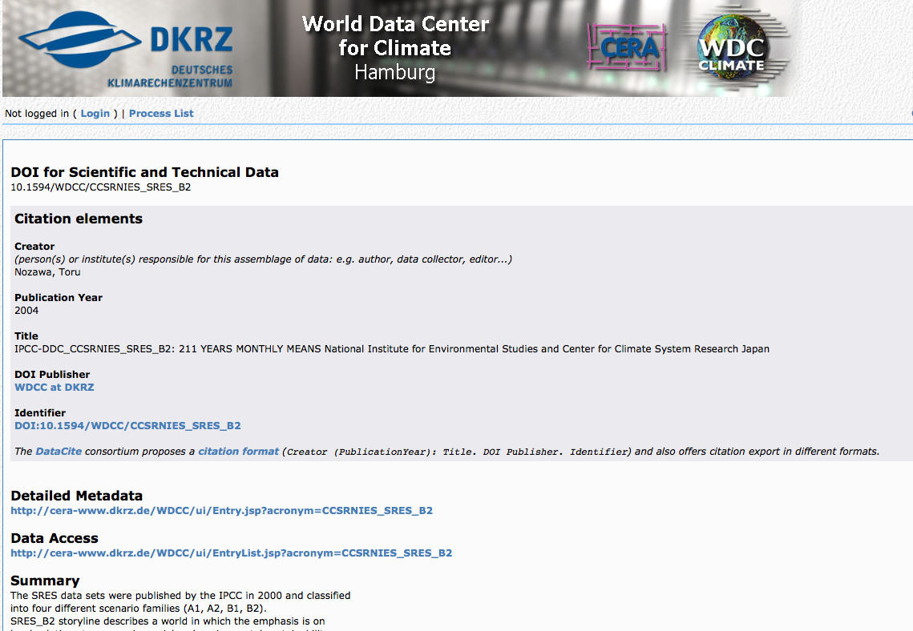
Example
http://cera-www.dkrz.de/WDCC/ui/Compact.jsp?acronym=CCSRNIES_SRES_B2

Slide 10
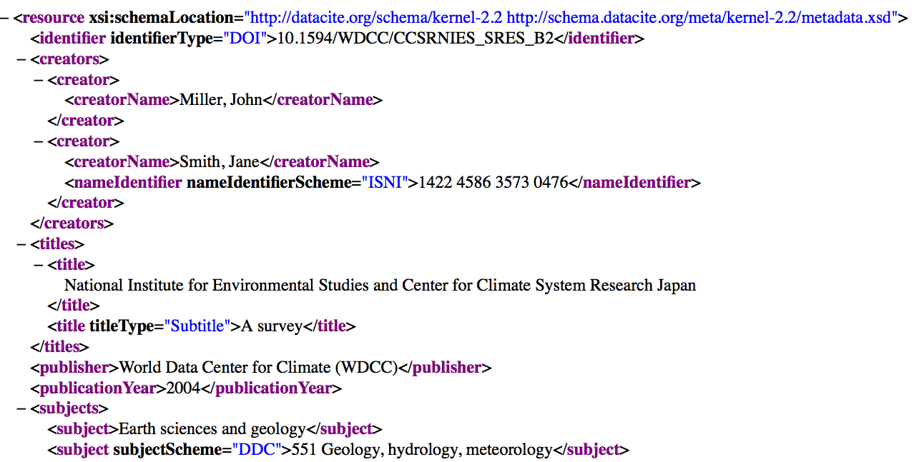

Slide 11
Structural Metadata
…indicates how compound objects are put together, for example, how pages are ordered to form chapters, or, how different observation events were combined for a “set” of data observations, etc.

Slide 12
Example
METS

Slide 13
Administrative Metadata
…provides information to help manage a resource, such as when and how it was created, file type and other technical information, and who can access it.

Slide 14
Subsets of Admin. Metadata
Rights management metadata, which deals with intellectual property rights. (OFTEN EMBEDDED IN PRES METADATA)
Preservation metadata, which contains information needed to archive and preserve a resource.

Slide 15
Premis (preservation metadata)
2003 OCLC + RLG created Preservation Metadata Implementation Strategy working group
Builds upon fundamentals of OAIS
Produced: data vocabulary, data dictionary, and data model
Notes:
See http://www.slideshare.net/jenlrile/premis for more info.

Slide 16
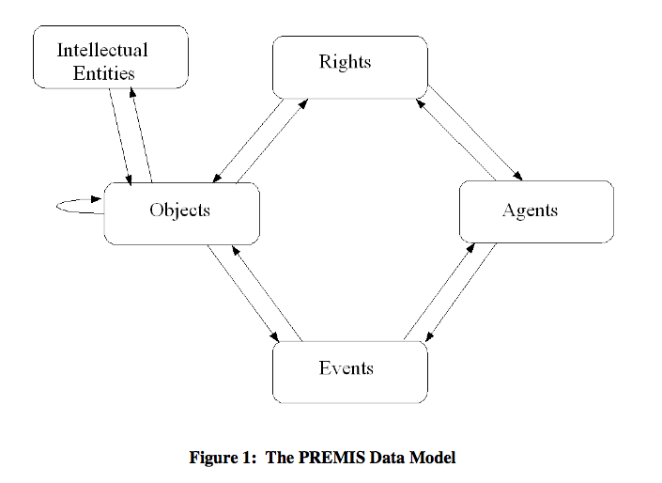
PREMIS: Data Model
Captures information that “supports and documents digital preservation process”

Slide 17
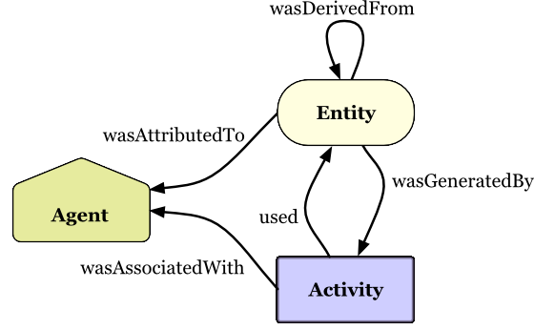
Evolution of a Standard
Captures information that “supports and documents digital preservation process”
Notes:
As scholarship begins to happen on the web, this is the evolution of this model …. From

Slide 18
CASE STUDY OF PREMIS

Slide 19
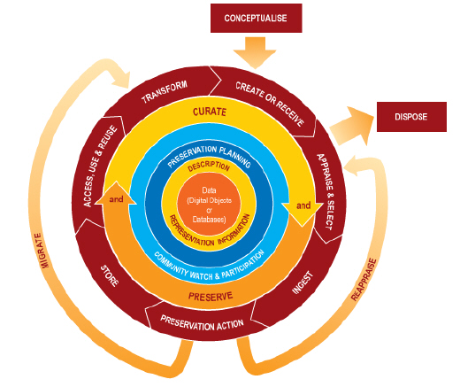
Notes:
Where in this lifecycle do we create metadata? Creating and recieiving data – ingesting into a new data management environment – any time we perform a preservation action we create metadata – and any time the data are reused, there is likely additional linkages to be created or maintained.
Different actors have different roles In the creation of metadata in this lifecycle

Slide 20
Who creates What metadata, and When…
Curators : When data are received / ingested, preservation actions are taken, after reuse occurs.
Type: Descriptive, Structural, and (esp) Admin
Data creators: When data are collected, transformed, reused.
Type: Descriptive + Structural
Notes:
What your metadata should describe, and when are subject of next module.

