Slide 1

Metadata II: Evaluating and Selecting Metadata Schemas

Slide 2
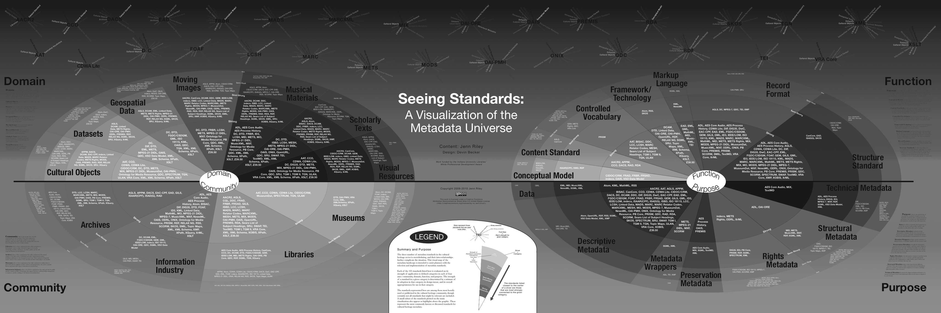
There are a LOT of different metadata schemas…

Slide 3
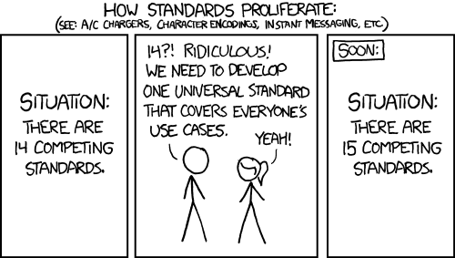
And yet…

Slide 4
But there is hope
Clearly articulating your and your users’ needs can help you better clarify what you need out of a schema
And understanding the strengths vs. limitations of a schema will help you decide which to use, or adapt

Slide 5
Step 1: Evaluate your needs
Before looking at schemas, concentrate on the specificities of your repository and your users
Marie Kennedy suggests we ask following 9 questions:
Who will be using the collection?
Who is the collection cataloguer?
How much time/money do you have?
Notes:
Before we start looking at and comparing schemas its important to ask, “what’s the goal”
She’s not talking about data –
Still an emerging set of resources about data objects

Slide 6
Kennedy 2008 continued
How will your collection be accessed?
How is your collection related to other collections?
What is the scope of your collection?
Will your metadata be harvested?
Do you want your collection to work with other collections?
How much maintenance or quality control do you wish?

Slide 7
Step 2: Evaluate Schemas
Returning to our many kinds of metadata
Notes:
With these requirements in mind, you can return to resources like “Seeing Standards” or
http://www.dcc.ac.uk/resources/metadata-standards
and begin the process of choosing a metadata schema.
Unfortunately, while the 9 questions do help you determine the scope of your collections and needs, they don’t provide you with a mechanism to point you to a schema

Slide 8
From Greenberg, 2005
Notes:
There have been efforts to ask similar questions of the schemas themselves
Going to step through one example that’s out of the Research in DC world
It is more complex than the last example but might still be useful.
community, domain, function, and purpose

Slide 9
The MODAL framework
Developed by Jane Greenberg (Drexel)
Conceptual framework for analyzing Metadata Objectives and principles, Domain, and Architectural Layout
2005 paper establishes framework, Willis, Greenberg & White apply it to scientific data schemas in 2012
Notes:
Note that these categories are similar to descrptive, technical

Slide 10
MODAL applied
Research questions:
What is the scope of scientific metadata schemes?
What are the similarities and differences between scientific metadata schemes?
What may be the fundamental requirements of metadata schemes for scientific data?

Slide 11
Application to Practice
MODAL is a more robust way of analyzing schemas?
That said, it’s not a magic bullet (because there is no magic bullet)
Notes:
Come back to this slide

Slide 12
Need to find some more resources on ACTUALLY PICKING SOMETHING

Slide 13
There will always be many possible ways to do the same thing
100 a Shakespeare, William d 1564-1616
245 a Hamlet
260 a New York: b Penguin Books, c 2003
<dc:creator>Shakespeare, William, 1564-1616</>
<dc:title>Hamlet</>
<dc:publisher>Penguin Books</>
<dc:date>2003</>
Notes:
Note that these are equally flawed, too…

Slide 14
Avoid the Goldilocks problem
Dublin Core is too sparse but MARC is too verbose!
CDWA is too complicated but VRA Core doesn’t describe all my data!
DarwinCore looks like it will work, but it doesn’t have a DTD!
Notes:
Delete probably

Slide 15
Step 3: Understand that “good enough” is better than instead of “just right”
Standards will always have limitations
Expressivity
Interoperablity

Slide 17
Metadata III: Crosswalking, reconciliation and propagation

Slide 18

Metadata in the wild

Slide 19
Consider the following
100 a Shakespeare, William d 1564-1616
245 a The Tempest
260 a London: b Arden Shakespeare, c 1999
<dc:creator>Shakespeare, William, 1564-1616</>
<dc:title>Hamlet</>
<dc:publisher>Penguin Books</>
<dc:date>2003</>

Slide 20
Consider the following
Notes:
Note that these are equally flawed, too…
Talk more about trade offs and affordances here
GCMD is broader, RDA is more specific (narrower Designated community)
Then show XML
Decision of what attrinbute value pair to use has a real consequence

Slide 21
Consider the following
One more example – maybe HTRC?

Slide 22

Crosswalking
bringing different overlapping standards together
Necessary for aggregation and integration
Can be hugely time consuming!

Slide 23
But there’s hope
Resources for crosswalking:
http://www.getty.edu/research/publications/electronic_publications/intrometadata/crosswalks.html
https://marinemetadata.org/guides/mdatastandards/crosswalks
http://www.dlib.org/dlib/december04/godby/12godby.html
http://www.ukoln.ac.uk/metadata/interoperability/

Slide 24
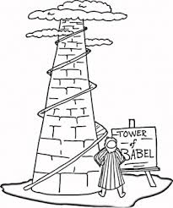
Crosswalking

Slide 25
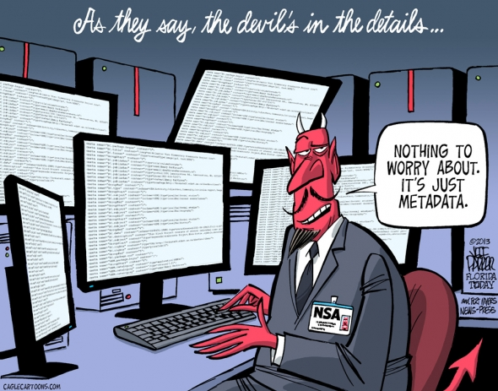

Slide 26
Just as there are many metadata schemas there are many ways to categorize metadata schemas…
From Greenberg, 2005
Notes:
My poit

