Slide 1

Digital Libraries, Fall 2014

Slide 2
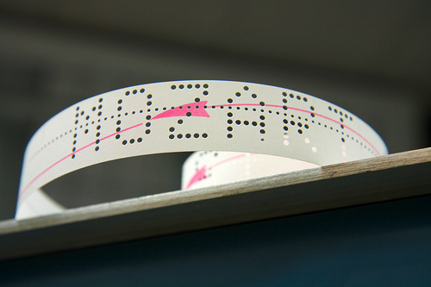
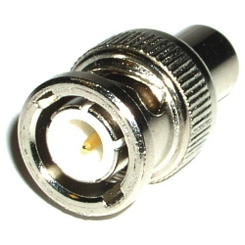
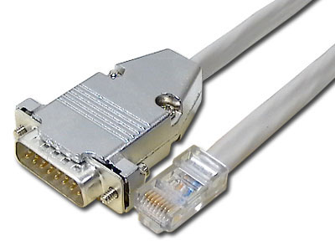

THE PHYSICAL LAYER

Slide 3
CHARACTERS
‘A’
0000000001000001 (Unicode UTF-16)
01000001 (ASCII, Unicode UTF-8)
11000001 (EBCDIC)
000001 (CDC Display Code)
001011 (DECSystem-10)

Slide 4
Encoding Mechanism
XML
  <xs:element name="any" type="SimpleLiteral" abstract="true"/>
  <xs:element name="title" substitutionGroup="any"/>
BER
Type | Length | Value
000000100 OCTET String | 01010110 86 Octets Long | “Twas brillig…

Slide 5
Syntax
MARC:
  245 10$aFifty years of television :$ba guide to series and pilots, 1937-1988 /$cVincent Terrace.
  650 #0$aTelevision pilot programs$zUnited States$vCatalogs.
XML Schema:
  <dc:title>Fifty years of television : a guide to series and pilots, 1937-1988</dc:title>
  <dc:subject>Television pilot programs -- United States -- Catalogs</dc:subject>
RDF
  <rdf:Description about=“urn:isbn:0845348116”>
  <dc:title> Fifty years of television : a guide to series and pilots, 1937-1988</dc:title> </rdf:Description>

Slide 6
Semantics
Rules of Description
  AACR2, RDA, DACS, RAD, CCO
Ontologies
Controlled Vocabularies / Authority Control
Profiles

Slide 7
Protocols
OAI-PMH
Z39.50

Slide 8
You say ‘tomato,’ I say ‘solanum lycopsicum”
Crosswalks -- when we agree to disagree
  MARC to DC Example
And the downsides
  One to Many Problems
  Many to one problems
  Missing target field
  Missing source data
  1:M / 1:1 or my model isn’t your model

Slide 9
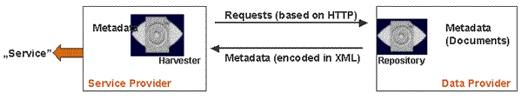
OAI-PMH: WHAT IS IT?
“…a low-barrier mechanism for repository interoperability. Data Providers are repositories that expose structured metadata via OAI-PMH. Service Providers then make OAI-PMH service requests to harvest that metadata.”
Built upon HTTP, XML, Dublin Core and other community metadata standards.

Slide 10
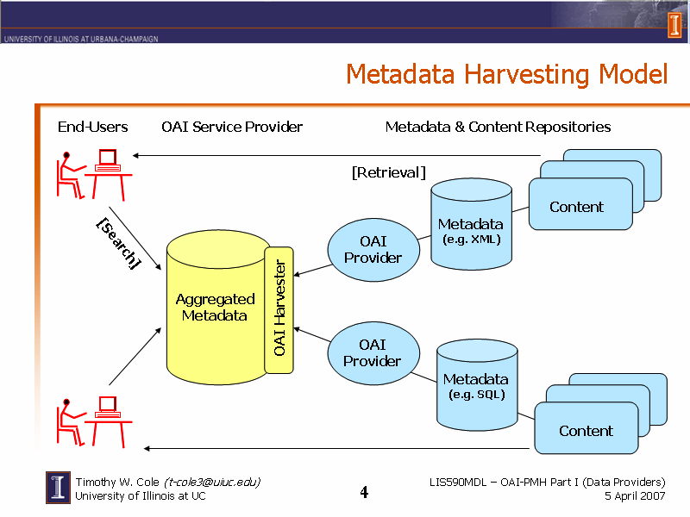
METADATA HARVESTING MODEL

Slide 11
METADATA HARVESTING MODEL
Service Provider is middleman between content providers and end-user for selected metadata transactions (resource discovery, value-added link mediation)
Transactions involving actual content still conducted directly between end-users and content providers

Slide 12





HOW OAI-PMH WORKS
OAI Verbs
  Identify
  ListMetadataFormats
  ListSets
  ListIdentifiers
  ListRecords
  GetRecord
Service
Provider
Data
Provider
HARVESTER
REPOSITORY
OAI
HTTP Request
(OAI Verb)
OAI
HTTP Response
(Valid XML)

Slide 13
WHY USE OAI-PMH?
Allows a data provider to advertise the availability of their content while retaining full control over access to that content
Implement once, provide metadata to multiple services
Performance impact is lower than standard web harvesting
Much simpler to implement than other protocols (e.g., Z39.50)
BUT…
  Less control over how your metadata is presented to end-users
  Less control over context in which your metadata appears
Question to consider: How valuable a commodity is your metadata?

Slide 14
UIUC Harvesting Experiments
People don’t follow rules well
  Records don’t all contain core fields (to the tune of about 90% in some cases)
  Changes in local practice (245$c changes from being mapped to dc:title to dc:creator)
Flat out incorrect mapping of semantics (e.g., <type>1 photographic print: b&w; 3 x 4 3/4 in.</type>, date vs. coverage)
Problems with mapping syntax (e.g., <subject> information science ; engineering, chemical</subject> instead of <subject>information science</subject><subject>engineering, chemical</subject>
Inconsistency in element content syntax (e.g., John V. Smith vs. Smith, John V., 2009-10-12 vs. Oct. 12, 2009)
Different Rules of Description in play
Different Controlled Vocabularies
Having an agreed protocol doesn’t mean you always communicate

Slide 15

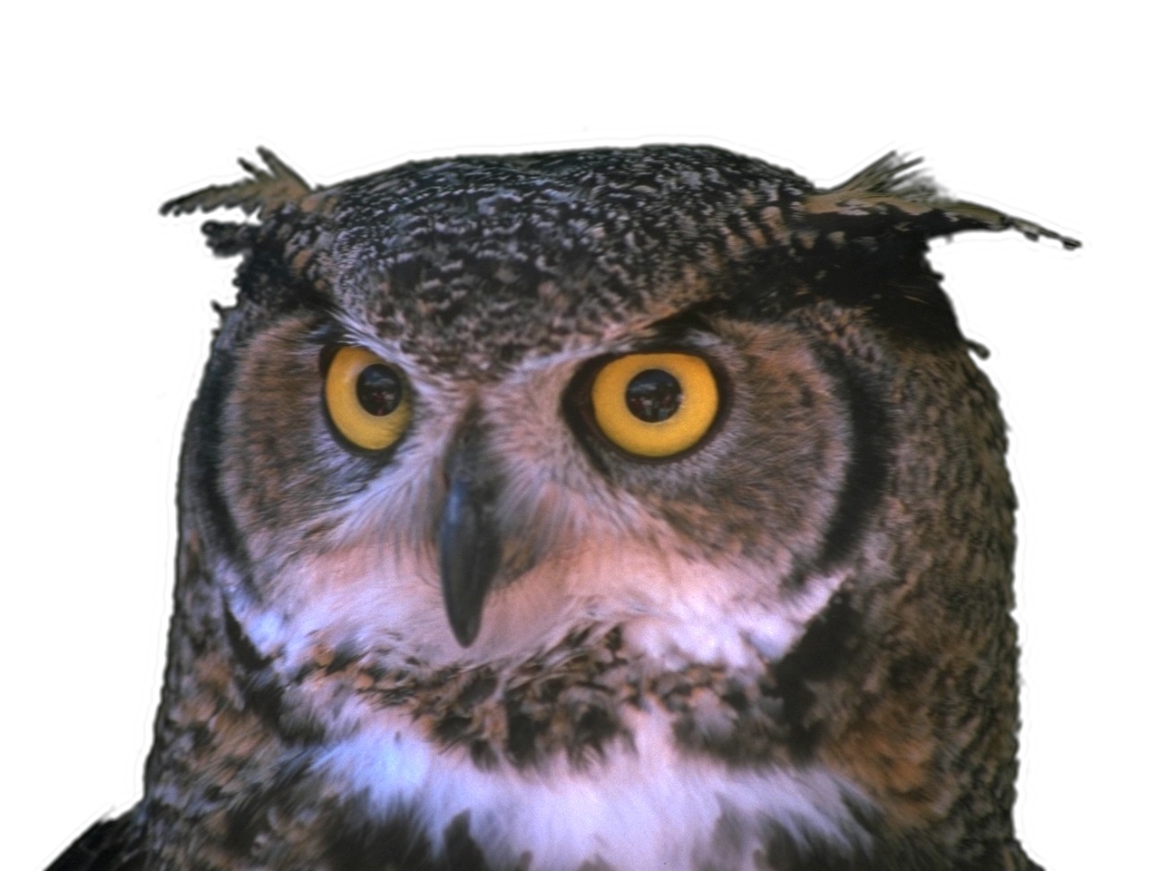

Slide 16




RDF
urn:isbn:0143039938
urn:dc:title
“The Book of Imaginary Beings”
Subject
Predicate
Object

Slide 17











RDF: Blank Nodes
urn:isbn:0143039938
urn:dc:creator
urn:vcard:
formattedName
urn:vcard:
birthday
“Jorge Luis Borges”
1899-08-24

Slide 18
RDF/XML
<?xml version="1.0" encoding="UTF-8"?>
<rdf:RDF xmlns:foaf="http://xmlns.com/foaf/0.1/"
xmlns:dc="http://purl.org/dc/elements/1.1/"
xmlns:xsd="http://www.w3.org/2001/XMLSchema-datatypes"
xmlns:rdf="http://www.w3.org/1999/02/22-rdf-syntax-ns#">
<rdf:Description rdf:about="urn:isbn:0143039938">
<dc:creator>
<foaf:Person rdf:nodeID="person1">
<foaf:name>Jorge Luis Borges</foaf:name>
<foaf:birthday>1899-08-24</foaf:birthday>
</foaf:Person>
</dc:creator>
<dc:title>The Book of Imaginary Beings</dc:title>
<dc:publisher>Penguin Classics</dc:publisher>
<dc:date>2006</dc:date>
</rdf:Description>
</rdf:RDF>

Slide 19
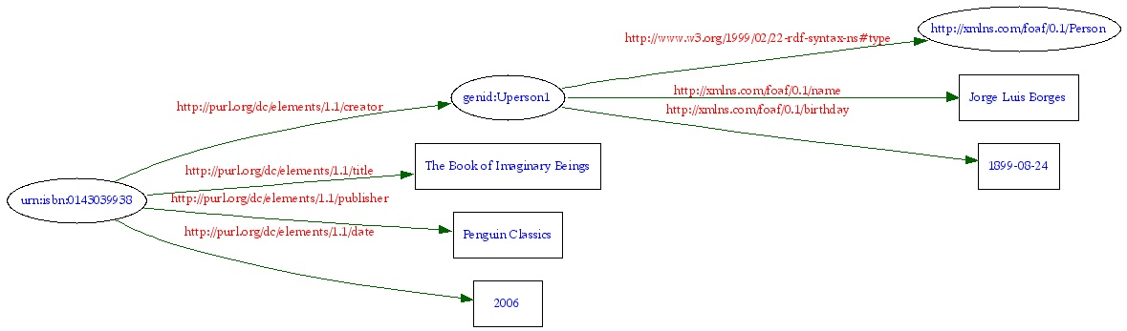
RDF Graph

Slide 20
Ontologies: What are they?
“An ontology is a set of precise descriptive statements about some part of the world (usually referred to as the domain of interest or the subject matter of the ontology). Precise descriptions satisfy several purposes: most notably, they prevent misunderstandings in human communication and they ensure that software behaves in a uniform, predictable way and works well with other software.” – OWL 2 Web Ontology Language Primer
To put it another way, ontologies are a formal representation of human knowledge about a particular field, amenable to computational analysis and application.

Slide 21
Enter the OWL
World Wide Web Consortium Recommendation
Built on top of RDF and RDFS.
Three ‘species’ of OWL:
  OWL-Lite – supports creation of a classification hierarchy and simple constraints, e.g., it allows cardinality constraints, but only values of 0 or 1
  OWL DL – Maximum expressiveness while retaining computational completeness (all conclusions are guaranteed to be computable) and decidability (all computations will finish in finite time).
  OWL Full – Maximum expressiveness and syntactic freedom of RDF, with no computational guarantees.

Slide 22





Components of OWL
Classes
Properties
Individuals
Wine
Zinfandel
* Grandpere
hasMaker
* Cotturi Zinfandel
Winery
locatedIn
Region
* Elyse
* Renwood
locatedIn
* Amador County
hasMaker
* Cotturi
* Sonoma

Slide 23


