Slide 1
Case Studies of Data Curation in Academic Libraries
Day 1

Slide 2
Agenda
What is case study research in data curation?
Tools and frameworks
Examples:
Johns Hopkins University
Data Conservancy
Penn State University
Scholar Sphere
Discussion sections

Slide 3
Case studies for data curation
Pros
Quick overview
Cons

Slide 4
Frameworks for Case Study
Institution and Organizational level
Formal
Social Science Case studies (Yin, 2014
Informal
‘Landscape studies’ (Akers et al, 2014)
Unit / department / individual level:
Data Curation profiles (in laboratory)

Slide 5
Case Study research
Following elements:
1. A study's questions
2. Propositions
3. Unit(s) of analysis
4. Logic linking the data to the propositions
5. Criteria for interpreting the findings
(Yin, 2003).

Slide 6
Validity
Internal Validity Is largely applicable to causal explanations, and requires intensive pattern matching, repeated findings across cases, building a logic model, and addressing rival explanations in answering a set of propositions.
External Validity Concerns the generalizability of the findings, and the extent to which they are representative of a phenomenon in different contexts. In single cases, external validity is addressed through the use of theory, and comparing or contrasting the support of that theory with the explanations produced from a case study.

Slide 7

Data Conservancy
Cost Recovery Model

Slide 8


Slide 9

Scholar Sphere :
Hydra (repository development) : http://projecthydra.org/

Slide 10
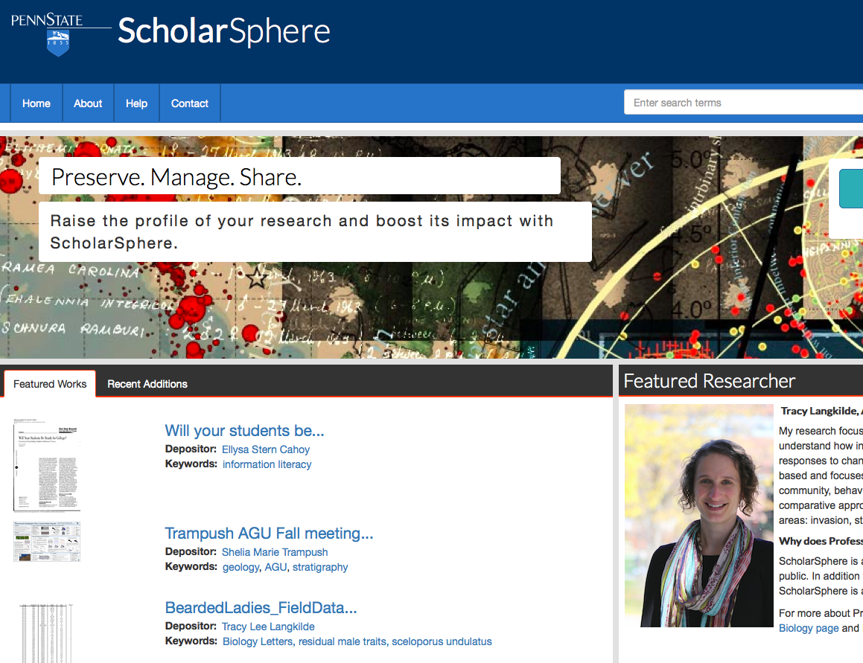

Slide 11
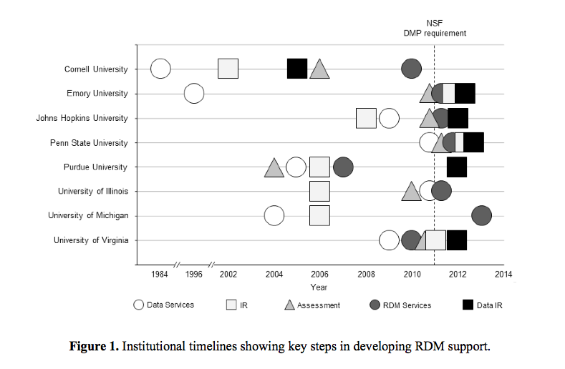
From Akers et al 2014 : http://www.ijdc.net/index.php/ijdc/article/viewFile/9.2.171/376
Notes:
DATA IR – ARE RELATIVELY NEW ....

Slide 12
Activity
In five small groups:
Look at one of the academic libraries in Akers et al 2014 (links are in books, page X)
Use links / web to answer questions listed in book…
In 20 minutes we will report back

Slide 13
Report back
Choose one person to record notes
Chose two people to report back to larger group
Answer questions from book
Tell us what is helpful, and what more would you like to know...

