Slide 1

Lab: Data markup, cleaning and transformation with Open Refine

Slide 2
Cleaning data
Data changes throughout its lifecycle
Different users have different needs
Different repositories have different formats
Data needs to be normalized, or cleaned for integration, publication and sharing
Excel is no good for this!
Notes:
Say what normalized is
Talk about how normal it is to get data in Excel – and encourage them to work with excel – and think of this as something you can teach your clients

Slide 3
Open Refine
A powerful tool for manipulating and cleaning data
Looks like a spreadsheet (Excel), acts like a database
Great, free, open tool for data curation!

Slide 4
In this lab
We’ll learn:
The basics of Open Refine
Creating a project, basic faceting and normalization
Reconciliation
Introduction to linking to linked data
Publishing XML metadata with Refine

Slide 5
I. Open Refine Basics
Creating a New Project
Basic Normalization
Faceting and Clustering
Records vs. Rows
Advanced Transformations
Notes:
-- Note that it runs on desktop but opens in browser.
-- Demonstrate how to create a new project; how to do basic normalization; how to facet and cluster
-- Hands on exercise for 15 minutes (if there are advanced users, start a break-out discussion group)

Slide 6
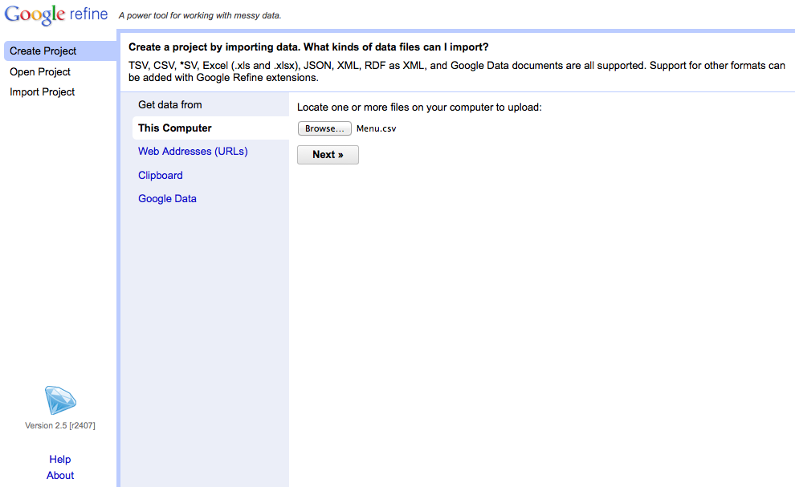
Creating a Project
Notes:
-- Choose create project (notice that you can also open projects you’ve worked on previously or import projects. The import feature is especially useful for collaboration)
-- Upload “Menu.csv”. Caveat: the other files are very large. It’s possible to allocate additional memory to Open Refine when working with large datasets, but not for the purposes of this demo. If this is important to you, we can discuss it during the hands-on session.

Slide 7
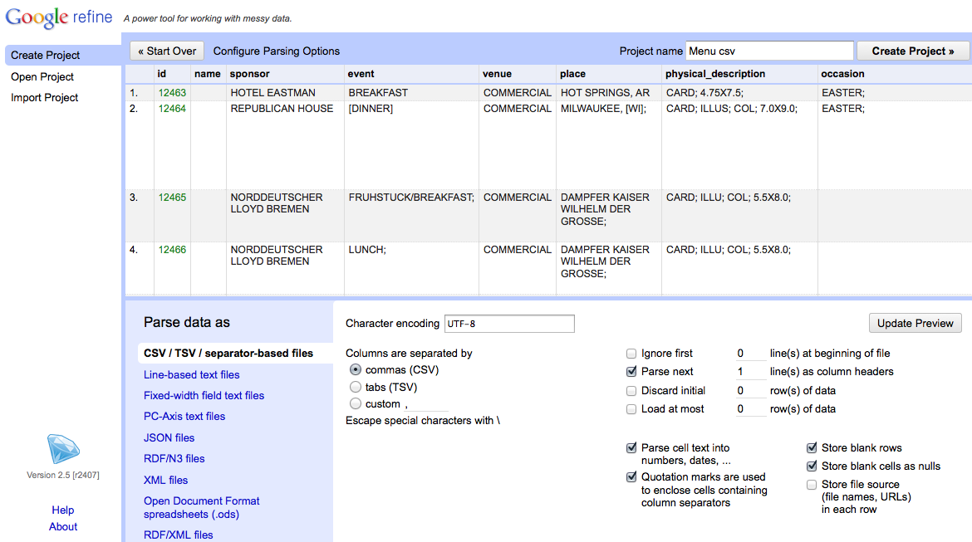
Creating a Project
Notes:
-- Use the preview window to review the data
-- Notice the parse options
-- for this data set, be sure that character encoding is UTF-8, Columns are set as CSV, and first line is parsed as a header
-- note quotation marks option. In this case, we have it checked, but it you use quotations in your data set for other purposes it may cause parsing issues
-- When you selected among options, click “update preview”, review again, and if all looks well, choose a project name and click “create project”

Slide 8
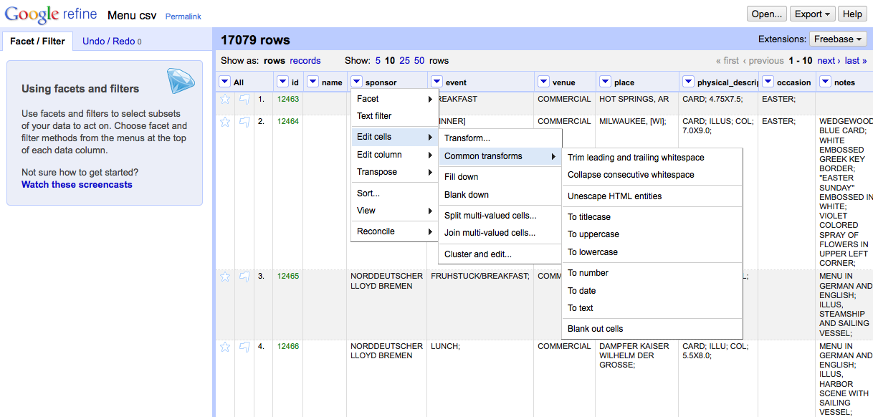
Basic Normalization
Notes:
-- click the arrow to the left of sponsor for a drop-down menu (notice the option your menu options)
-- choose edit cells
-- choose common transforms
-- start by trimming whitespace (you’ll notice that 14 cells were effected)
-- collapsing whitespace effects another 126 cells. Computers are better than humans at detecting white space.
-- also play with uniformly setting the cases

Slide 9
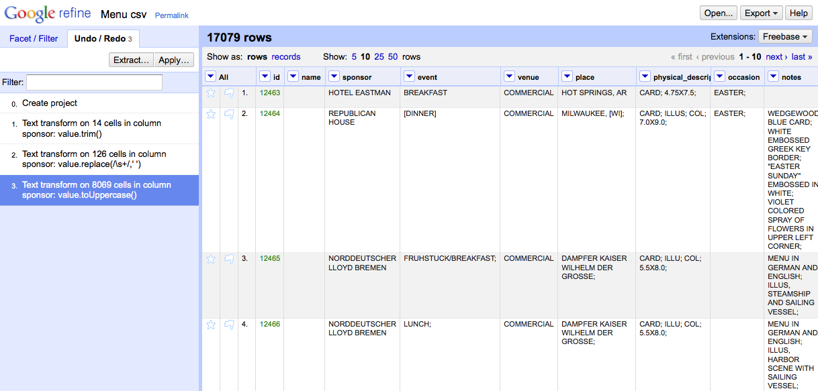
Tracking Project History
Don’t be afraid to make mistakes!
…you can always use the Undo/Redo tab to navigate to earlier stages in your project.
Notes:
Caveat: if you choose to navigate backward in your project history, you won’t be able to access any steps you’d taken after that point once you’ve made another change.

Slide 10
Extract and Apply!
Don’t be afraid to make mistakes!
…you can always use the Undo/Redo tab to navigate to earlier stages in your project.
Notes:
After

Slide 11
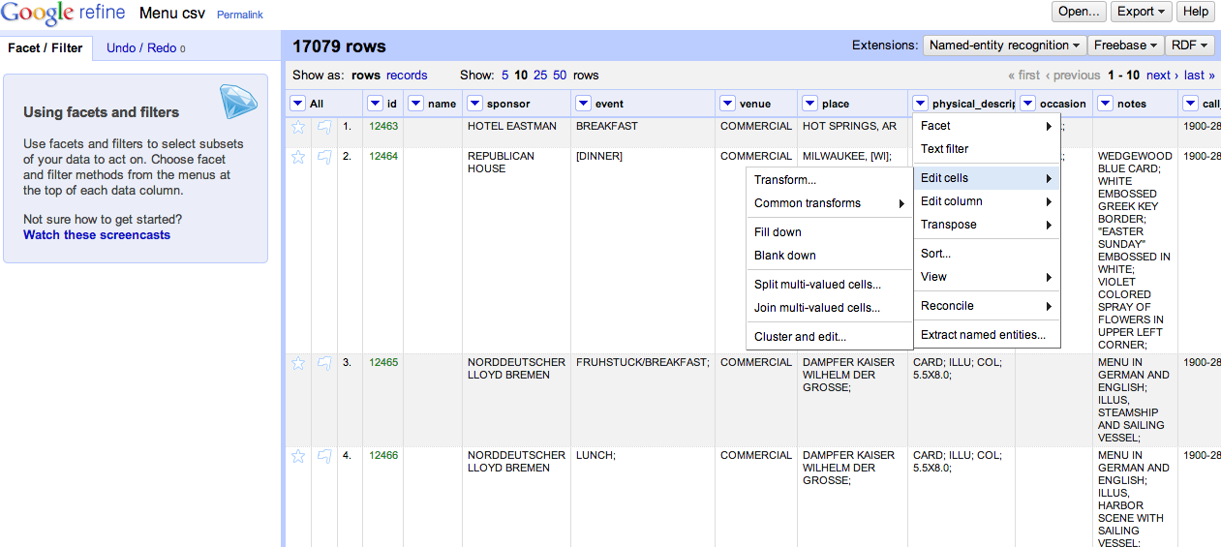
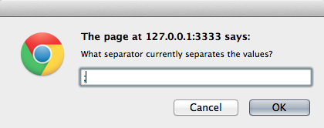
Records vs. Rows
Notes:
-- to review the different between records and rows, beginning by splitting some multi-valued cells

Slide 12
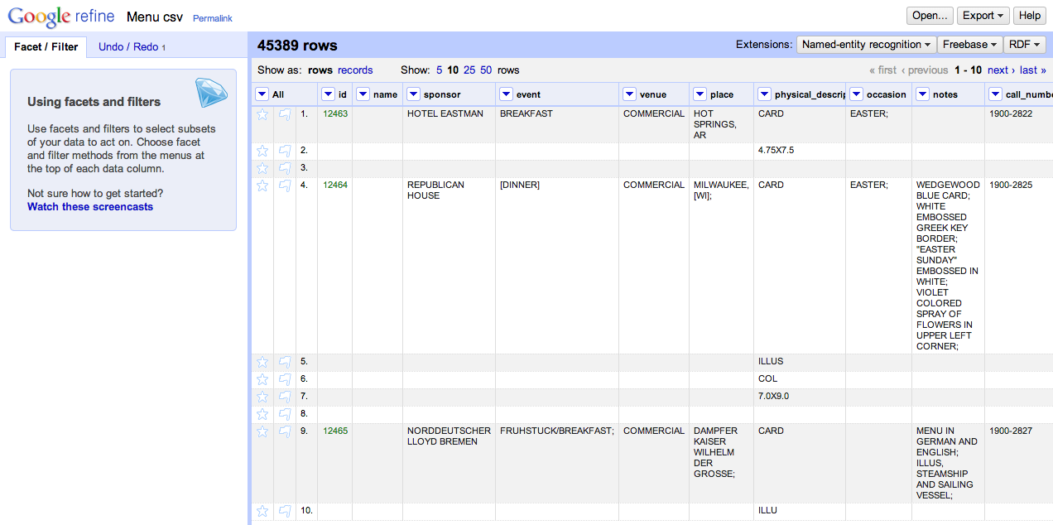
Multiple Values, Multiple Rows
Notes:
This is good if you’re only interested in specific values from the physical description, like whether or not menus are illustrated.
BUT, notice how the rest of rows 5, 6, and 7 are blank

Slide 13
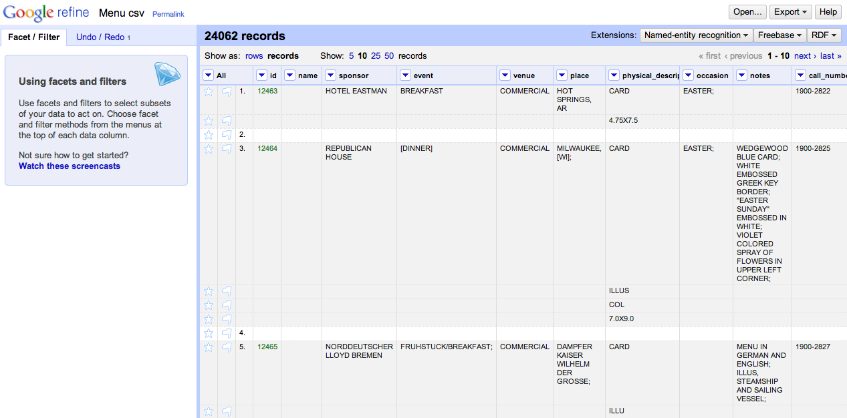
One Record, Multiple Rows
Notes:
Switching to the records view gives you the flexibility of gathering multiple rows together under the same ID.

Slide 14
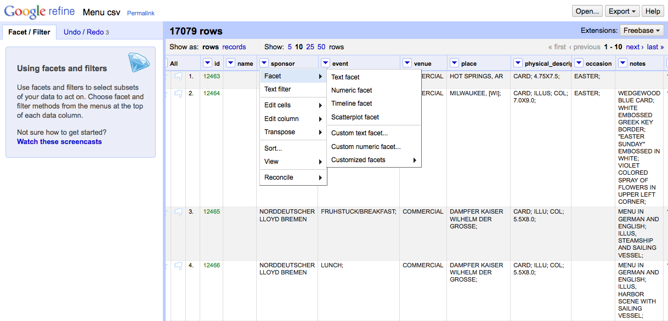
Faceting and Clustering
Notes:
-- Navigation to “Facet → Text facet”

Slide 15
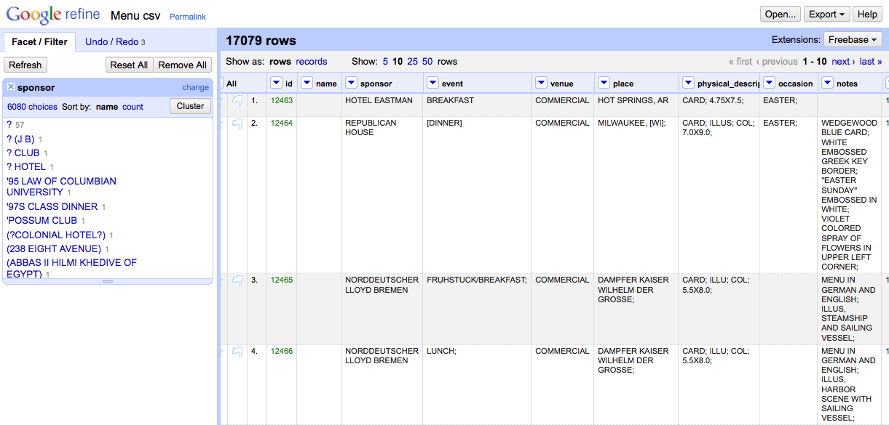
Faceting and Clustering
Notes:
-- Click “Cluster”

Slide 16
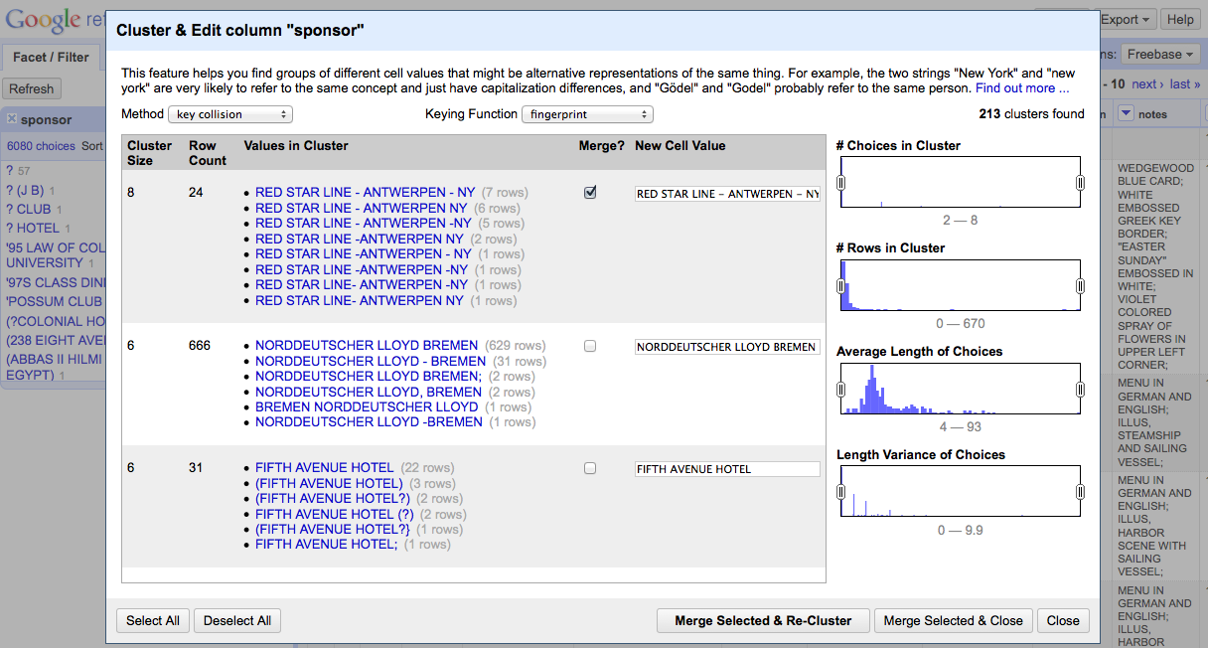
Faceting and Clustering
Notes:
-- For each cluster, review the values in the cluster, and (where needed) determine the preferred cell value.
-- Select the “Merge?” check box
-- Then select “Merge Selected and Re-Cluster”

Slide 17
Kinds of clustering
Key collision (fastest, safest)
Fingerprint, Ngram Fingerprint = defaults
Match normalized strings in different ways
Metaphone = english pronunciation
Nearest Neighbor
PPM = Partial matching
Levenshtein = edit distance

Slide 18
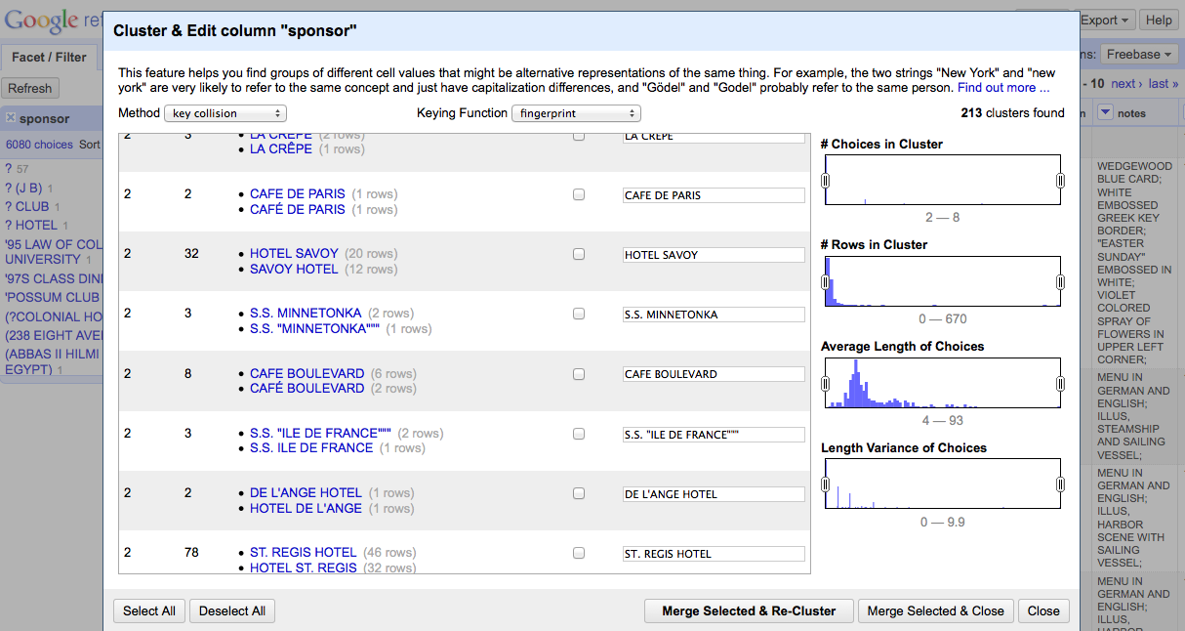
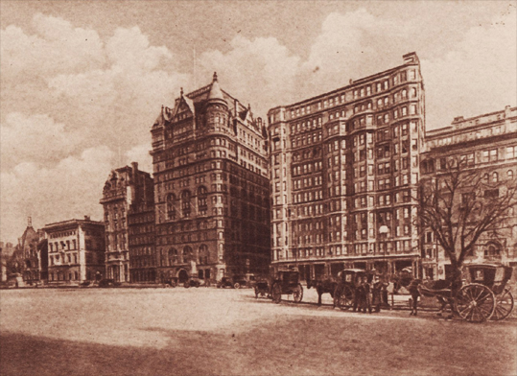
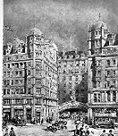
Check your clusters!
Hotel Savoy
59th St. & 5th Ave.
New York, New York
Savoy Hotel
Strand
London WC2R 0EU
United Kingdom
Notes:
Just because their names are similar doesn’t mean they’re the same!
-- Today the Hotel Savoy is an Apple Store. The Savoy Hotel is still in operation.

Slide 19
Activity: Explore Open Refine
Using the NYPL dataset, try clustering and cleaning your data
What transformations need to be made?
What clustering methods work best?

Slide 20
Activity: Explore Open Refine
Try extracting your operations

Slide 21
II. Reconciliation
For this example, we’ll use the “biodiversity.txt” dataset
Load “biodiversity.txt” into Open Refine

Slide 22
First, clean the data

Slide 23
Name Reconciliation

Slide 24
Georeferencing

Slide 25
III. Open Refine for publishing XML-formatted metadata

Slide 26
Summary
Strengths:
Open source,
Much more powerful than excel (some functions easier to use)
Platform independent
Great history tracking (provenance!)
Can export commonly used functions for reuse (more provenance!)
Notes:
Don’t neglect to get to this point and slide
Think about adding some more discussion poitns

Slide 27
Summary
Weaknesses:
Can be a little unstable at times
Relies on many external services
Some methods require light programming knowledge
More advanced functions are possibly biased toward English/Western languages (unfortunately a common problem in text processing)

