Slide 1

Bill Shelton
Solutions Engineering Candidate

Slide 2
Roadmap
Collecting Metrics
Visualizing Data
Monitoring Data
Collecting APM Data
What Would You Use Datadog for?
Automatic Data Generation

Slide 3
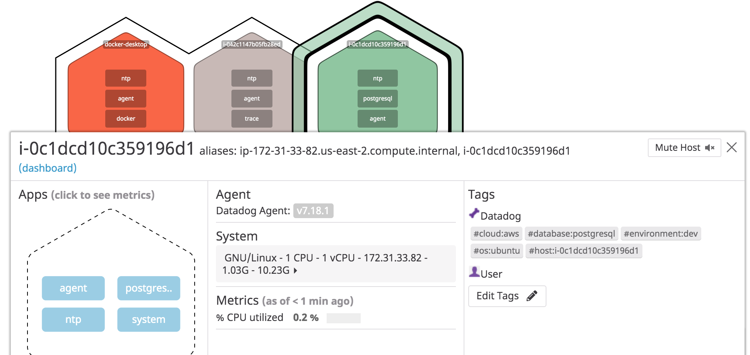
Collecting Metrics
This image shows the three hosts that I installed the Datadog agent on. I installed the agent on a Docker container, and two Ubuntu AWS images. I then added relevant tags to differentiate and sort the hosts.

Slide 4
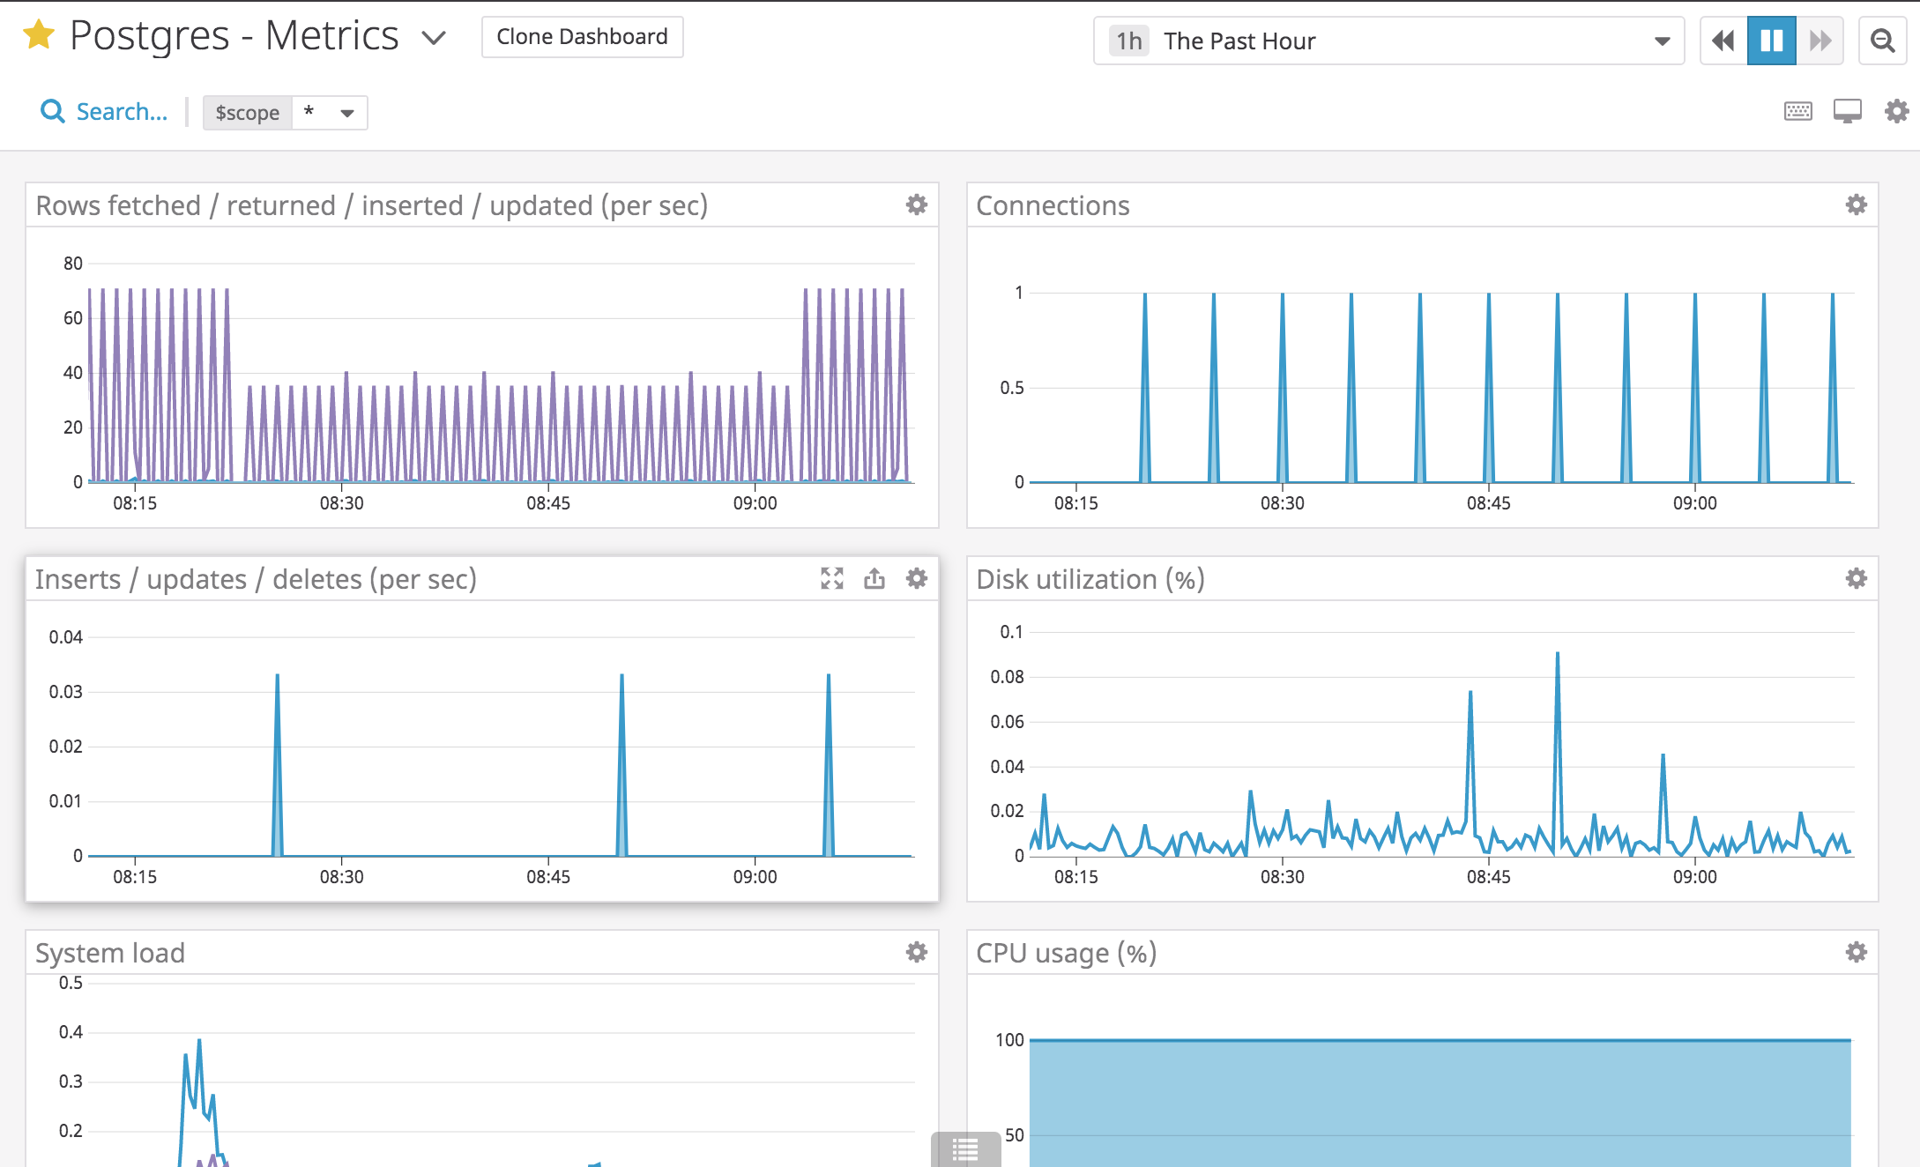
Collecting Metrics
This dashboard shows the information produced through the installation of Datadog monitoring on my Postgresql database.

Slide 5
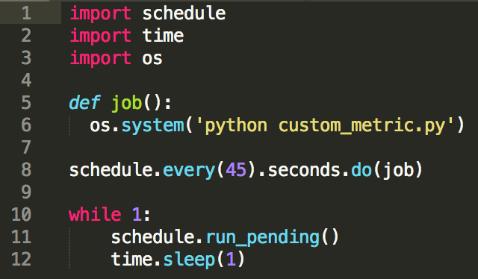
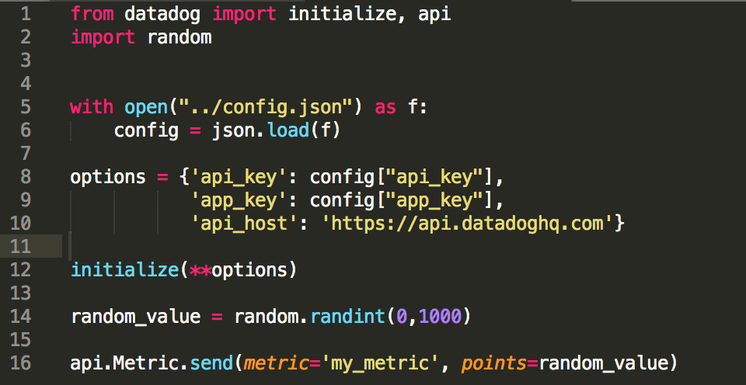
Collecting Metrics
I implemented a python script that sent a random value between 0 and 1000 via the API to Datadog.
I also developed a script that called the data generating script every 45 seconds.
interval.py
custom_metric.py

Slide 6
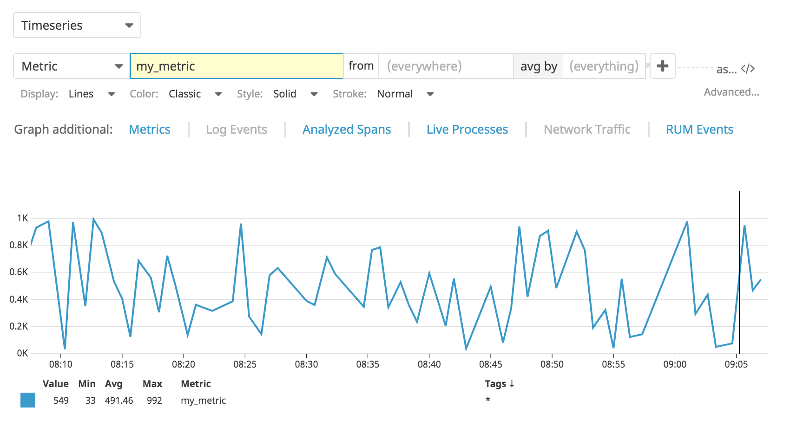
Collecting Metrics
The graph below shows the data generated by the python script.

Slide 7
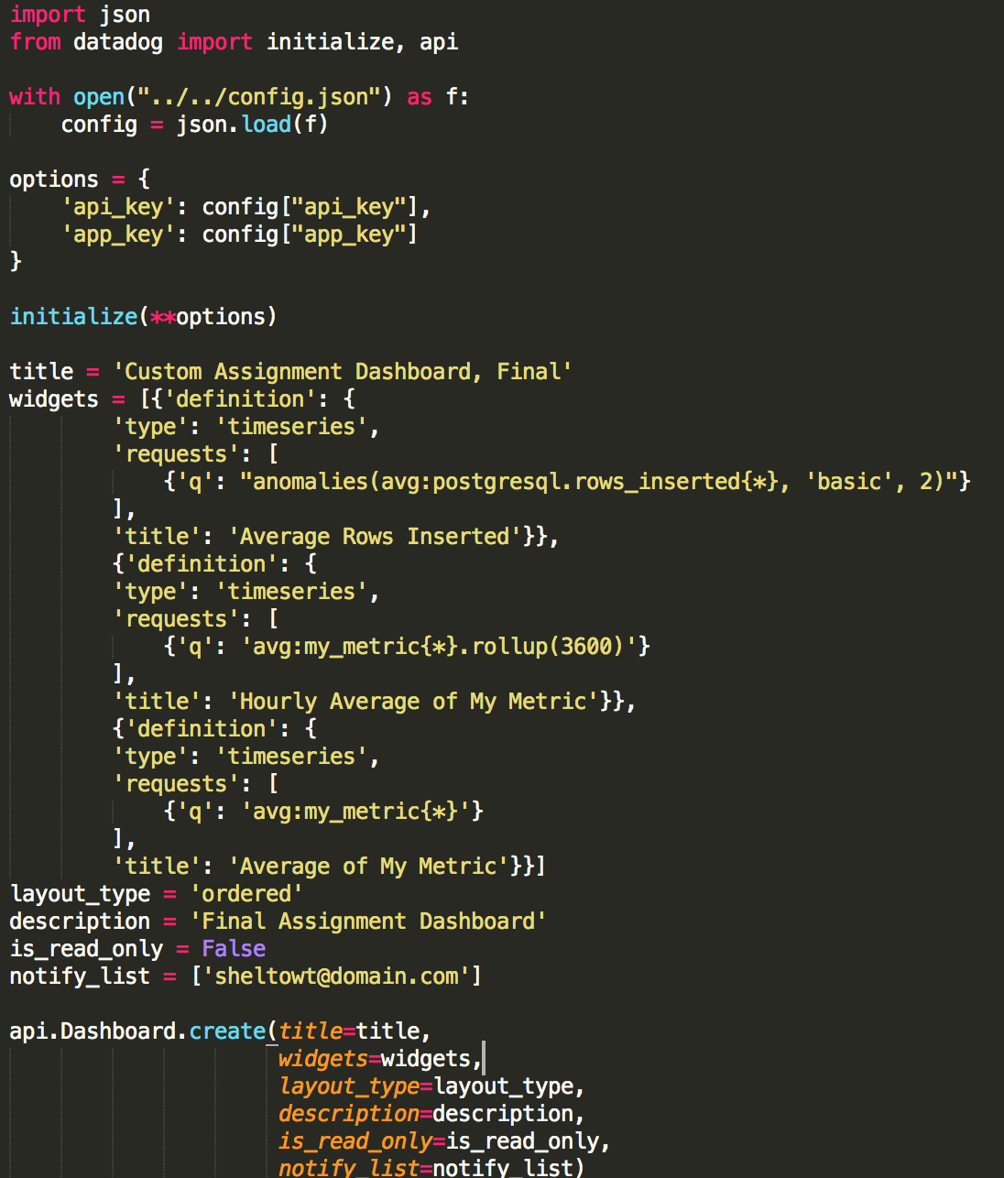
Visualizing Data
This python script generate a dashboard with a graph for the postgresql database with the anomaly function applied, my custom metric, and my custom metric with a one hour roll up.

Slide 8
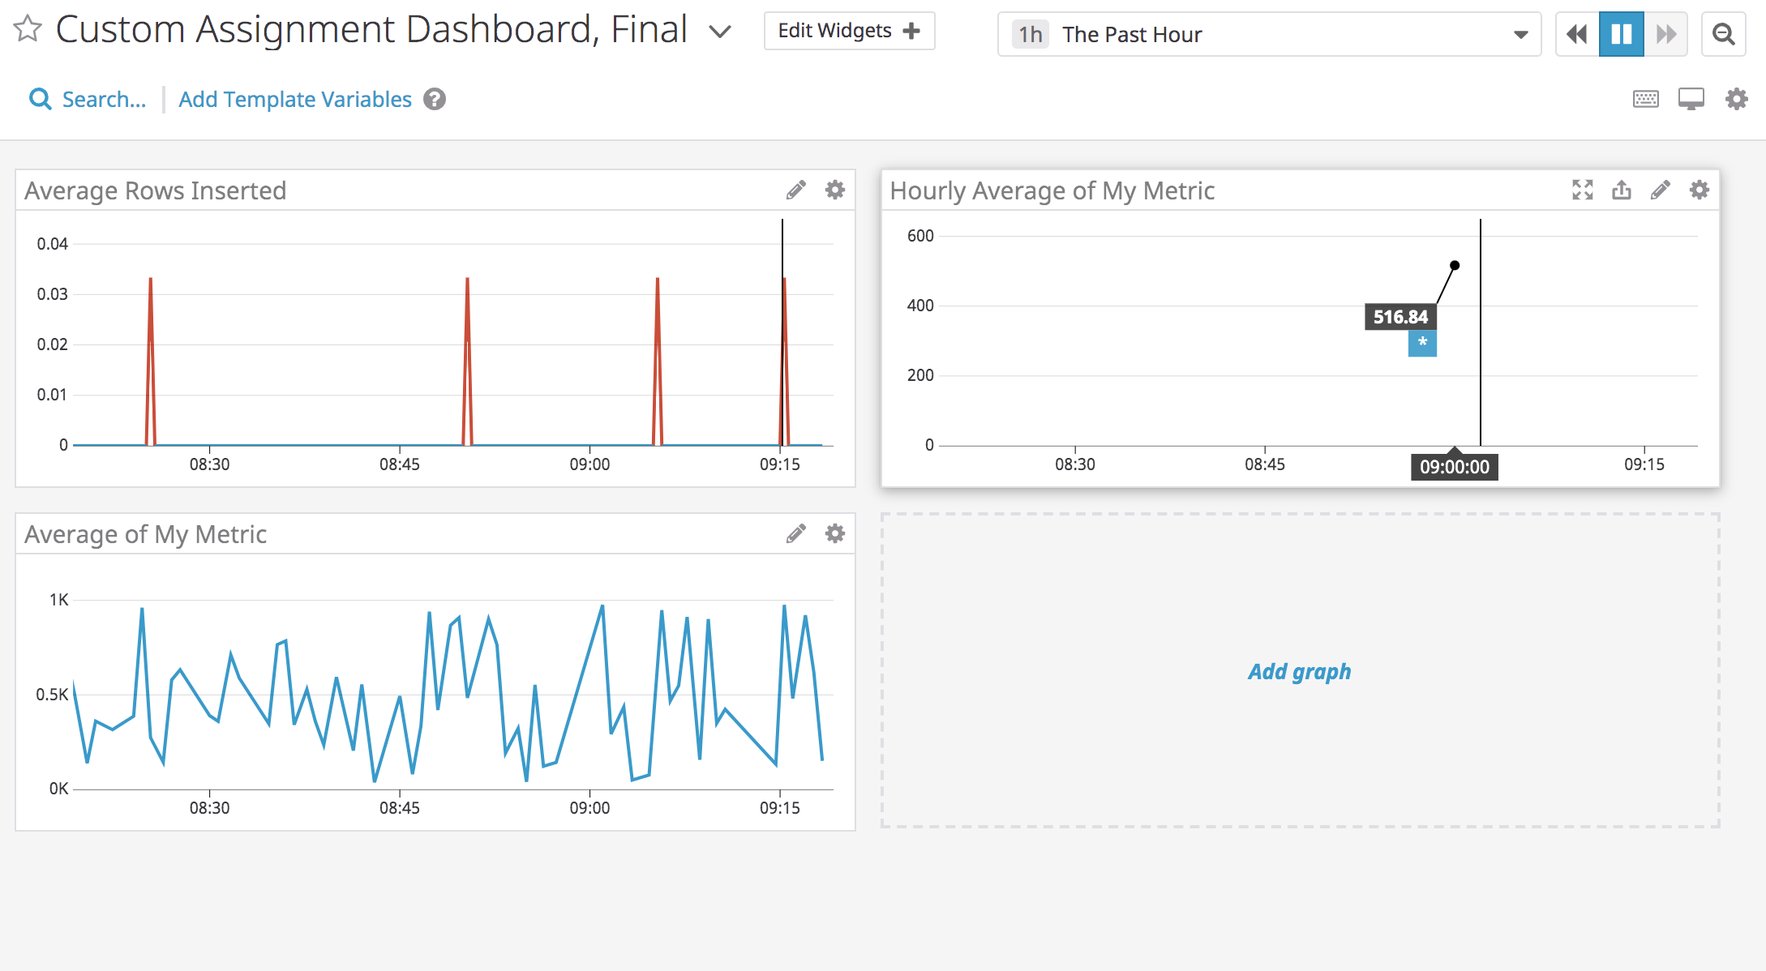
Visualizing Data
API generated custom dashboard
The anomaly graph is displaying rows inserted into the database with the basic anomaly algorithm applied and a set of two bounds. The basic algorithm uses a lagging rolling quantile computation to determine the range of expected values.

Slide 9
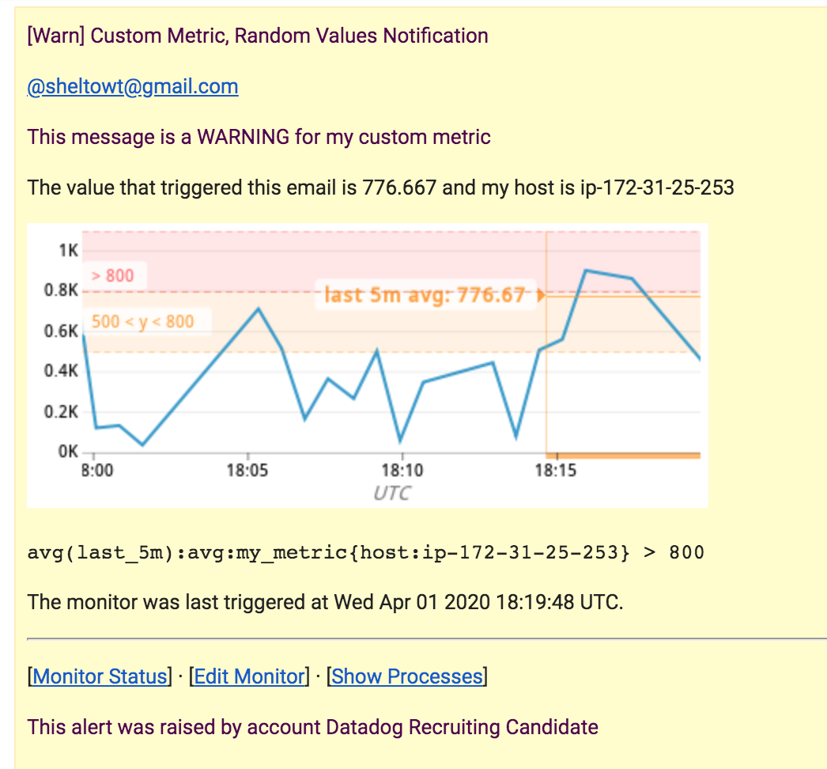
Monitoring Data
The email below was triggered because my_metric had a value over 500 for a period greater than five minutes.

Slide 10
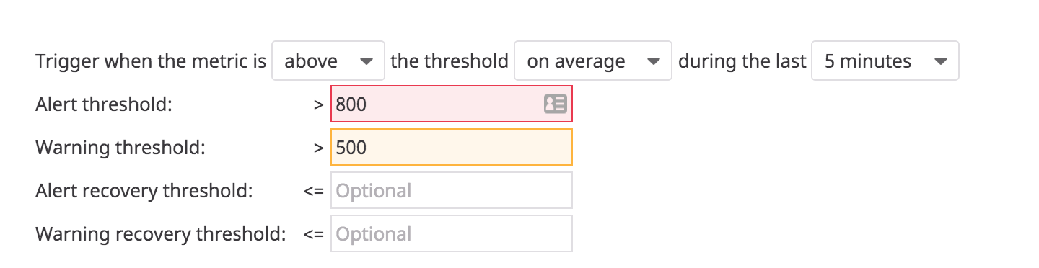
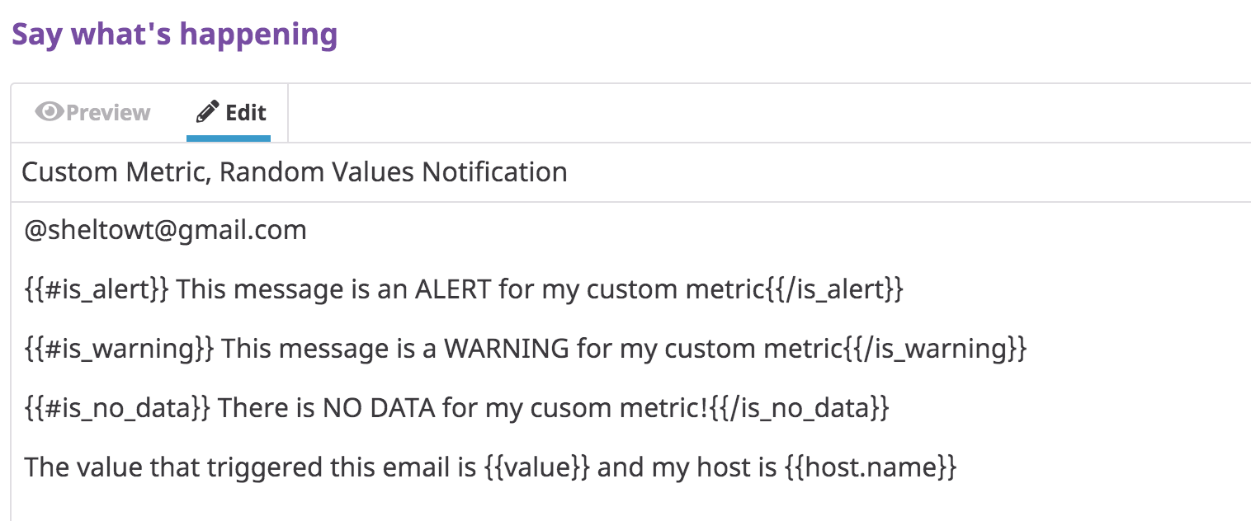
Monitoring Data
The images below show the configuration of the thresholds and email templates.

Slide 11
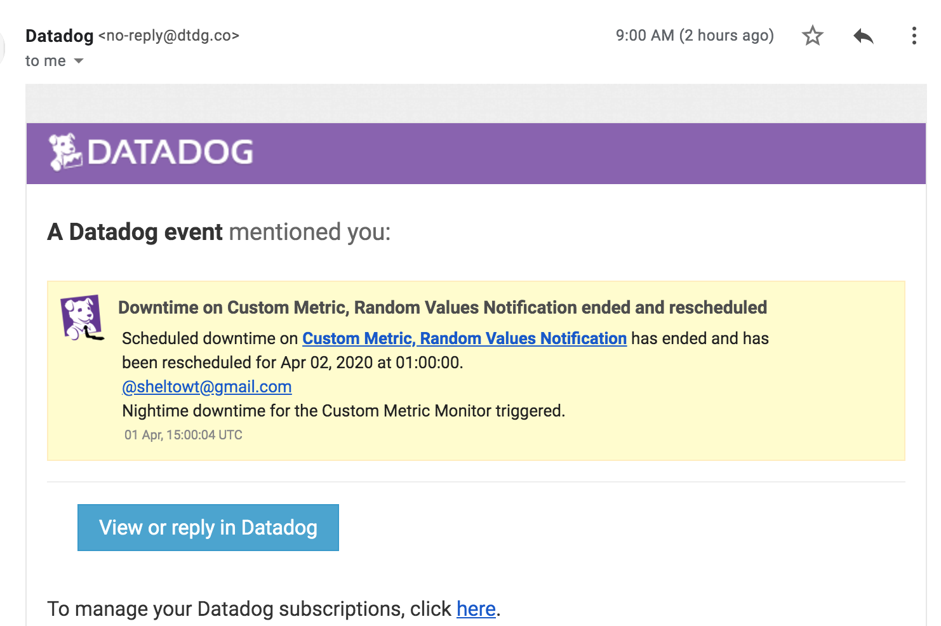
Monitoring Data
The image below shows the email triggered by scheduled downtime ending.

Slide 12
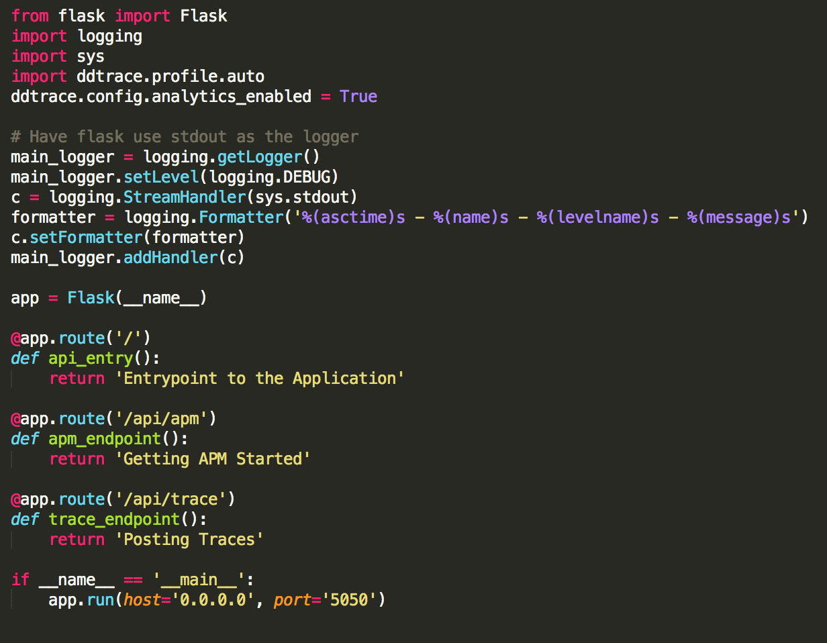
Collecting APM Data
This script instruments the APM functionality within a Flask API. I installed an Nginx server that pointed to the Flask API so I could generate dummy data both locally and automatically from another cloud server.

Slide 13
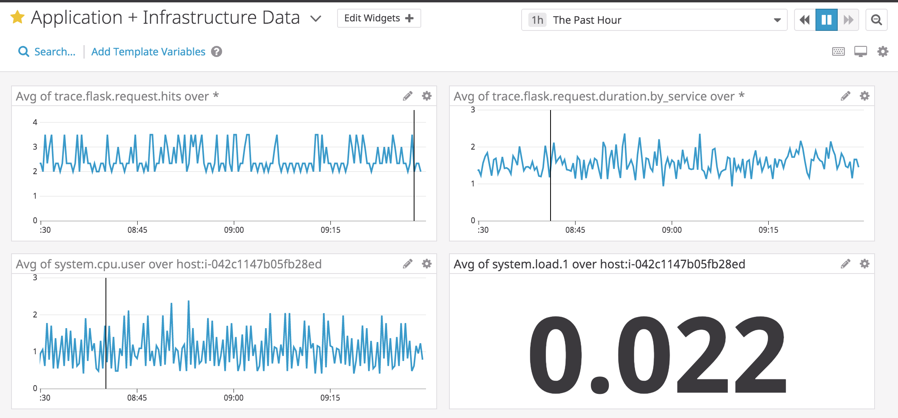
Collecting APM Data
These graphs show data generated from the Flask app in terms of requests and request duration, as well as CPU and system load information from the server running the application.
A resource supports a specific piece of data such as a user of an application. REST semantics structure a set of operations that can take place on the piece of data such as updating, creating, deleting and retrieving.
A service is a software implementation that supports a business relevant functionality, such as an authentication service.

Slide 14
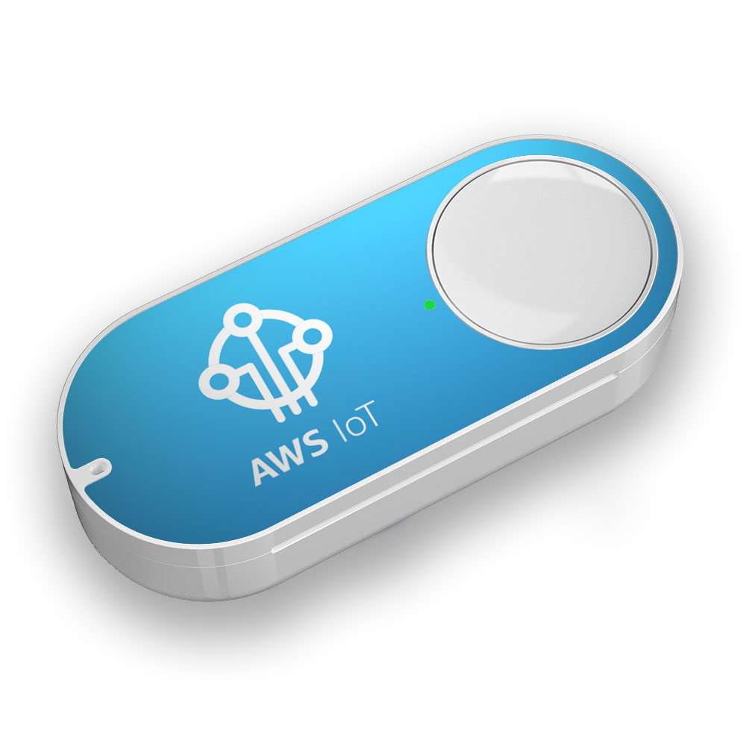
What Would You Use Datadog For?
I would place an AWS IoT button next to the sink and track the frequency with which I am washing my hands.
I would set an alert if the button was not triggered within a 3 hour time frame during the hours of 7am to 10pm. ☺

Slide 15
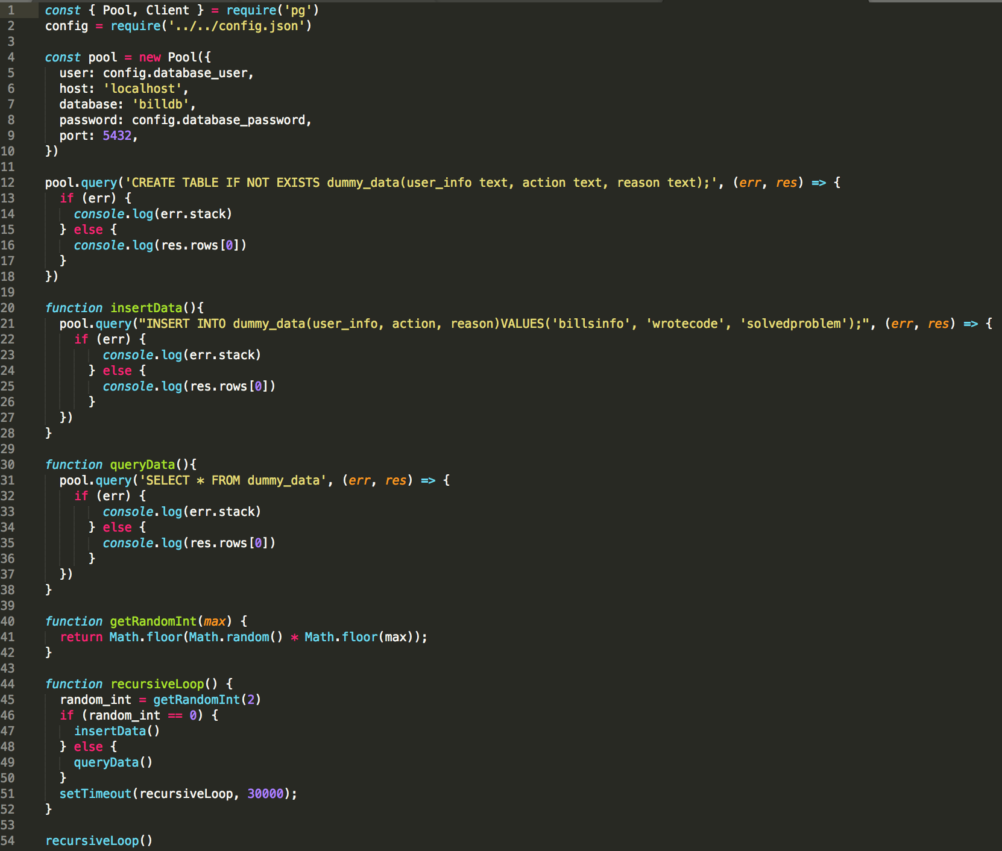
Automatic Data Generation
This script executes a recursive function that either queries or inserts data into the database.
database_activity.js

Slide 16
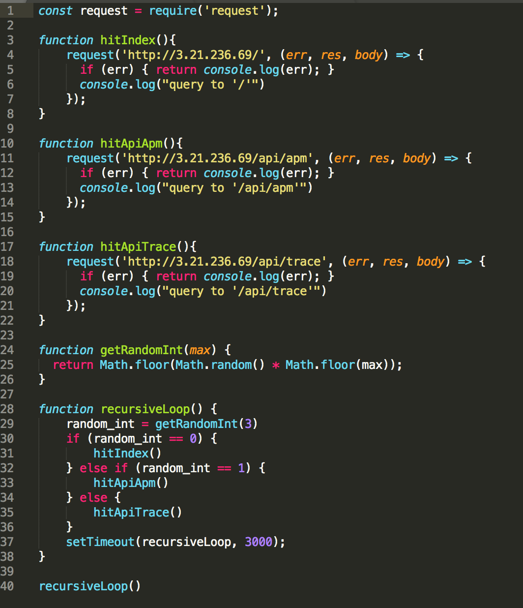
Automatic Data Generation
This script executes a recursive function that hits one of the endpoints on the application monitored with APM.
webserver_activity.js

Slide 17
GitHub Repos
https://github.com/sheltowt/hiring-engineers/tree/bill_shelton

