Slide 1

Bill Shelton
Solutions Engineering Candidate

Slide 2
Roadmap
Collecting Metrics
Visualizing Data
Monitoring Data
Collecting APM Data
What Would You Use Datadog for?

Slide 3
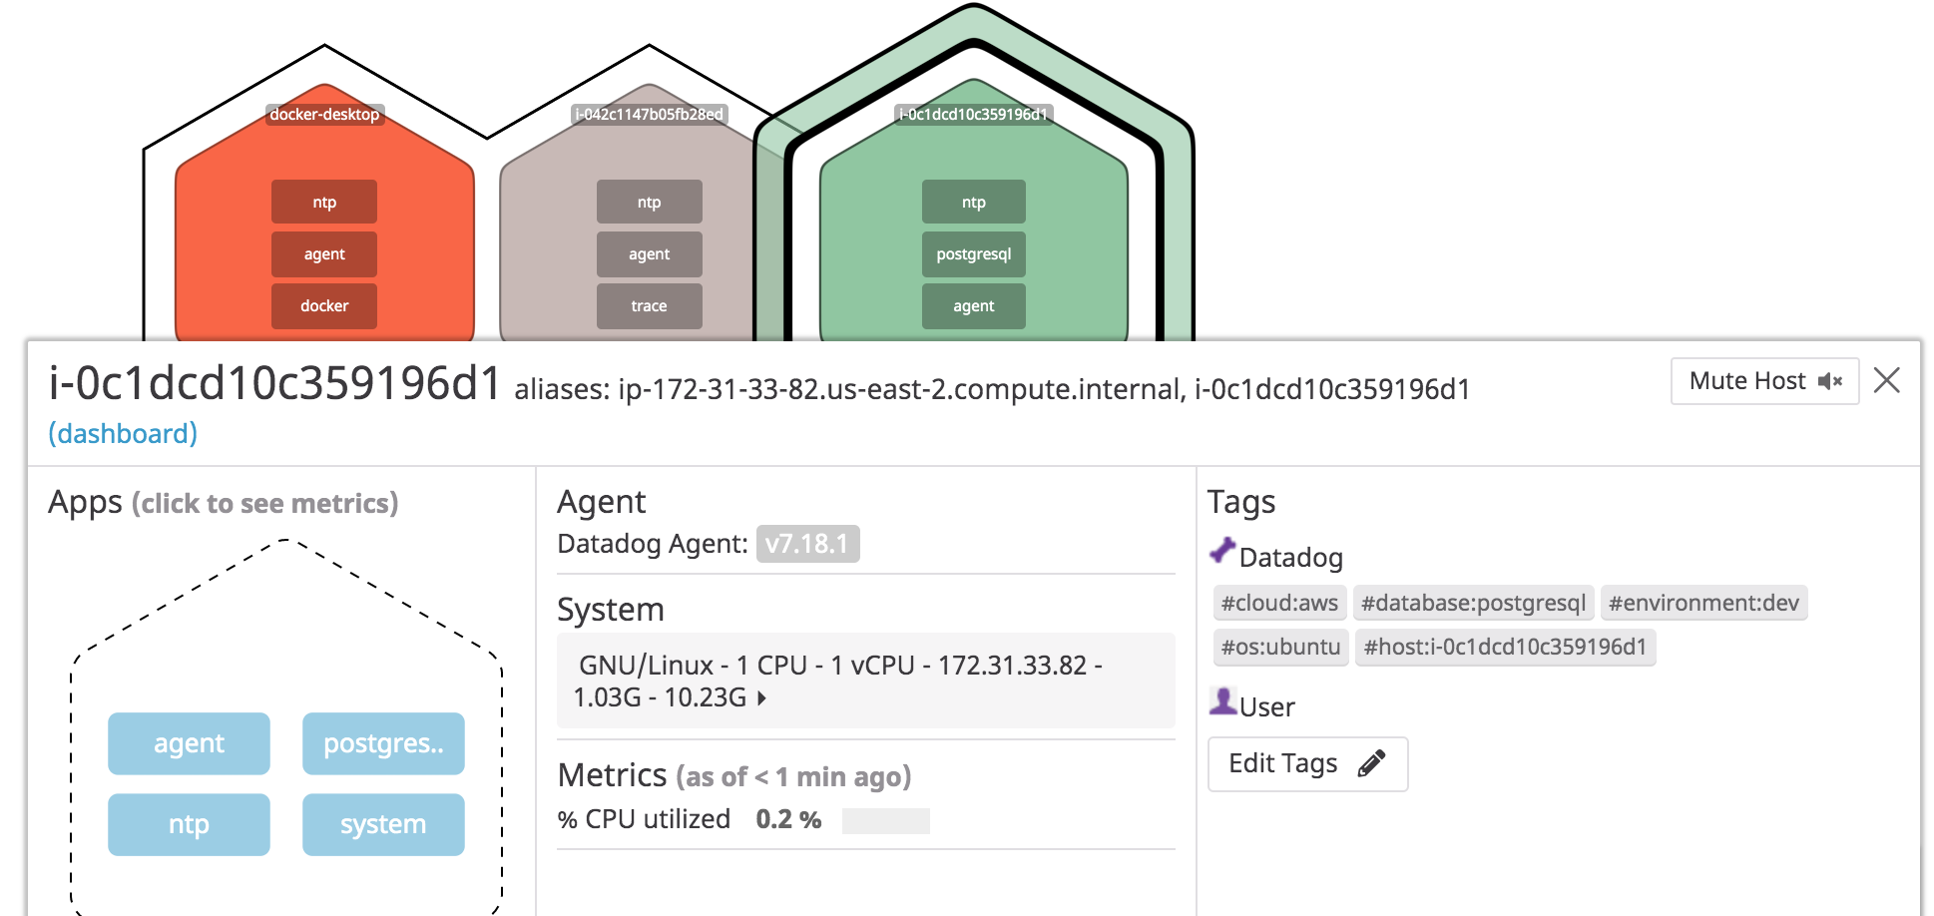
Collecting Metrics

Slide 4
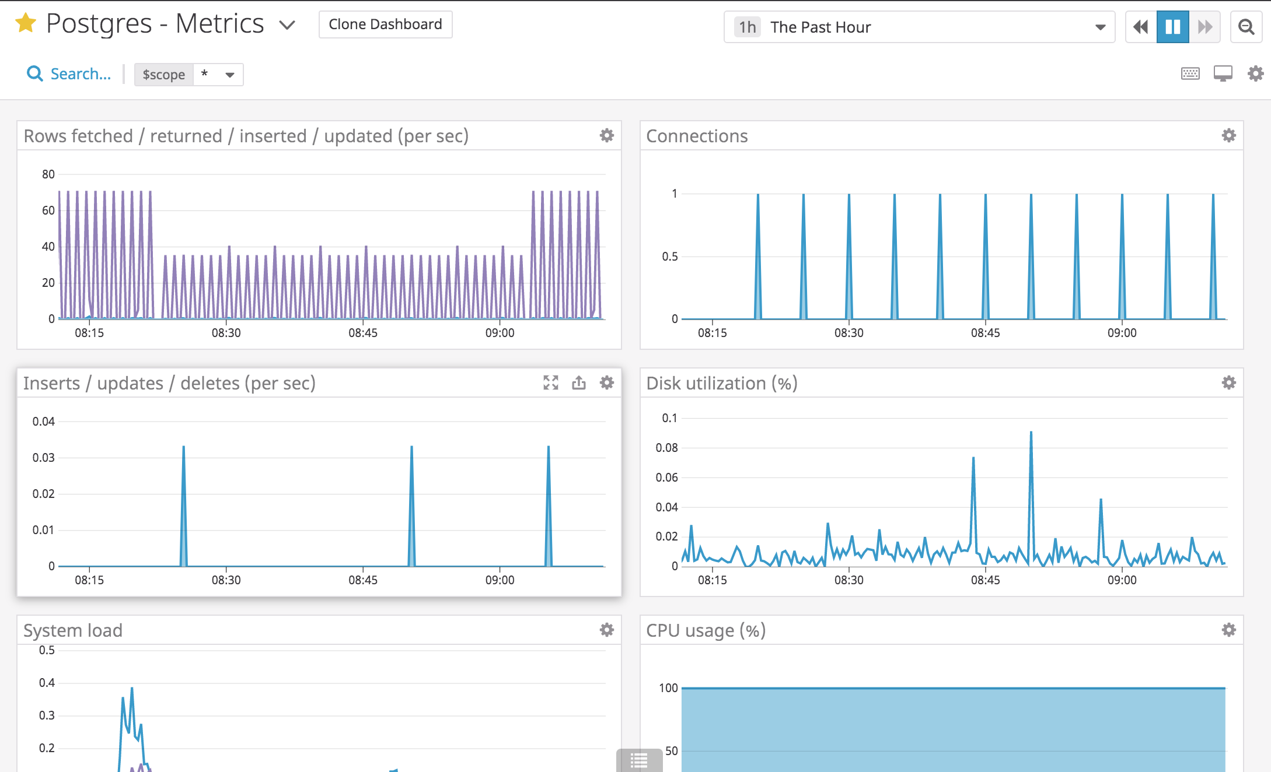
Collecting Metrics

Slide 5
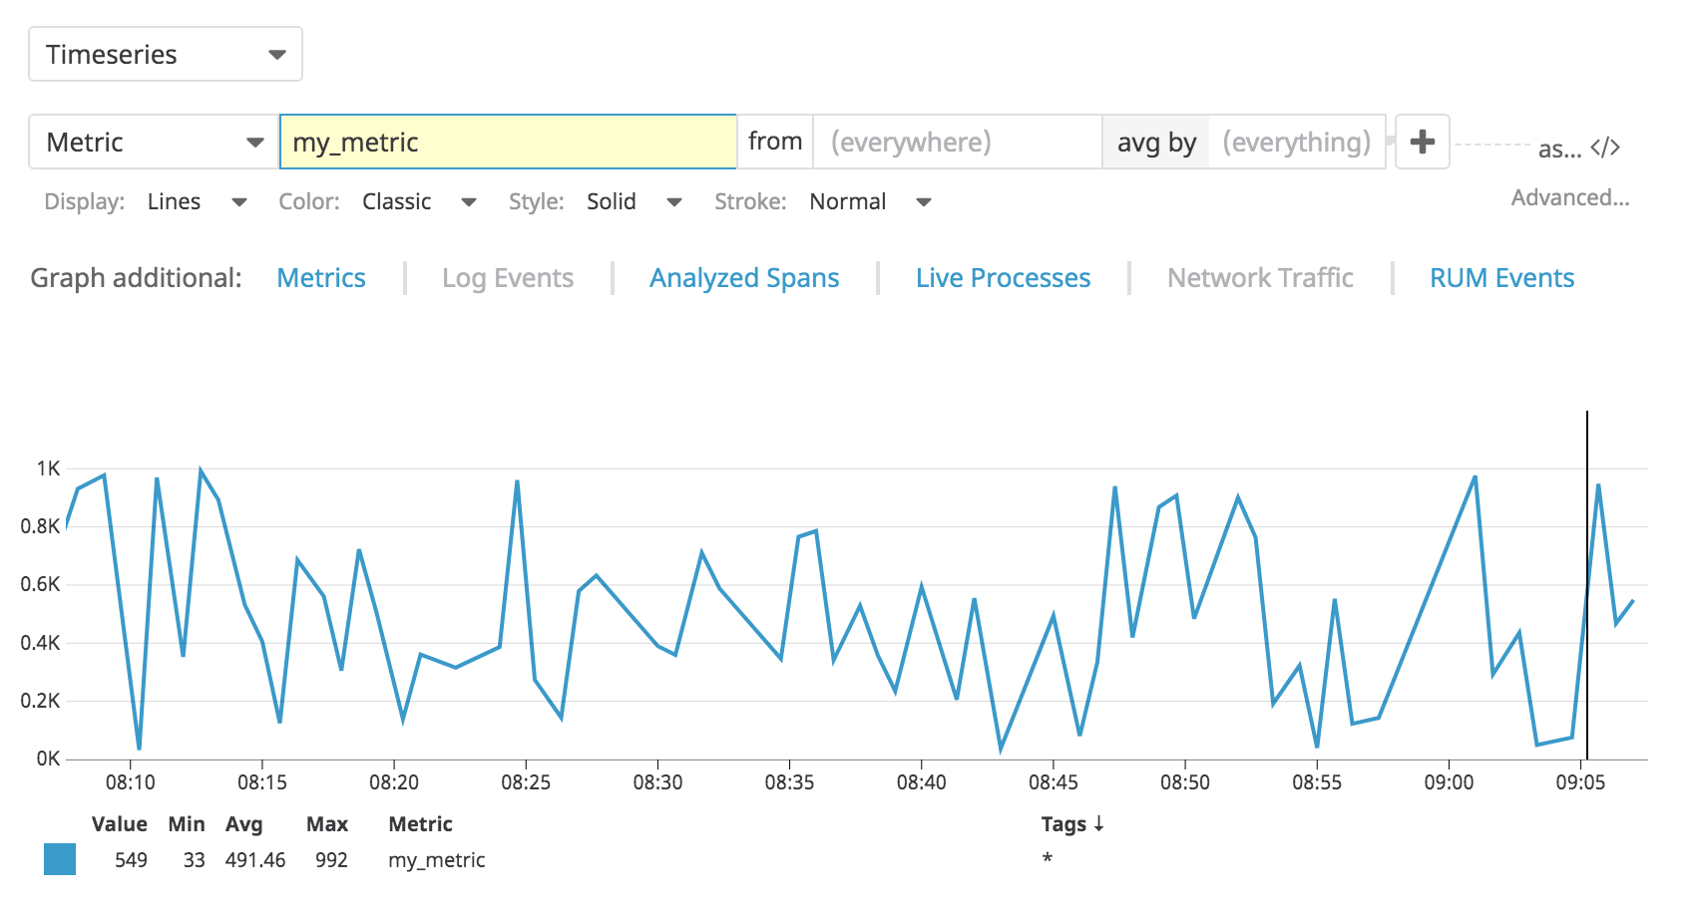
Collecting Metrics

Slide 6
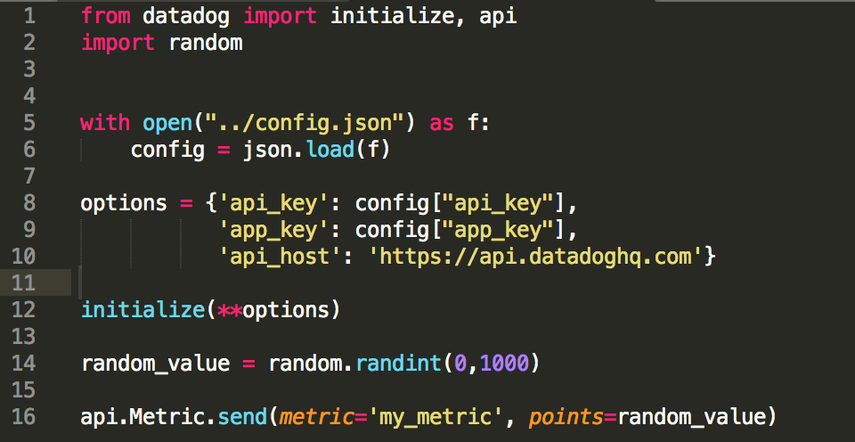
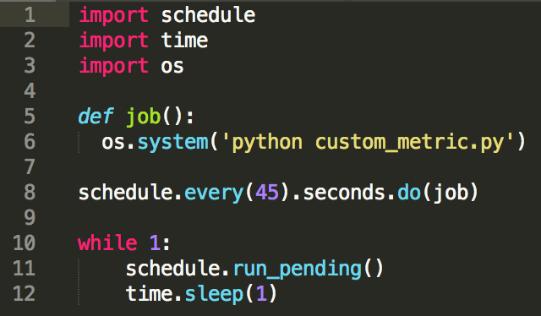
Collecting Metrics

Slide 7
Visualizing Data
Utilize the Datadog API to create a Timeboard that contains:
* Your custom metric scoped over your host.
* Any metric from the Integration on your Database with the anomaly function applied.
* Your custom metric with the rollup function applied to sum up all the points for the past hour into one bucket
Please be sure, when submitting your hiring challenge, to include the script that you've used to create this Timeboard.
Once this is created, access the Dashboard from your Dashboard List in the UI:
* Set the Timeboard's timeframe to the past 5 minutes
* Take a snapshot of this graph and use the @ notation to send it to yourself.
* **Bonus Question**: What is the Anomaly graph displaying?

Slide 8
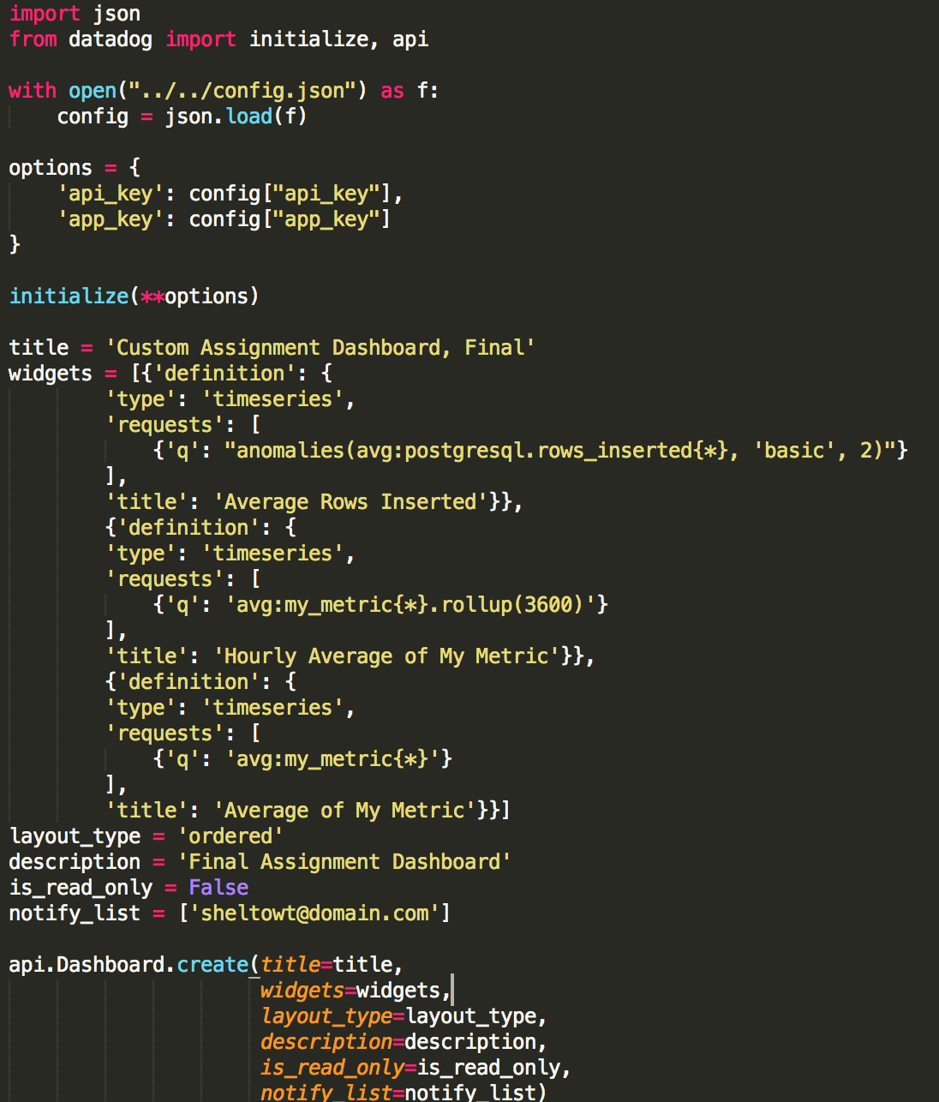
Visualizing Data

Slide 9
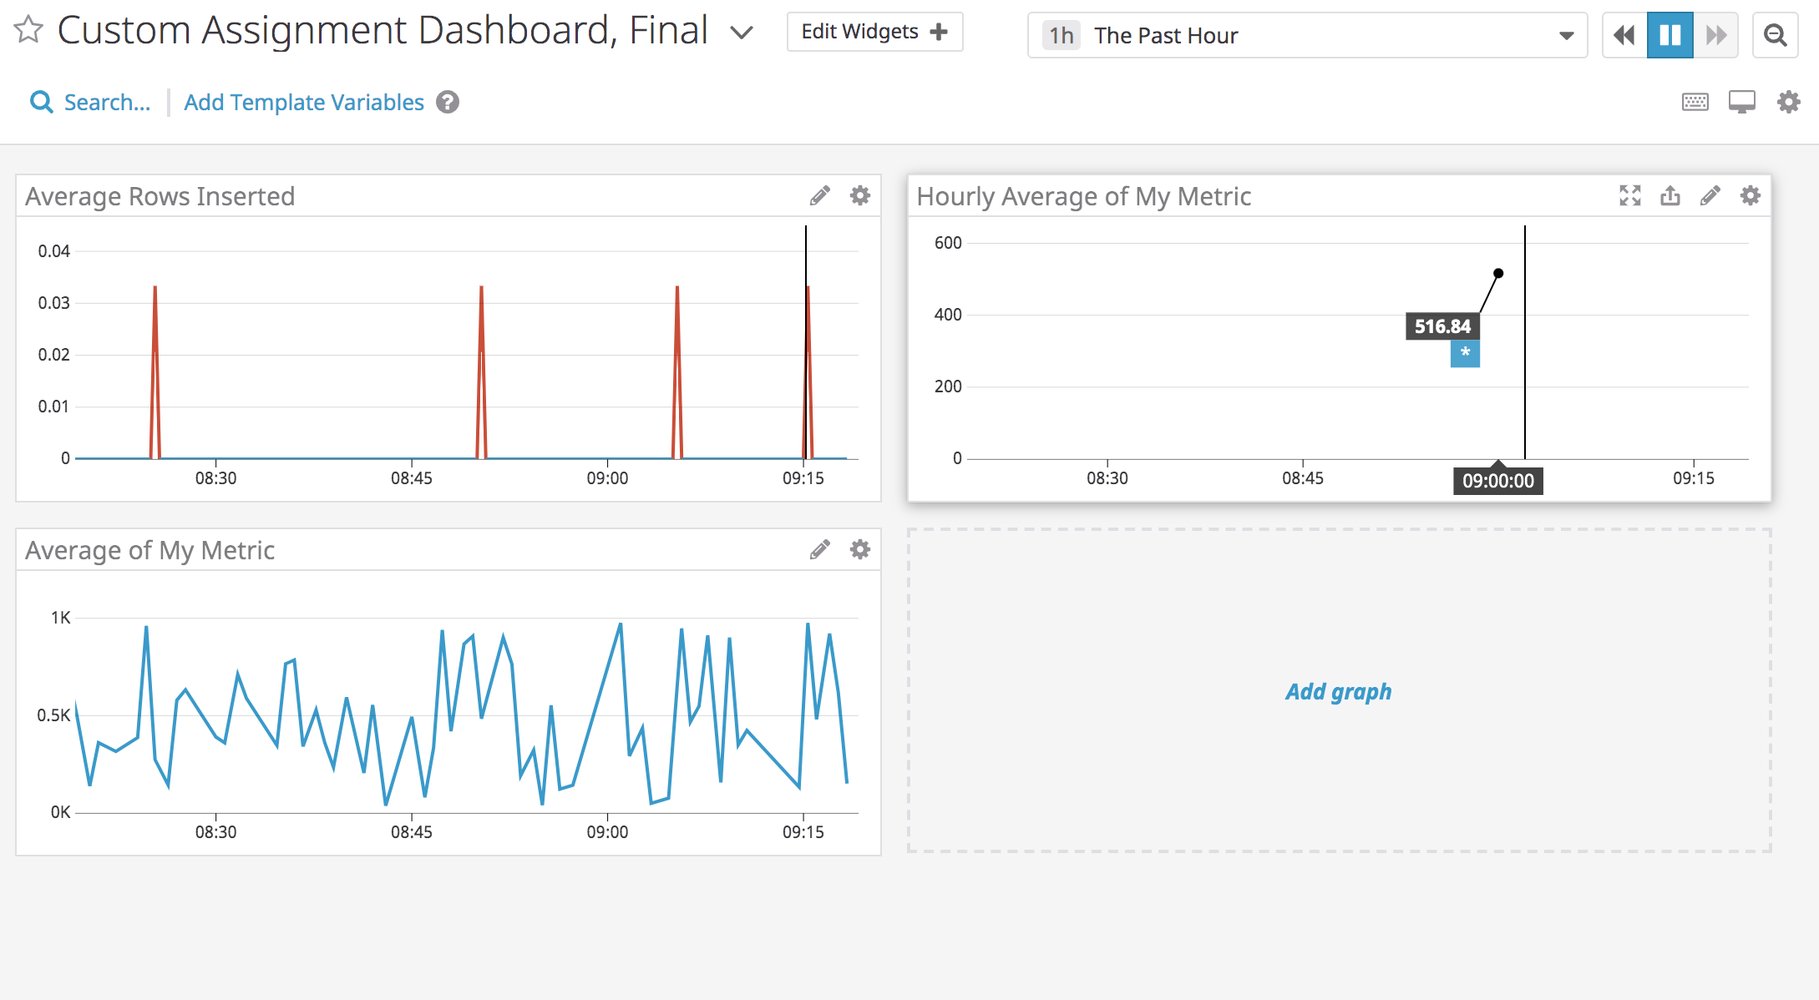
Visualizing Data
What is the anomaly graph displaying?

Slide 10
Monitoring Data
Since you’ve already caught your test metric going above 800 once, you don’t want to have to continually watch this dashboard to be alerted when it goes above 800 again. So let’s make life easier by creating a monitor.
Create a new Metric Monitor that watches the average of your custom metric (my_metric) and will alert if it’s above the following values over the past 5 minutes:
* Warning threshold of 500
* Alerting threshold of 800
And also ensure that it will notify you if there is No Data for this query over the past 10m.
Please configure the monitor’s message so that it will:
* Send you an email whenever the monitor triggers.
* Create different messages based on whether the monitor is in an Alert, Warning, or No Data state.
* Include the metric value that caused the monitor to trigger and host ip when the Monitor triggers an Alert state.
* When this monitor sends you an email notification, take a screenshot of the email that it sends you.
* **Bonus Question**: Since this monitor is going to alert pretty often, you don’t want to be alerted when you are out of the office. Set up two scheduled downtimes for this monitor:
* One that silences it from 7pm to 9am daily on M-F,
* And one that silences it all day on Sat-Sun.
* Make sure that your email is notified when you schedule the downtime and take a screenshot of that notification.

Slide 11
Monitoring Data
Since you’ve already caught your test metric going above 800 once, you don’t want to have to continually watch this dashboard to be alerted when it goes above 800 again. So let’s make life easier by creating a monitor.
Create a new Metric Monitor that watches the average of your custom metric (my_metric) and will alert if it’s above the following values over the past 5 minutes:
* Warning threshold of 500
* Alerting threshold of 800
And also ensure that it will notify you if there is No Data for this query over the past 10m.
Please configure the monitor’s message so that it will:
* Send you an email whenever the monitor triggers.
* Create different messages based on whether the monitor is in an Alert, Warning, or No Data state.
* Include the metric value that caused the monitor to trigger and host ip when the Monitor triggers an Alert state.
* When this monitor sends you an email notification, take a screenshot of the email that it sends you.
* **Bonus Question**: Since this monitor is going to alert pretty often, you don’t want to be alerted when you are out of the office. Set up two scheduled downtimes for this monitor:
* One that silences it from 7pm to 9am daily on M-F,
* And one that silences it all day on Sat-Sun.
* Make sure that your email is notified when you schedule the downtime and take a screenshot of that notification.

Slide 12
Collecting APM Data
Given the following Flask app (or any Python/Ruby/Go app of your choice) instrument this using Datadog’s APM solution:
* **Note**: Using both ddtrace-run and manually inserting the Middleware has been known to cause issues. Please only use one or the other.
* **Bonus Question**: What is the difference between a Service and a Resource?
Provide a link and a screenshot of a Dashboard with both APM and Infrastructure Metrics.
Please include your fully instrumented app in your submission, as well.

Slide 13
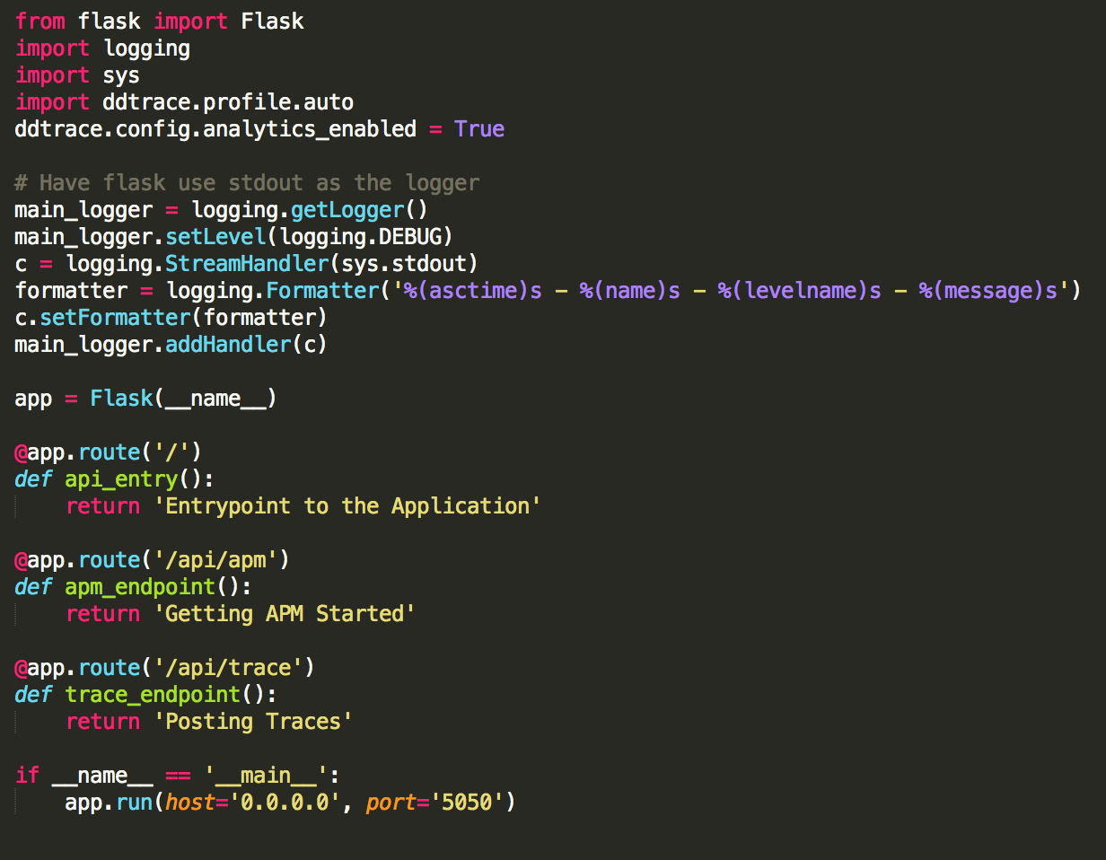
Collecting APM Data
What is the difference between a Service and a Resource?

Slide 14
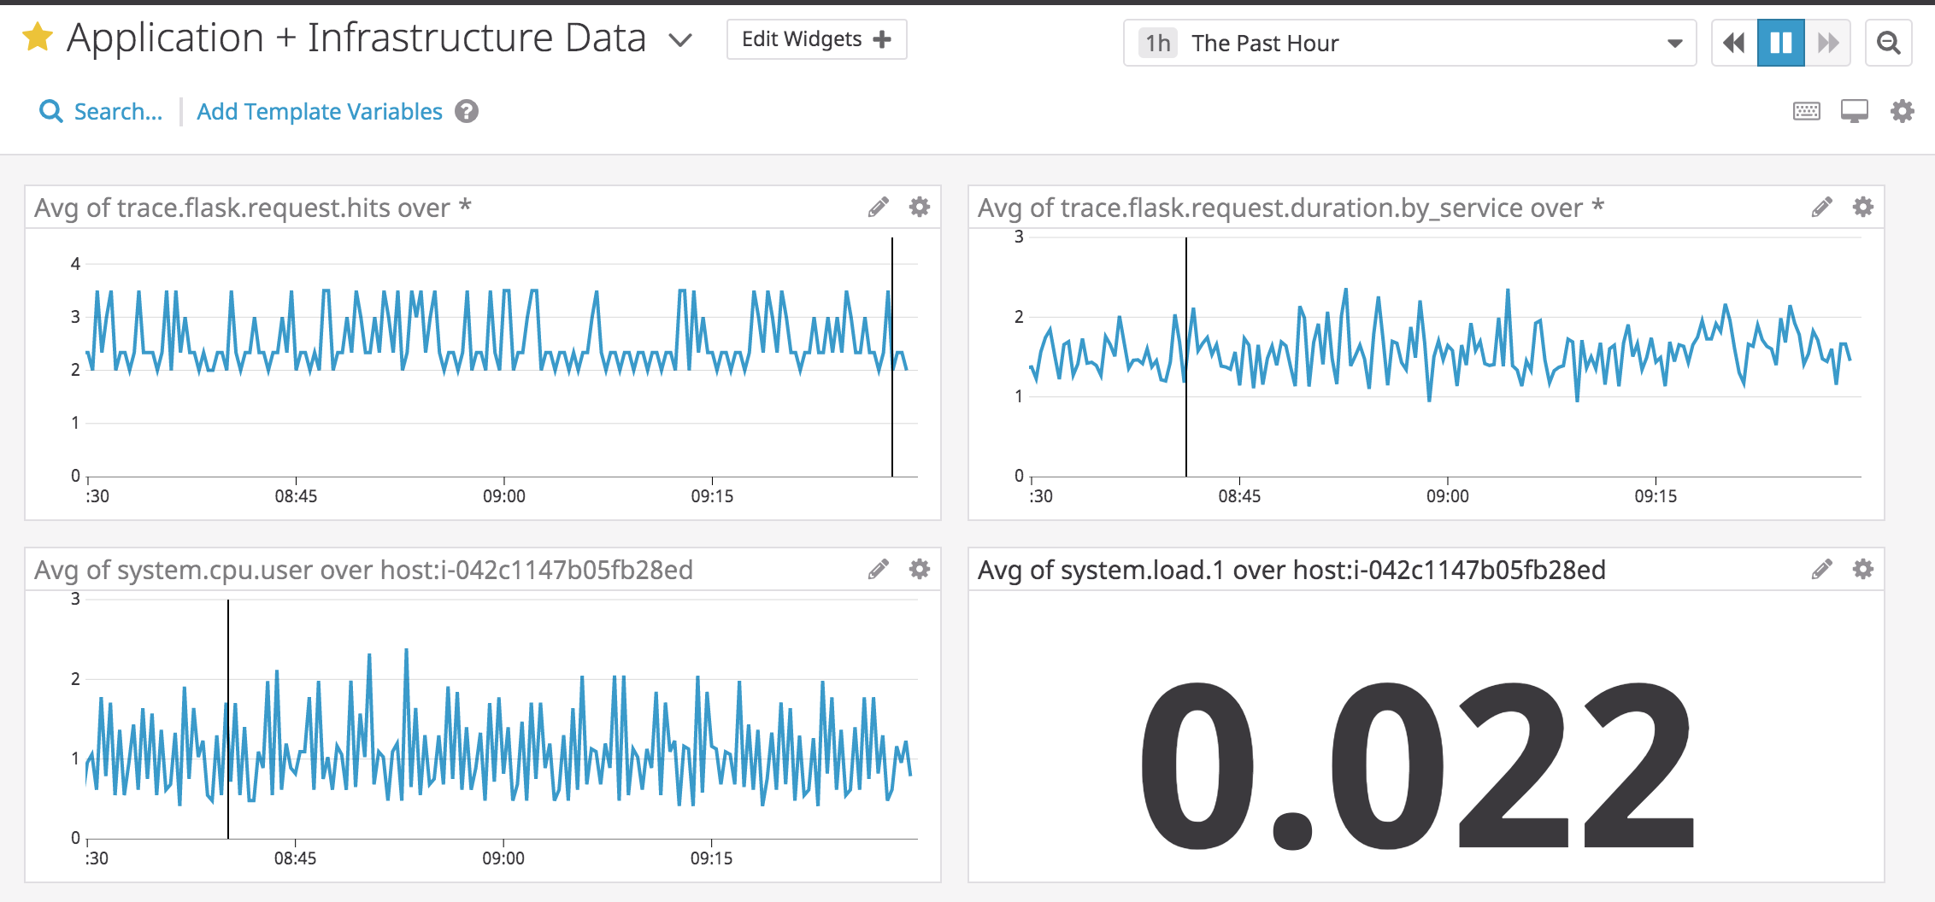
Collecting APM Data

Slide 15
What Would You Use Datadog For?
Datadog has been used in a lot of creative ways in the past. We’ve written some blog posts about using Datadog to monitor the NYC Subway System, Pokemon Go, and even office restroom availability!
Is there anything creative you would use Datadog for?

Slide 16
References
asdf

Slide 17
GitHub Repos
https://github.com/sheltowt/hiring-engineers/tree/bill_shelton

