Slide 1
DataDog – Hiring Engineers
Exercise Outcome
Candidate – sundance071
11 April 2019

Slide 2
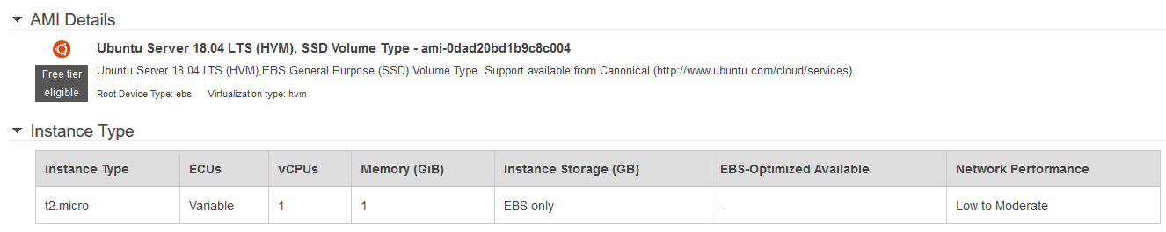
Test Environment
Amazon Web Services (AWS)
Ubuntu Linux

Slide 3
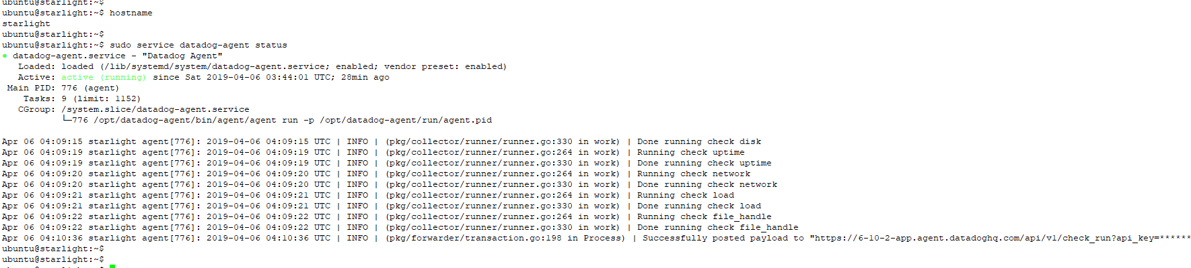
Verify agent install & status

Slide 4
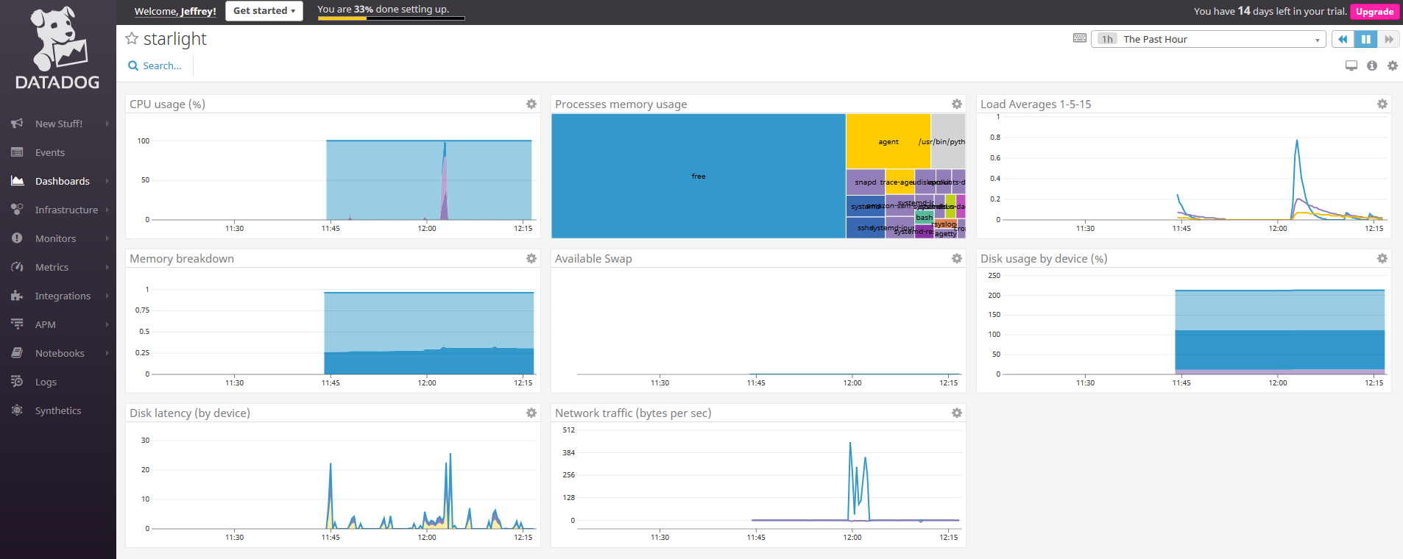
Verify data collection

Slide 5
Collecting metrics

Slide 6

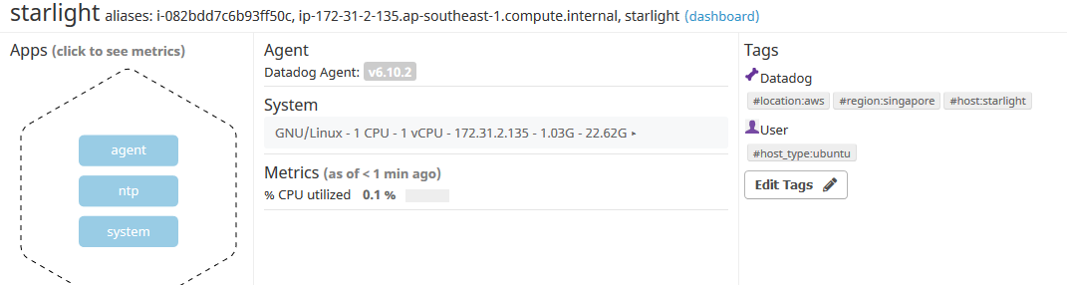
Tagging
Adding Tags via editing the agent configuration file in /etc/datadog-agent/datadog.yaml
Adding Tags via the Datadog console

Slide 7
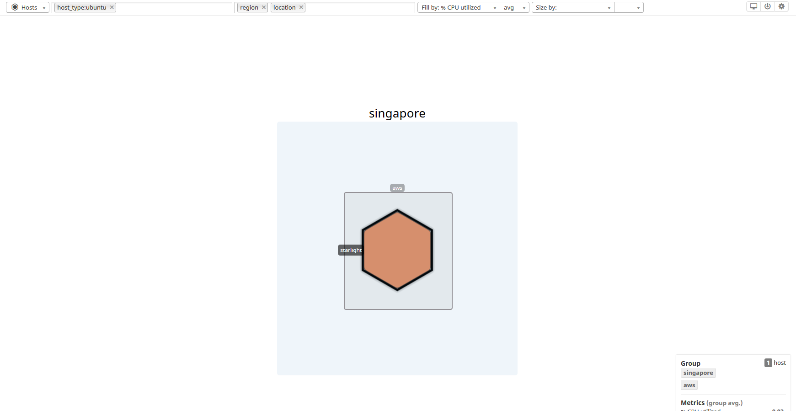
TAGGing
Filtering by Tags

Slide 8
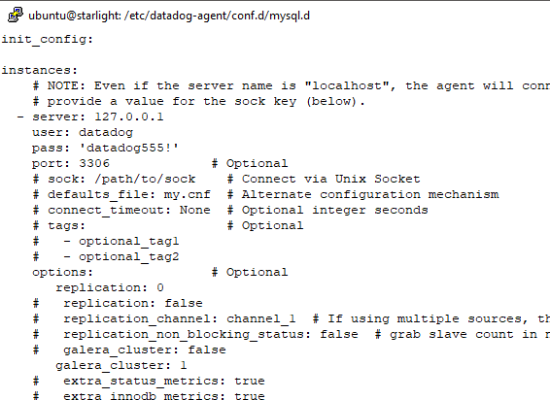
Database integration
Configuration

Slide 9
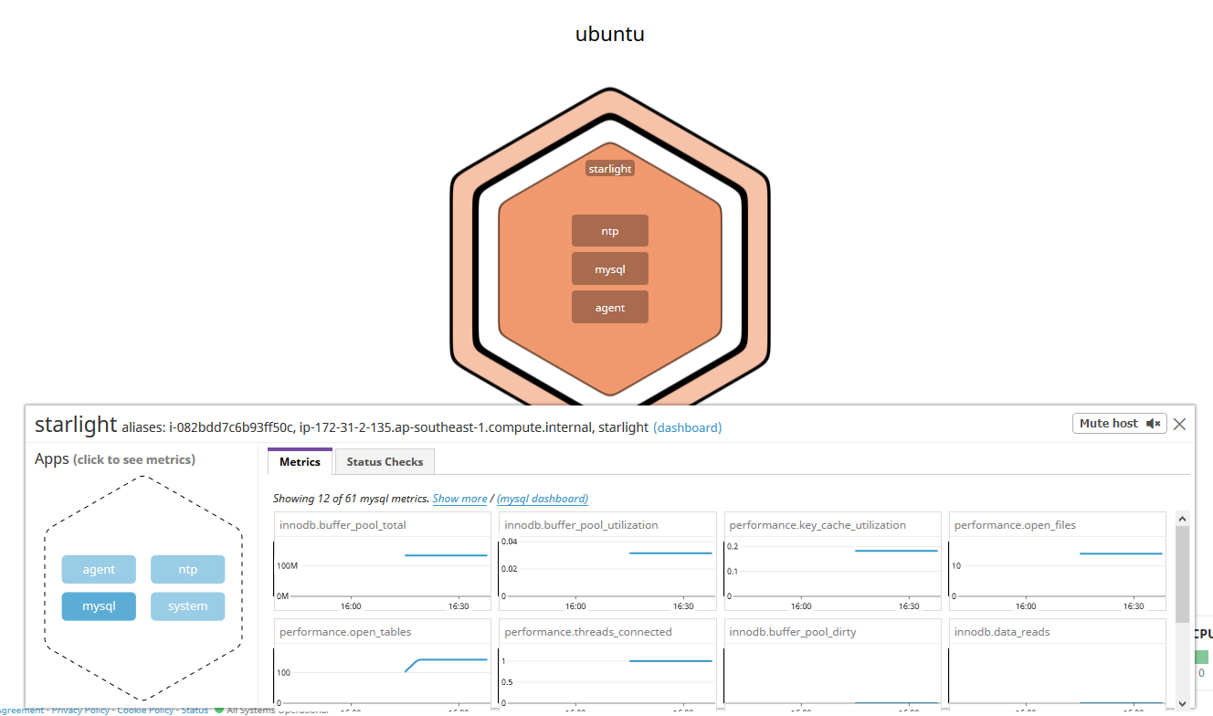
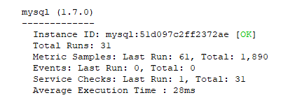
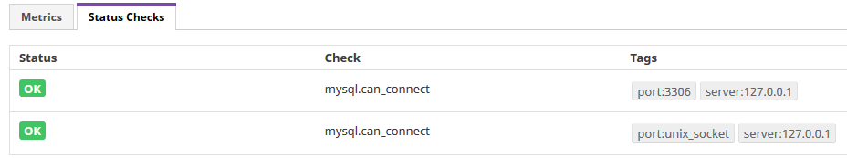
Database integration
Verification

Slide 10
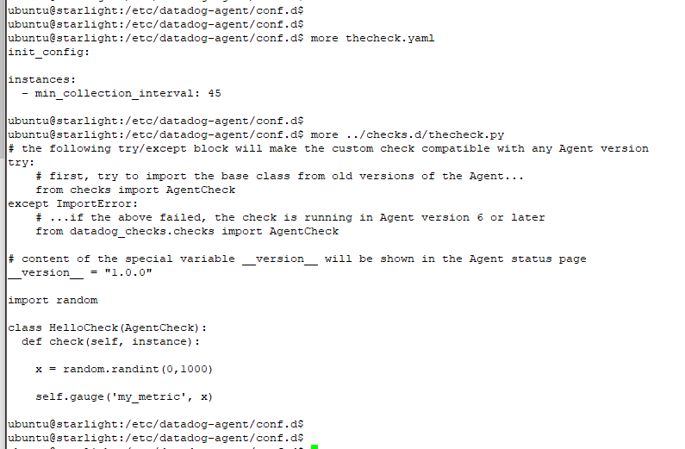
Custom agent check
Configuration

Slide 11
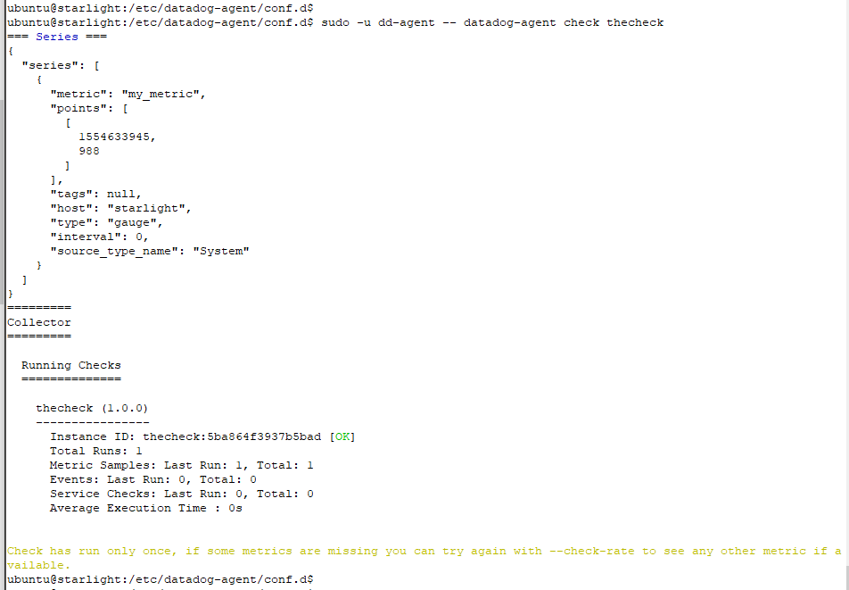
Custom agent check
Verification

Slide 12
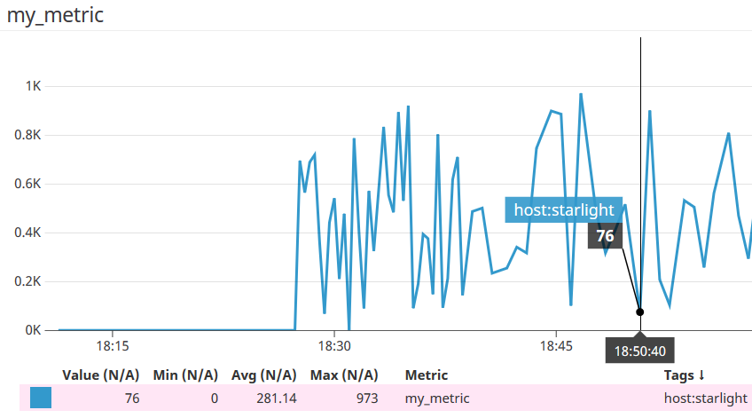
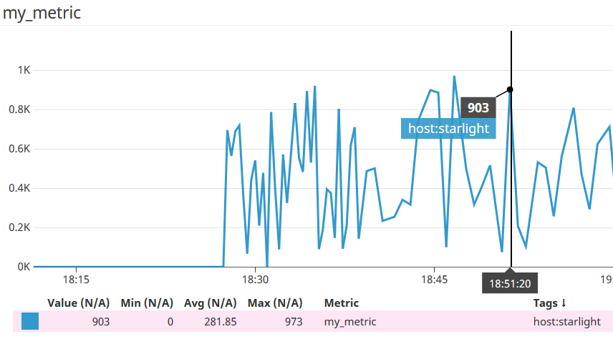
Custom agent check
Verification that metric collection is once every 45 seconds

Slide 13
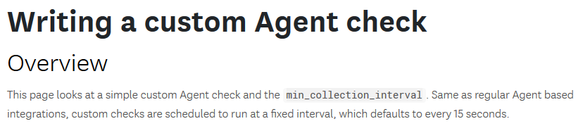
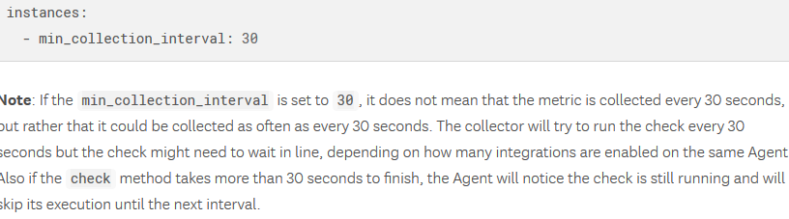
Bonus Q: Custom agent check
Bonus question – changing the collection interval without modifying the Python check file created
Answer – besides using the parameter min_collection_interval in the yaml configuration file for the check, this looks possible if there is a method to change the default collection interval via a configuration file item. However, I am not able to find it in the datadog.yaml configuration file … it could perhaps be an undocumented command/method

Slide 14
Visualizing data

Slide 15
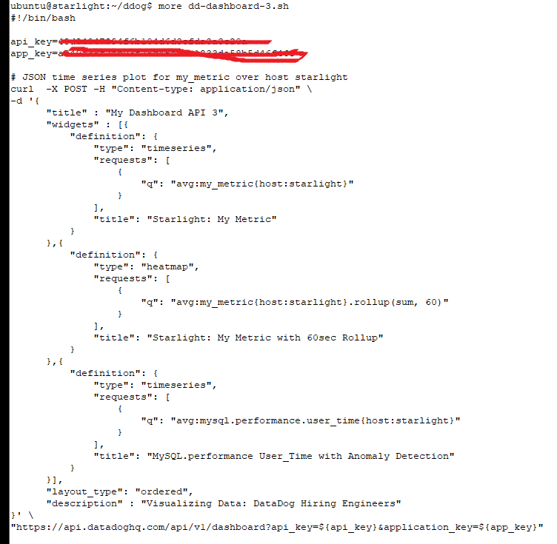
Timeboard creation by api

Slide 16
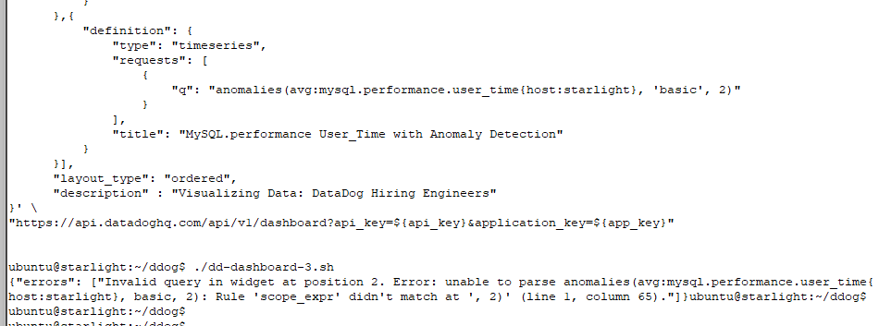
Timeboard creation by api
Reported this error to the recruiter. Something must have changed with the anomalies() function call …

Slide 17
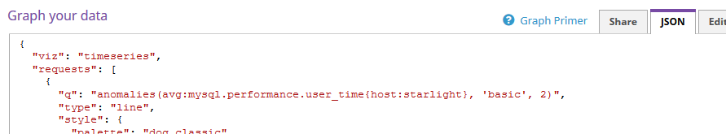
Timeboard creation by api
I have verified the API call … looks correct to me

Slide 18
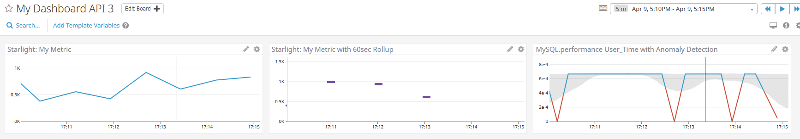
Timeboard for the past 5 mins
Drag and select over the graph for the past 5 mins

Slide 19
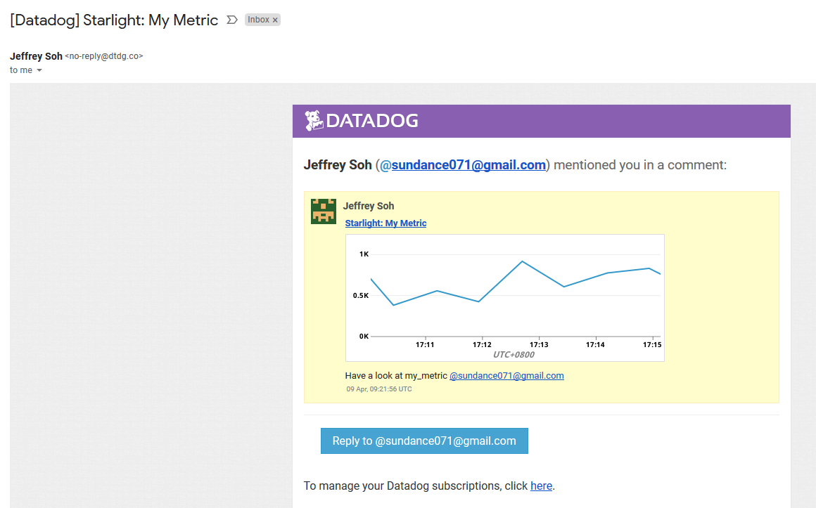
Sent snapshot of a graph

Slide 20
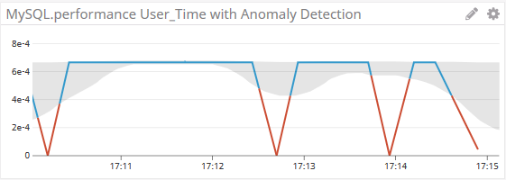
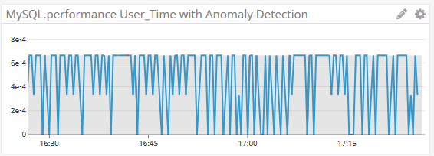
Bonus Q: Anomaly graph
It displays the deviation from normal readings. These are indicated by the red lines
The normal readings lie within the grey shaded areas

Slide 21
monitoring data

Slide 22
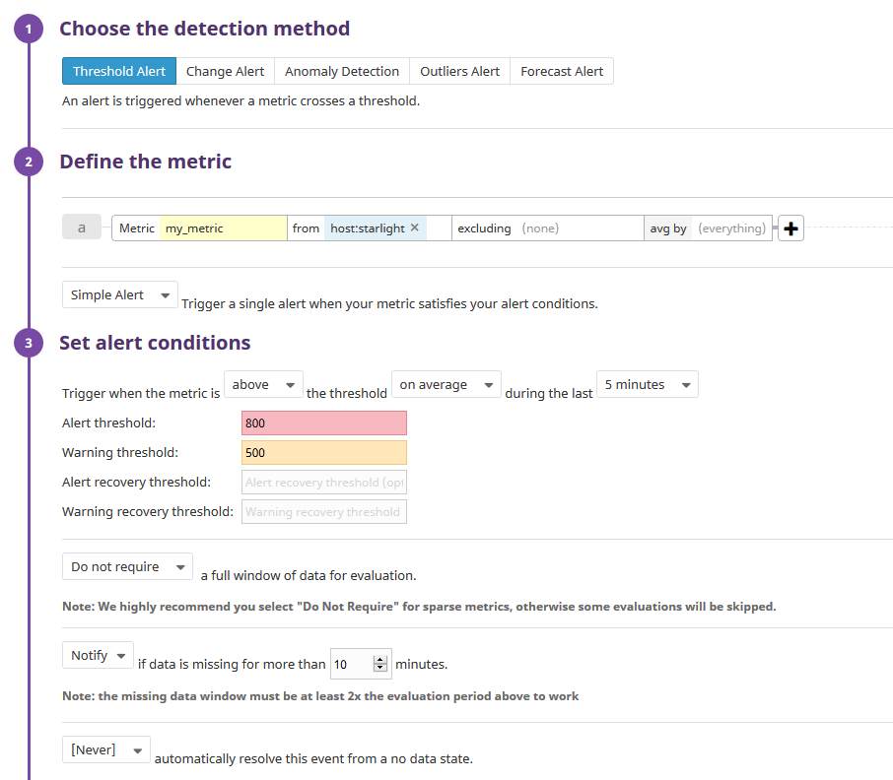
Monitor setup

Slide 23
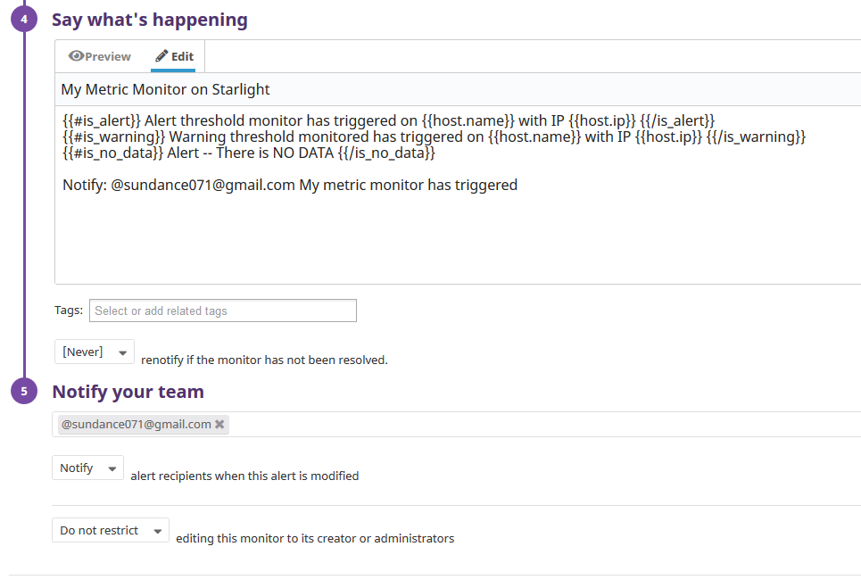
Monitor setup

Slide 24
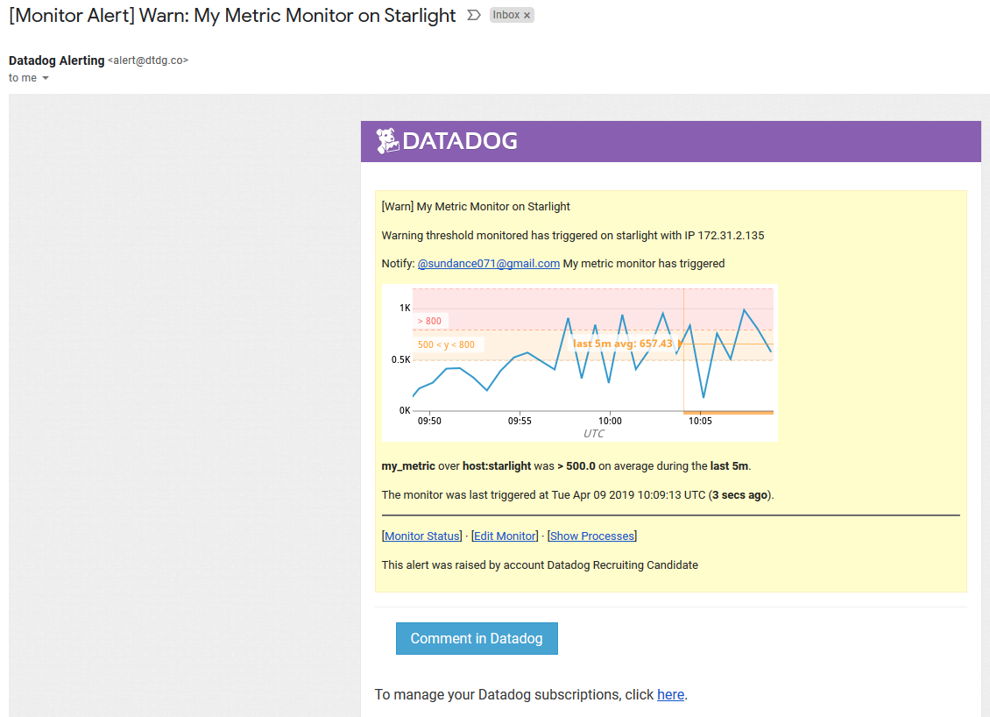
Monitor triggered email

Slide 25
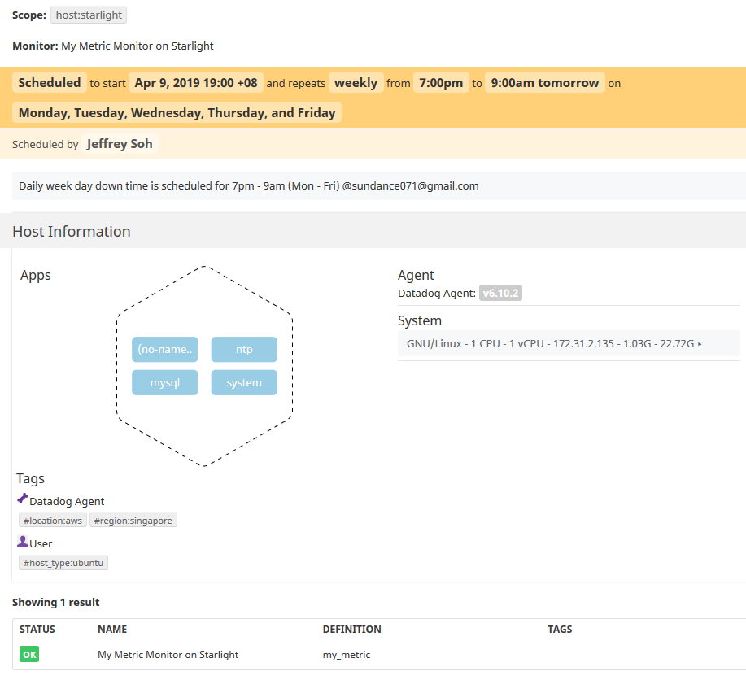
Bonus Q: Weekday down time

Slide 26
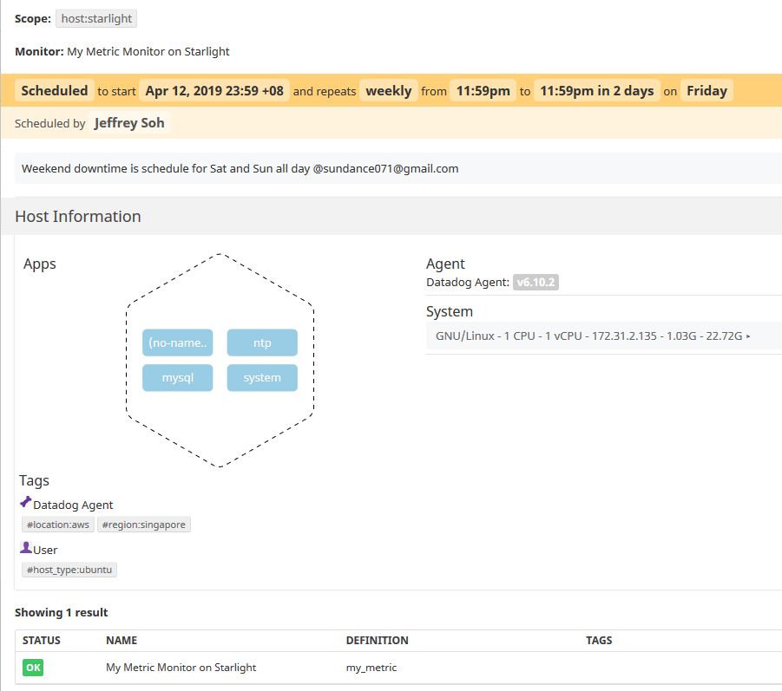
Bonus Q: weekend downtime

Slide 27
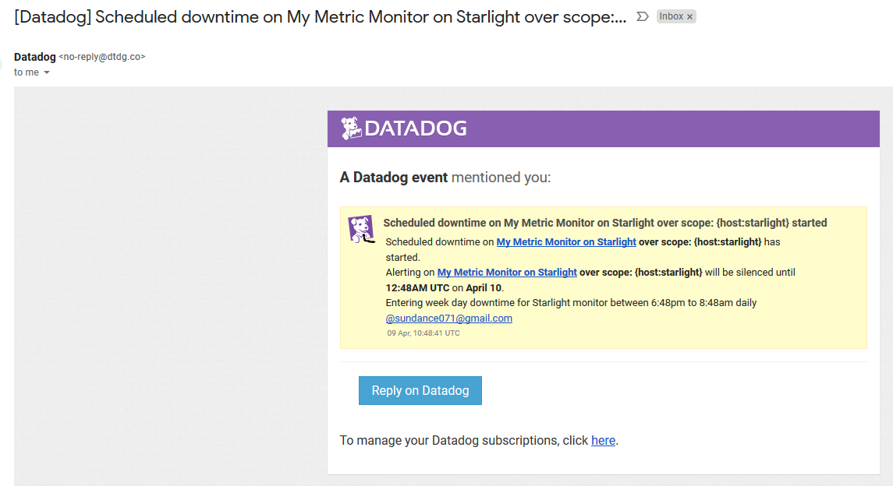
Bonus q: downtime email notification
Note: bringing forward downtime schedule for verification

Slide 28
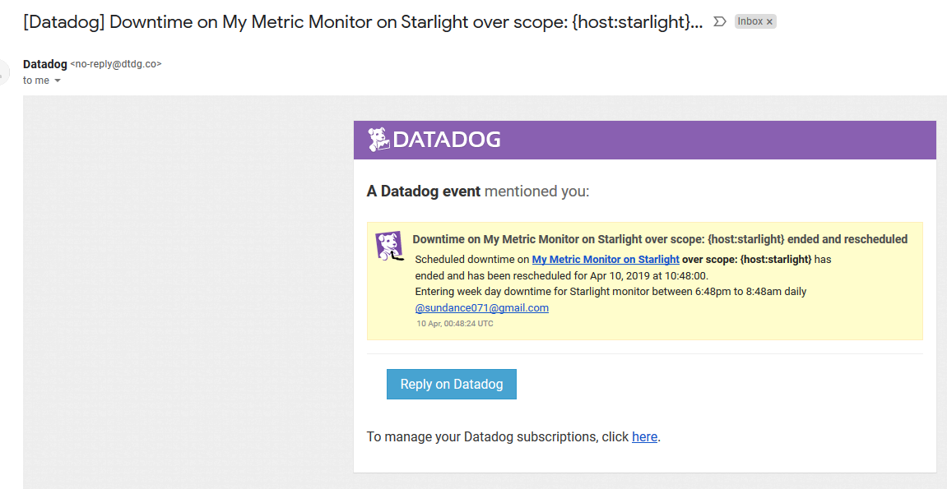
Bonus q: downtime email notification

Slide 29
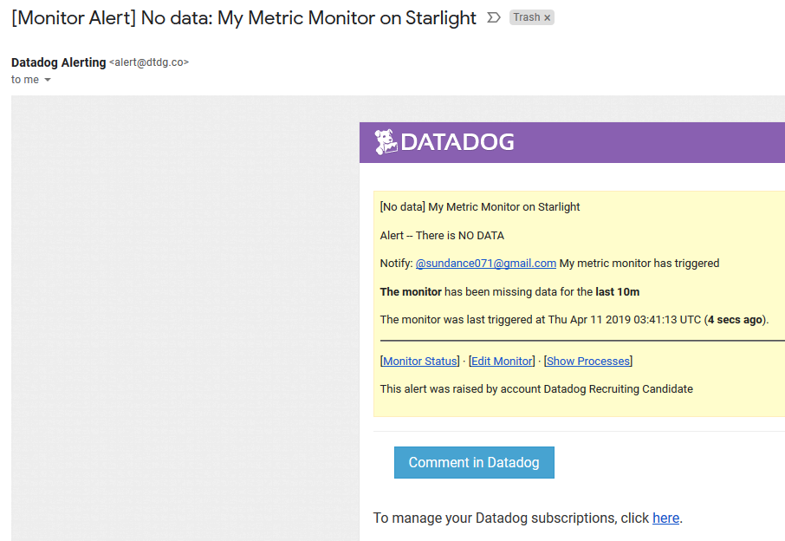
No Data alert

Slide 30
Collecting apm data

Slide 31
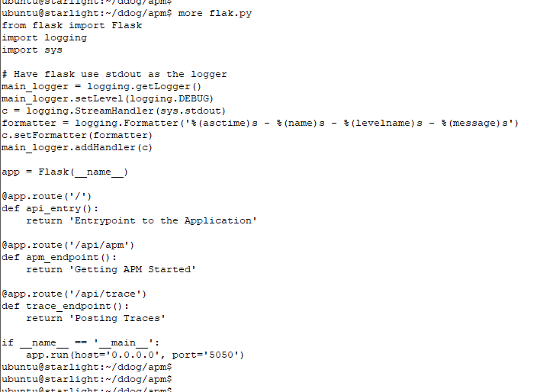
APM INSTRUMENTATION

Slide 32
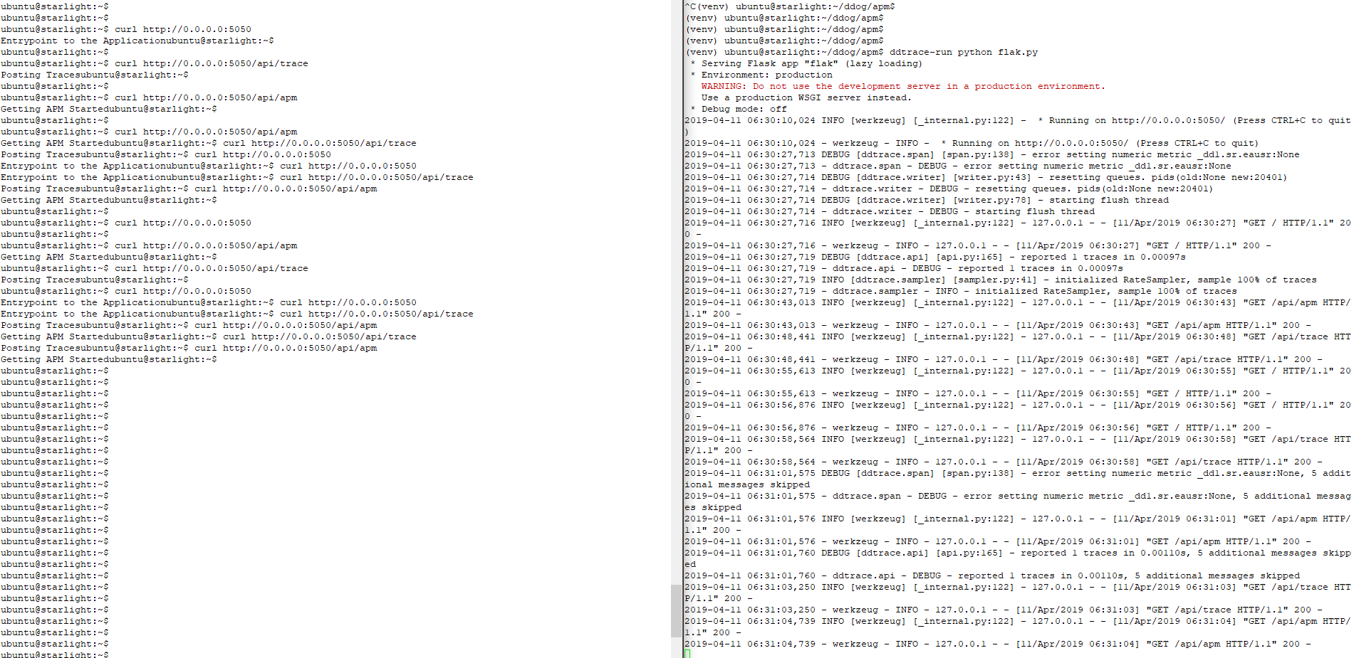
APM INSTRUMENTATION

Slide 33
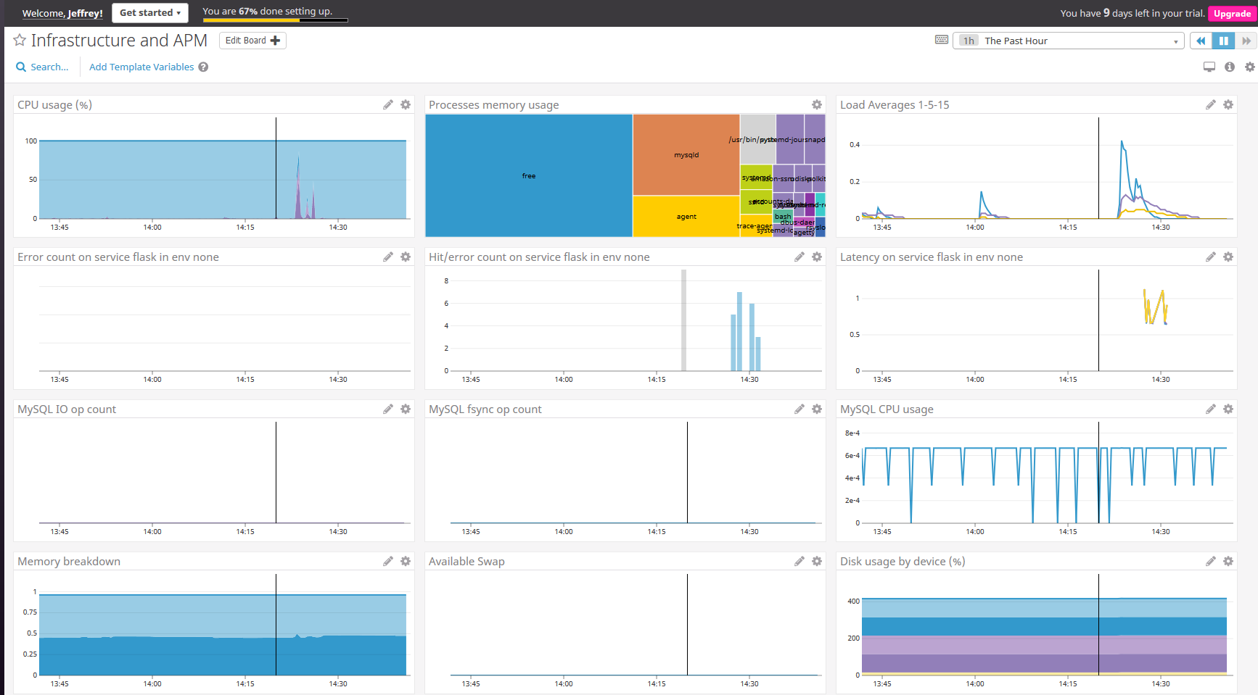
Apm and instructure dashboard

Slide 34
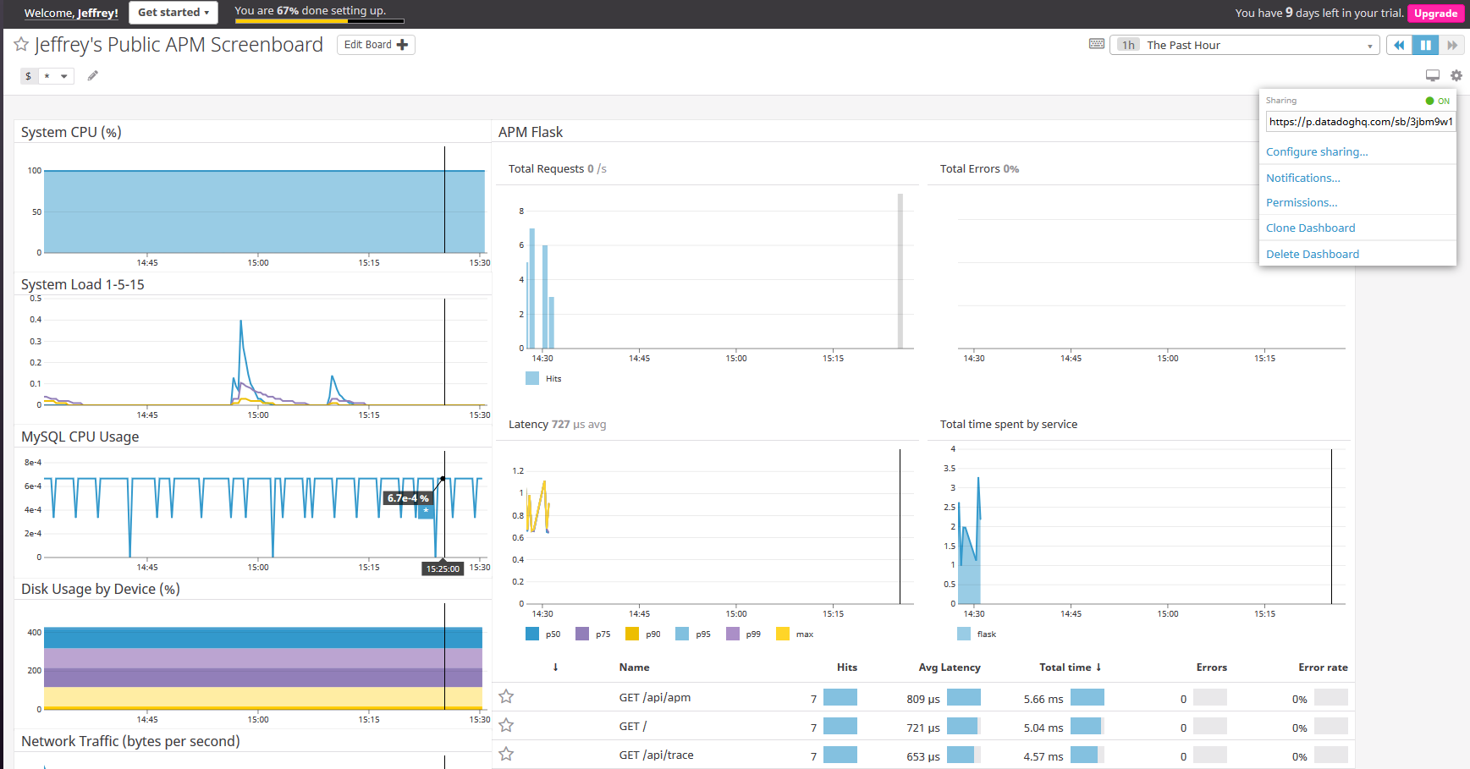
Public timeboard

Slide 35
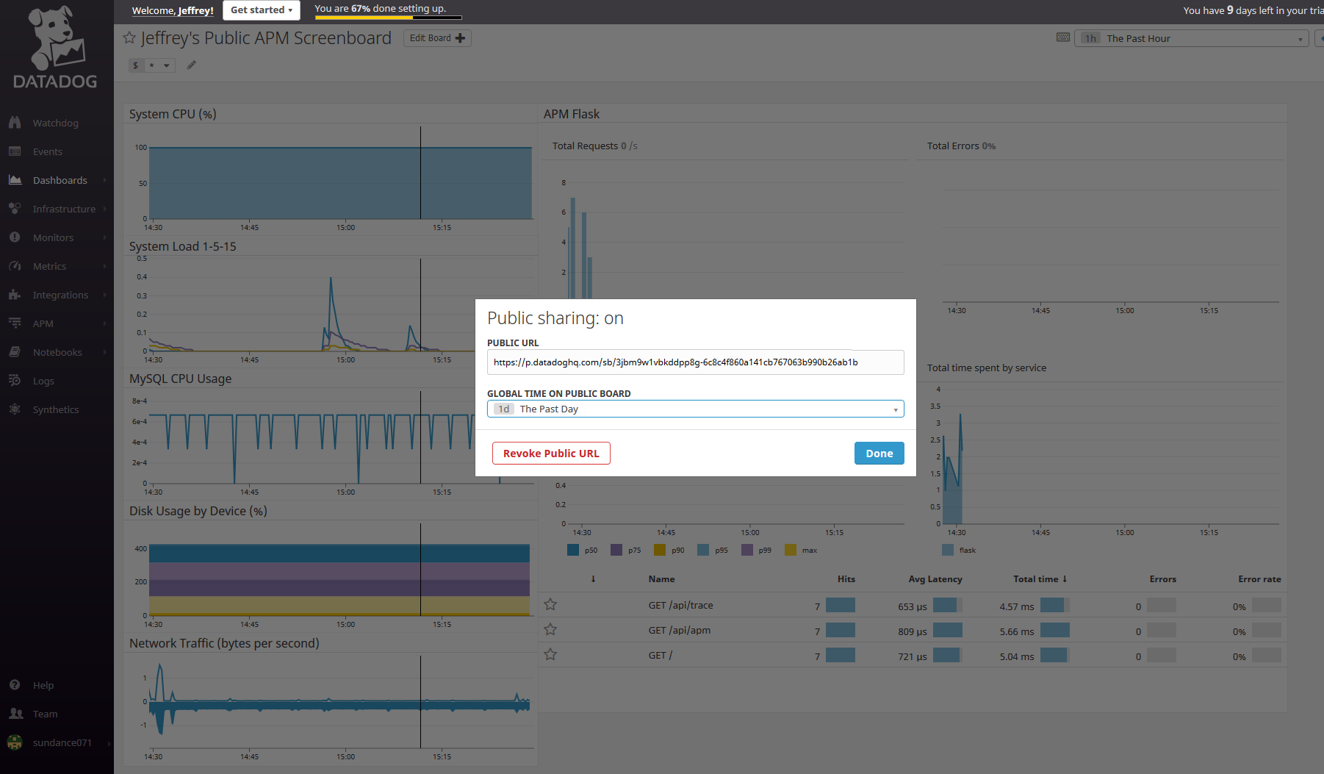
Public timeboard
https://p.datadoghq.com/sb/3jbm9w1vbkddpp8g-6c8c4f860a141cb767063b990b26ab1b

Slide 36
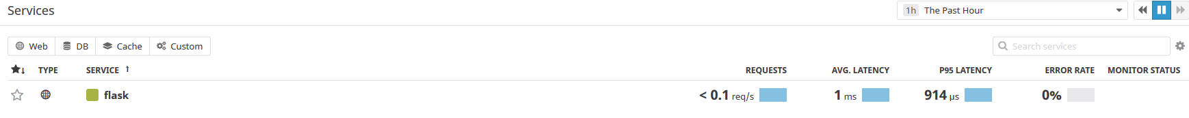
Bonus question
Service
A process that does a job
For example, flak.py is a (web) process

Slide 37
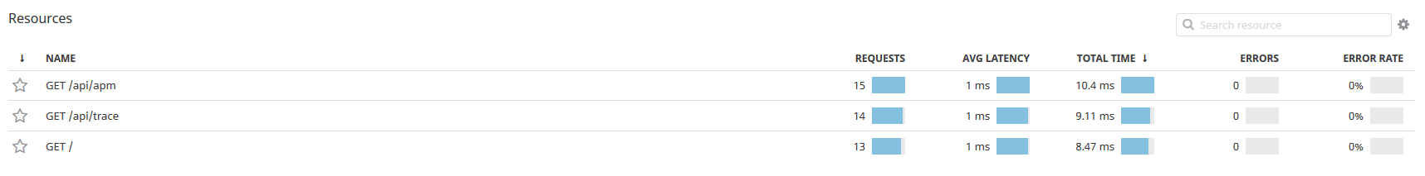
Bonus question
Resource
A particular action for a service
For example, in the flak.py process, there are 3 resources
http://0.0.0.0:5050
http://0.0.0.0:5050/api/apm
http://0.0.0.0:5050/api/trace

Slide 38
Final question

Slide 39
Final question – an application
Given that Singaporeans are obsessed with sending their children to private tuition classes, I would like to plot a distribution that breaks down the hours spent on private tuition against the final grade achieve to see the correlation
https://www.straitstimes.com/forum/letters-in-print/better-ways-to-help-kids-than-tuition
https://www.straitstimes.com/lifestyle/gifted-kids-get-tuition-too
https://www.straitstimes.com/forum/letters-in-print/tuition-centres-are-filling-the-exam-gap
https://www.straitstimes.com/singapore/education/tuition-centres-should-not-prey-on-parents-anxieties-over-removal-of-exams-ong

Slide 40
Submitted by sundance071

