Slide 1

Use Python Regular Expressions to Process File Data
Dave Dalsveen

Slide 2
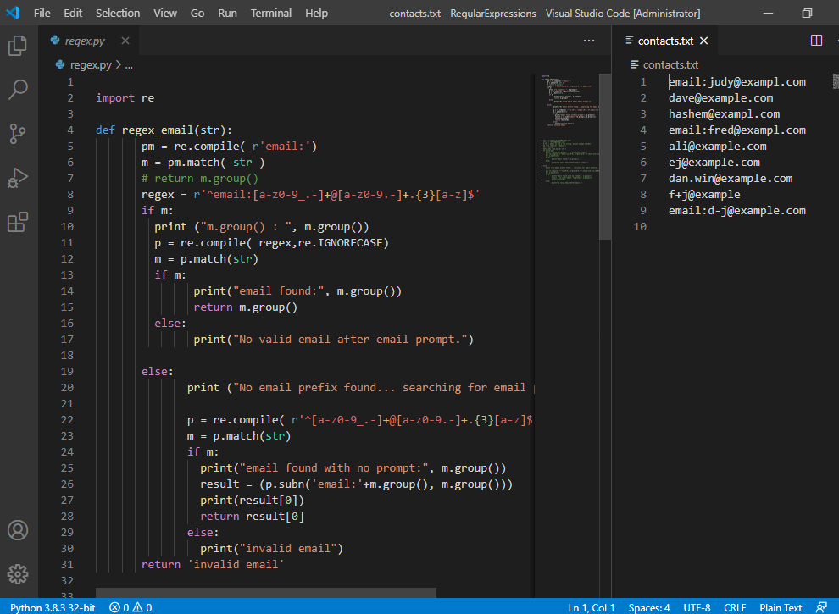
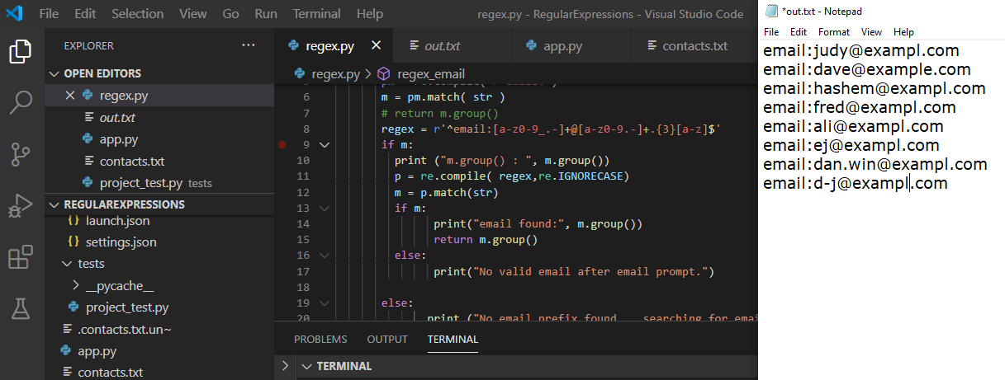
Completed Project and Output

Slide 3
Task1: Create a Python Regular Expression pattern test.
Describe the problem.
Create a Virtual Environment to avoid conflicts
Create a function stub for processing a regular expression.
Create a Unit test for a simple regular expression.

Slide 4
Task2: Create strings to test a simple regular expression.
Add another test for valid email that lacks a prefix.
Create the first regular expression and compile it in the regex_email function.
Test the regular expression by running the first test.
The second test case has not been implemented in the function; it should fail..

Slide 5
Task3: Implement a Python function that matches an email pattern.
Implement the regular expression to use to match emails.
Modify the function to check the match and return the matched email with the email: prefix.
Add an ignore case flag to allow upper-case emails and lower-case emails.

Slide 6
Task4: Read from a file containing emails using Python and match each line.
Complete the regex_email function by checking for a valid email with no prefix..
If the valid email exists, return the email prefix and the output from the match.
Print and return invalid email if no email was found.
Input the file data and pass each line to the regex_email function.

Slide 7
Task5: Use Python Regular Expressions to replace missing email prefixes in a file.
In the case of the valid email with no prefix, use the regular expression subn function to add the email prefix.
Return the prefixed email from the function.
Process each string returned from the regex function for an email prefix (valid email).
Append the valid email to a list.
Write the list to an output file.

