Slide 1
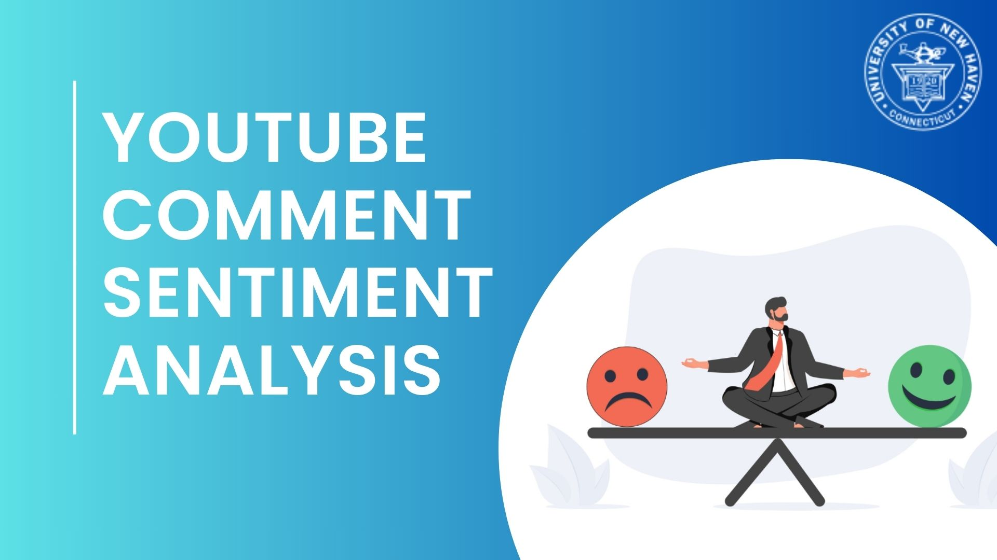

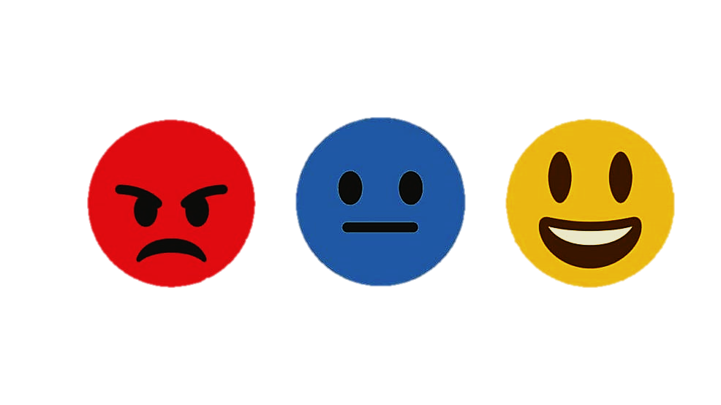
YouTube Comment Sentiment Analysis
Team 8
Final Project – Group 8
Distributed and Scalable Data Engineering

Slide 2




Team Members
Sai Rekha Unnam
(Team Leader)
Harshith Reddy Pathpi
(Data Scientist)
Sai Chaitanya Kolli
(Data Modeling)
Manikanta Teja Babu Paritala (Data Visualization)

Slide 3
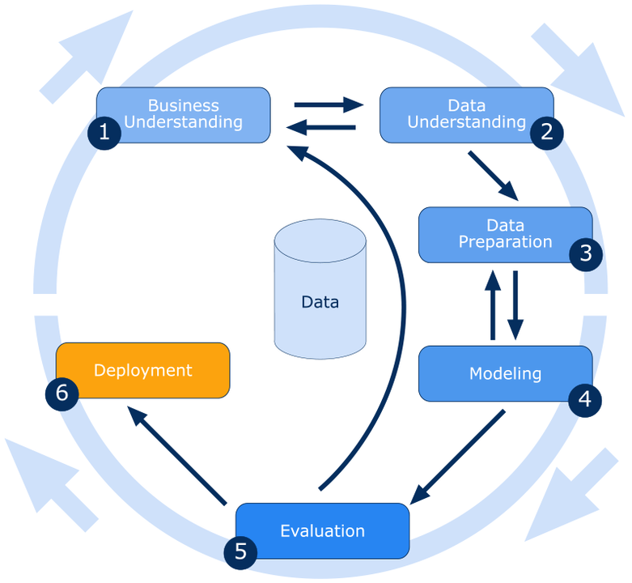
Crisp DM Methodology

Slide 4
Sentiment Analysis- Brief Overview
Sentiment Analysis is the most common text classification tool that analyses an incoming message and tells whether the underlying sentiment is positive, negative and neutral
Ex: I won the lottery Today Positive
The food is ready Neutral
The weather is terrible Negative

Slide 5
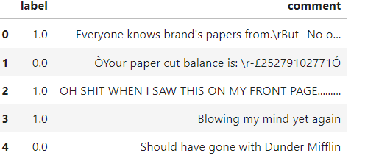
Dataset Sample
We have taken the datasets from Kaggle.
Link: https://www.kaggle.com/datasets/kevinleekrus/youtube-videos-comments-analysis

Slide 6
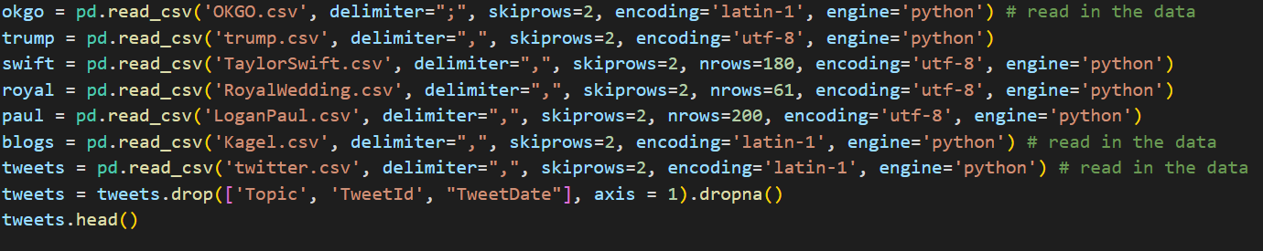
Business Understanding
We have initially loaded different datasets to train our algorithm to perform well on test dataset.

Slide 7
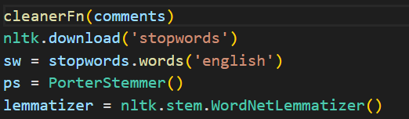

Data Understanding and Data Preparation
We performed several data cleaning and processing steps on the comments DataFrame:
Conversion of comments to strings.
Cleaning comments by keeping only words with alphabetic characters.
Downloading NLTK's stopwords and initializing a stemmer and lemmatizer.
Applying natural language processing functions (nlpFunction) to tokenize, remove stopwords, lemmatize, and stem comments.

Slide 8
Machine Learning Models:
Multinomial Naive-Bayes Model
Logistic Regression
SVC (Support Vector Classifier)
Decision Tree
Random Forest

Slide 9
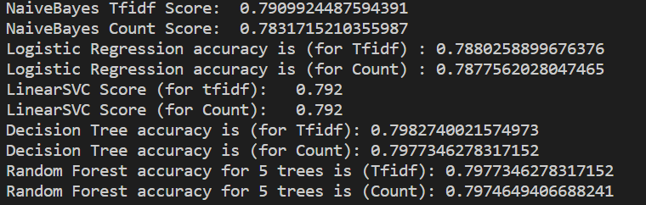
Evaluation
Evaluation metric we have used is Accuracy , the model which has The higher the accuracy, the better the model is at correctly predicting the labels of the test set.
For the labels which I have used I got accuracy for each has below, and among them decision tree has highest accuracy.

Slide 10
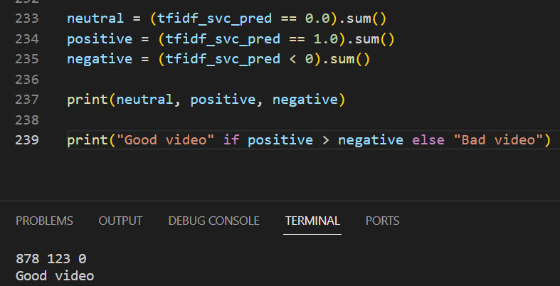
Results
We have extracted the positive, negative and neutral comments, to identify whether it is a good or bad video.
Output:

Slide 11
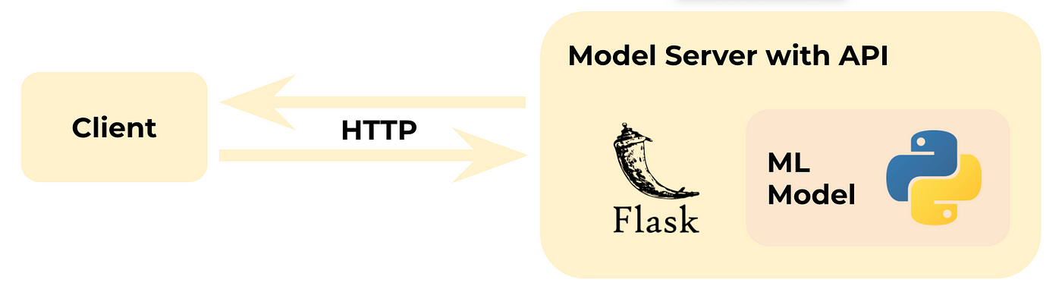
Deployment
We have deployed our code in flask , where it takes link as input and predicts the video as good or bad.

Slide 12


