Slide 1
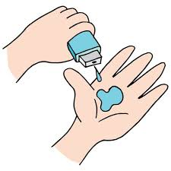
Project Title – Healthcare Analytics for Doctor Visits
Anusha Upadhyay
Amity University, Gwalior
B.tech-Computer Science Engineering

Slide 2

PROBLEM STATEMENT
- Create a healthcare analytics system that analyzes patient data like demographics, visit frequencies, common illnesses, and busiest times.
- Use this data to improve scheduling efficiency, reduce wait times, and allocate resources more effectively.
- Aim to provide timely care and enhance patient satisfaction by understanding and adapting to patient behaviors and visit patterns.

Slide 3
Project Description
The Healthcare Analytics for Optimizing Doctor Visits project uses data analysis to improve doctor appointments. By studying patient demographics, visit patterns, common illnesses, and busy times, the system helps healthcare providers schedule efficiently, reduce waits, and improve patient care. It aims to use resources effectively and ensure timely treatment, enhancing overall healthcare delivery.

Slide 4

WHO ARE THE END USERS?
Doctors: Improve scheduling and patient care with actionable insights.
Nurses: Enhance patient coordination and flow management.
Administrative Staff: Simplify appointment booking and minimize wait times.
Patients: Enjoy shorter waits and personalized care experiences.
Hospital and Clinic Managers: Optimize resources and operational efficiency.
Healthcare Data Analysts: Analyze data for actionable insights and improved service delivery.
Insurance Companies: Utilize data for enhanced risk assessment and streamlined claims processing.

Slide 5

Technology Used
Integrated Development Environment (IDE):
- Visual Studio Code (VS Code)
Version Control and Collaboration:
- GitHub for repository management and version control
Data Analysis and Manipulation:
- Python for data cleaning, preprocessing, and analysis
- Numpy for numerical computing and array operations
- Pandas for data manipulation and analysis
Data Visualization:
- Matplotlib and Seaborn for visualizing data within VS Code
Presentation Creation:
- Microsoft PowerPoint for preparing project presentations

Slide 6
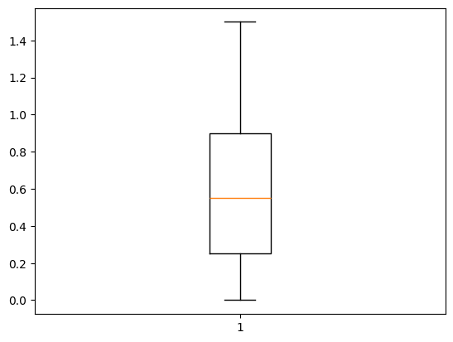
RESULTS

Slide 7
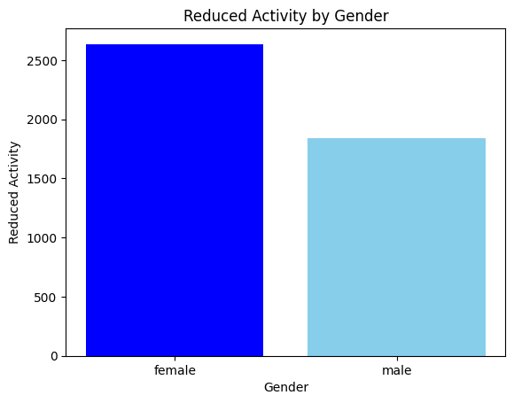
RESULTS

Slide 8
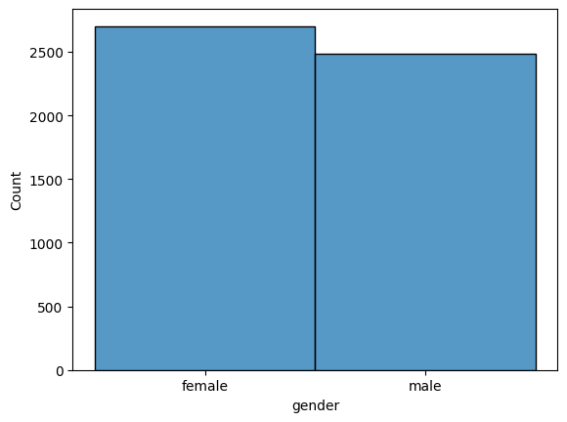
RESULTS

Slide 9
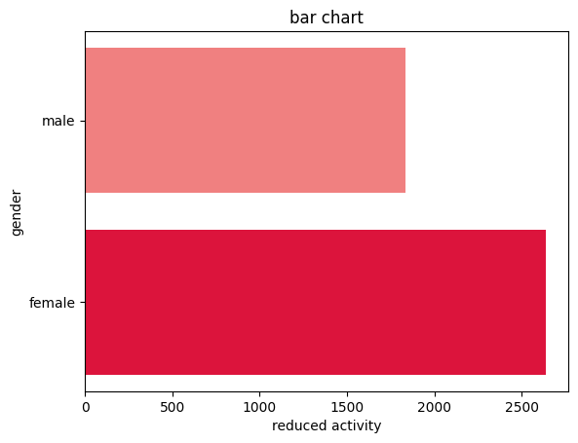
RESULTS

Slide 10
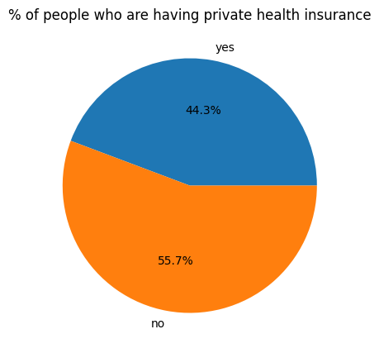
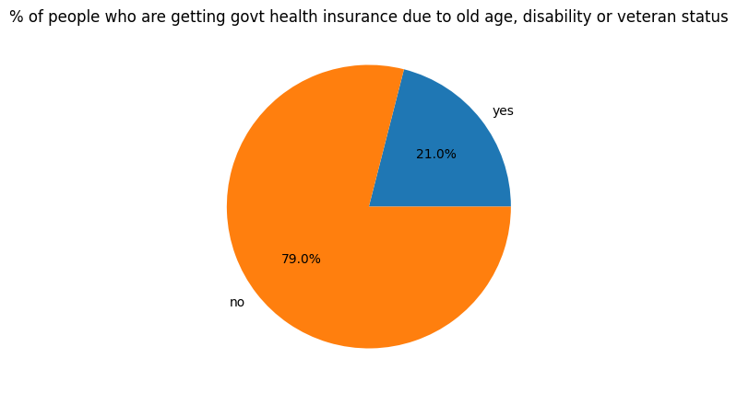
RESULTS

Slide 11
Thank You
.
.

