Slide 1
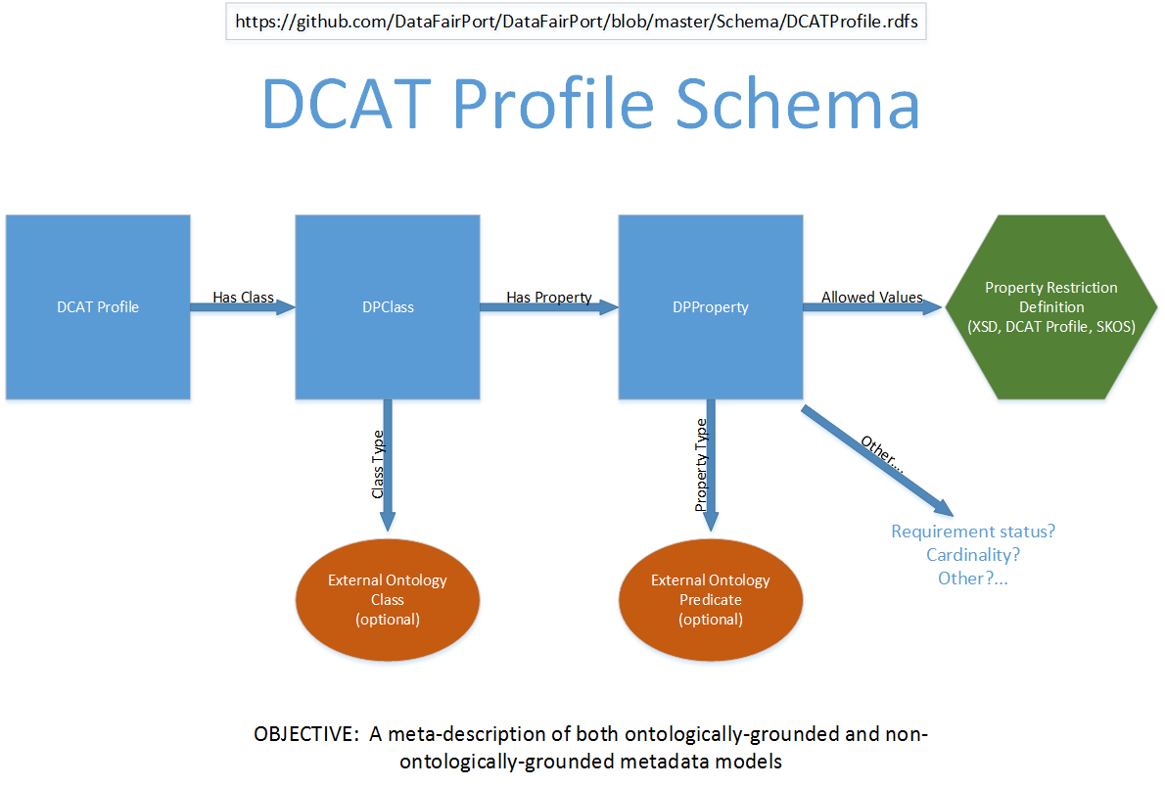

Slide 2
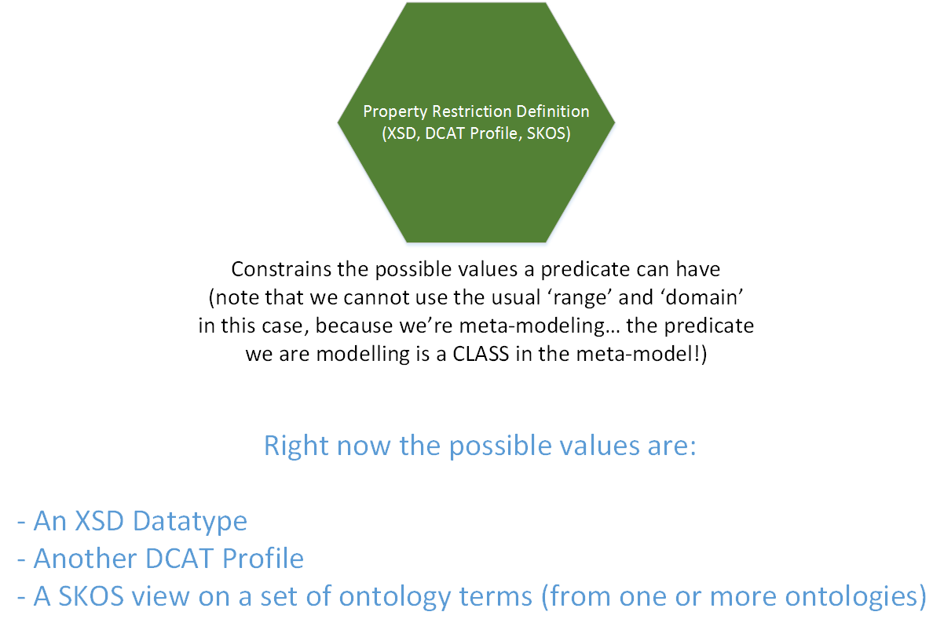

Slide 3
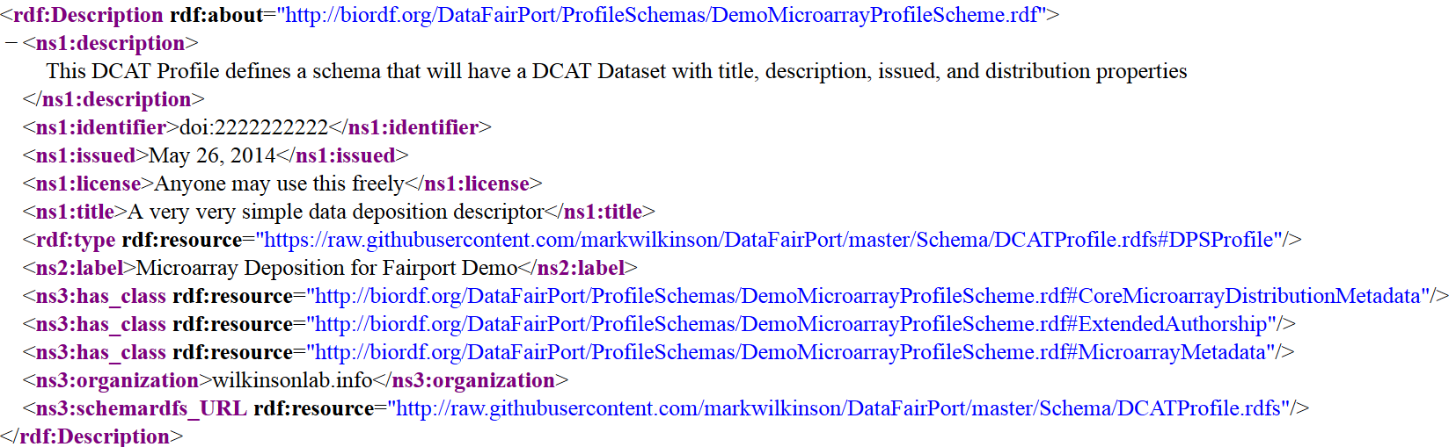
A DCAT Profile (an RDF document that follows the DCAT Profile Schema)
A DCAT Profile with three has_class elements (in this case, all three of them are internal references to fragments of the same document but this does not have to be true, as we’ll see later… these documents are NOT intended to be self-contained!)

Slide 4
A DCAT Profile
For the moment, let’s just look at the definition of the CoreMicroarrayDistributionMetadata Descriptor (from some arbitrary organization…)

Slide 5
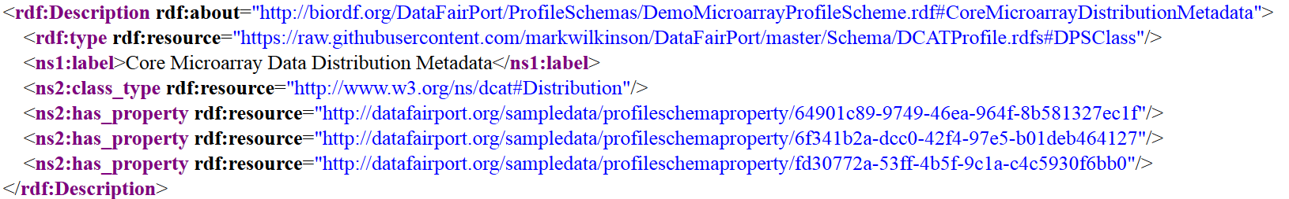
CoreMicroarrayDistributionMetadata Descriptor
This Meta-Descriptor element is a DCAT Profile Schema Class

Slide 6
CoreMicroarrayDistributionMetadata Descriptor
The Metadata it describes follows the DCAT Distribution metadata model

Slide 7
CoreMicroarrayDistributionMetadata Descriptor
Within that model, it utilizes three properties

Slide 8
CoreMicroarrayDistributionMetadata Descriptor: Property #1
Look at one of those properties in detail…

Slide 9
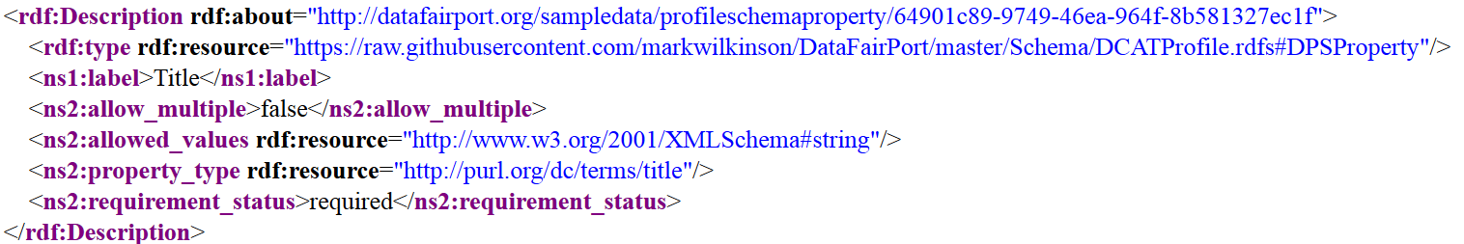
CoreMicroarrayDistributionMetadata Descriptor: Property #1
This Meta-Descriptor element is a ‘DCAT Profile Property’ Class

Slide 10
CoreMicroarrayDistributionMetadata Descriptor: Property #1
This is its label within that organizations Metadata Descriptor

Slide 11
CoreMicroarrayDistributionMetadata Descriptor: Property #1
This is the “real” predicate used in that organizations Metadata descriptor

Slide 12
CoreMicroarrayDistributionMetadata Descriptor: Property #1
And within that organization, this Metadata element value is any kind of string

Slide 13
CoreMicroarrayDistributionMetadata Descriptor: Property #2
Looking at the second property of this Meta-Descriptor….

Slide 14
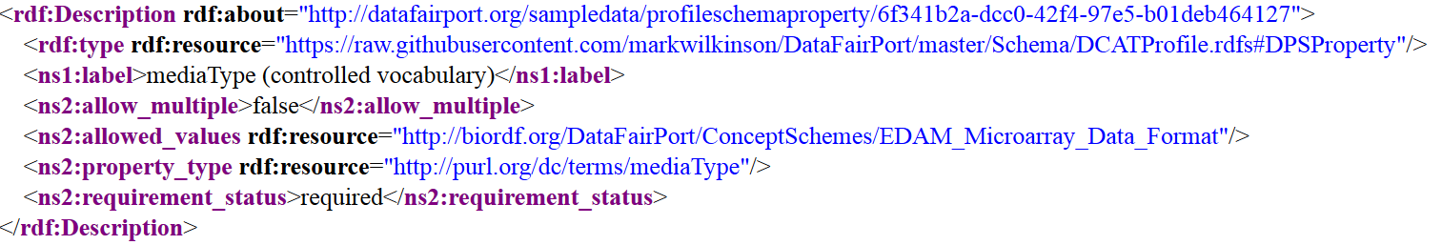
CoreMicroarrayDistributionMetadata Descriptor: Property #2
It’s also a DCAT Profile Schema Property Class

Slide 15
CoreMicroarrayDistributionMetadata Descriptor: Property #2
This is it’s label in the target Metadata Descriptor

Slide 16
CoreMicroarrayDistributionMetadata Descriptor: Property #2
This is the ontological predicate associated with this property in that descriptor

Slide 17
CoreMicroarrayDistributionMetadata Descriptor: Property #2
And in the target Metadata Descriptor, it is constrained by a certain set of ontology terms defined in the SKOS Concept Scheme EDAM_Microarray_Data_Format

Slide 18
<rdf:Description xmlns:ns1="http://www.w3.org/2002/07/owl#"
rdf:about="http://biordf.org/DataFairPort/ConceptSchemes/EDAM_Microarray_Data_Format">
<rdf:type rdf:resource="http://www.w3.org/2002/07/owl#Ontology"/>
<rdf:type rdf:resource="http://www.w3.org/2004/02/skos/core#ConceptScheme"/>
<ns1:imports rdf:resource="http://purl.bioontology.org/ontology/EDAM"/>
</rdf:Description>
<rdf:Description
xmlns:ns1="http://www.w3.org/2000/01/rdf-schema#"
xmlns:ns2="http://www.w3.org/2004/02/skos/core#"
rdf:about="http://edamontology.org/format_1641">
<rdf:type rdf:resource="http://www.w3.org/2002/07/owl#NamedIndividual"/>
<rdf:type rdf:resource="http://www.w3.org/2004/02/skos/core#Concept"/>
<ns1:label>affymetrix-exp</ns1:label>
<ns2:broader rdf:resource="http://edamontology.org/format_2056"/>
<ns2:inScheme rdf:resource="http://biordf.org/DataFairPort/ConceptSchemes/EDAM_Microarray_Data_Format"/>
</rdf:Description>
<rdf:Description
xmlns:ns1="http://www.w3.org/2000/01/rdf-schema#"
xmlns:ns2="http://www.w3.org/2004/02/skos/core#"
rdf:about="http://edamontology.org/format_2056">
<rdf:type rdf:resource="http://www.w3.org/2002/07/owl#NamedIndividual"/>
<rdf:type rdf:resource="http://www.w3.org/2004/02/skos/core#Concept"/>
<ns1:label>Microarray experiment data format</ns1:label>
<ns2:broader rdf:resource="http://biordf.org/DataFairPort/ConceptSchemes/EDAM_Microarray_Data_Format"/>
<ns2:inScheme rdf:resource="http://biordf.org/DataFairPort/ConceptSchemes/EDAM_Microarray_Data_Format"/>
</rdf:Description>
http://biordf.org/DataFairPort/ConceptSchemes/EDAM_Microarray_Data_Format

Slide 19
A DCAT Profile
Finally, we’ll return to the very top of our Meta-Descriptor we’ll look at the ExtendedAuthorship Class of our DCAP Profile

Slide 20
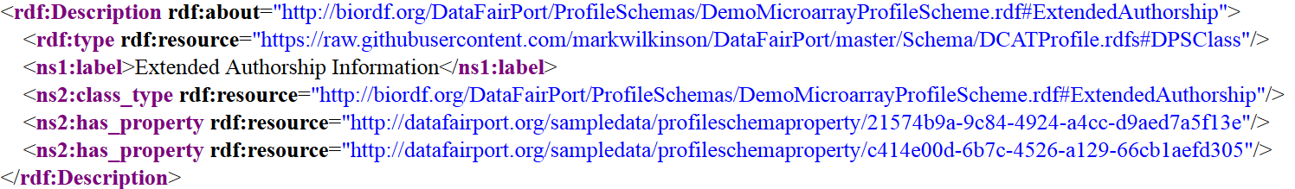
ExtendedAuthorship
One of the properties of the ExtendedAuthorship Element of our target Metadata Descriptor is…

Slide 21
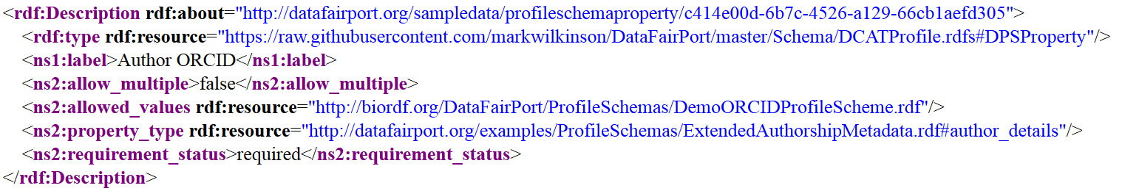
Author ORCID

Slide 22
Author ORCID
In our target Metadata Descriptor, the allowed values are defined by an external DCAT Profile…

Slide 23
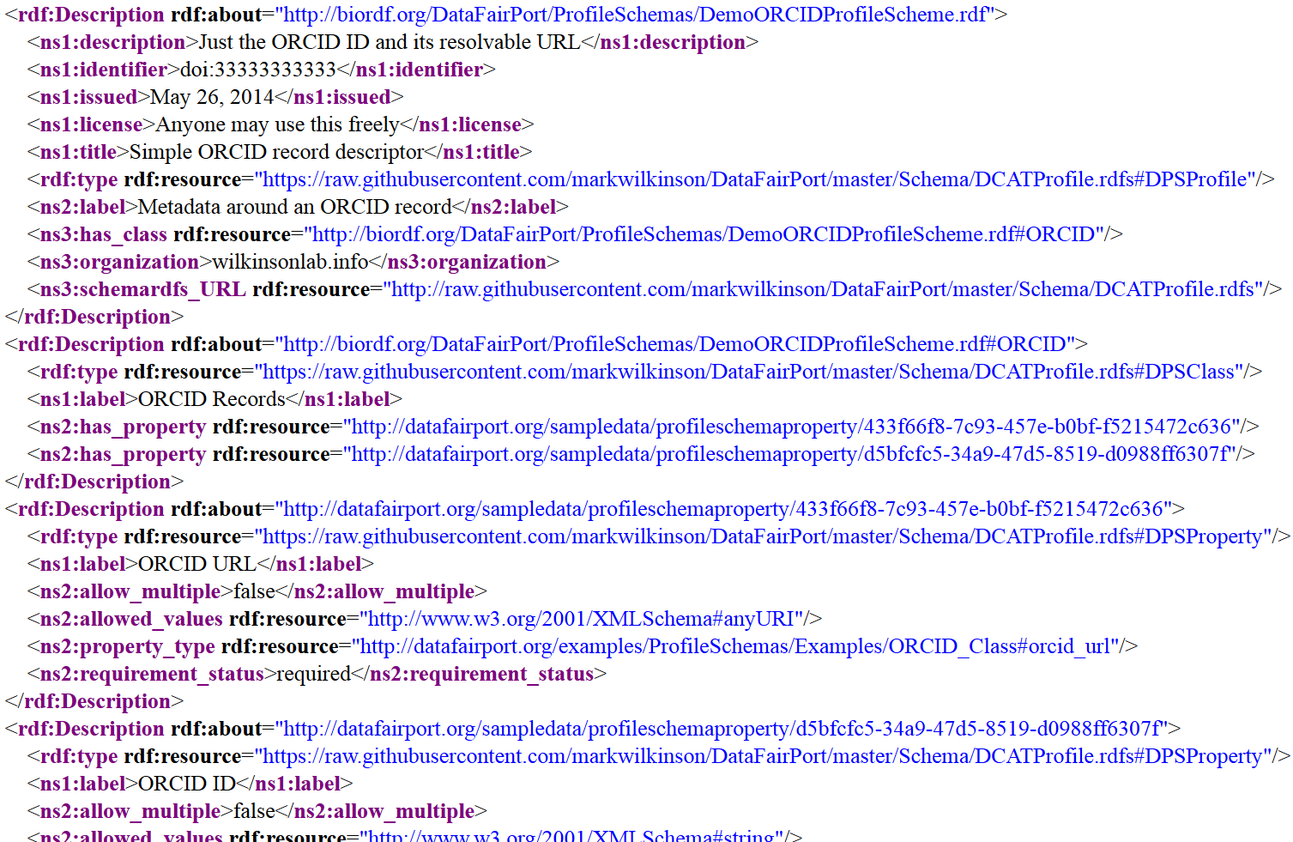
http://biordf.org/DataFairPort/ProfileSchemas/DemoORCIDProfileScheme.rdf

Slide 24
http://biordf.org/DataFairPort/ProfileSchemas/DemoORCIDProfileScheme.rdf
This is parsed in exactly the same way as our original DemoMicroarrayProfileScheme, but is embedded within it as the value of the author_ORCID property.
…Arbitrary levels of complexity…

Slide 25
So to build a metadata capture interface from a Meta-descriptor…
[1] Parse all DCAT Profile classes
Parse the properties of each class
Determine the target predicate Determine the target value-restrictions
Call [1] if restriction is a DCAT Profile
Create a metadata capture facet with that predicate and that restriction

Slide 26
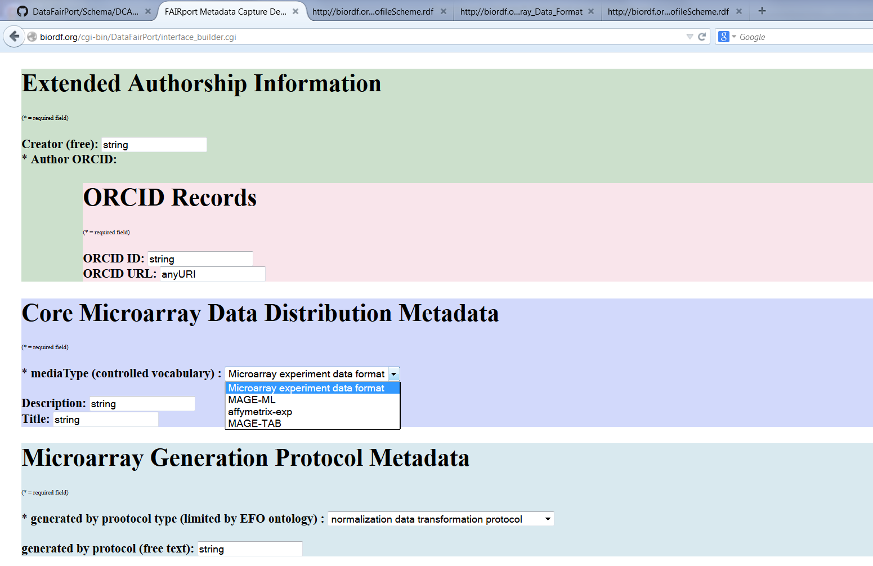

Slide 27
“Classes” may be associated with an ontology to allow reasoning, or may just represent an “arbitrary” grouping of properties within the Target metadata descriptor
Descriptor-specific labels associated with ontology predicates (if applicable)
DCAT Profile Class #1
DCAT Profile
Class #4 (embedded)
Metadata Descriptor-specific details are captured e.g. this field is required by this target Metadata Descriptor
DCAT Profile Class #2
Value constraints
DCAT Profile Class #3

