Slide 1
Met Drivers for PalEON MIP 3: Ensemble of Ensembles for Data Assimilation

Slide 2
Goals of The MIP3 Met Drivers
Account for uncertainty in the downscaling process
Bias-correction & splicing of data products
Downscale multiple GCMs for multiple realizations of paleo climate

Slide 3
Available Met Datasets
1980 – 2015: Land Data Assimilation Systems
NLDAS – 1-hourly, 0.125-degree, contiguous US
GLDAS – 3-hourly, 0.250-degree, global
1901 – 2010: CRUNCEP
6-hourly, 0.5-degree, global
1850 – 2005: CMIP5 historical
Mostly daily, variable resolution, global
0850 – 1849: CMIP5 p1000
Mostly daily, variable resolution, global

Slide 4
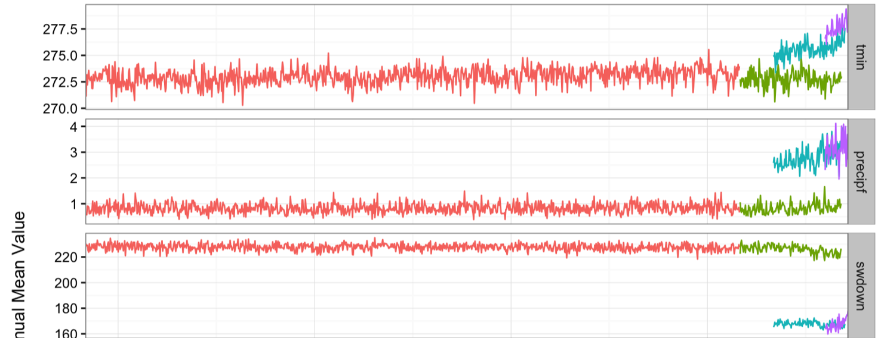
Raw Data Comparison: Annual Time Series

Slide 5
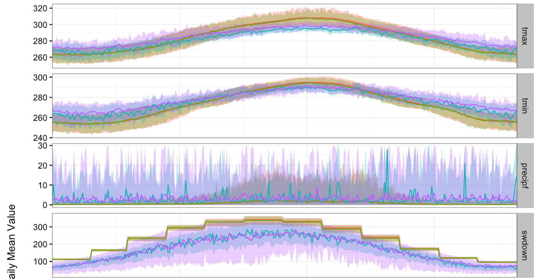
Raw Data Comparison: Seasonal Cycles

Slide 6
Challenges in Downscaling
Bias-correct to reduce abrupt jumps in data
Correct seasonal cycles in GCMs
Maintain driver covariance
Introduce high-frequency stochasticity (weather)
Introduce low-frequency uncertainty (climate)
Account for full uncertainty

Slide 7
Downscaling Approach
2-Stage Generalized Additive Mixed Model
Bias-correct climatic means: training ~ s(doy) + raw + covariates
Adjust variance of daily anomalies:
If overlapping empirical observations: anom.train ~ s(doy) + anom.raw + covariates
If GCM, use variance from training dataset: anom.train ~ s(doy, k=4) + covariates
Add in parameter & residual error
Parameter error accounts for covariance
Residual error added independently to each day
Met variables downscaled sequentially
Tmax, Tmin first

Slide 8
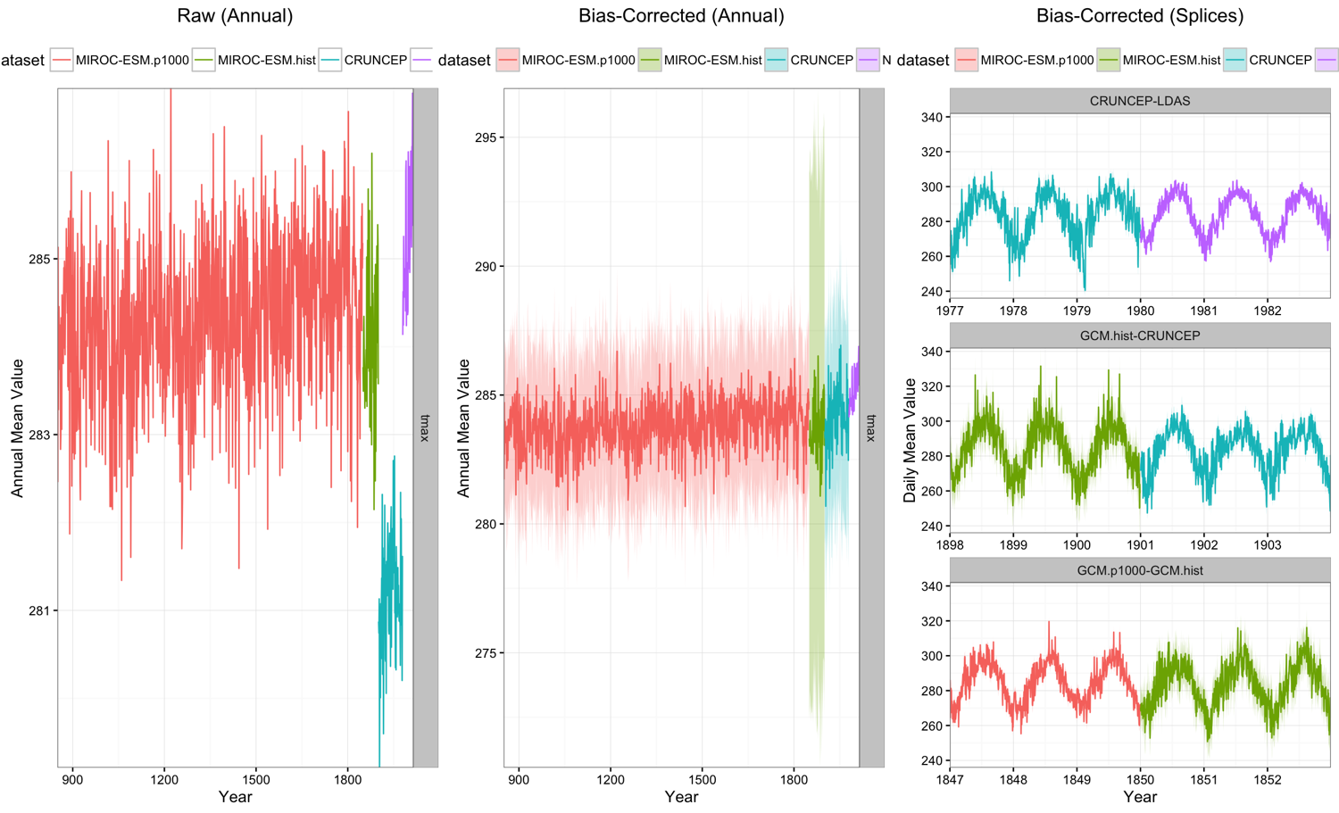
Before & After Tmax

Slide 9
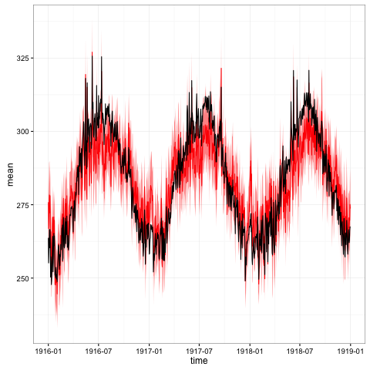
Before & After Tmax
Daily GCM, 3 years

Slide 10
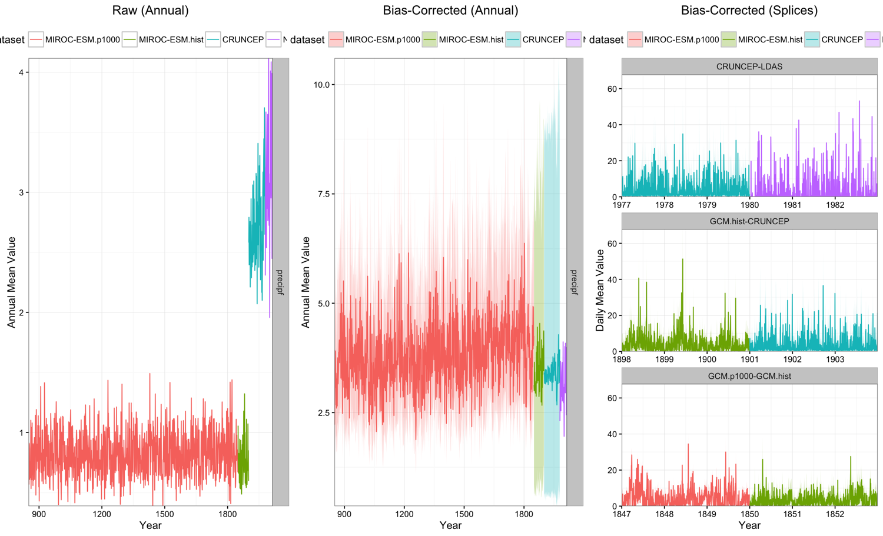
Before & After Precipf

Slide 11
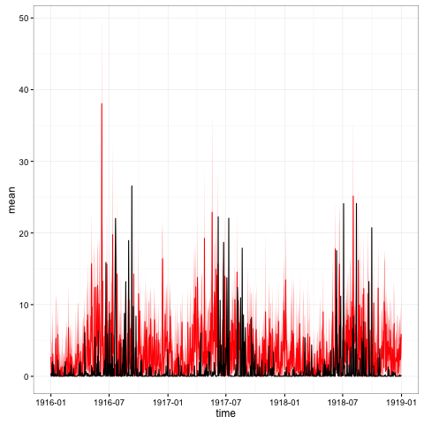
Before & After Precipf
Daily GCM, 3 years

Slide 12
Code & Test Ensembles Available for Harvard
Code on Github:
https://github.com/PalEON-Project/modeling_met_ensemble
Data Available on Dropbox (for now):
https://www.dropbox.com/sh/y6h0kbc598zjshv/AADMCRIrhT5d-n9c1UkIuFe8a?dl=0
Ensembles as .tar.bz2 in GCM/day
Sub-daily coming soon

