Slide 1
Update Datafusion Tools
New developments

Slide 2
Updates
Bug fixes
Documentation updates
Find closer points function created

Slide 3
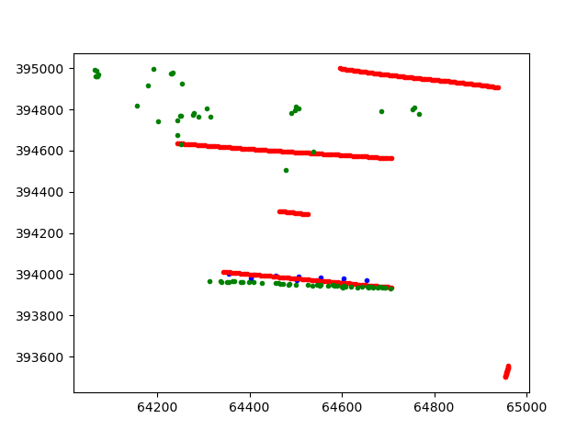
Find closer point function (1/4)
The user wants to fuse cpt and insar data together
The user can select the number of insar points that can be fused
The insar data can be aggregated by using method:
Max
Min
Mean
Sum

Slide 4
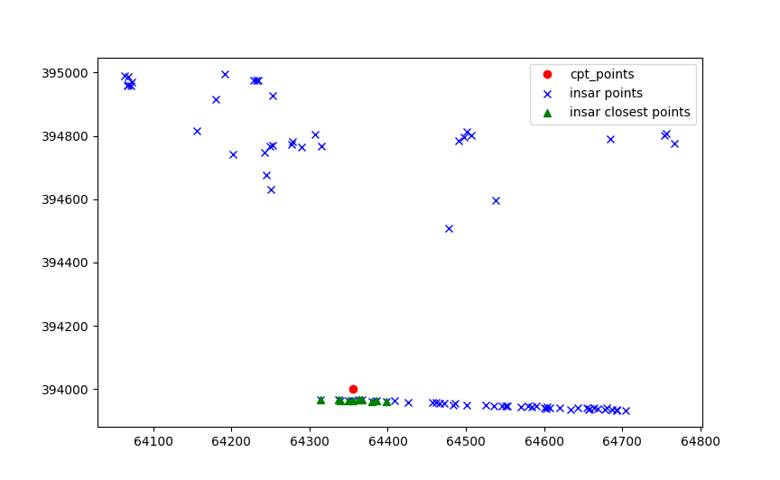
Find closer point function (2/4)
Ten closest points selected by the user

Slide 5
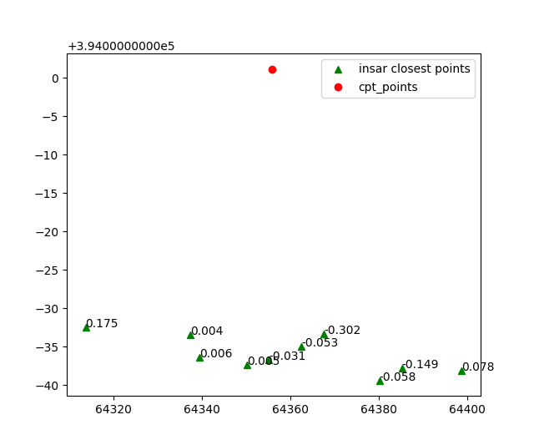
Find closer point function (3/4)
Aggregate method is SUM so the sum of displacements is calculated per insar point
Then the SUM of these points is defined for the cpt

Slide 6
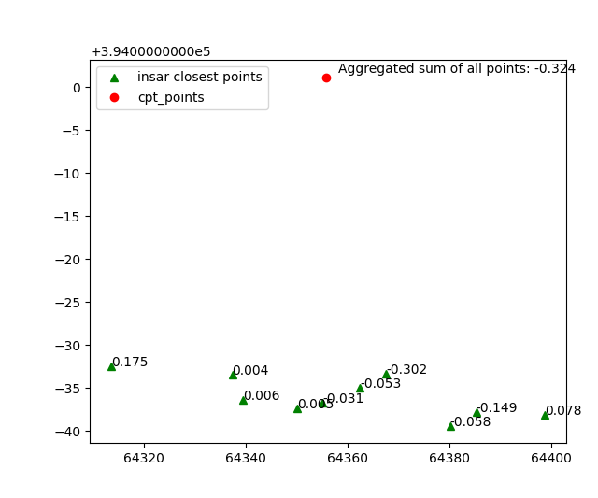
Find closer point function (4/4)
Aggregate method is SUM so the sum of displacements is calculated per insar point
Then the SUM of these points is defined for the cpt

Slide 7
Code find closer points

Slide 8
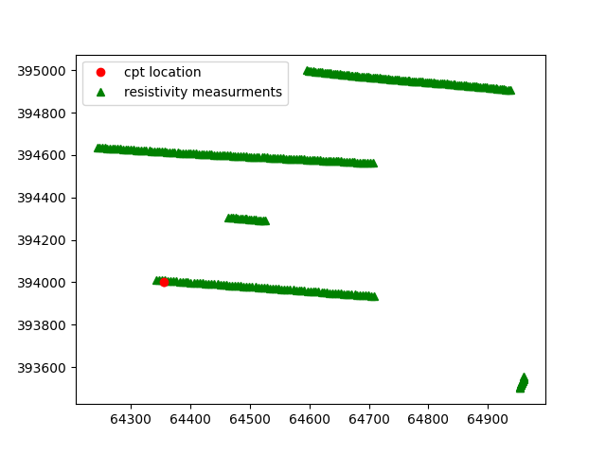
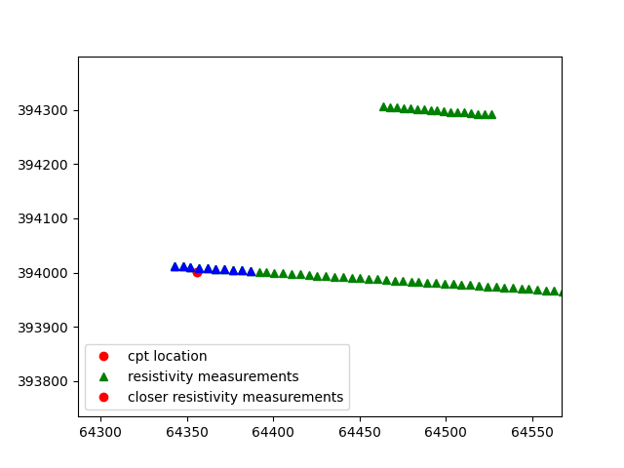
Interpolate resistivity on depth
Cpt and resistivity data
10 closer resistivity points

Slide 9
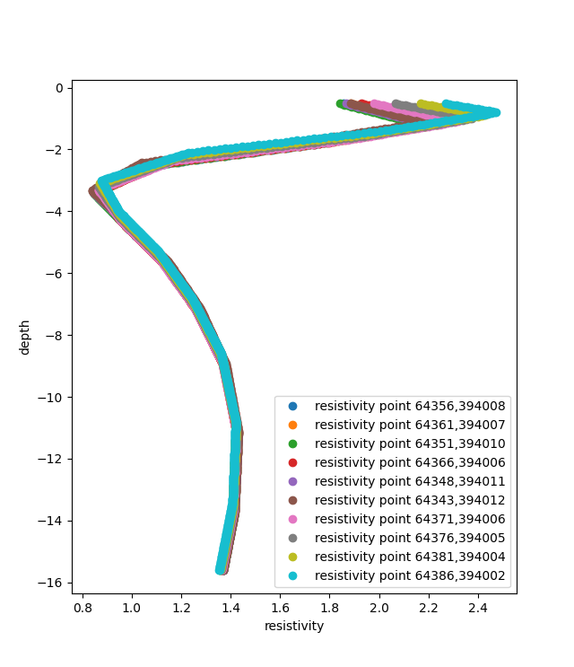
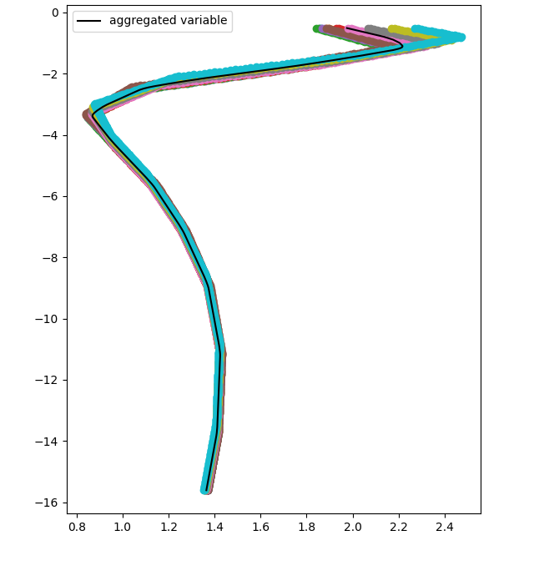
Interpolate resistivity values on cpt depth

Slide 10
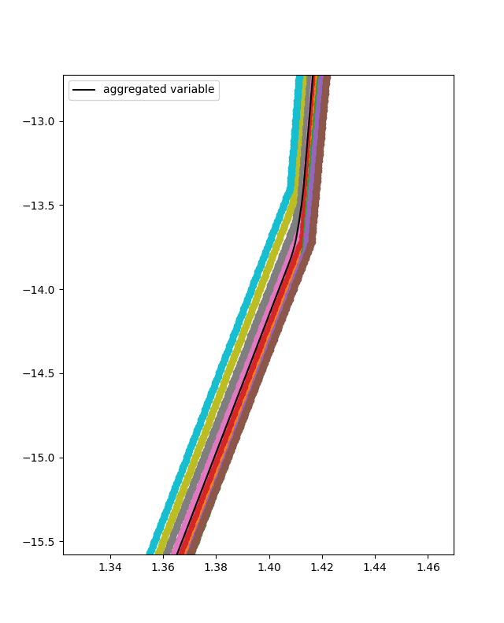
Interpolate resistivity values on cpt depth

Slide 11
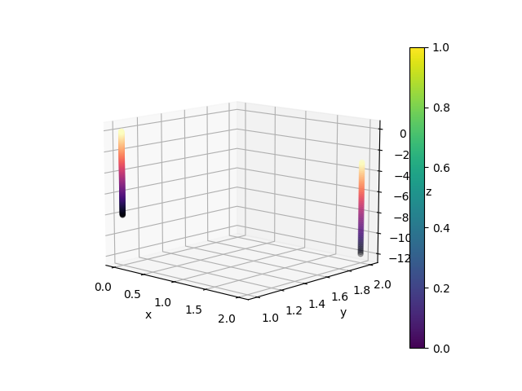
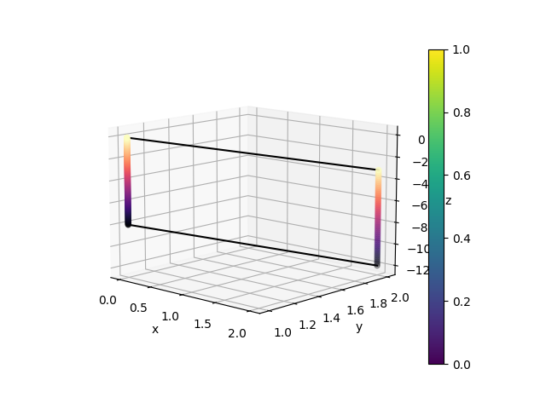
Get 2d interpolated slice
Interpolate between two fake “cpts”
The slice will be defined between the max tops and bottoms of the two “cpts”

Slide 12
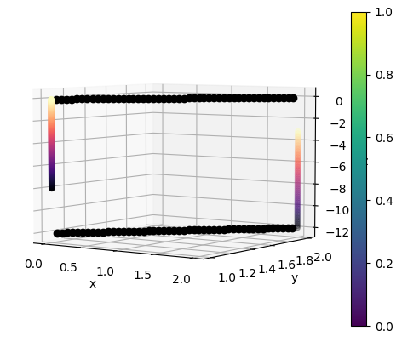
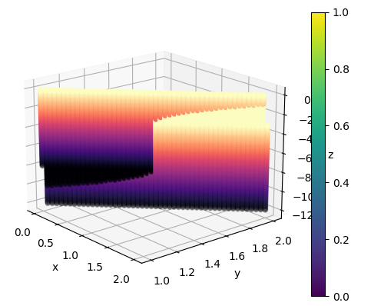
Get 2d interpolated slice
Determine the points of the slice
The resulting 2d slice

