Slide 1
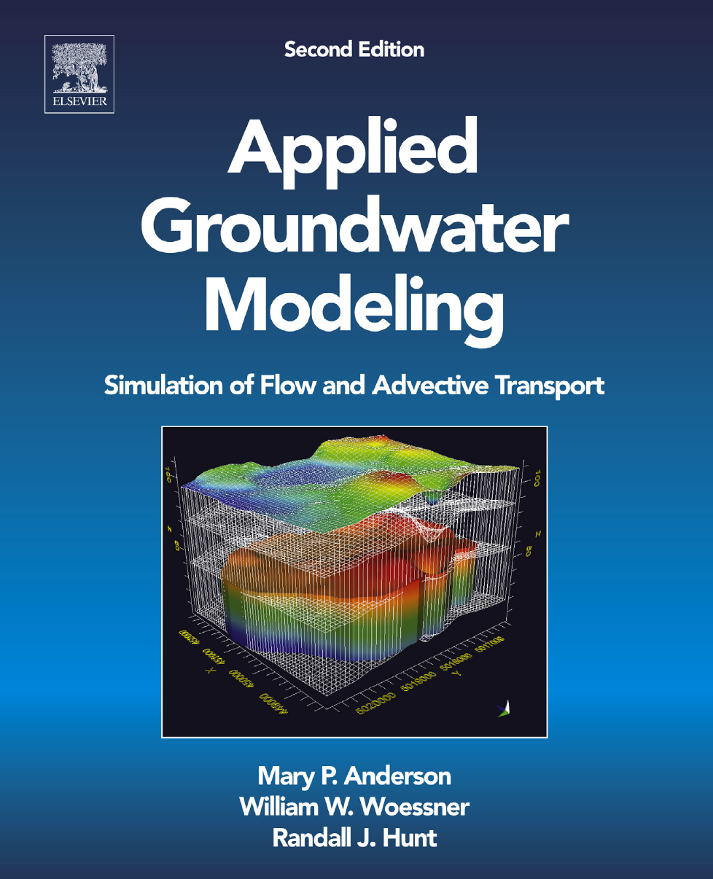
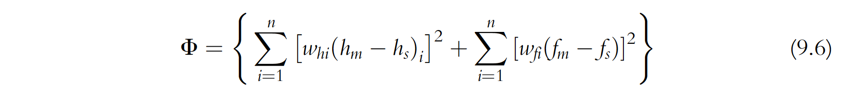
What can a measurement objective function tell us: Reading the contours of the problem A short 2nd Act

Slide 2
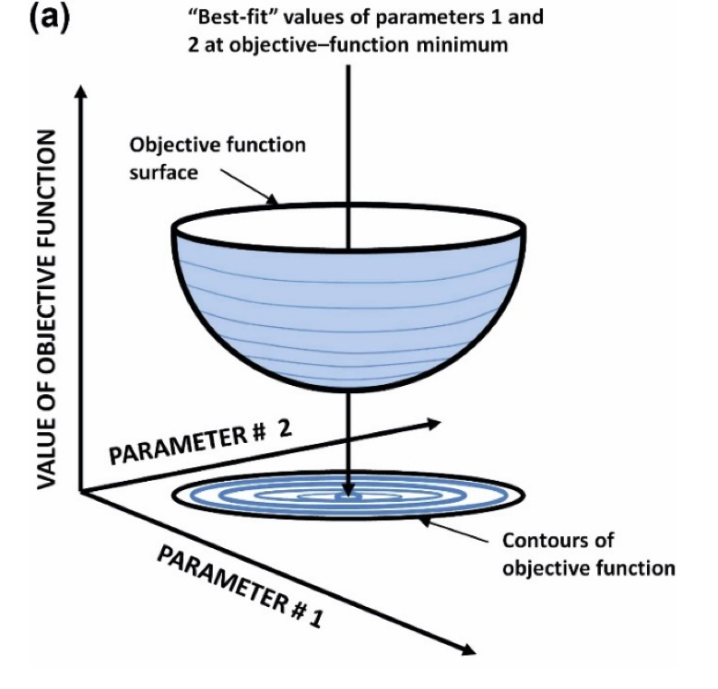
Fig. 9.10a modified from Himmelblau 1972

Slide 3
Objective function contours
linear model
p₂
Objective function
minimum
p₁
J. Doherty

Slide 4
Objective function along section line
model fits data well
objective function
Objective function
minimum
parameter values
J. Doherty

Slide 5
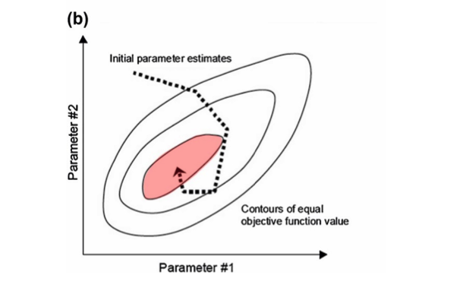
Fig. 9.10, modified from Doherty 2014

Slide 6
Objective function contours
linear model: high parameter correlation
p₂
p₁
J. Doherty

Slide 7
Objective function along section line
linear model: high parameter correlation
Objective function
minimum
objective function
Objective function is nearly at a minimum at these points
parameter values
J. Doherty

Slide 8
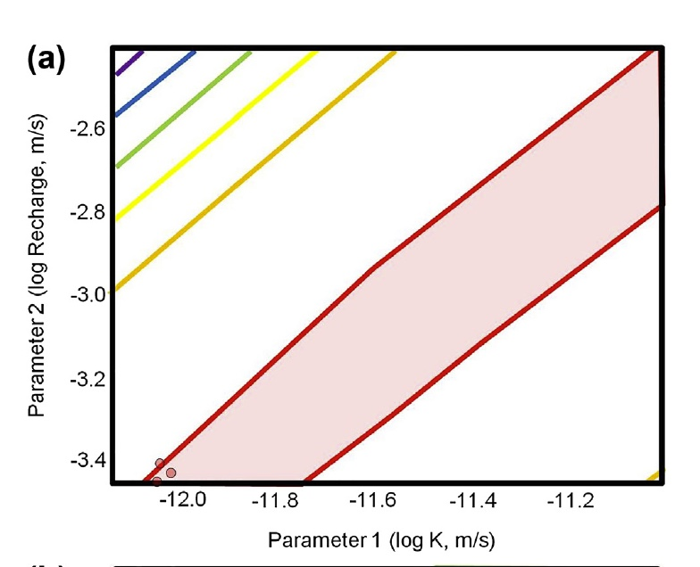
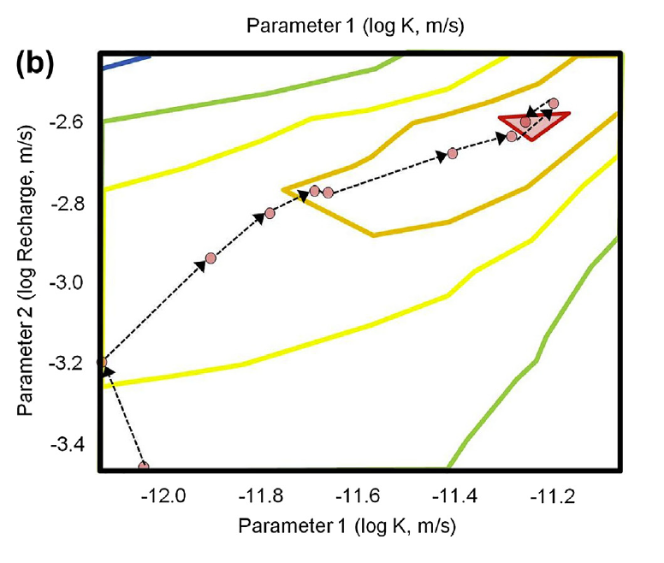
Correlation can be so bad that we can have a trough (but we want a bullseye)
Fig. 9.11 modified from Bravo et al. ( 2002)

Slide 9
Objective function contours
nonlinear model
p₂
Objective function
minimum
p₁
J. Doherty

Slide 10
Four things which make the objective function minimum less distinct:-
a large amount of data noise
poor model suitability
a high degree of correlation between parameters
poor model stability

Slide 11
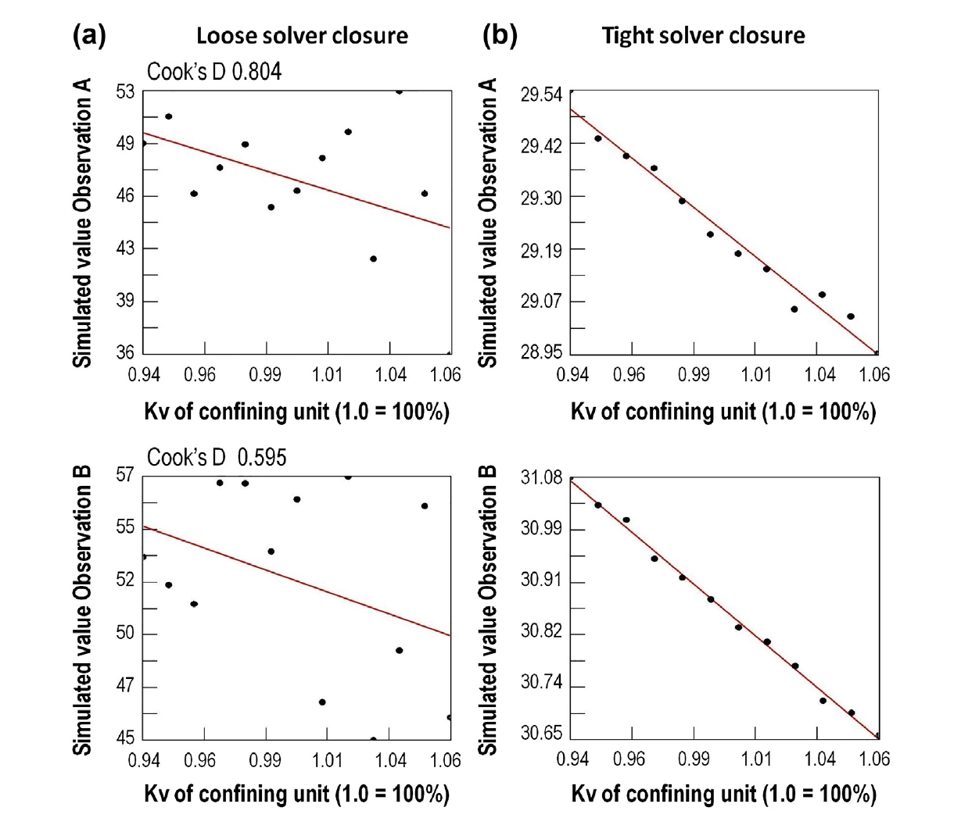
Effects of model instability
Fig. 9.13 modified from Feinstein et al. (2008)

Slide 12
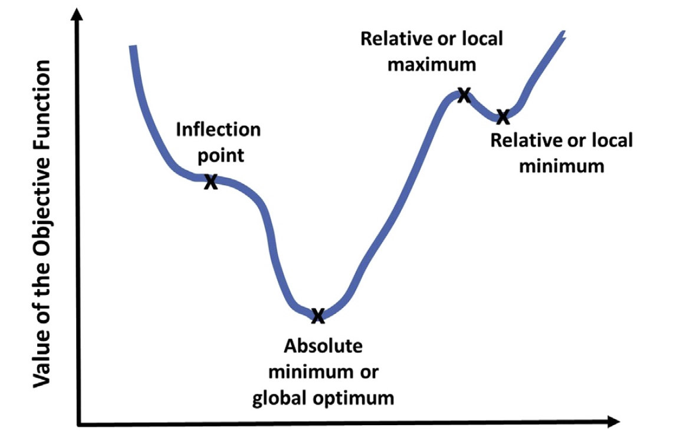
So what can result? Be aware if not afraid…
Fig. 9.12 modified from Zheng and Bennett( 2002)

