Slide 1
IES and localization

Slide 2
“A very very dark art” - J Doh

Slide 3
Iterative Ensemble Smoother

Slide 4
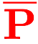
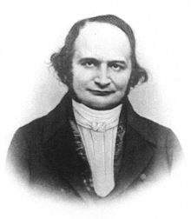
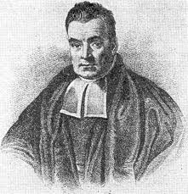
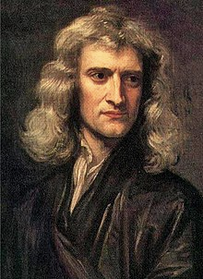
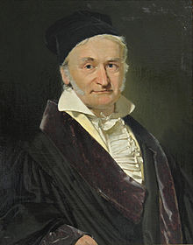
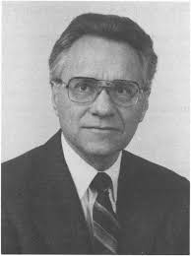

Iterative Ensemble Smoother
P ( ne x npar)
D_{sim} ( ne x nobs)
 | hk | rech | sconc
real1 | 0.123 | 1101 | 12.3
real2 | 0.321 | 1234 | 32.1
real3 | 0.987 | 2001 | 69.0
realN | 0.789 | 1959 | 54.1
 | head | conc | flux
real1 | 1.11 | 0.0001 | 3.21
real2 | 2.22 | 0.003 | 1.23
real3 | 3.33 | 0.0003 | 9.6
realN | 4.44 | 0.001 | 1.45
model runs = ne (number reals)
(e.g. Monte Carlo)
 | 0.51 | 1751 | 31.4
 | 3.35 | 0.002 | 4.51

Slide 5

Iterative Ensemble Smoother
P ( ne x npar)
D_{sim} ( ne x nobs)
 | hk | rech | sconc
real1 | 0.123 | 1101 | 12.3
real2 | 0.321 | 1234 | 32.1
real3 | 0.987 | 2001 | 69.0
realN | 0.789 | 1959 | 54.1
 | head | conc | flux
real1 | 1.11 | 0.0001 | 3.21
real2 | 2.22 | 0.003 | 1.23
real3 | 3.33 | 0.0003 | 9.6
realN | 4.44 | 0.001 | 1.45
model runs = ne (number reals)
(e.g. Monte Carlo)
 | 0.51 | 1751 | 31.4
 | 3.35 | 0.002 | 4.51

Slide 6

Iterative Ensemble Smoother
P ( ne x npar)
D_{sim} ( ne x nobs)
 | hk | rech | sconc
real1 | 0.123 | 1101 | 12.3
real2 | 0.321 | 1234 | 32.1
real3 | 0.987 | 2001 | 69.0
realN | 0.789 | 1959 | 54.1
 | head | conc | flux
real1 | 1.11 | 0.0001 | 3.21
real2 | 2.22 | 0.003 | 1.23
real3 | 3.33 | 0.0003 | 9.6
realN | 4.44 | 0.001 | 1.45
model runs = ne (number reals)
(e.g. Monte Carlo)
 | 0.51 | 1751 | 31.4
 | 3.35 | 0.002 | 4.51

Slide 7
P ( ne x npar)
D_{sim} ( ne x nobs)
 | hk | rech | sconc
real1 | 0.123 | 1101 | 12.3
real2 | 0.321 | 1234 | 32.1
real3 | 0.987 | 2001 | 69.0
realN | 0.789 | 1959 | 54.1
update via GLM
(e.g. maths)
 | head | conc | flux
real1 | 1.11 | 0.0001 | 3.21
real2 | 2.22 | 0.003 | 1.23
real3 | 3.33 | 0.0003 | 9.6
realN | 4.44 | 0.001 | 1.45
model runs = ne (number reals)
(e.g. Monte Carlo)
 | 0.51 | 1751 | 31.4
 | 3.35 | 0.002 | 4.51

Slide 8
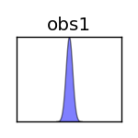
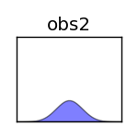

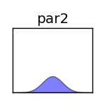
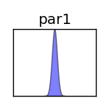
An aside: approximating derivatives with ensembles

Slide 9
PESTPP-IES
Fully compatible with PEST(_HP)
“Just works”
++ again
Fundamental element: ensemble
Scales up to 15M pars
multi-threaded solver
White and others (2019). PEST++ users manual. https://github/usgs/pestpp

Slide 10
PESTPP-IES
Initialize
Draw or read
Eval if needed
Calc upgrade matrices
One per lambda
Select subset
Random by default
Eval subset and find lowest phi
Eval remaining reals in best upgrade matrix
White and others (2019). PEST++ users manual. https://github/usgs/pestpp

Slide 11
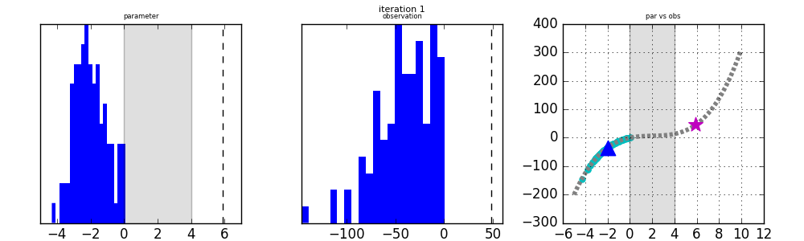

Chen and Oliver (2013): 1 par, 1 obs, 100 realizations

Slide 12
Chen and Oliver (2013): 1 par, 1 obs, 100 realizations

Slide 13
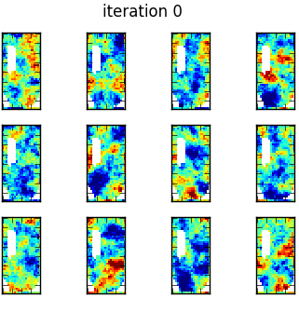
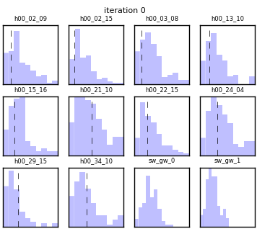
Freyberg (1988) - 761 pars, 10 obs, 100 realizations

Slide 14
Freyberg (1988) - 761 pars, 10 obs, 100 realizations

Slide 15

PESTPP-IES

Slide 16
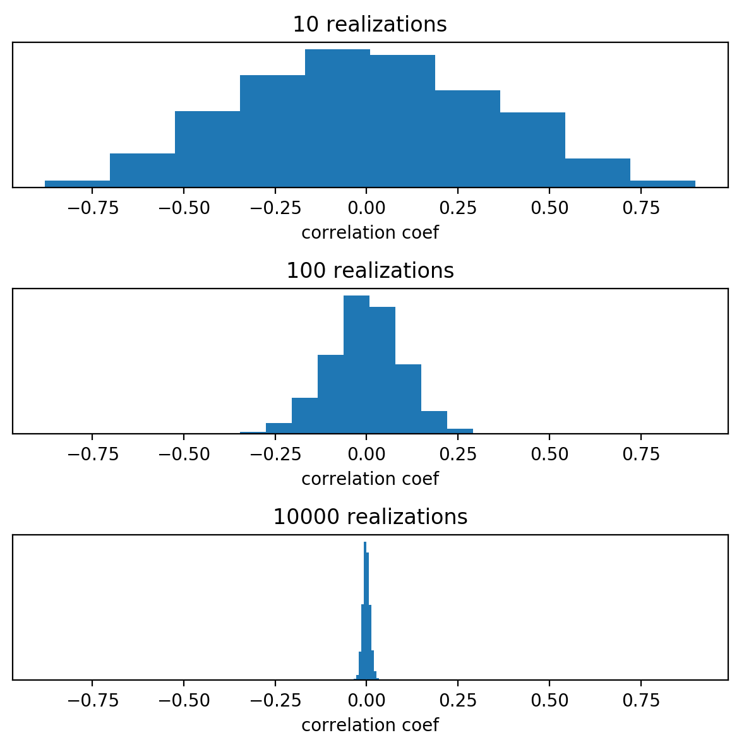
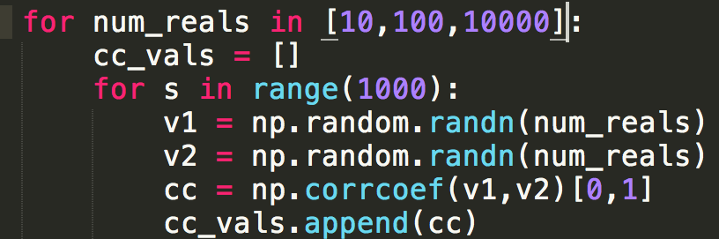
Why localization pt 1: spurious correlation
causality vs correlation

Slide 17
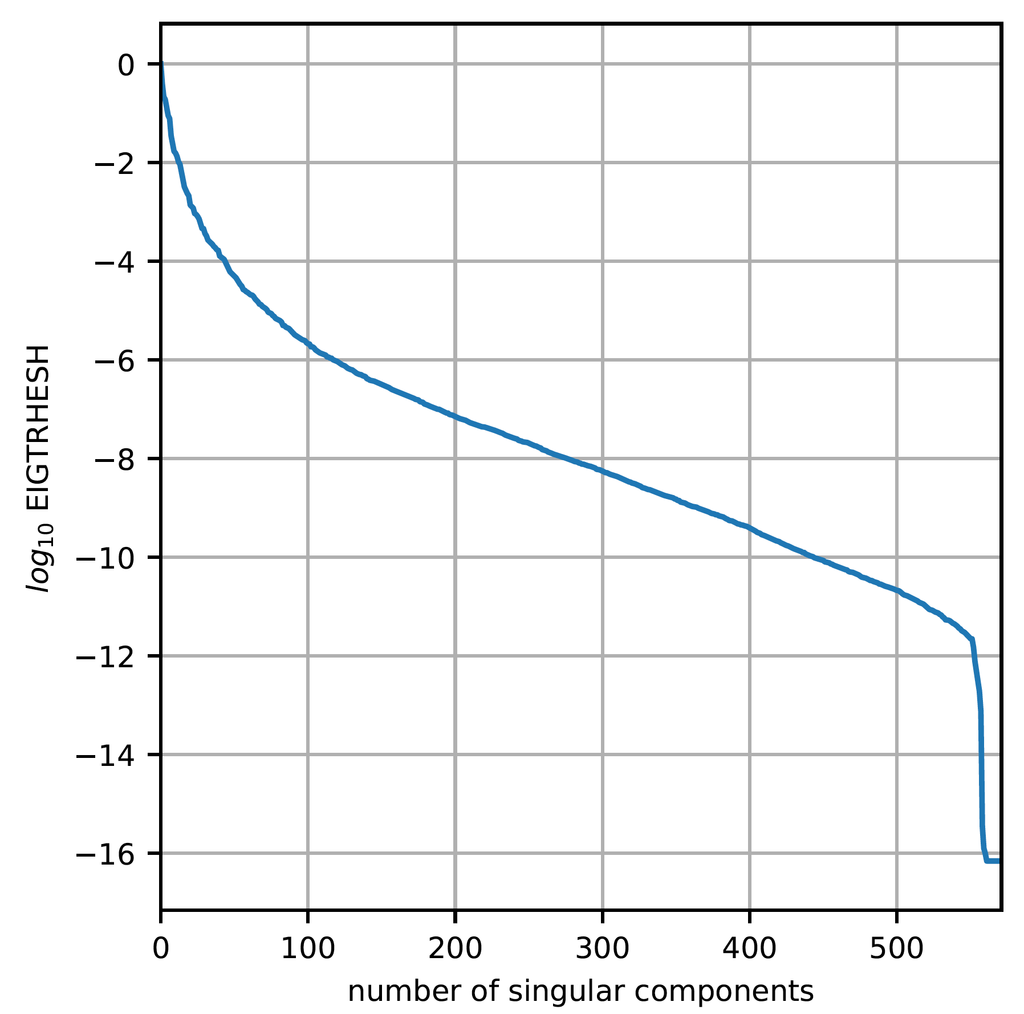
Why localization pt 2: low-rank approximation
Too many reals = too many model runs
Too few reals < solution space
Chen and Oliver (2017). Localization and regularization for iterative ensemble smoothers

Slide 18
The easy stuff: temporal localization
Temporal parameters can’t influence observations backwards-in-time (duh!)
Recharge in 2019 can’t influence heads in 2018
Temporal parameters probably don’t influence observations too far into the future
Allow some system memory

Slide 19
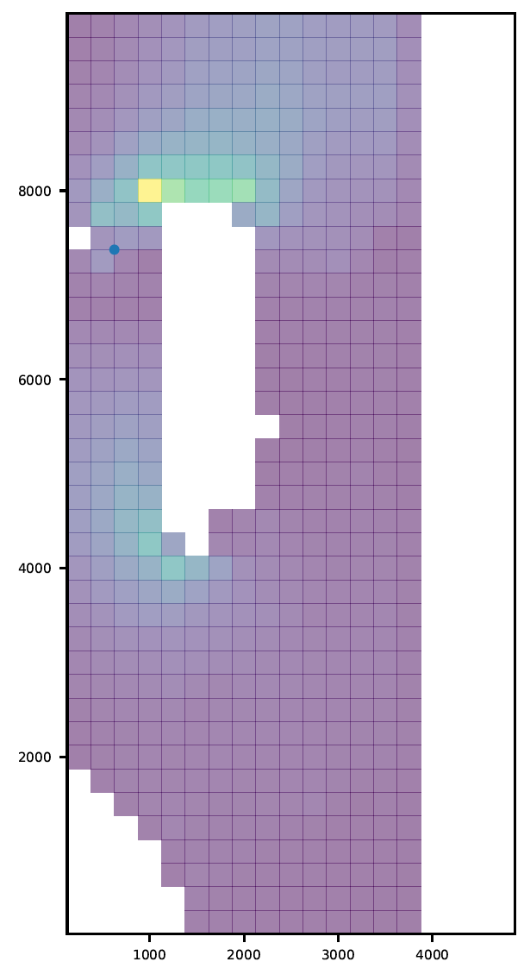
Spatial localization
Historical:
linear and local state covariances in weather
Temperature measured at a given location is only correlated (linearly) with other nearby temperatures
In the parameter estimation setting, its less clear
Physics transmits parameter influence over large(r) distances and in complex patterns
Area of active research

Slide 20
How matrix-based localization is implemented
In PESTPP-IES: ++ies_localizer(“loc.mat”)
must list all adjustable parameters
In either groups or names
Must list all non-zero weight obs
In either groups or names
Values must range between 0 and 1
Each column (par/pargp) is processed individually to build up the upgrade matrix
An embarrassingly parallel problem
multi-threaded
White and others (2019). PEST++ users manual. https://github/usgs/pestpp

Slide 21
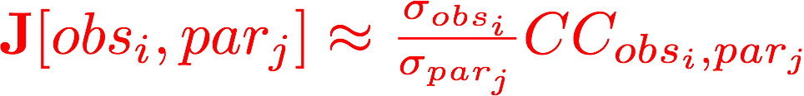
Automatic adaptive localization
Pearson Correlation Coef
between parameter par_{j} and observation obj_{i}
Standard deviation of parameter par_{j} and observation obj_{i}
(“known”)
Anderson (2012). Localization and Sampling Error Correction in Ensemble Kalman Filter
Data Assimilation

Slide 22
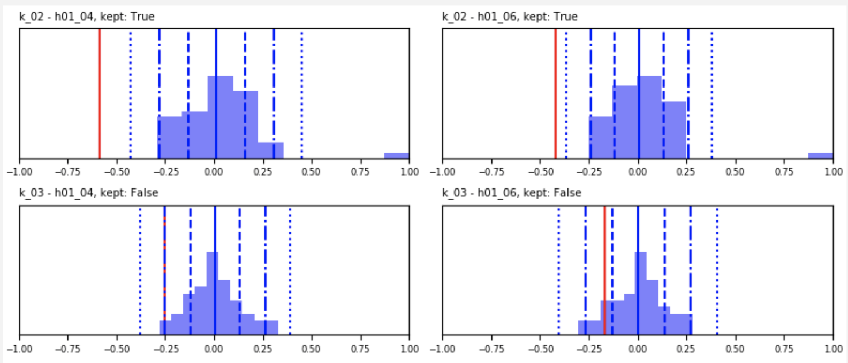
Automatic adaptive localization
Luo and Bakhta (2018). Towards Automatic And Adaptive Localization For Ensemble-Based History Matching

Slide 23
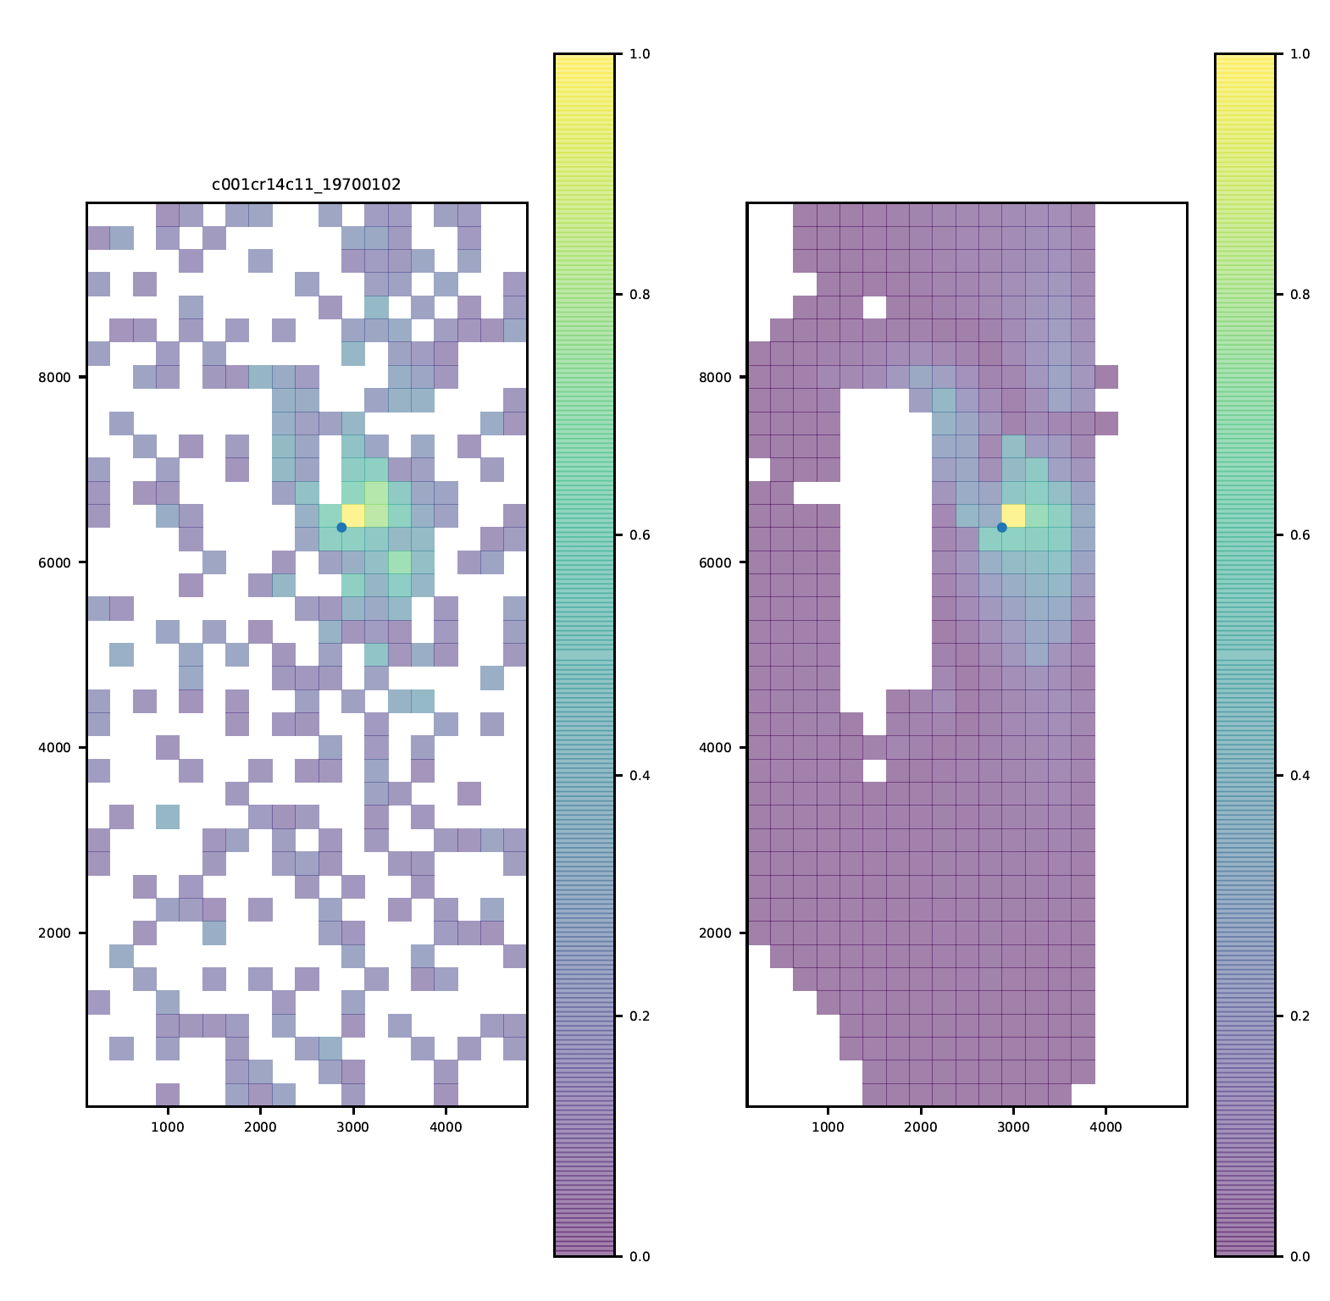
Automatic adaptive localization

