Slide 1
PESTPP-OPT
A foray into OUU

Slide 2
Optimization mgmt vs PE/UQ: terminology
Parameters
(historic) observations
forecast/prediction
Objective function
Prior information
Jacobian matrix
Decision variables
?
Model-based constraints
Objective function
Prior information constraints
Response matrix

Slide 3
Optimization concepts
PESTPP-OPT solves the sequential linear programming problem with option of using chance constraints to incorporate parameter uncertainty into the optimal solution
Again, ++args…
The iteration scheme is very similar to pest(_hp,pp-glm): fill matrix, calc upgrade…

Slide 4
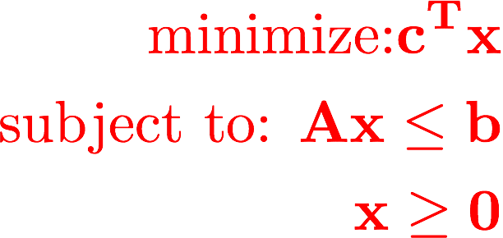
(S)LP: theory

Slide 5
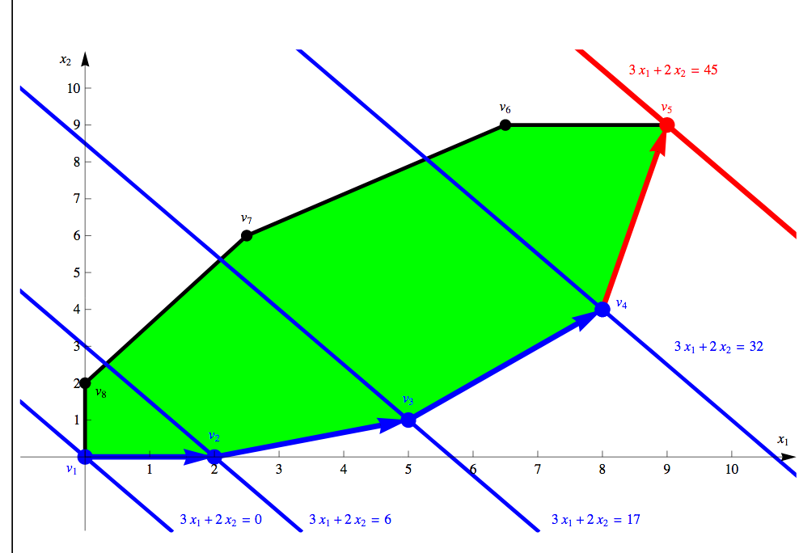

Slide 6
(S)LP: Mechanics
Filling the resp matrix
Identifying PI and model-based constraints
Identifying the obj function (and direction)
White and others (2018). A tool for efficient, model-independent management optimization under uncertainty

Slide 7
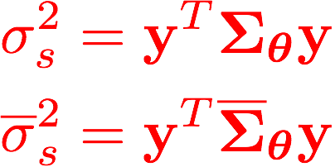
Chance constraints: Theory
We can use the same FOSM trickery to estimate uncertainty in model-based constraints
concept of “risk” to “shift” the model-based constraints along the implied gaussian distribution
prior and posterior
forecast variance
Model-based constraint
Wagner and Gorelick (1987). Optimal groundwater quality management under parameter uncertainty.

Slide 8
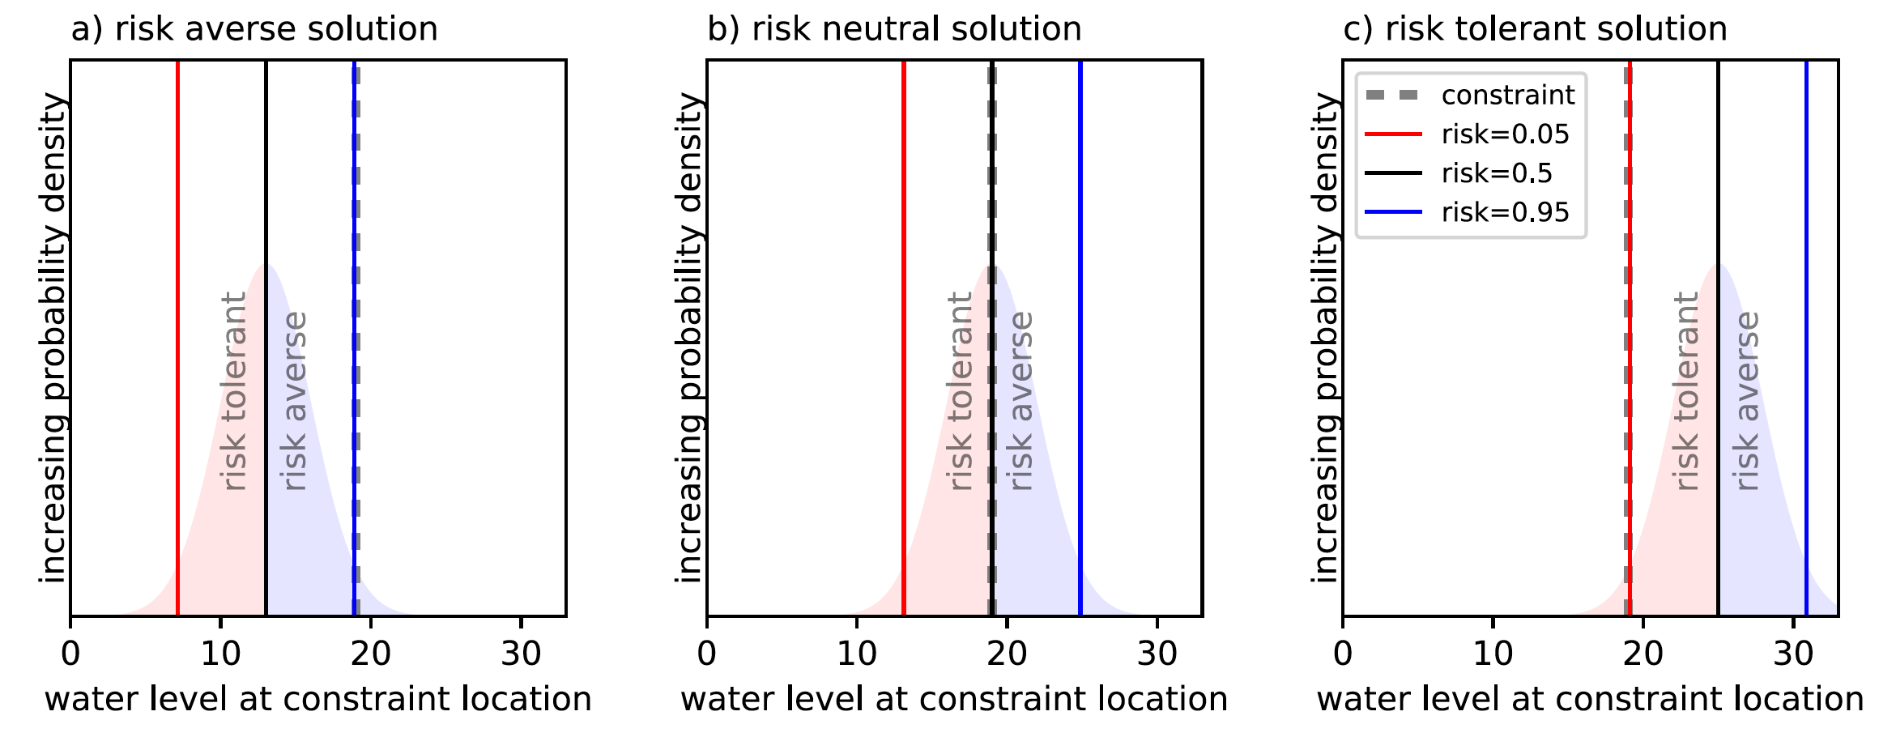
Chance constraints: Theory

Slide 9

Chance constraints: Mechanics
Fill jacobian (mapping between pars and constraints)
FOSM linear algebra to estimate constraint standard deviation
Shift along implied CDF to find risk-based value
Solve LP as before
Enjoy (deterministic) optimal solution that includes uncertainty - WAT!?

Slide 10
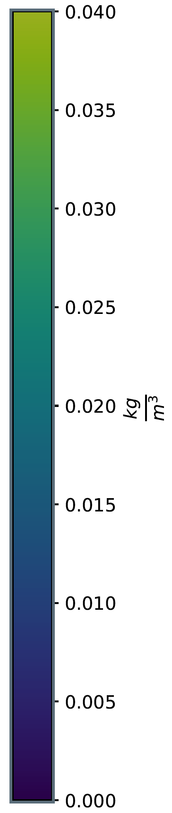
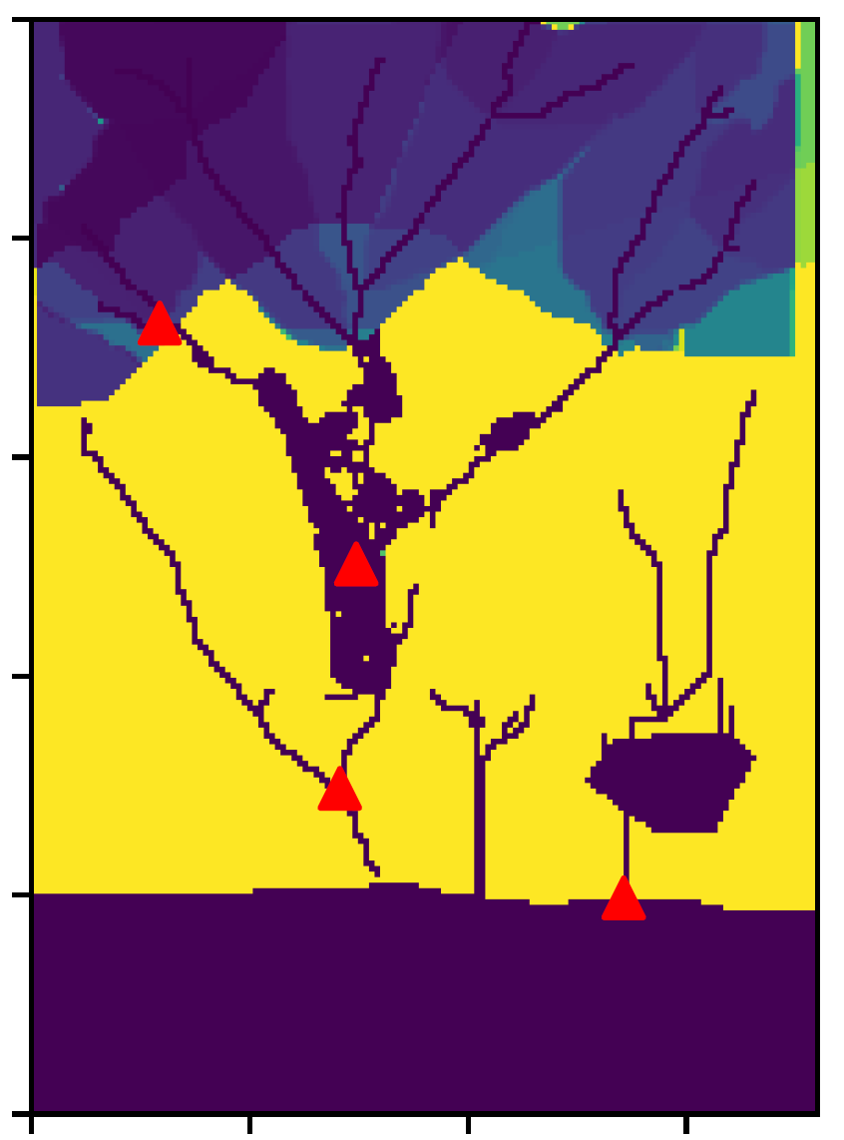
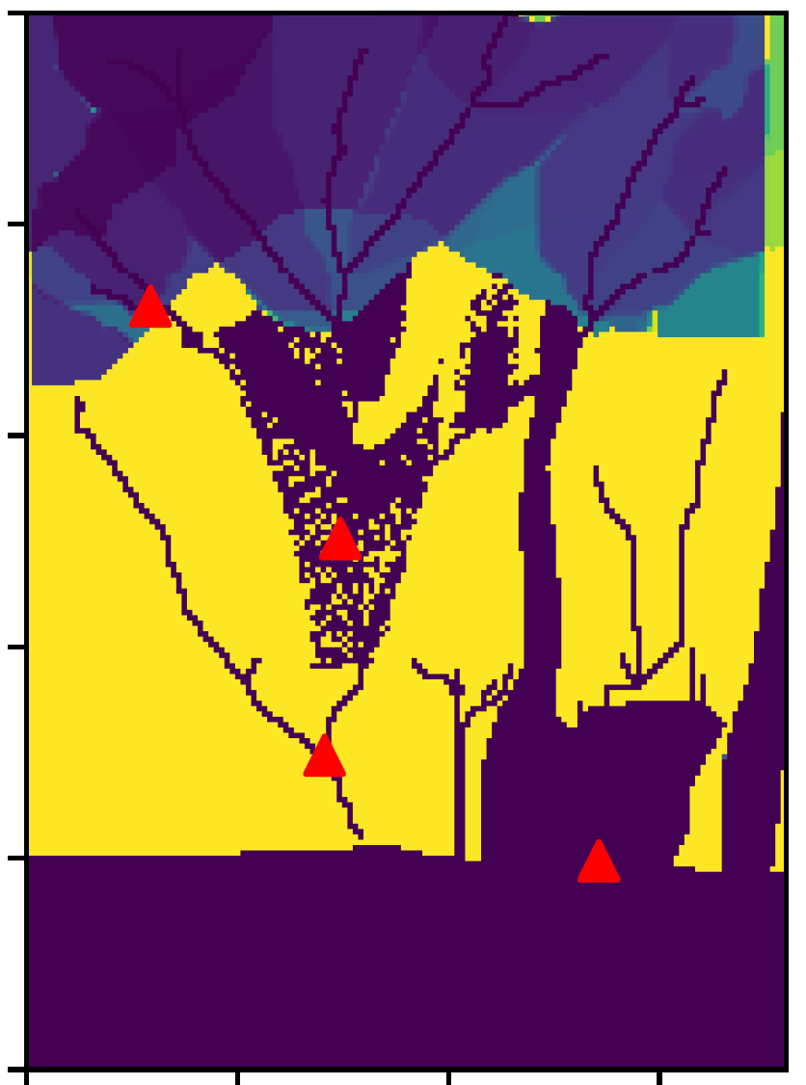
14K dec var for nitrate loading vs SW quality
risk tolerant
risk averse

