Slide 1
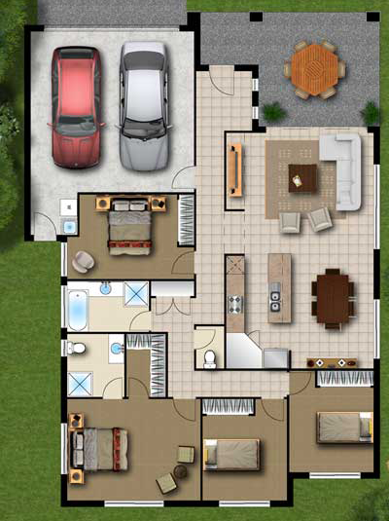
Bayes’ Theorem: Where are my Keys????
Probability
BR1
BR2
BR3
BR4
Living
Patio
Kitchen
Garage
Bathrooms

Slide 2

Bayes’ Theorem: Where are my Keys????
Probability
BR1
BR2
BR3
BR4
Living
Patio
Kitchen
Garage
Bathrooms

