Slide 1

Exploratory Data Analysis
G2M insight for Cab Investment firm
Name: Roger Burek-Bors
Location: Warsaw, Poland
Team: Data and Analytics
Date: March 11, 2021

Slide 2

Agenda
Executive Summary
Problem Statement
Approach
EDA
EDA Summary
Recommendations

Slide 3
Executive Summary
Descriptive, correlation and contextual analysis were made to help XYZ firm in identification of the right cab company to make investment.
6 hypothesis were constructed to gain knowledge on the subject and formulate final recommendation. Main topics included:
patterns among cities when it comes to population and cab users
market size and access
cost, income and profit per each company
trip patterns in particular cities per each company
payment method preferences
economic trends and seasonality
I recommended XYZ firm to invest in Yellow Cab based on evidence collected and outcome of my analysis.

Slide 4
Problem Statement
XYZ is a private firm in US. Due to remarkable growth in the Cab Industry in last few years and multiple key players in the market, it is planning for an investment in Cab industry and as per their Go-to-Market (G2M) strategy they want to understand the market before taking final decision.
Objective:
XYZ is interested in actionable insights to help them identify the right company to make their investment.

Slide 5
Approach
Verification of data sets provided by XYZ, features descriptive analysis and combining into joint data frame.
Formulation of hypothesis.
Performing EDA over formulated hypothesis (correlation and contextual analysis).
Concluding EDA and writing recommendation.

Slide 6
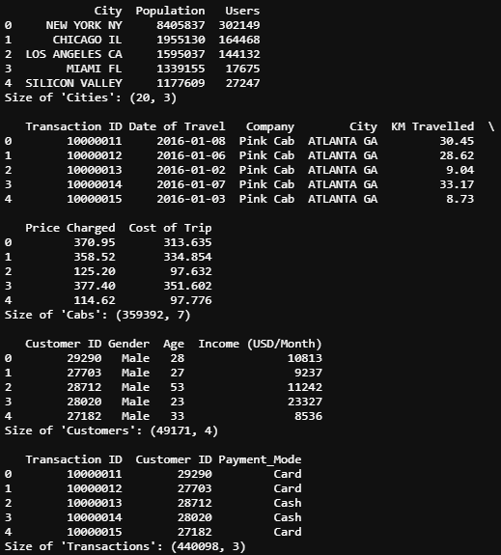
EDA – provided data sets
XYZ provided 4 data sets:
City.csv
Cab_Data.csv
Customer_ID.csv
Transaction_IDta.csv
There was total of 17 features in provided data sets.
4 features repeated across data sets and as master features were used to integrate data into one data frame.
There was no data duplication while checking on master features in each data sets:
‚City’ in City.csv
‚Transaction ID’ in Cab_Data.csv
‚Customer ID’ in Customer_ID.csv
‚Transaction ID’ in Transaction_IDta.csv
There was no NaN values in provided data.

Slide 7
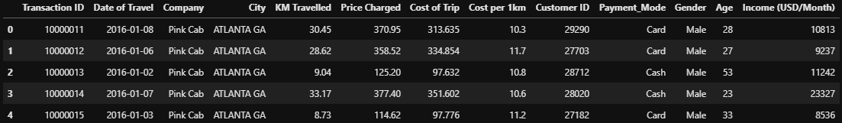
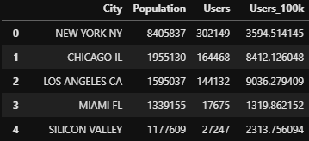
EDA – created joint data frame
Joint DF:
Time period of the data: 2016-01-02 to 2018-12-31.
Total features: 13
Total data points: 359,392
Supporting DF:
Statistical information about cities
Total features: 4
Total data points: 20

Slide 8
EDA – hypothsis
Hypothesis no. 1: bigger cities have more cab users.
Hypothesis no. 2: bigger cities provide more profit and equal opportunities to cab companies.
Hypothesis no. 3: costs for cab companies are lower in big cities
Hypothesis no. 4: drivers in smaller cities have shorter rides than in bigger ones.
Hypothesis no. 5: customers like to pay by cash.
Hypothesis no. 6: cab market is stable business and there is no seasonality in the demand.

Slide 9
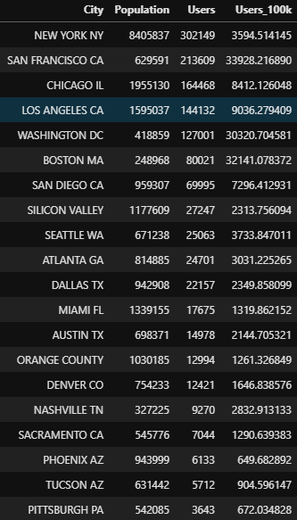
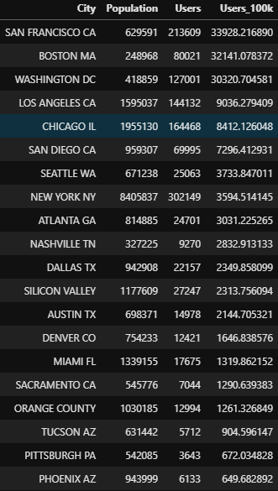
EDA - Hypothesis no. 1
„cab users”
Ranking of cities – total no of users
Ranking of cities – users per 100k
Size of the city does not determine quantity of cab users.
There are cities like San Francisco, Boston or Washington D.C. to have more cab users per 100k citizens than much bigger cities.
NYC has relatively low number of cab users when calculated per 100k of population. It might be due to developed network of public transpo-rtation.
To make best investment decision we should analyse more closely market size and market share between Yellow and Pink Can companies in: NYC, San Francisco, Boston, Washington D.S., Loas Angeles and Chicago.

Slide 10
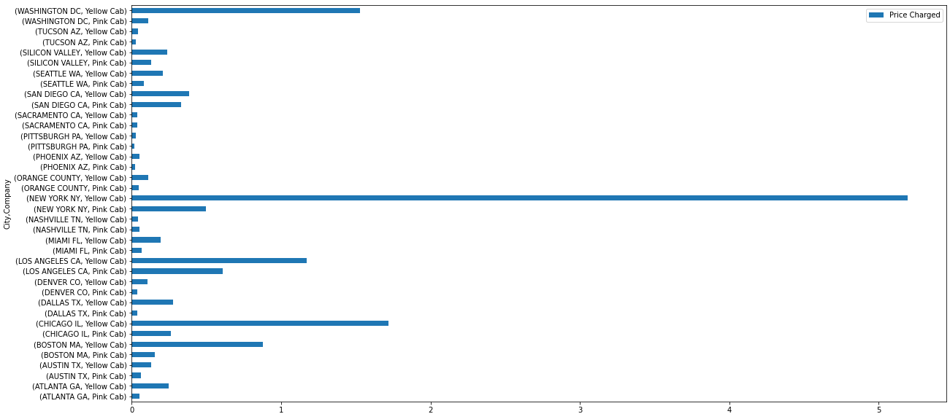
EDA - Hypothesis no. 2
„size of market”
Yellow Cub has superior market position in:
NYC
Washington D.C.
Miami
Los Angeles
Dallas
Chicago
Boston
Atlanta
Pink Cab performs better only in Nashville.
Equal market size is in Sacramento.
Market value of 20 cities:
Total: 152 mln $ (100%)
Yellow Cab: 125 mln $ (82%)
Pink Cab: 27 mln $ (18%)

Slide 11
EDA - Hypothesis no. 3
„cost, income & profit”
Mean cost per trip (= all expenses like petrol, car amortisation, driver salary, dispatching, etc.):
Yellow Cab – 297.92 $
Pink Cab – 238.15 $
Mean income per trip (= money earned on trip, excluding tip for driver):
Yellow Cab – 458.18 $
Pink Cab – 310.80 $
Mean profit per trip:
Yellow Cab – 160.25 $ (35%)
Pink Cab – 72.65 $ (23%)

Slide 12
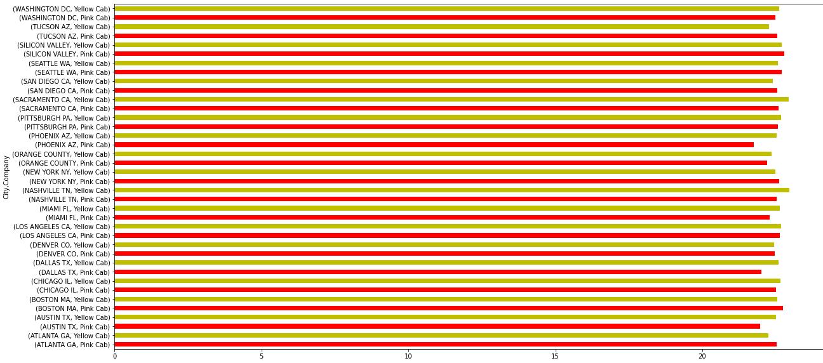
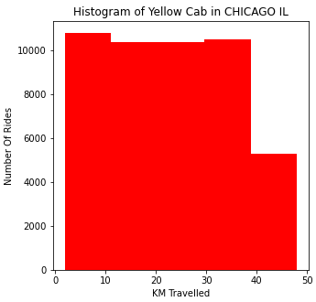
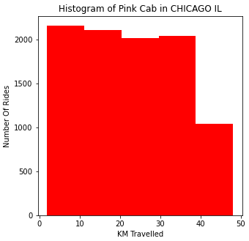
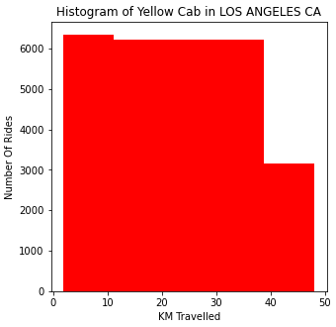
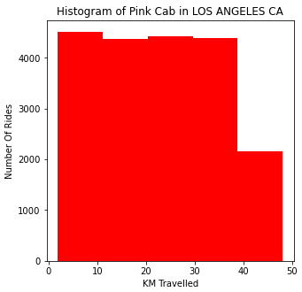
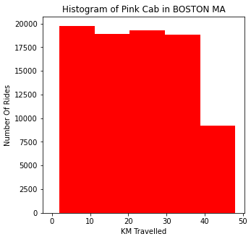
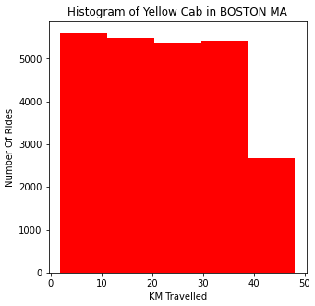
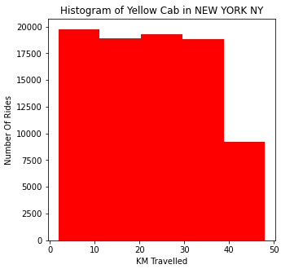
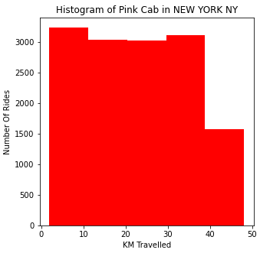
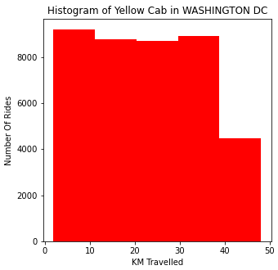
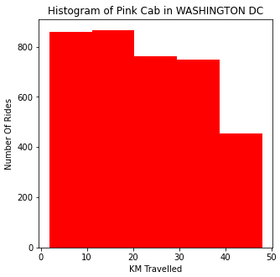
EDA - Hypothesis no. 4
„parameters of trips”

Slide 13
EDA - Hypothesis no. 5
„payment methods”
Nowadays customers likes to pay by cards.
Quantity and value analysis indicate that card payment method scores 60%, against cash payment – 40%,
Both companies must invest in card terminals in cabs since there is quite similar preference among their customer base.

Slide 14
EDA - Hypothesis no. 6
„annual income and trends”

Slide 15
EDA Summary
Provided data sets were verified for duplication and missing values. Most promising features were selected and few features added that broaden the expertise.
Joint data frame was created for future modelling.
6 hypothesis were constructed and verified in correlation and contextual analysis.
Final recommendation was provided based on outcome of analysis.

Slide 16
Recommendations (1)
To choose between particular cab company we should understand the market first. Market situation in enumerated below cities should be crucial to take investment decision. NYC provides the largest and outstanding market worth more than 56 million USD in analyzed period (2016-18). Cities that provided cab market bigger than 10 million USD in analyzed period (2016-18) are:
Chicago IL – 20 million USD
Los Angeles – 18 million USD
Washington D.C. – 16 million USD
Boston MA – 10 million USD
Another important decision factor is number of users in particular city:
In global:
Boston MA – 80,021
Washington D.C. – 127,001
Los Angeles – 144,132
Chicago IL – 164,468
San Francisco – 213,609
NYC – 302,149
And per 100k citizens:
NYC – 3,595
Chicago IL – 8,412
Los Angeles – 9,036
Washington D.C. – 30,321
Boston MA – 32,141
San Francisco – 33,928

Slide 17
Recommendations (2)
Therefore, investors should choose cab company based on data and metrics for those cities.
Yellow Cab took more than 75% market when it comes to revenue in NY City, Chicago, Los Angeles, Washington and Boston.
Comparison of mean profit generated from all performed trip is in favor for Yellow Cab:
Yellow Cab – 160.25 $ (35% of income)
Pink Cab – 72.65 $ (23% of income)
Both companies have similar profit trends within the year, and also while comparing year-to-year. Seasonality in demand grows bigger in second part of the year.
Investing in Yellow Can require founds for equipping cabs with card terminals since card payments are the most popular among customers.
Final recommendation:
I would recommend to investors Yellow Cab as they can count on more return on investment.

Slide 18
Thank You

