Slide 1

G2M Case Study
Virtual Internship
Huu Thien Nguyen
19-May-2022

Slide 2
Background –G2M(cab industry) case study
XYZ is a private equity firm in US. Due to remarkable growth in the Cab Industry in last few years and multiple key players in the market, it is planning for an investment in Cab industry.
Objective : Provide actionable insights to help XYZ firm in identifying the right company for making investment.
The analysis has been divided into four parts:
Exploratory data analysis
Finding the most profitable Cab company
Forecasting profit
Recommendations investment strategy

Slide 3


1. Exploratory data analysis
Summary:
22 Features (including feature engineering)
Timeframe: 02-Jan-2016 to 31-Dec-2018
Total observations: 359392
Cab_data.csv
Customer.csv
Transaction.csv
City.csv
Full dataframe

Slide 4
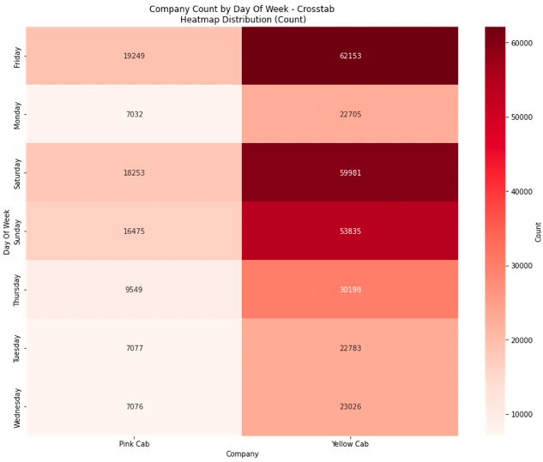
1. Exploratory data analysis
Insight #1
Weekends (Fri, Sat, Sun) accounted for 64% of the transaction.
Businesses should prepare more workforce and resources on the weekend occasion

Slide 5
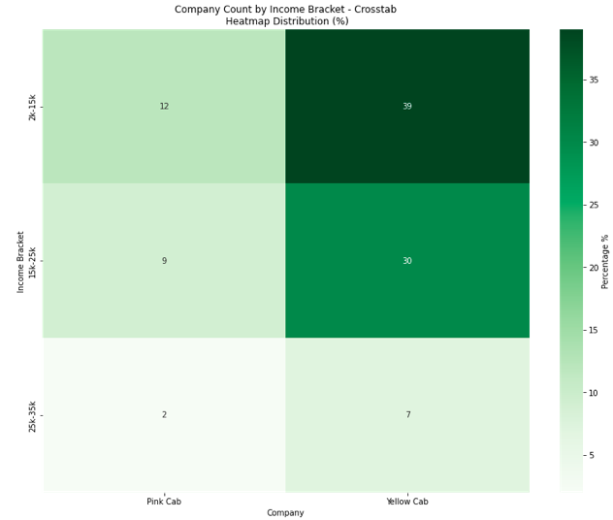
1. Exploratory data analysis
Insight #2
Customer’s income segment from 2k-25k USD/month accounted for 91% of the total transaction.
Marketing campaign should focus on these groups.

Slide 6
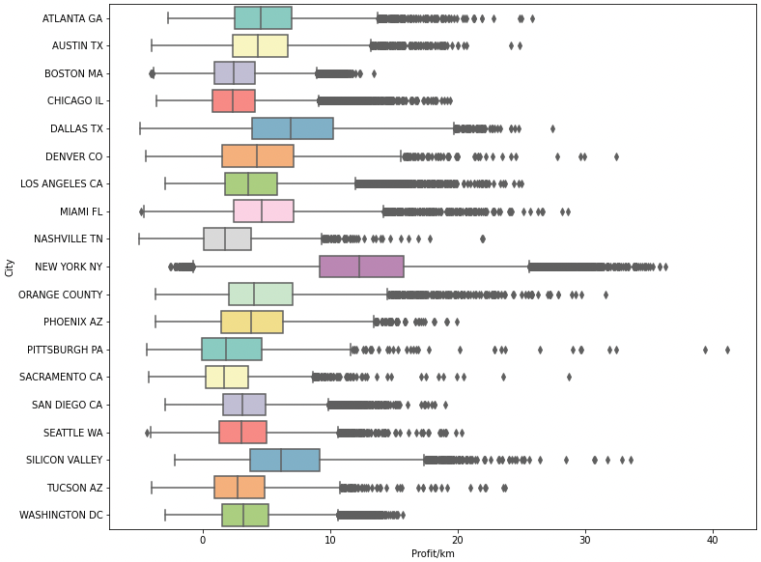
1. Exploratory data analysis
Insight #4
New York has the highest Profit/km out of any city (mean > 10$)
We can focus of the New York to increase the profit / or invest in other city to increase coverage, depend on strategy.

Slide 7
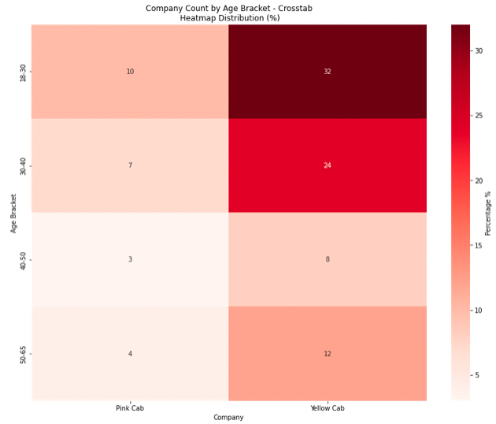
1. Exploratory data analysis
Insight #3
The customer’s age bracket from 18-40 accounted for 73% of the total transaction.
The marketing campaign should focus on this sector.

Slide 8
Profit Analysis
2. Finding the most profitable Cab company
3 main criteria to determine the investment:
Total profit
Average profit/km
Total number of transaction

Slide 9
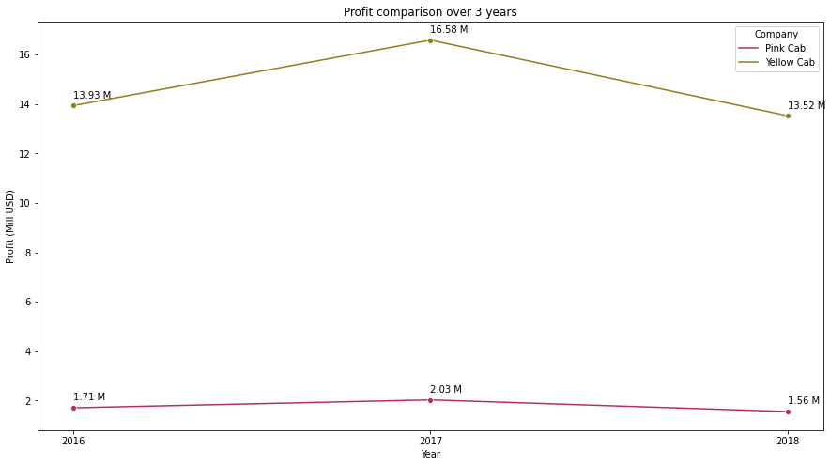
Profit Analysis
2. Finding the most profitable Cab company
Total profit
The Yellow Cab had a substantial higher Profit compared to the Pink Cab.
Both companies had a decrease in Profit in 2018.
The Yellow Cab had a decrease that lower around 3 million $ in the Profit. However, it was still relatively high and nearly as much as in 2016.

Slide 10
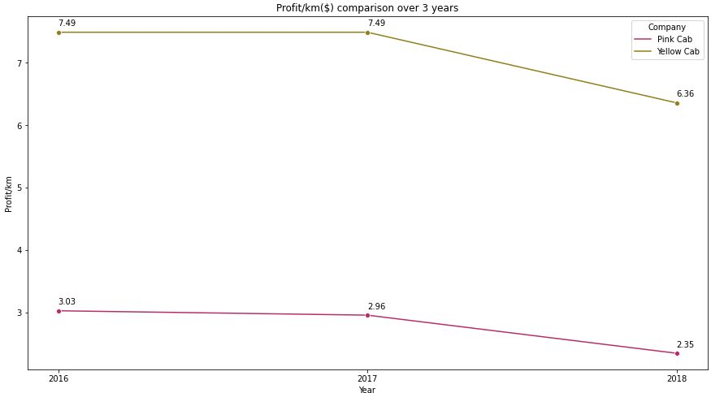
Profit Analysis
2. Finding the most profitable Cab company
Average profit/km
The Profit/km in Yellow Cab company is much higher than Pink Cab. Both had a decrease in 2018.
The Profit/km is only decrease in 2018 for Yellow Cab. The Profit/km remained the same in 2016 and 2017.

Slide 11
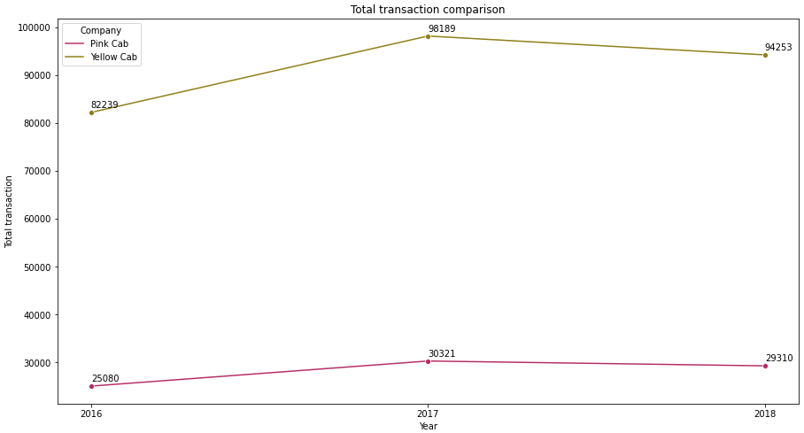
Profit Analysis
2. Finding the most profitable Cab company
Total number of transaction
The Total transaction in Yellow Cab company was much higher than Pink Cab. Both had a decrease in 2018
There was a slight drop in Pink Cab compared to Yellow Cab.
Number of transactions in Yellow Cab was also much higher

Slide 12
Profit Analysis
2. Finding the most profitable Cab company
Investment recommendation: We should invest in the Yellow Cab since it had higher profit, amount of transactions (larger market), and has potential (the Profit did not drop so much). With the correct strategy, we can leverage the brands and increase the profit. Next recommendation will go into detail about the strategies.

Slide 13
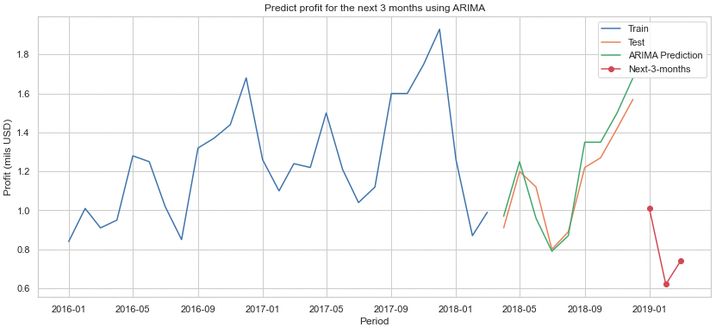
3. Forecasting profit
There was a drop in the beginning of the year and increase at the end of the year.
(There can be many factors, need more information to make a conclusion, but in general this is an interesting insight)
1.01
0.74
0.62
Next 3 months will be a huge downtrend based on ARIMA prediction, therefore we should wait until the end of the year to make an investment based on the seasonal trend

Slide 14
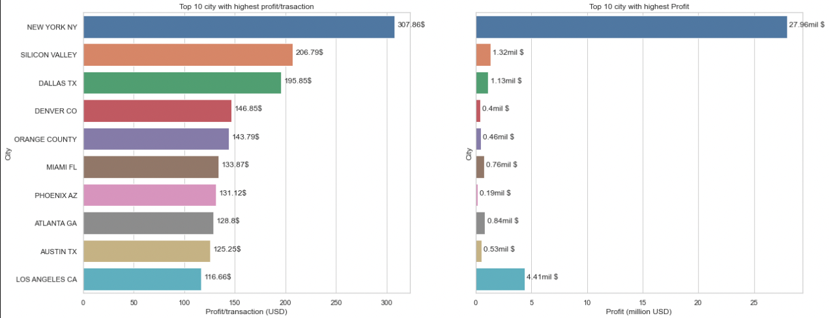
4. Recommendations investment strategy
New York city is the highest profit market and profit/transaction.
The resources should be focused on this market to optimize the cost and return on investment
Although Los Angeles had very high profit (4,41 mil USD in total), Dallas and Silicon Valley should have attention in the marketing since it had low profit but very high profit per transaction, which mean it has very high potential in this segment.

Slide 15
Thank You
For Reading

