Slide 1
CAB DATA

Slide 2
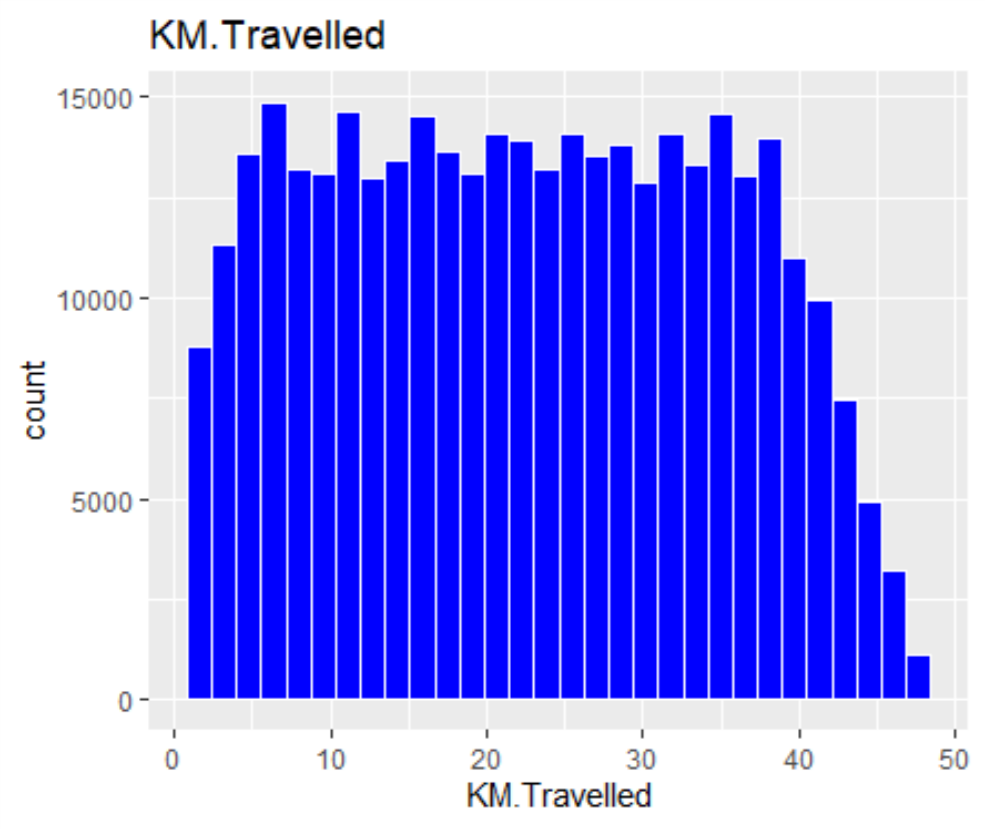
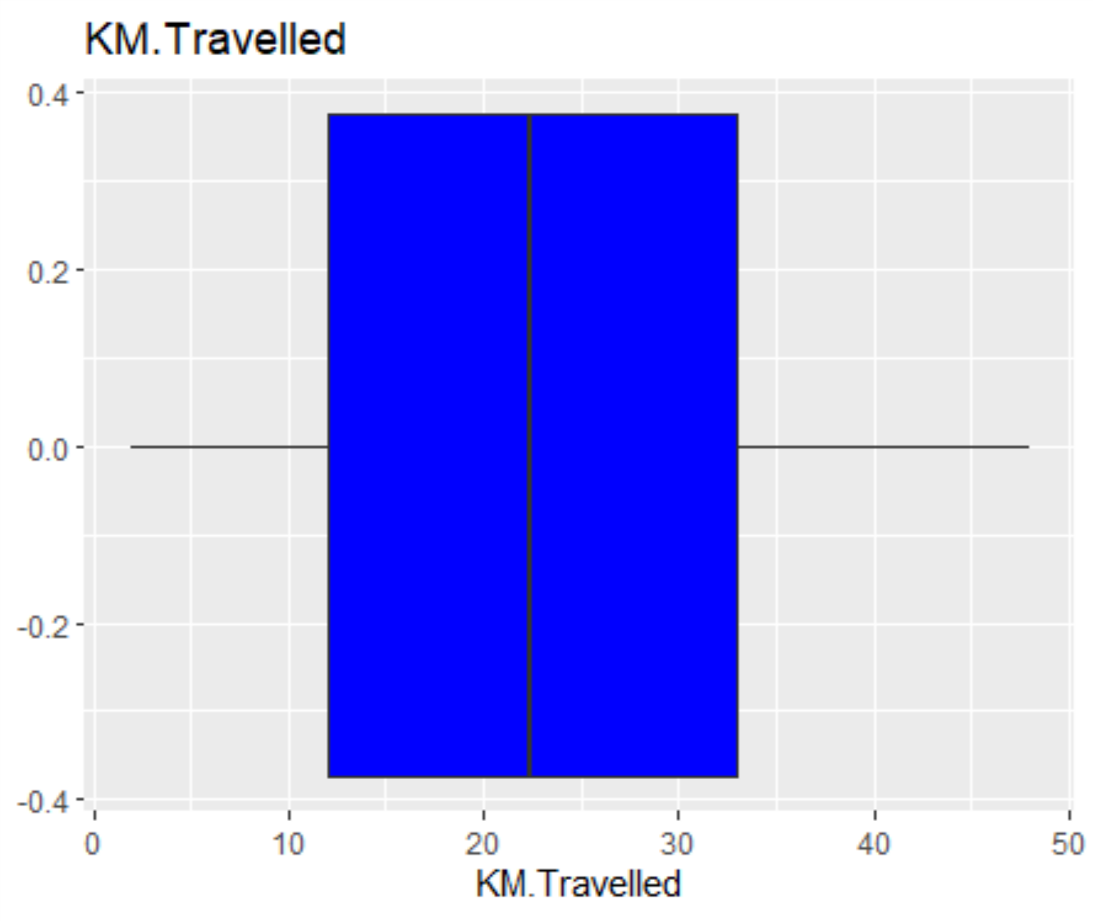
KM.Travelled
KM.Travelled
Min. : 1.90
1st Qu.:12.00
Median :22.44
Mean :22.57
3rd Qu.:32.96
Max. :48.00

Slide 3
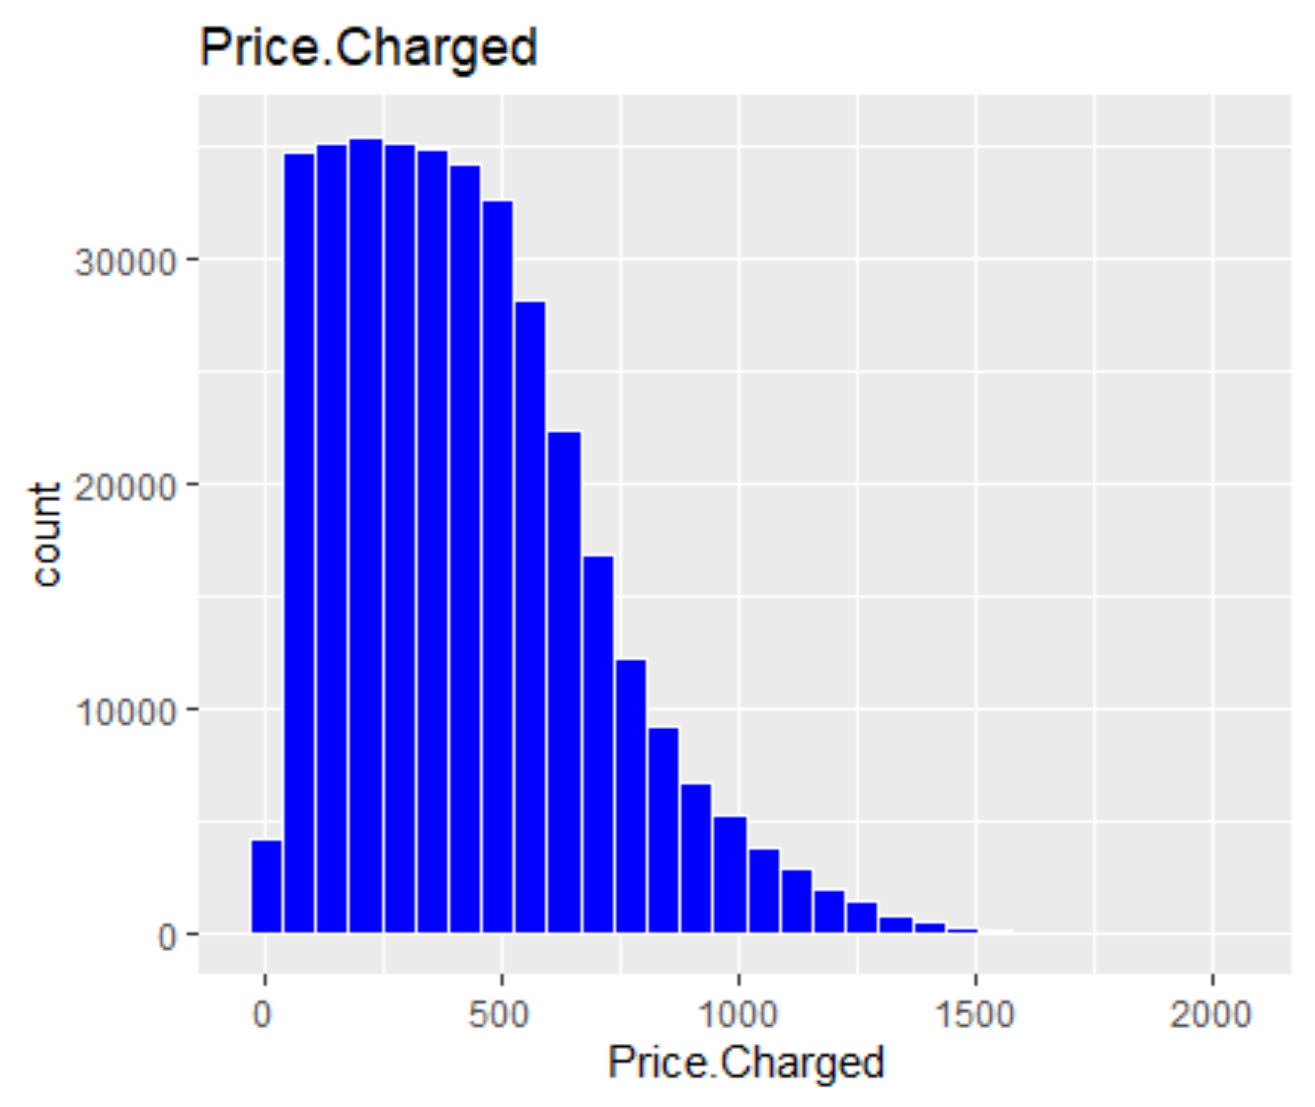
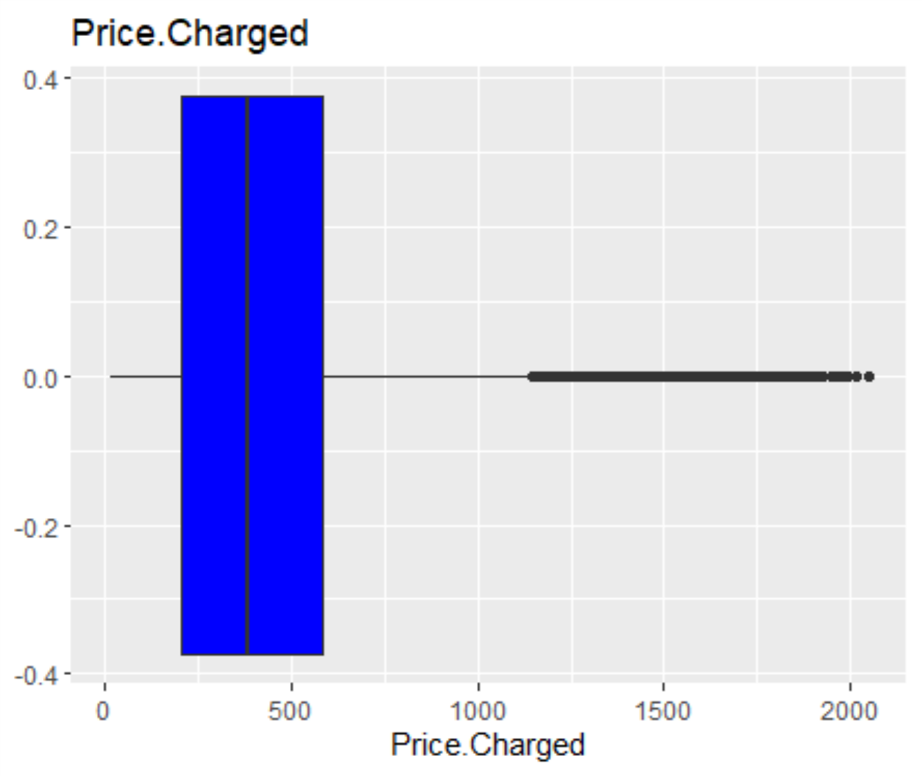
Price.Charged
Price.Charged
Min. : 15.6
1st Qu.: 206.4
Median : 386.4
Mean : 423.4
3rd Qu.: 583.7
Max. :2048.0

Slide 4
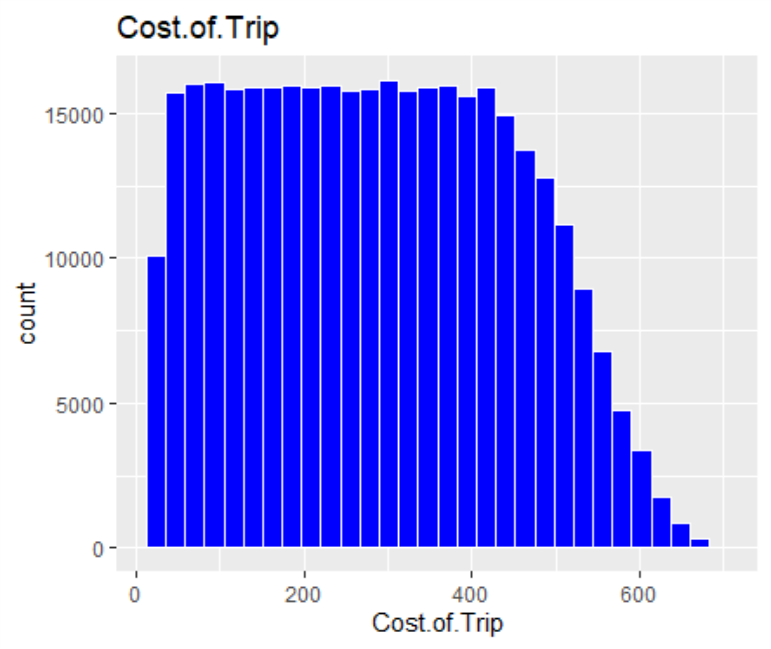
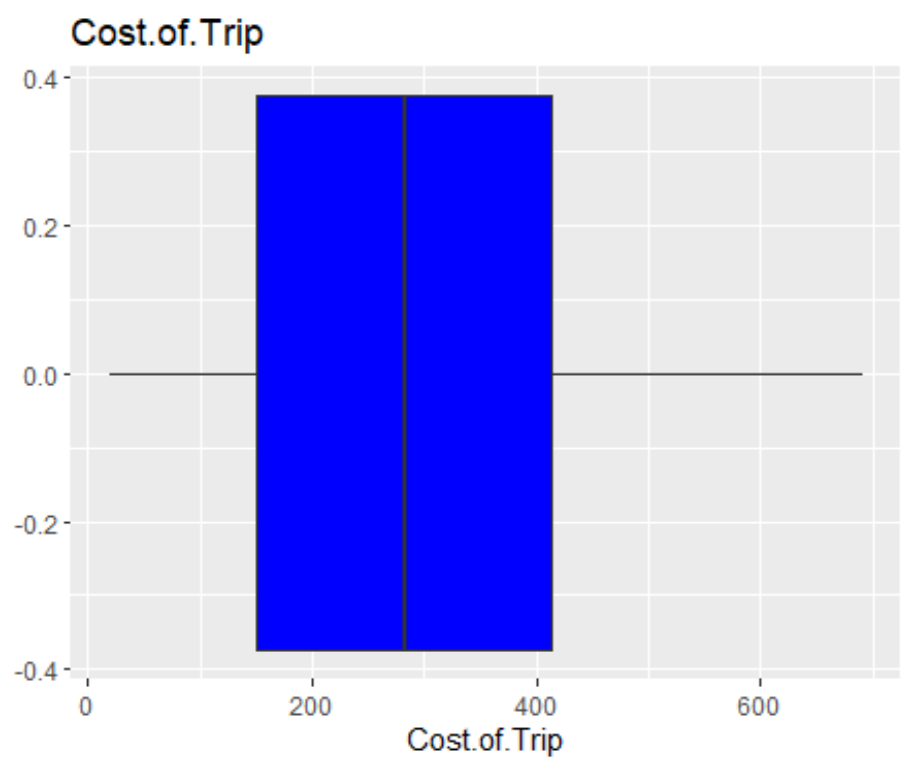
Cost.of.Trip
Cost.of.Trip
Min. : 19.0
1st Qu.:151.2
Median :282.5
Mean :286.2
3rd Qu.:413.7
Max. :691.2

Slide 5
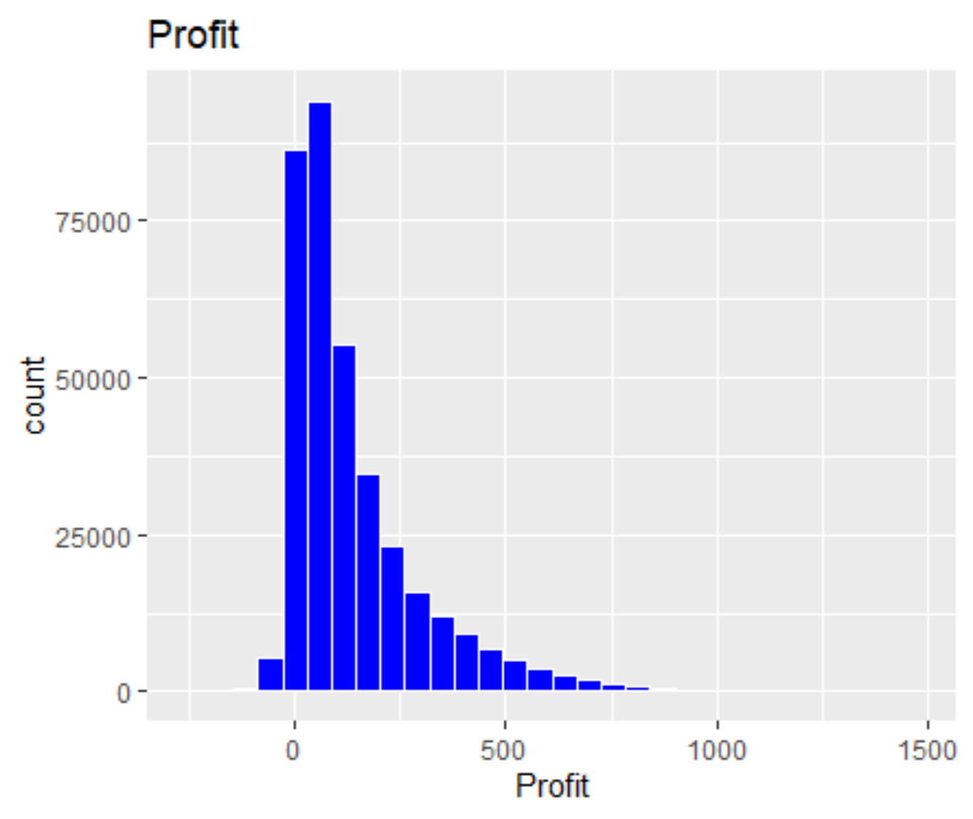
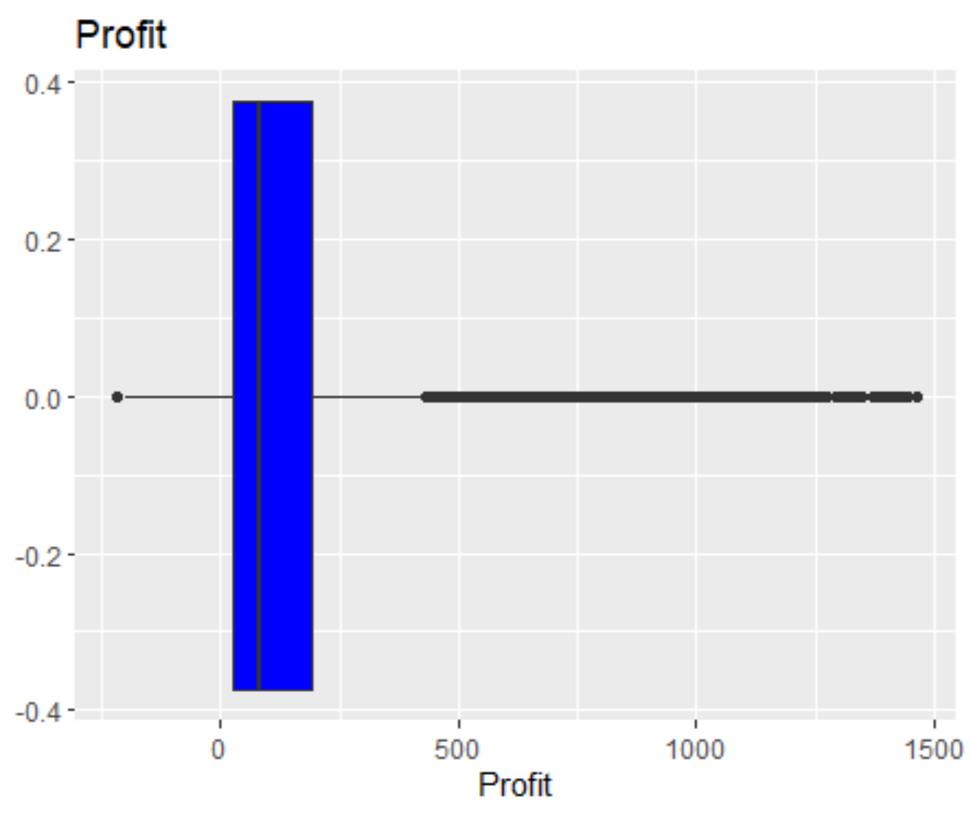
Profit
Profit
Min. :-220.06
1st Qu.: 28.01
Median : 81.96
Mean : 137.25
3rd Qu.: 190.03
Max. :1463.97

Slide 6
Pink Cab Yellow Cab
84711 274681
ATLANTA GA AUSTIN TX BOSTON MA CHICAGO IL DALLAS TX DENVER CO LOS ANGELES CA
7557 4896 29692 56625 7017 3825 48033
MIAMI FL NASHVILLE TN NEW YORK NY ORANGE COUNTY PHOENIX AZ PITTSBURGH PA SACRAMENTO CA
6454 3010 99885 3982 2064 1313 2367
SAN DIEGO CA SEATTLE WA SILICON VALLEY TUCSON AZ WASHINGTON DC
20488 7997 8519 1931 43737

Slide 7
Payment_Mode
Payment_Mode =Card
KM.Travelled Profit Payment_Mode
Min. : 1.90 Min. :-220.06 Length:215504
1st Qu.:12.00 1st Qu.: 28.08 Class :character
Median :22.44 Median : 82.16 Mode :character
Mean :22.57 Mean : 137.09
3rd Qu.:32.98 3rd Qu.: 189.82
Max. :48.00 Max. :1445.27

Slide 8
Payment_Mode
Payment_Mode =Cash
KM.Travelled Profit Payment_Mode
Min. : 1.90 Min. :-198.70 Length:143888
1st Qu.:11.99 1st Qu.: 27.90 Class :character
Median :22.44 Median : 81.64 Mode :character
Mean :22.56 Mean : 137.50
3rd Qu.:32.96 3rd Qu.: 190.49
Max. :48.00 Max. :1463.97

