Slide 1

Exploratory Data Analysis
Which one is good?
3-march-2021

Slide 2
G2M case study for cab
XYZ is a cab firm that is want to investigate to cab industry
Objective: We want to help the XYZ about right company. Which one is good?

Slide 3
Data Exploration
We used 4 data files about copmanies or country.
Such as, Cab_Data.csv, Customer_ID.csv,
Transaction_ID.csv, City.csv.
We combined these files and then we built some graphics about that
Here we go!
.

Slide 4
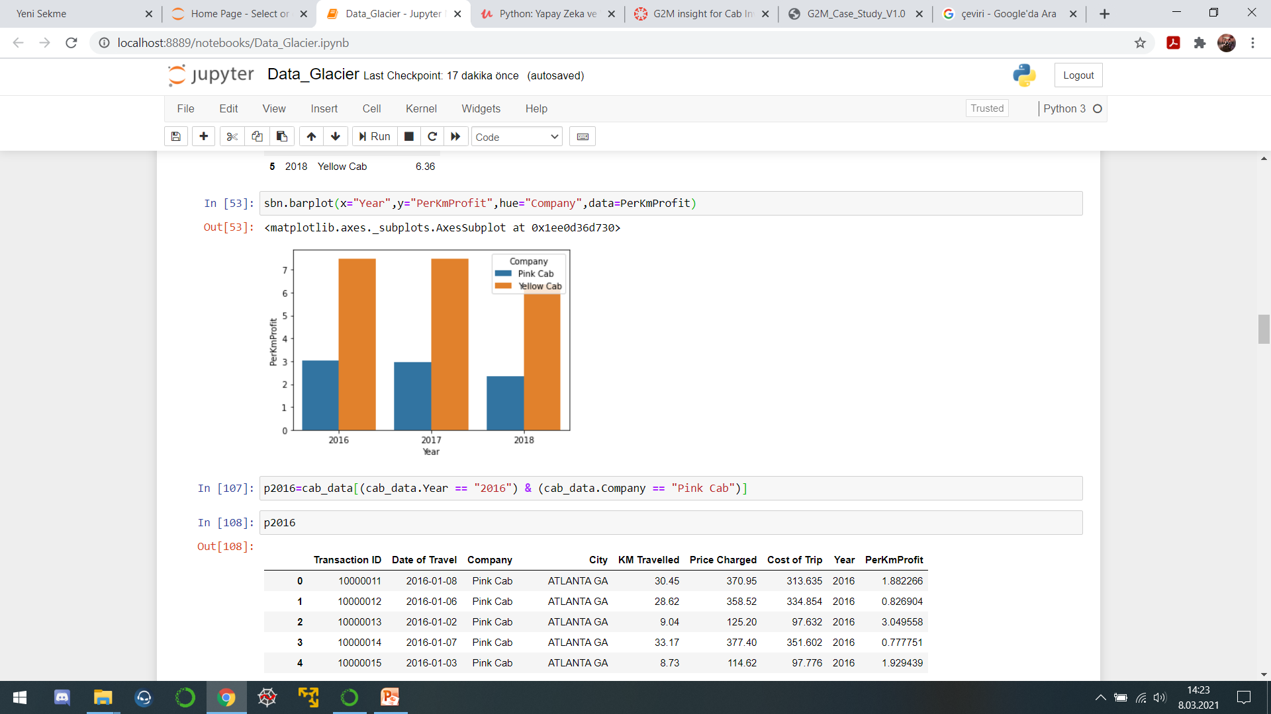
Profit Analysis
This graph shows companies profit per kilometer by years.

Slide 5
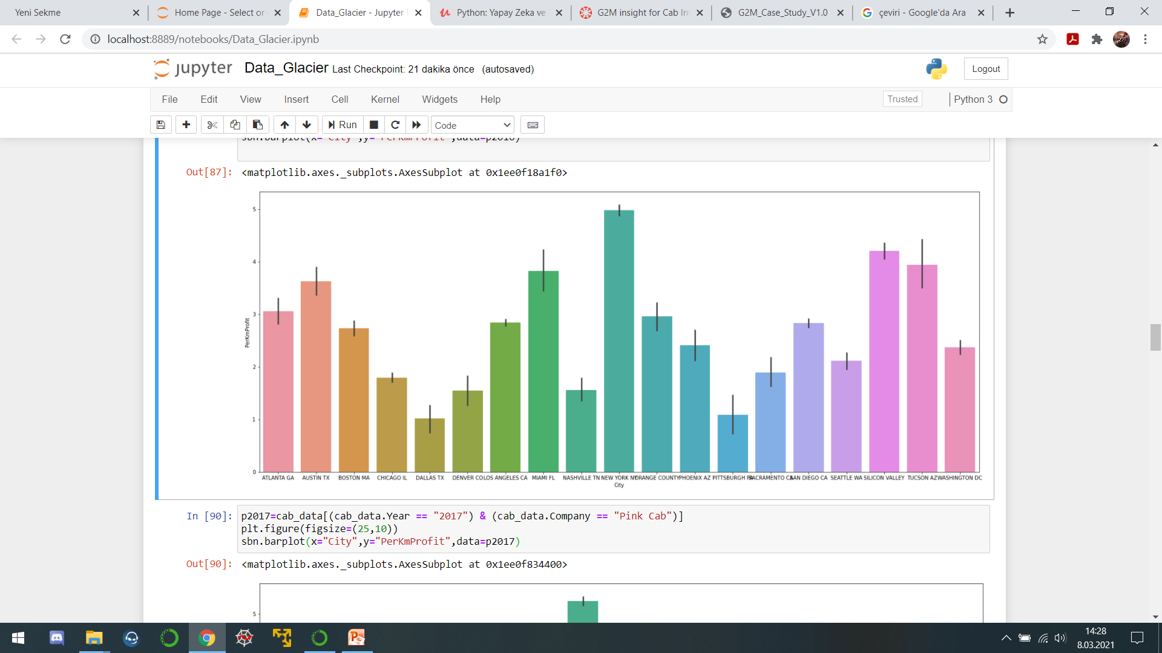
Profit Analysis
This graph shows companies' profit per kilometer by city by years. Pink Cab-2016

Slide 6
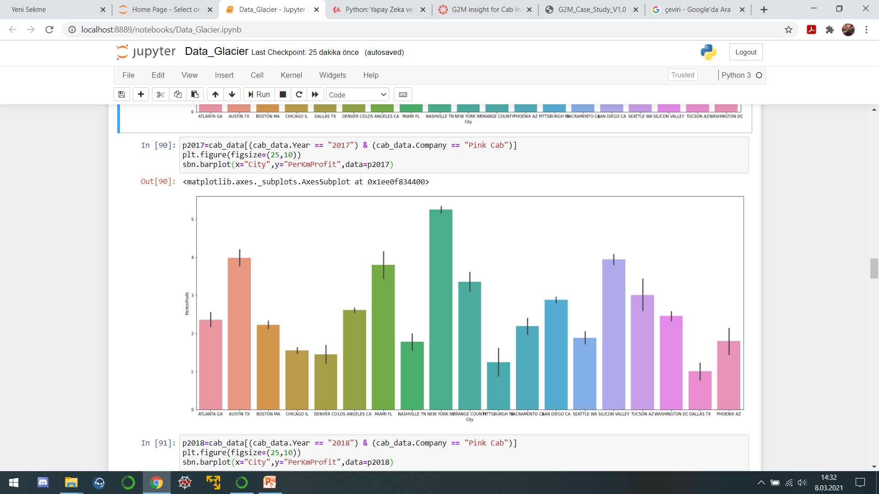
Profit Analysis
This graph shows companies' profit per kilometer by city by years. Pink Cab-2017

Slide 7
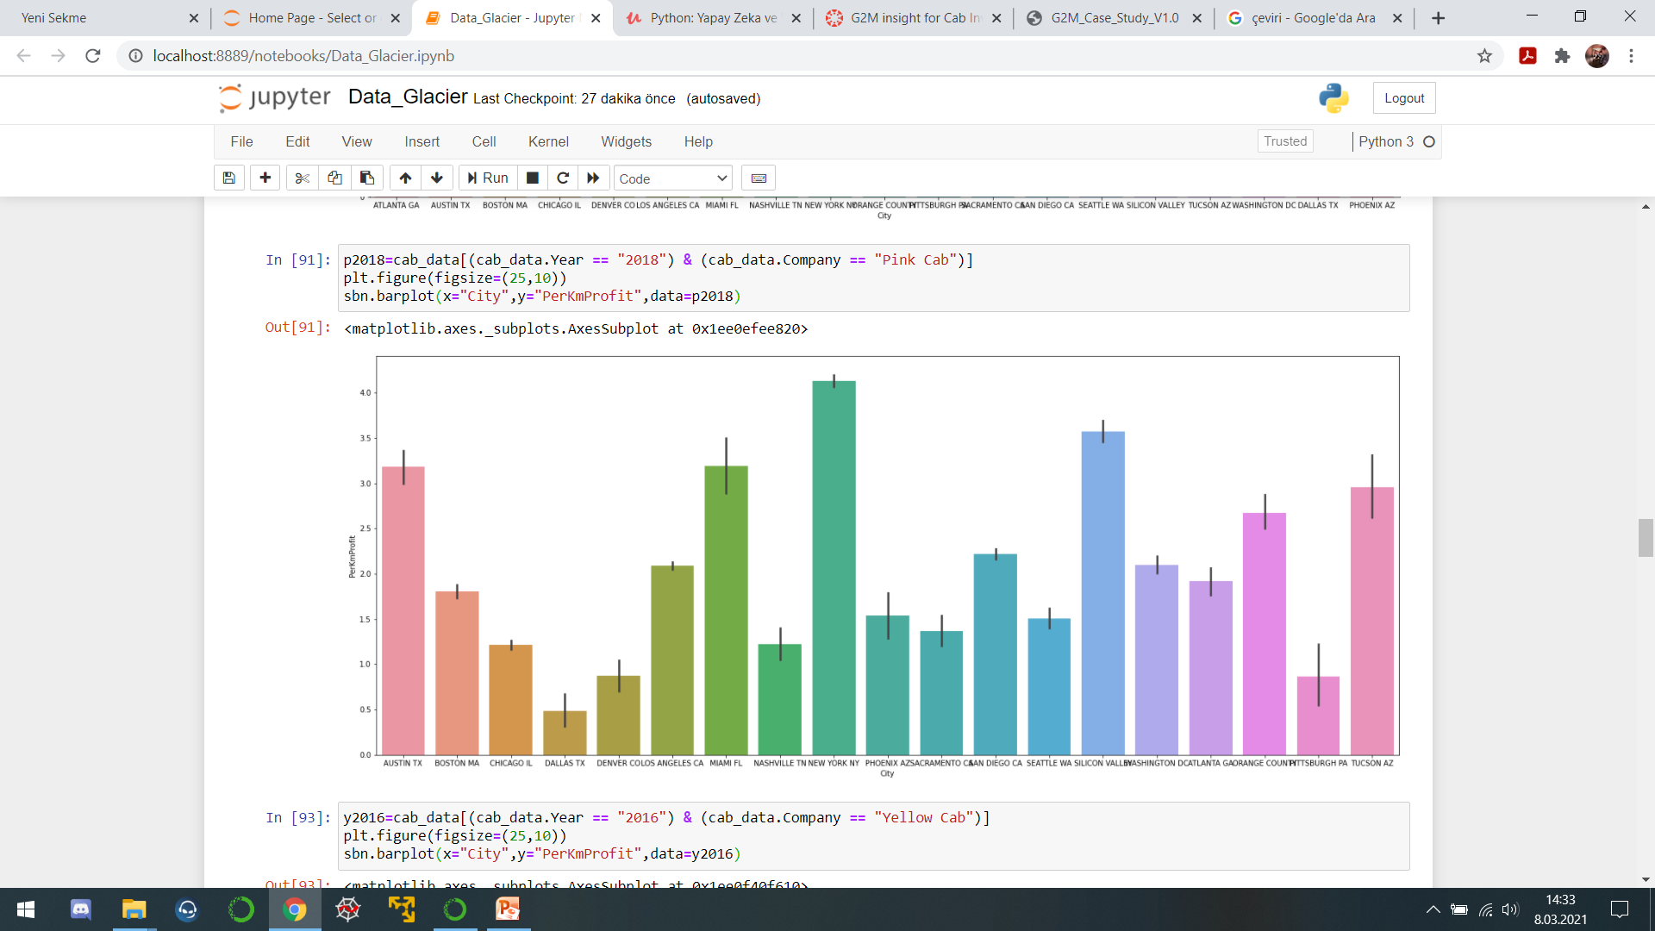
Profit Analysis
This graph shows companies' profit per kilometer by city by years. Pink Cab-2018

Slide 8
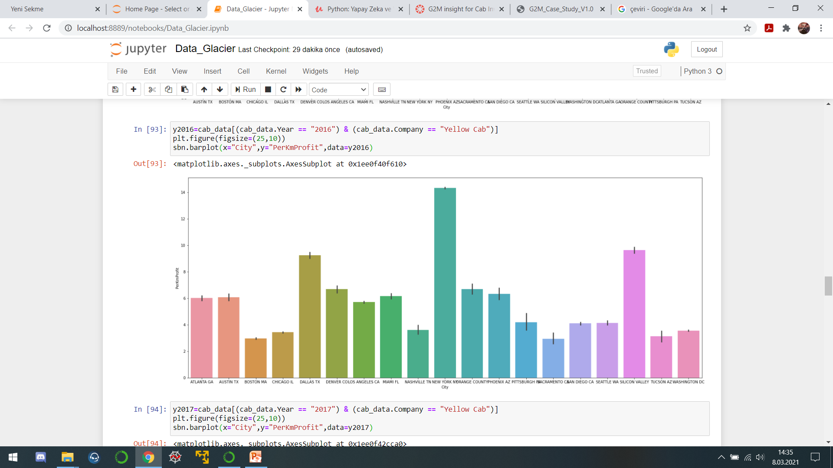
Profit Analysis
This graph shows companies' profit per kilometer by city by years. Yellow Cab-2016

Slide 9
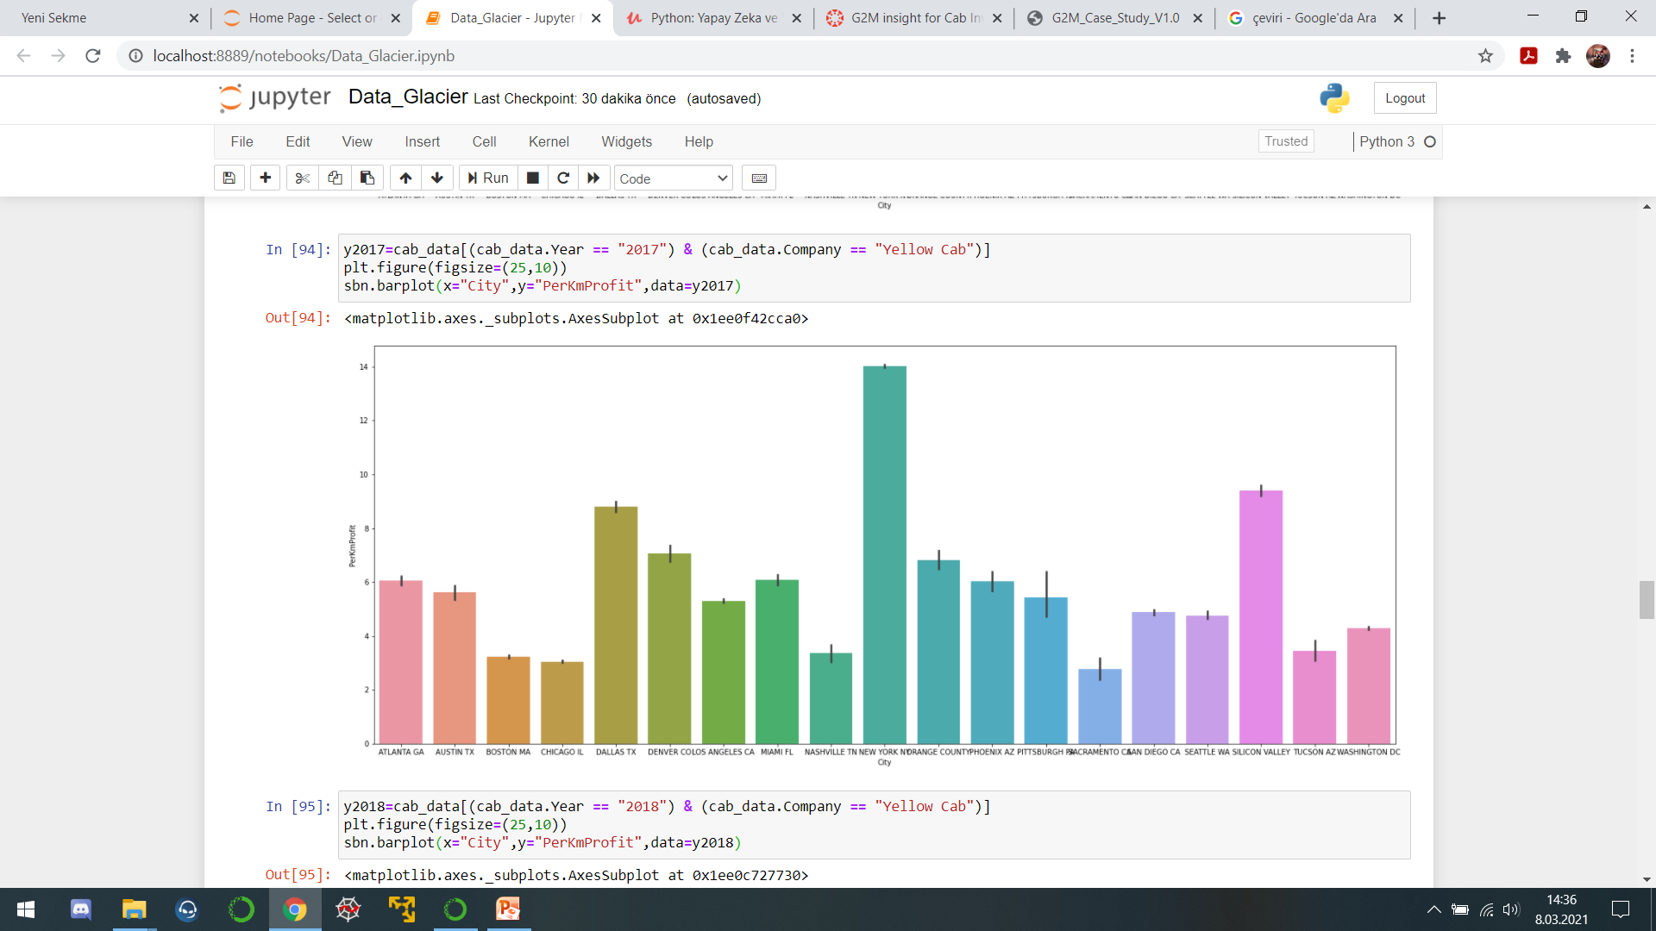
Profit Analysis
This graph shows companies' profit per kilometer by city by years. Yellow Cab-2017

Slide 10
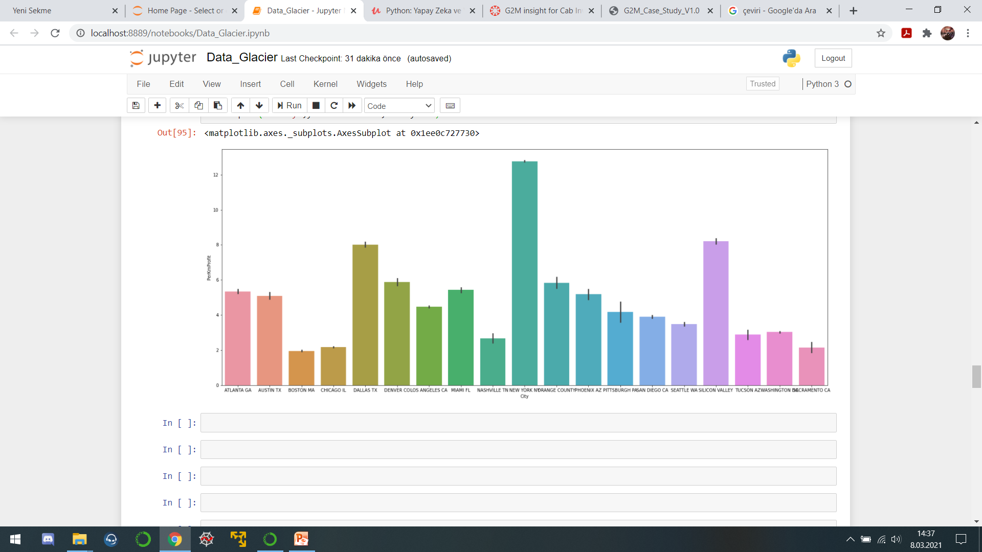
Profit Analysis
This graph shows companies' profit per kilometer by city by years. Yellow Cab-2018

Slide 11
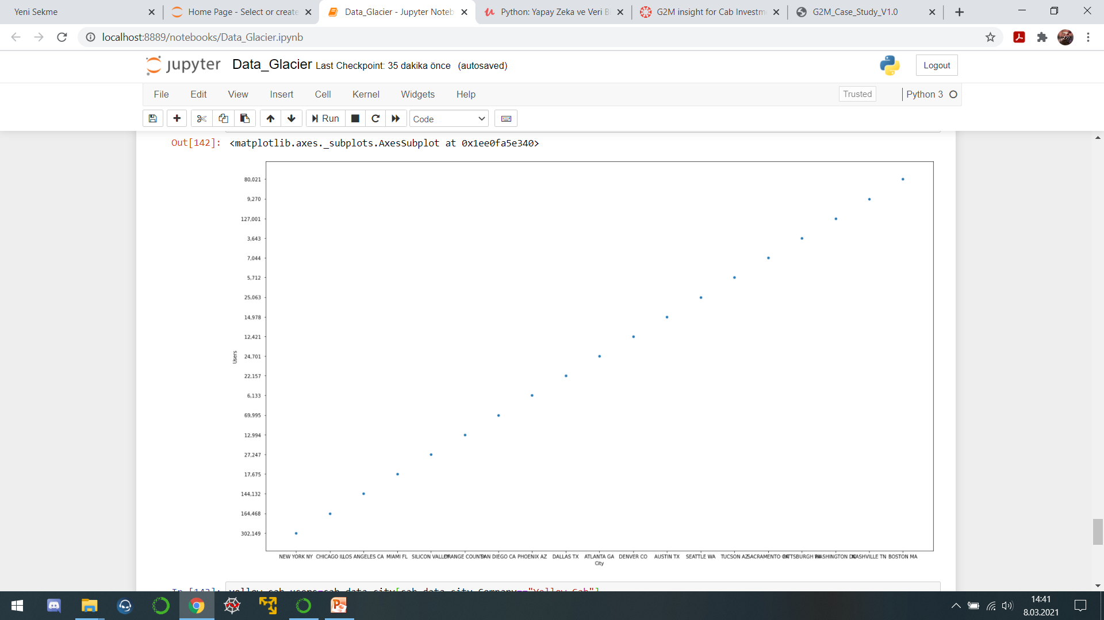
Pink Cab Users by cities

Slide 12
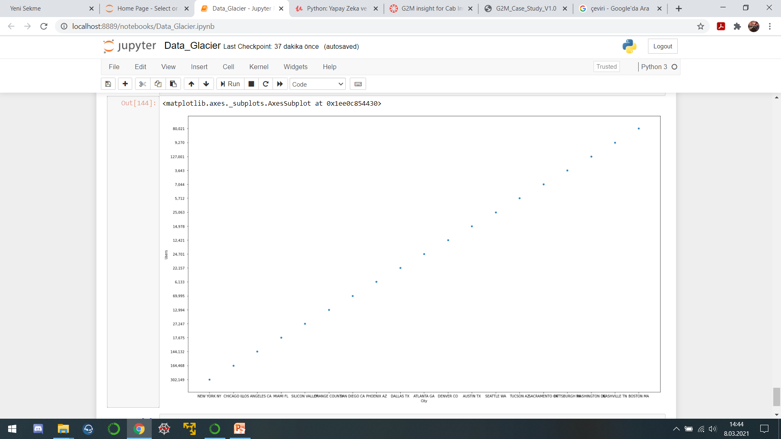
Yellow Cab users by cities

Slide 13
Recommendations
We have evaluated both the cab companies on following points and found Yellow cab better than Pink cab.
Customer Reach : Yellow cab has higher customer reach in 25 cities while Pink cab has higher customer reach in 4 cities. We have also observed that Yellow cab is doing good in covering other cab users as compared to Pink cab.
Average Profit per KM: Yellow cab’s average profit per KM is almost three times the average profit per KM of the Pink cab.
we will recommend Yellow cab for investment.

Slide 14

Thank You

