Slide 1

Exploratory Data Analysis
G2M insight for Cab Investment firm
18-aug-2023.
-Shreya.

Slide 2
Agenda
Executive Summary and Problem Statement
Data study
EDA
Conclusion

Slide 3
Executive Summary and Problem Statement
What the client wants:
XYZ is a private firm in US. Due to remarkable growth in the Cab Industry in last few years and multiple key players in the market, it is planning for an investment in Cab industry and as per their Go-to-Market(G2M) strategy they want to understand the market before taking final decision.
What is to be done:
You have been provided with multiple data sets that contains information on 2 cab companies. Each file (data set) provided represents different aspects of the customer profile. XYZ is interested in using your actionable insights to help them identify the right company to make their investment.
Let’s look at how to achieve this!

Slide 4
Data Study
Data Set:
We have 4 individual data sets. Time period of data is from 31/01/2016 to 31/12/2018.
Cab_Data.csv – 359392 entries, and 7 columns Transaction ID, Date of Trave, Company, City, KM Travelled, Price Charged, Cost of Trip
Customer_ID.csv – 49171 entries and 4 columns - Customer ID, Gender, Age, Income (USD/Month)
Transaction_ID.csv – 440098 entries, 3 columns - Transaction ID, Customer ID, Payment_Mode
City.csv – 20 entries, and 3 columns City, Population, Users

Slide 5
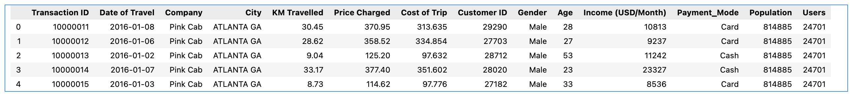
Data Study
All of the datasets have a common column. Merging the data on which we can create a master dataset which would help us derive insights by making comparisons. This dataset has 359392 entries and 14 columns.
The dataset has no null or missing values.

Slide 6
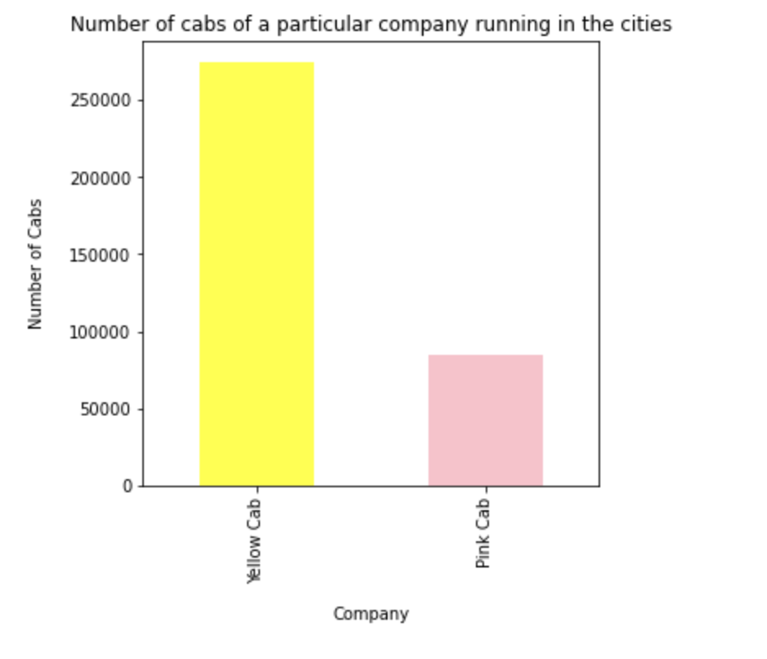
EDA
Comparing the number of cabs of both pink and yellow cab companies we can see that there are more yellow cabs than pink cabs.

Slide 7
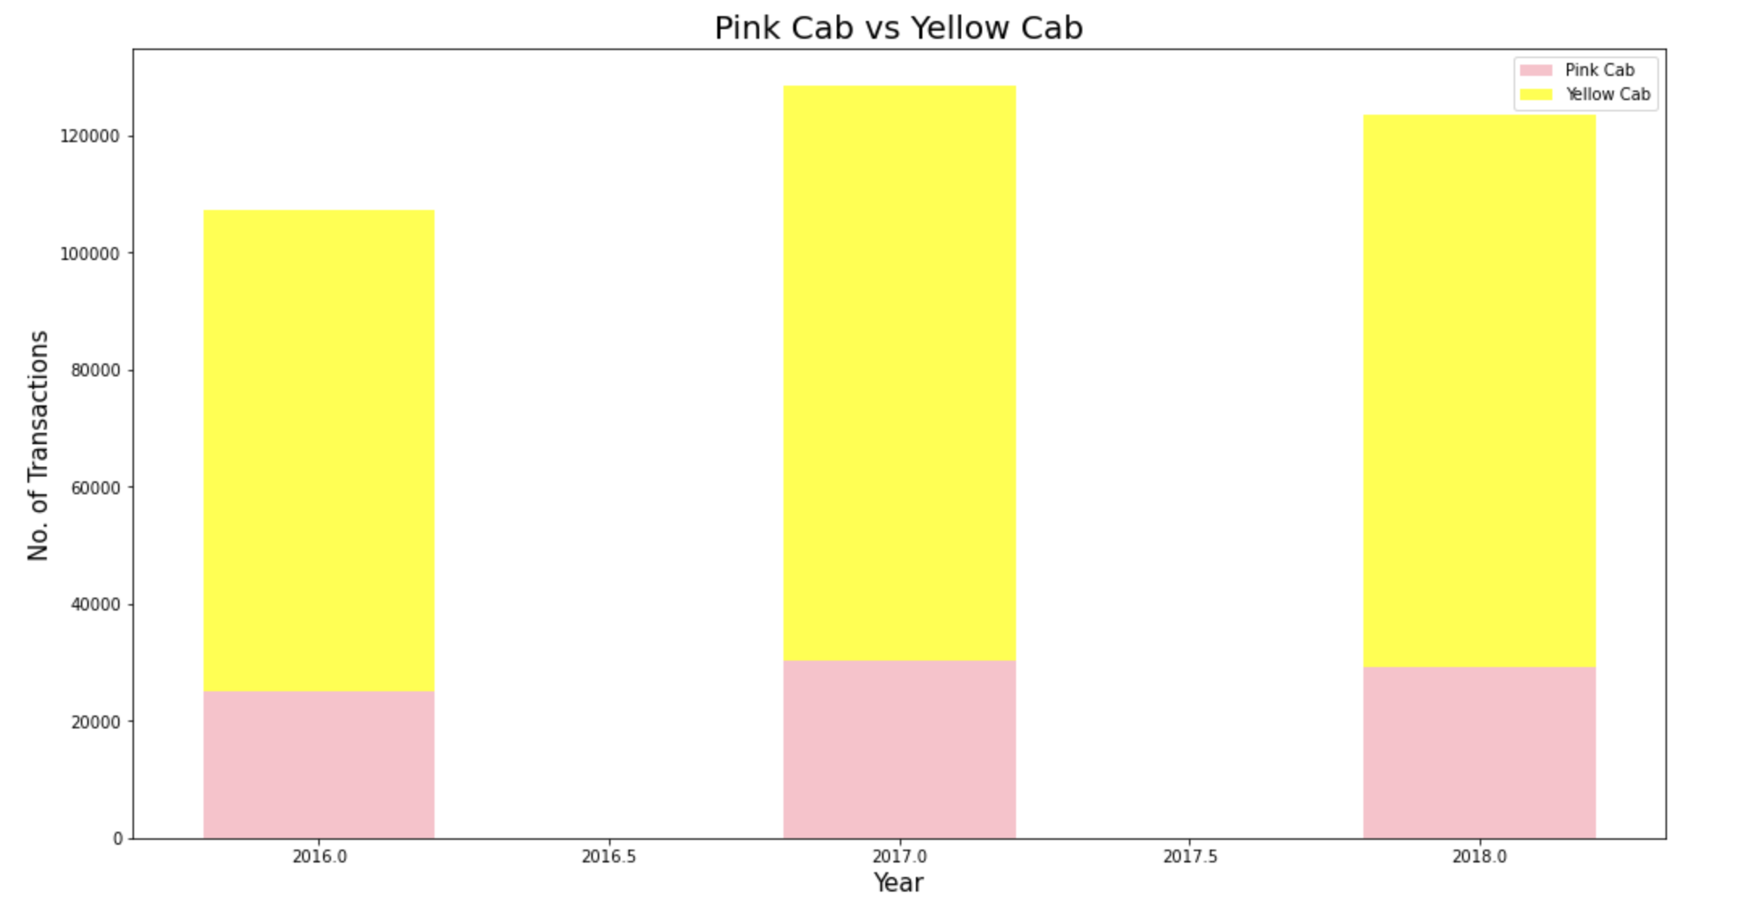
EDA
The number of transactions made per year for both the companies shows that the ratio is higher for yellow cabs.

Slide 8
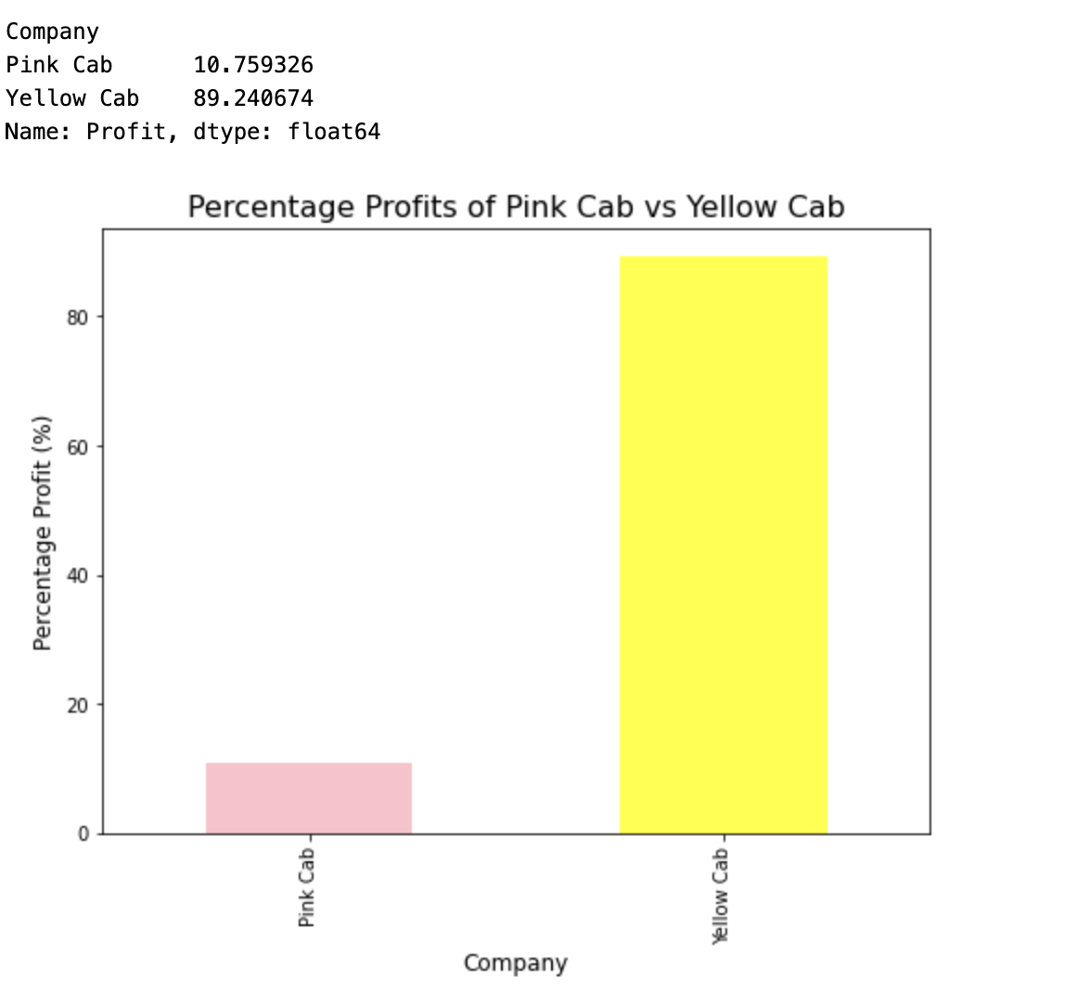
Conclusion
The same trend is seen in case of profit.
After comparing these trends, the recommendation would be that xyz company invests in yellow cab to gain better returns on investments.

Slide 9
Thank You

